Slide 1
MDAP Intern Presentation: Music Score Analysis through Natural Language Interfaces
Presented by: Anqi Liao
(Master of Data Science student at UniMelb, Intern at MDAP)
Supervised by: Dr. Daniel Russo-Batterham
(Senior Research Data Specialist at MDAP)
22/05/2026

Slide 2
Credit: Mohamed_hassan@pixabay
Credit: tanrıca@pixabay

Slide 3




Credit: Mohamed_hassan@pixabay

Slide 4



Credit: Mohamed_hassan@pixabay

Slide 6
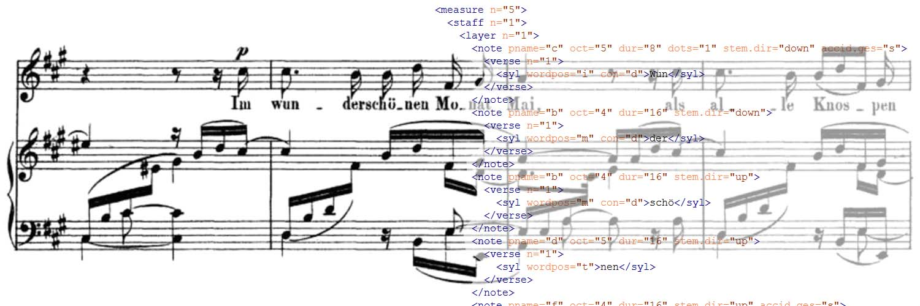
Physical and intellectual characteristics of music notation documents
eXtensible Markup Language (XML) schema
https://music-encoding.org/

Slide 9
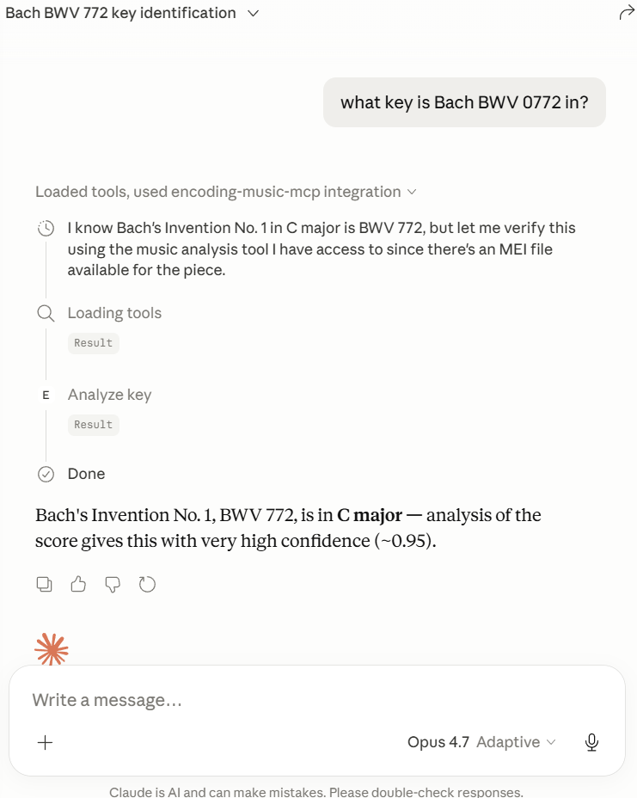
User asks questions in natural language

Slide 10
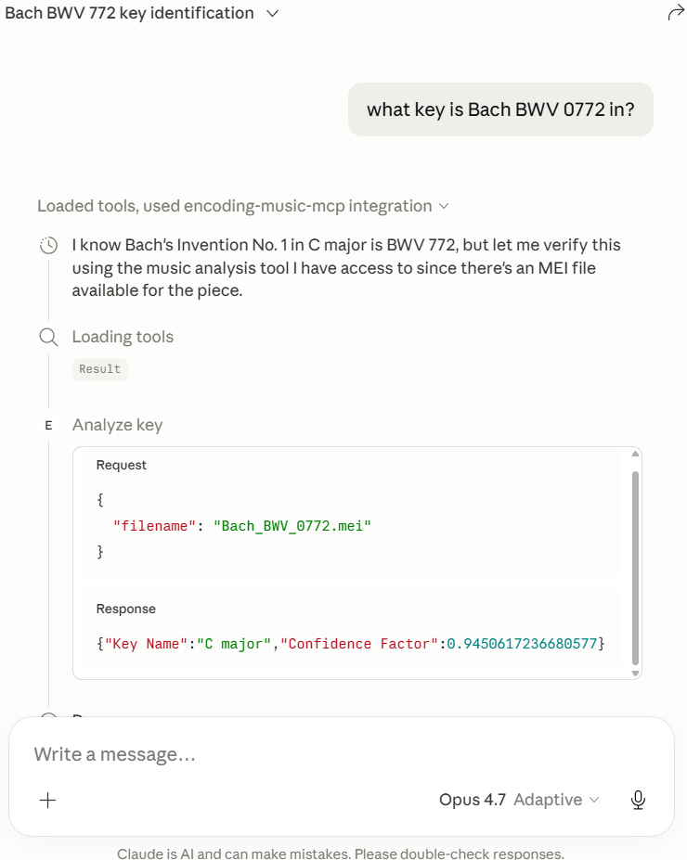
MCP client decides which tool(s) to call

Slide 11
MCP server returns the tool result

Slide 12
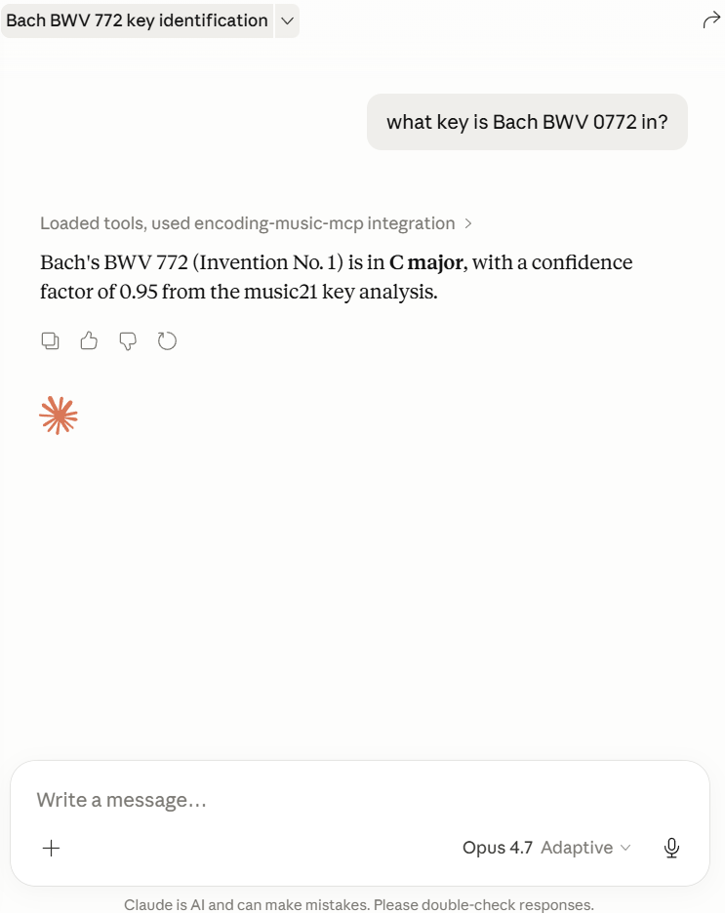
MCP client interprets the result

Slide 13


MCP client interprets the result

Slide 14
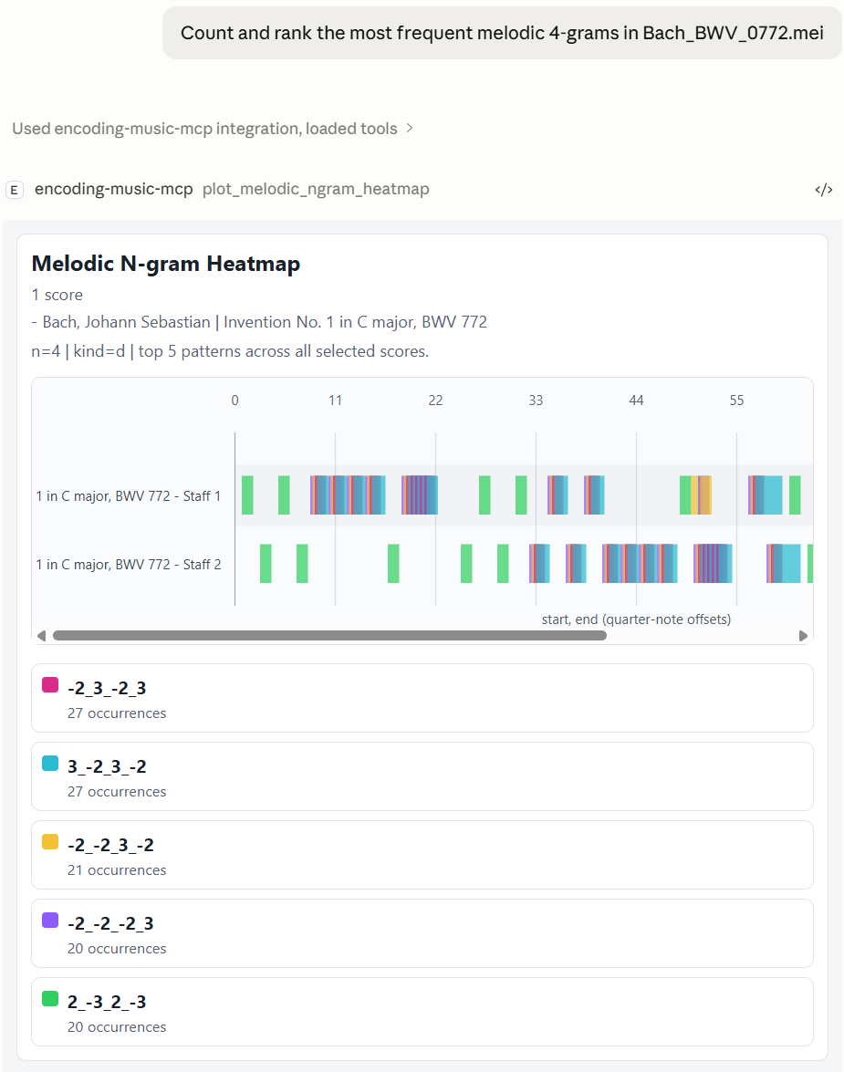
Visualisation tools
Melodic n-gram heatmap

Slide 15
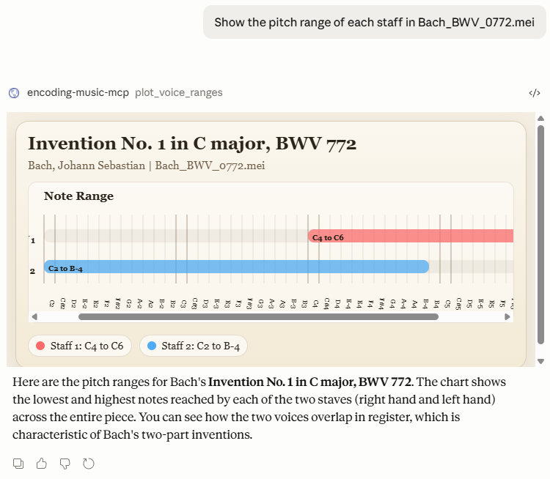
Visualisation tools
Melodic n-gram heatmap
Pitch range

Slide 16
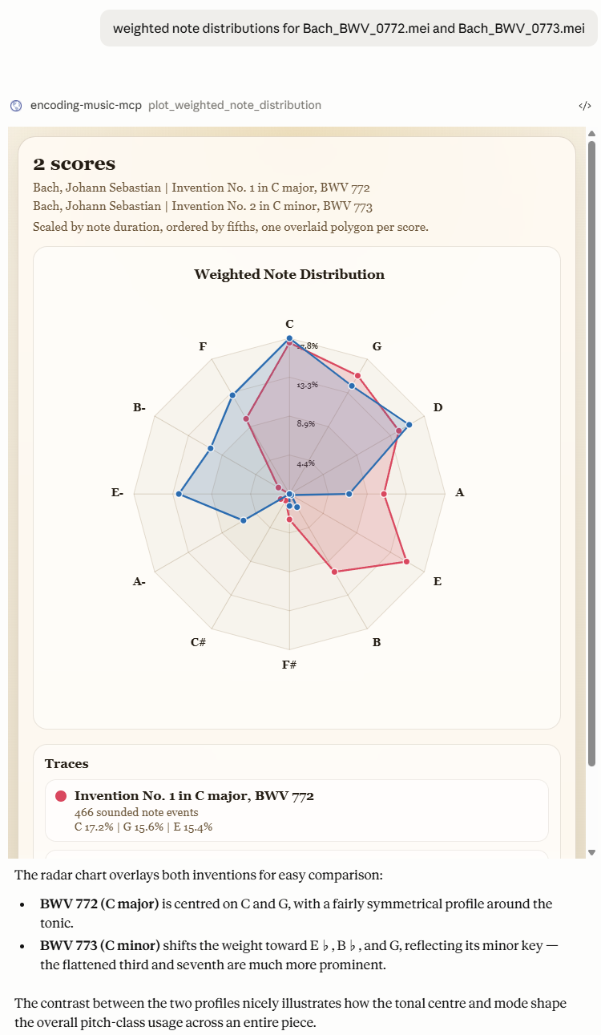
Visualisation tools
Melodic n-gram heatmap
Pitch range
Weighted note distribution

Slide 17
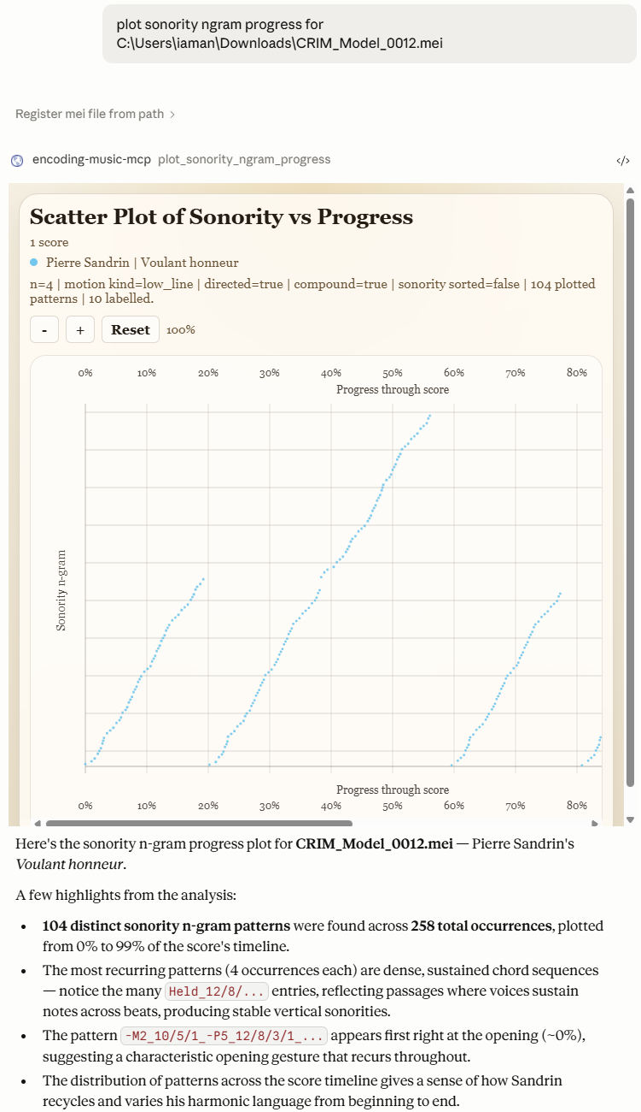
Visualisation tools
Melodic n-gram heatmap
Pitch range
Weighted note distribution
Sonority n-gram progress

Slide 18
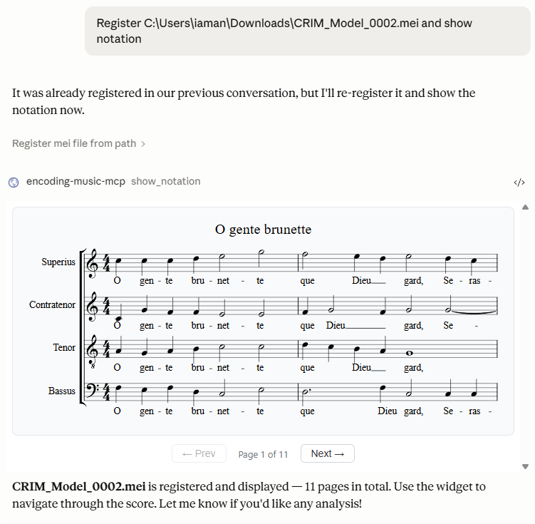
Visualisation tools
Melodic n-gram heatmap
Pitch range
Weighted note distribution
Sonority n-gram progress
Notation tools
Show notation

Slide 19
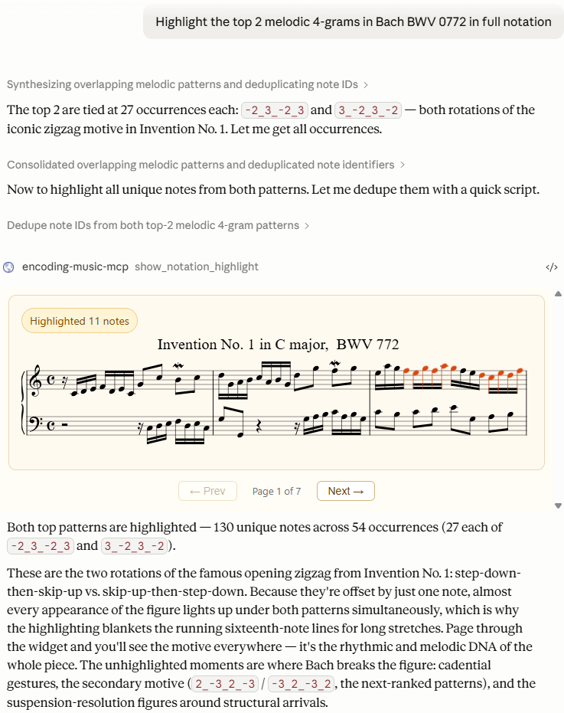
Visualisation tools
Melodic n-gram heatmap
Pitch range
Weighted note distribution
Sonority n-gram progress
Notation tools
Show notation
Show notation with highlight

Slide 20
Visualisation tools
Melodic n-gram heatmap
Pitch range
Weighted note distribution
Sonority n-gram progress
Notation tools
Show notation
Show notation with highlight
Show notation with elicitation

Slide 21
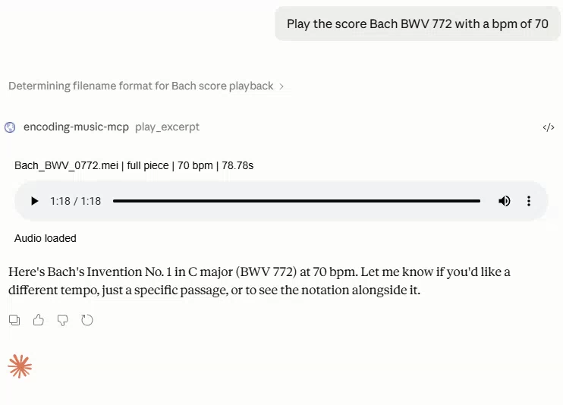
Visualisation tools
Melodic n-gram heatmap
Pitch range
Weighted note distribution
Sonority n-gram progress
Notation tools
Show notation
Show notation with highlight
Show notation with elicitation
Playback tools
Playback
Playback with elicitation

Slide 22
Future works
More visualisation tools
Presentation type tool
A tool to validate user-registered .mei files
A function allowing users to specify a bar range for focused analysis
…
encoding-music-mcp [https://github.com/unimelbmdap/encoding-music-mcp]

Slide 23
Reflection and Key Learnings
Music score analysis
Working with GitHub
Test-driven development
Designing tools for non-technical users
Data visualisation and interface design

Slide 24
Thank you MDAP!
Questions?

