Slide 1
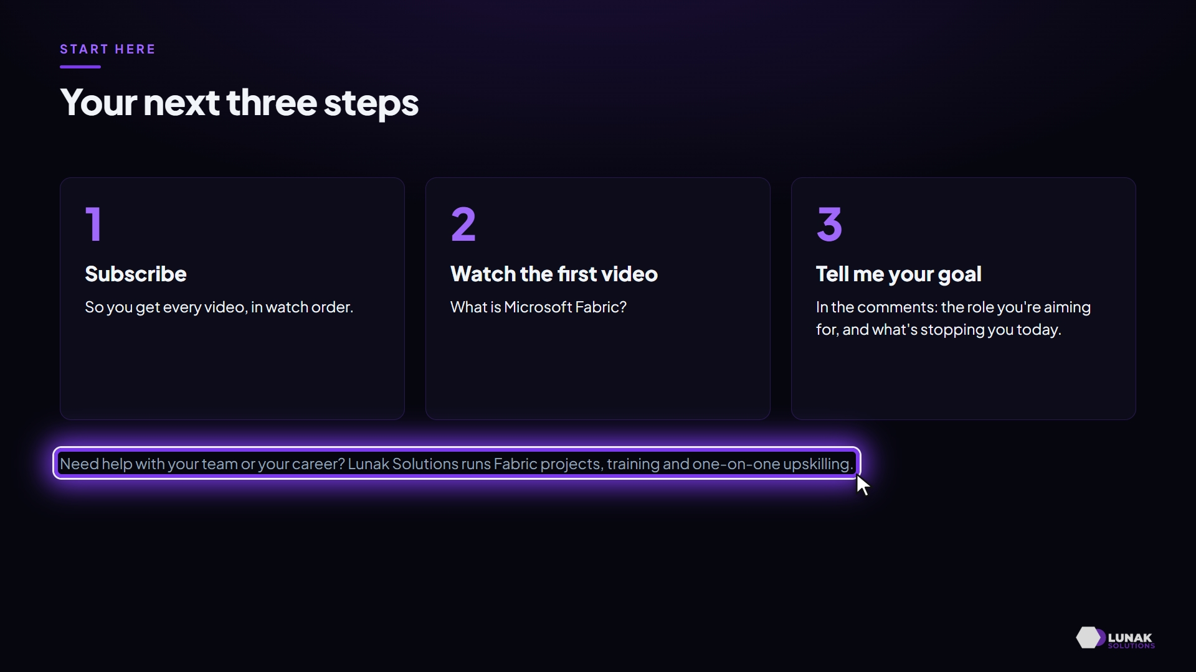

Start here - Microsoft Fabric Video Tutorials
What the Microsoft Fabric Video Tutorials series covers, how every video works, and how to use it to become a hands-on data engineer or architect who designs solutions.
Notes:
Start here - Microsoft Fabric Video Tutorials. What the Microsoft Fabric Video Tutorials series covers, how every video works, and how to use it to become a hands-on data engineer or architect who designs solutions. Follow the numbered steps; each slide shows exactly what to select or type.

Slide 2
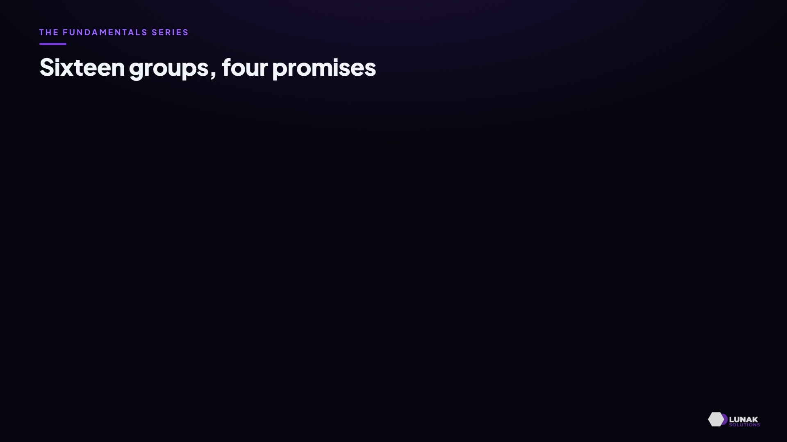
Before you start
4
minutes
to follow along · video 03:42
WHAT YOU WILL LEARN
What the Fundamentals series covers, in four promises
How every video works, and how the series ends
How to get the most out of it
WHAT YOU NEED
Curiosity, and a Microsoft Fabric trial or capacity to practise on
Where you start: this video
Notes:
Before you start. You will build: What the Fundamentals series covers, in four promises; How every video works, and how the series ends; How to get the most out of it. You need: Curiosity, and a Microsoft Fabric trial or capacity to practise on.

Slide 3
What you will learn
PART 1
Sixteen groups, four promises
Notes:
What you will learn: steps .

Slide 4
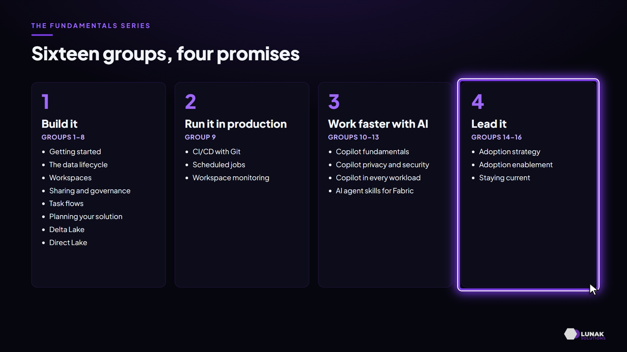
Sixteen groups, four promises
KEY IDEA
Build it (groups 1-8), run it in production (9), work faster with AI (10-13), lead it (14-16).
WHY IT MATTERS
Fundamentals first, so every later deep dive builds on solid ground.
Notes:
And fourth, lead it in your organisation, with adoption, governance and staying current.

Slide 5
How every video works
PART 2
How every video works
Notes:
How every video works: steps .

Slide 6
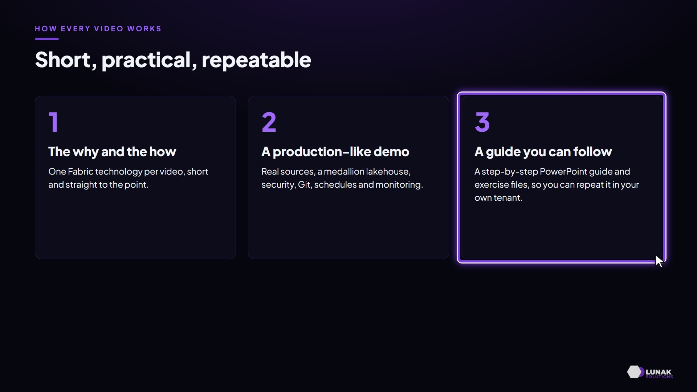
How every video works
KEY IDEA
The why and how of one technology, a production-like demo, and a step-by-step guide with exercise files.
WHY IT MATTERS
You don't just watch it; you can rebuild it.
Notes:
Plus a step-by-step PowerPoint guide, and exercise files where you need them, so you can repeat it in your own tenant.

Slide 7
Where the series goes
PART 3
Where the series goes
Notes:
Where the series goes: steps .

Slide 8
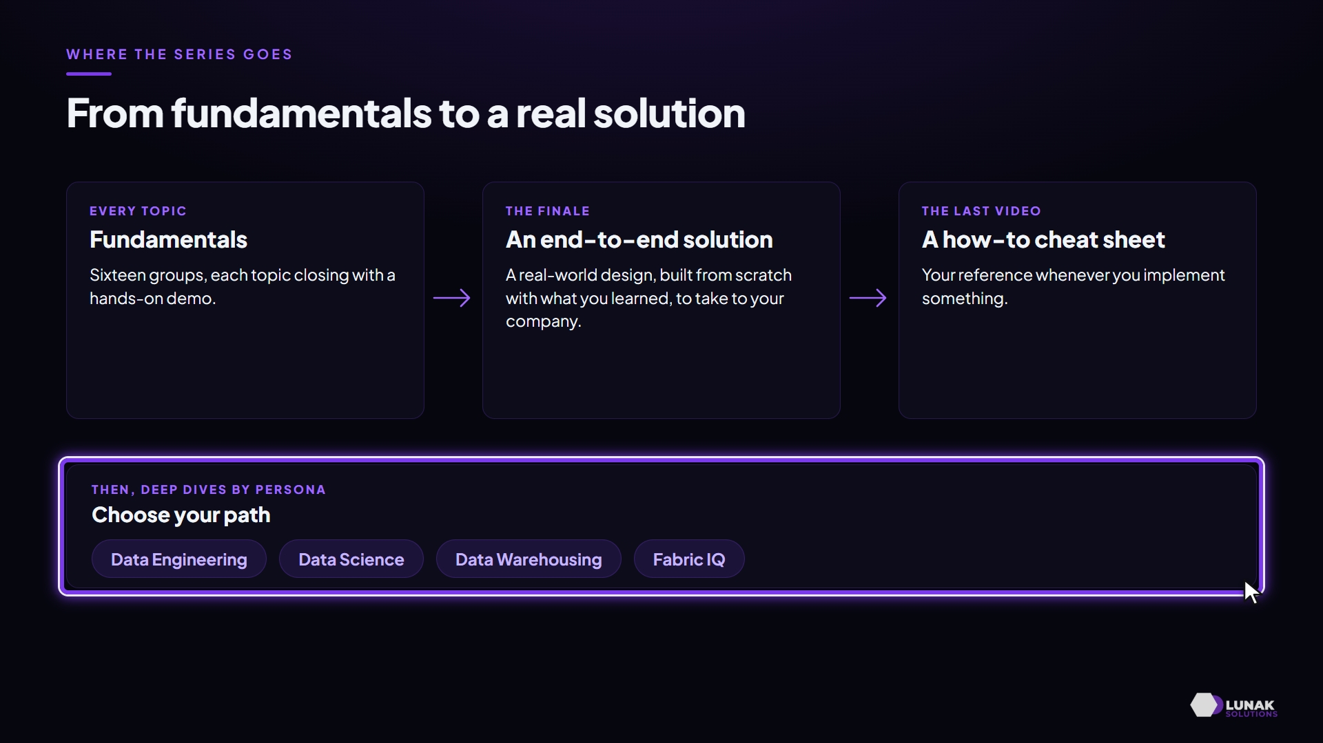
Where the series goes
KEY IDEA
Fundamentals, then an end-to-end solution, a how-to cheat sheet, and deep dives by persona.
WHY IT MATTERS
You finish with something you can implement at work.
Notes:
Then we go deep, by persona: data engineering, data science, data warehousing and Fabric IQ.

Slide 9
Make it your lab
PART 4
Make it your lab
Notes:
Make it your lab: steps .

Slide 10
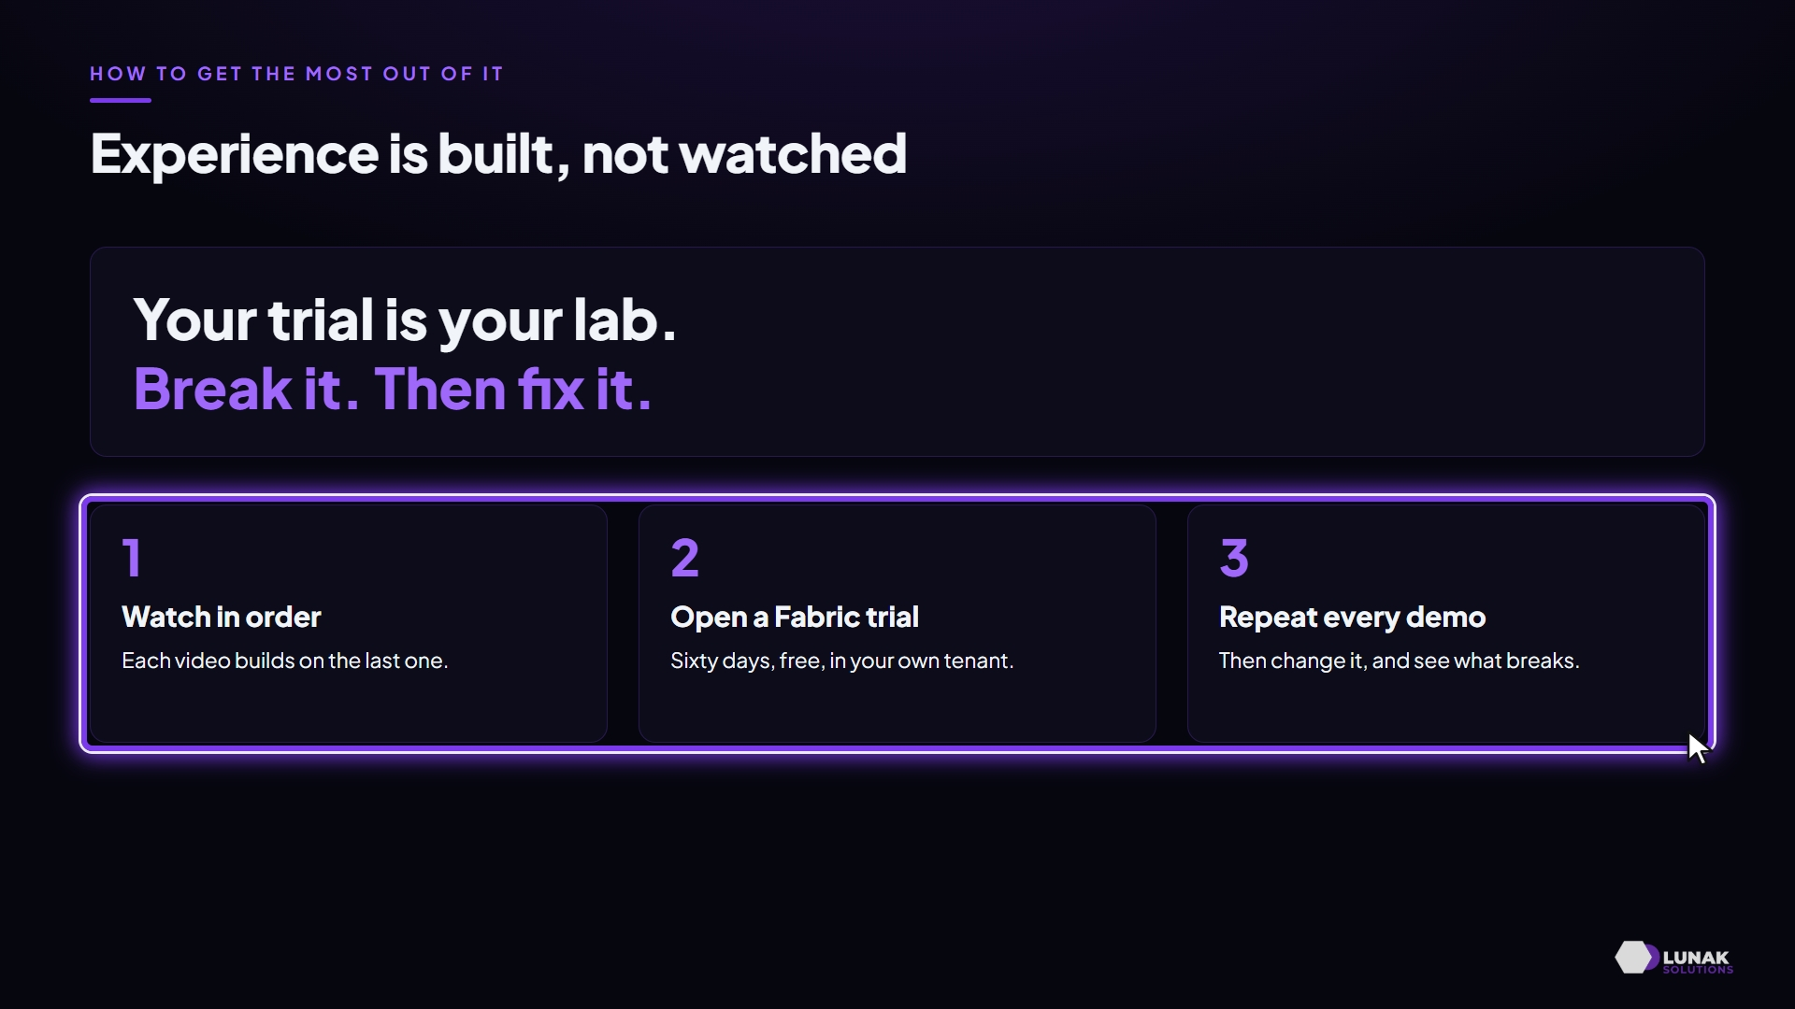
Make it your lab
KEY IDEA
Watch in order, open a Fabric trial, and repeat every demo. Then break it, and fix it.
WHY IT MATTERS
That's how experience is built.
Notes:
Watch in order, open a free trial, and repeat every demo. Then change something, and see what breaks. Be curious. The series gives you the path. The practice is yours.

Slide 11
The future you
PART 5
The future you
Notes:
The future you: steps .

Slide 12
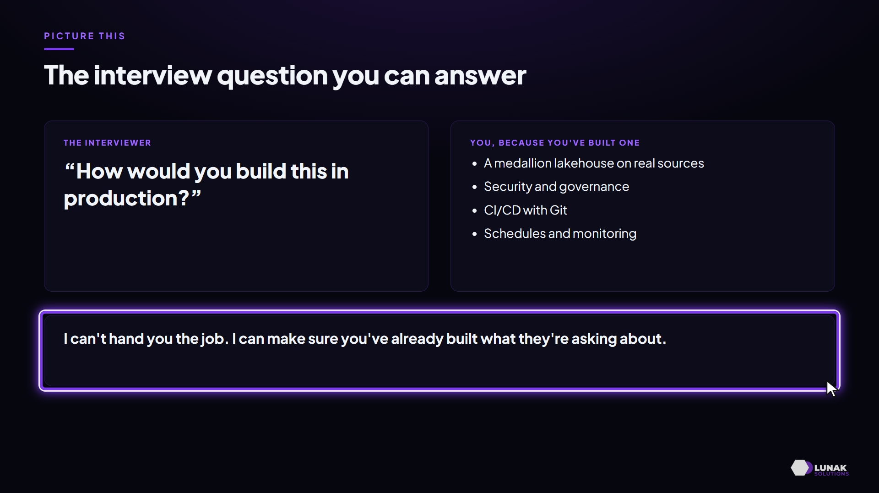
The future you
KEY IDEA
Answer "How would you build it in production?" from experience, because you've built it.
WHY IT MATTERS
Practise every demo, and you'll have the skills and the projects to show for them.
Notes:
I can't hand you the job. What I can do is make sure that when you walk into that interview, you've already built what they're asking about.

Slide 13
Summary and next steps
PART 6
Start here
Notes:
Summary and next steps: steps .

Slide 14
Start here
KEY IDEA
Subscribe, watch What is Microsoft Fabric?, and tell me your goal in the comments.
WHY IT MATTERS
The series gives you the path; the practice is yours.
IN PRACTICE
Next in the series, What is Microsoft Fabric?
Notes:
And if your team needs help with Fabric, Lunak Solutions runs projects, training and one-on-one upskilling. Let's get started.

Slide 15
Before you start
YOU SHOULD BE ABLE TO
✓
Name the four promises of the Fundamentals series
✓
Open a Fabric trial to use as your lab
Notes:
Check your result: Name the four promises of the Fundamentals series; Open a Fabric trial to use as your lab.

Slide 16
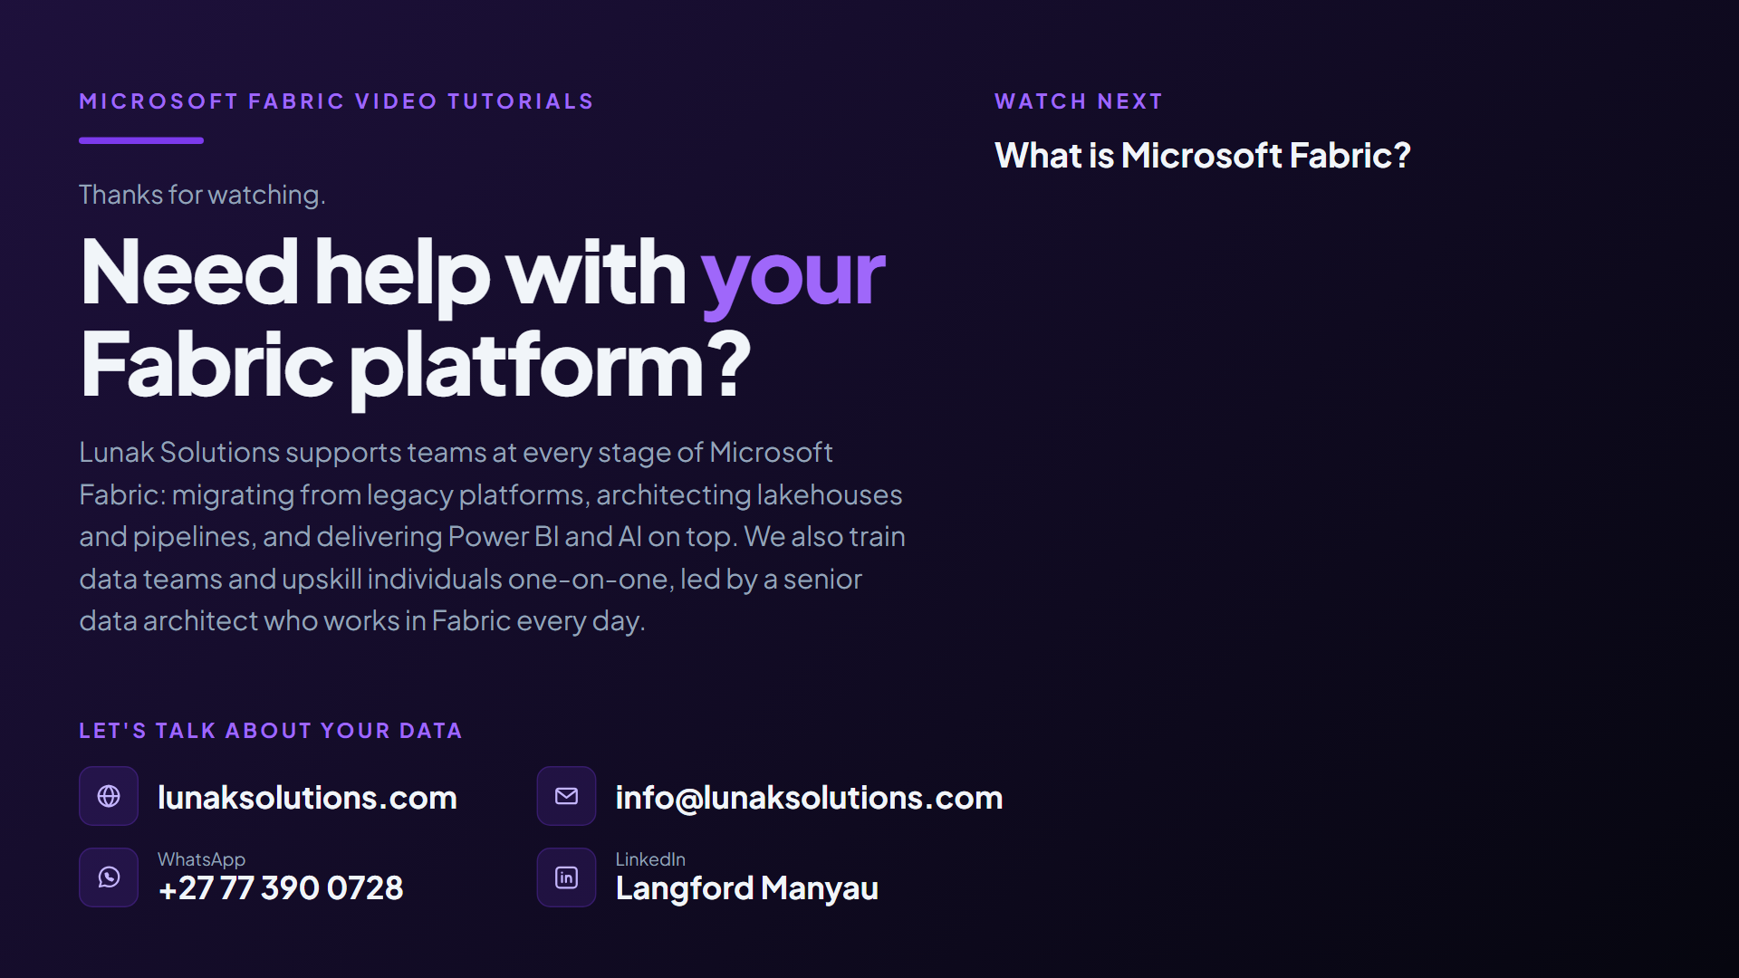
Notes:
Microsoft Fabric Video Tutorials. Thanks for watching. Need help with your Fabric platform? Lunak Solutions supports teams at every stage of Microsoft Fabric: migrating from legacy platforms, architecting lakehouses and pipelines, and delivering Power BI and AI on top. We also train data teams and upskill individuals one-on-one, led by a senior data architect who works in Fabric every day. Let's talk about your data: lunaksolutions.com; info@lunaksolutions.com; WhatsApp: +27 77 390 0728; LinkedIn: Langford Manyau. Watch next: What is Microsoft Fabric?.

