Slide 1

DIY PCB WORKSHOP
23rd and 24th Jan 2018

Slide 2
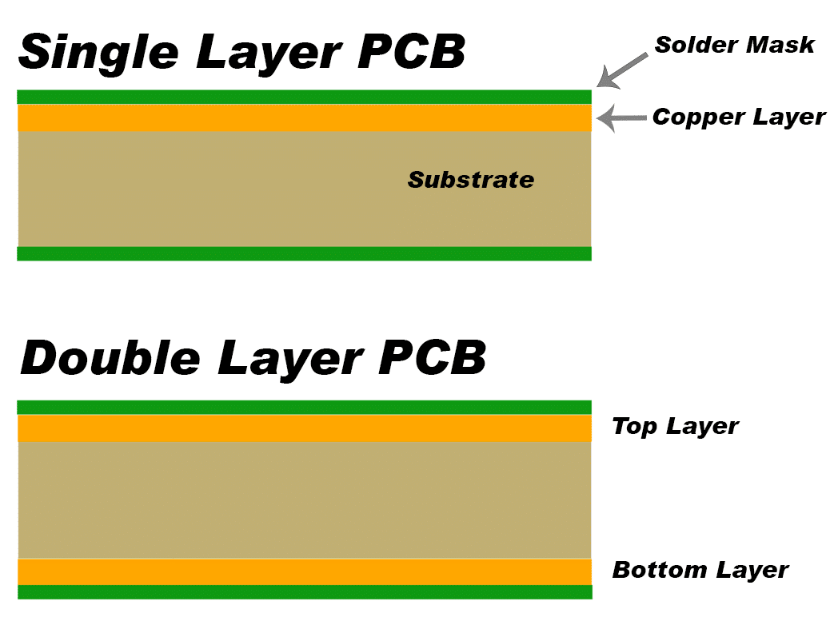
MAIN LAYERS OF A PCB

Slide 3
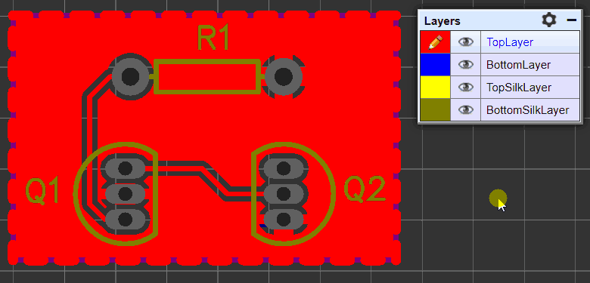
OTHER LAYERS

Slide 4
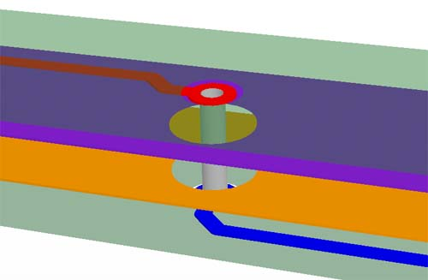
TWO LAYER PCB CONCEPT

Slide 5
prerequisite
To know to read a circuit
Basic component knowledge and their symbols

Slide 6
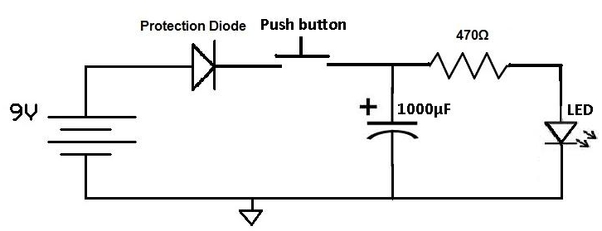
Lets get started

Slide 7
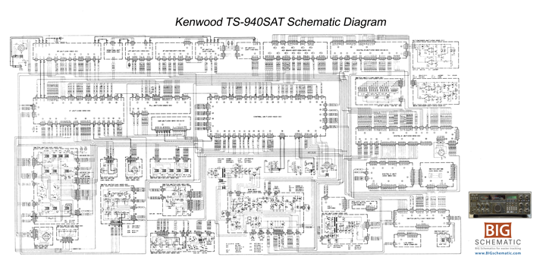
Big schematic

Slide 8
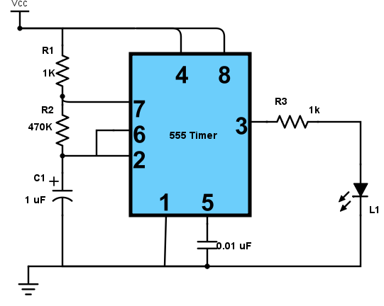
Circuit 2

Slide 9
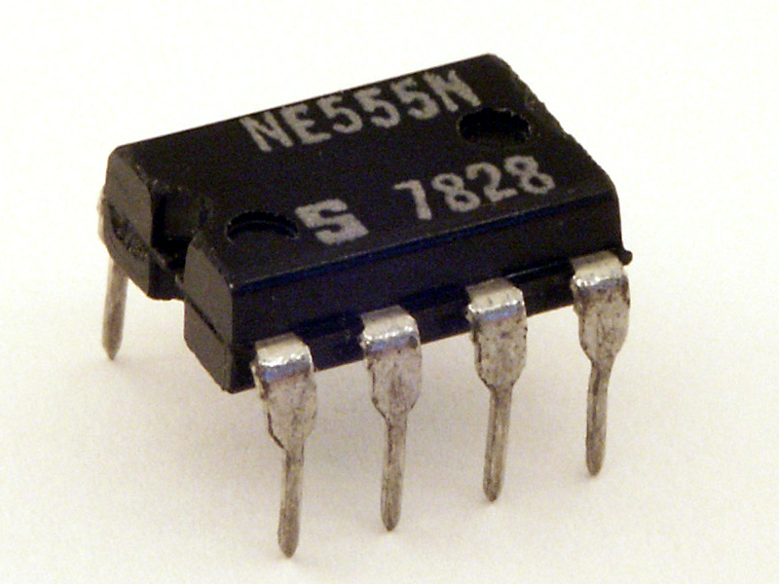
555 IC

Slide 10
CAP

