Slide 1
Exception Handling

Slide 2
Exception
An exception (or exceptional event) is a problem that arises during the execution of a program.
When an Exception occurs the normal flow of the program is disrupted and the program/Application terminates abnormally
which is not recommended, therefore, these exceptions are to be handled.

Slide 3
Reason
An exception can occur for many different reasons. Following are some scenarios where an exception occurs.
A user has entered an invalid data.
A file that needs to be opened cannot be found.
the JVM has run out of memory.
N.B: by user error, others by programmer error, and others by physical resources

Slide 4
Three categories of Exceptions
Checked exceptions
checked (notified) by the compiler at compilation-time, these are also called as compile time exceptions.

Slide 5
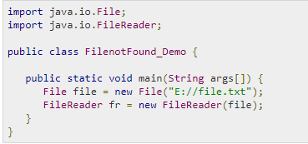
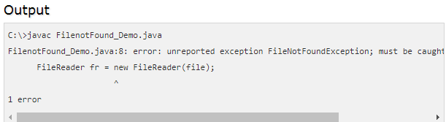
Example

Slide 6
Unchecked exceptions
An unchecked exception is an exception that occurs at the time of execution. These are also called as Runtime Exceptions.
These include programming bugs, such as logic errors or improper use of an API. Runtime exceptions are ignored at the time of compilation.

Slide 7
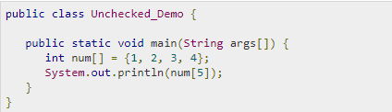

Example

Slide 8
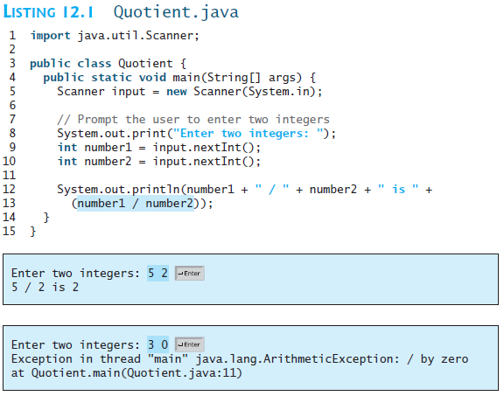

Slide 9
Errors − These are not exceptions at all, but problems that arise beyond the control of the user or the programmer.
Errors are typically ignored in your code because you can rarely do anything about an error.
For example, if a stack overflow occurs, an error will arise. They are also ignored at the time of compilation.

Slide 10
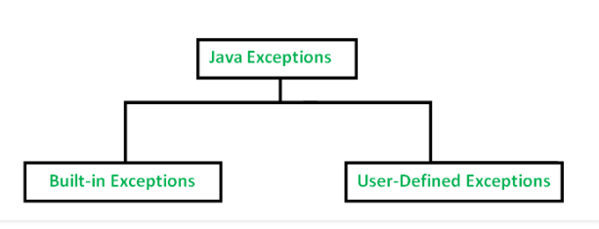
Types of Exception in Java

Slide 11
built-in exceptions
ArithmeticException
It is thrown when an exceptional condition has occurred in an arithmetic operation.
ArrayIndexOutOfBoundsException
It is thrown to indicate that an array has been accessed with an illegal index. The index is either negative or greater than or equal to the size of the array.
ClassNotFoundException
This Exception is raised when we try to access a class whose definition is not found
FileNotFoundException
This Exception is raised when a file is not accessible or does not open.
IOException
It is thrown when an input-output operation failed or interrupted

Slide 12
NoSuchFieldException
It is thrown when a class does not contain the field (or variable) specified
NoSuchMethodException
It is thrown when accessing a method which is not found.
NullPointerException
This exception is raised when referring to the members of a null object. Null represents nothing
NumberFormatException
This exception is raised when a method could not convert a string into a numeric format.
RuntimeException
This represents any exception which occurs during runtime.
StringIndexOutOfBoundsException
It is thrown by String class methods to indicate that an index is either negative than the size of the string

Slide 13
Motivations
When a program runs with Exception, the program terminates abnormally. How can you handle the runtime error so that the program can continue to run or terminate gracefully? This is the subject we will introduce in this chapter.

Slide 14
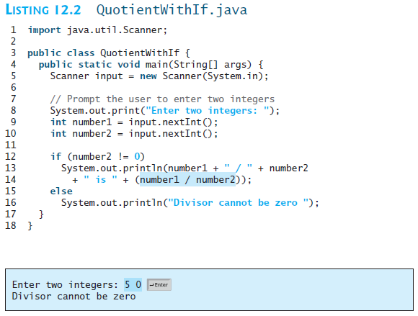

Slide 15
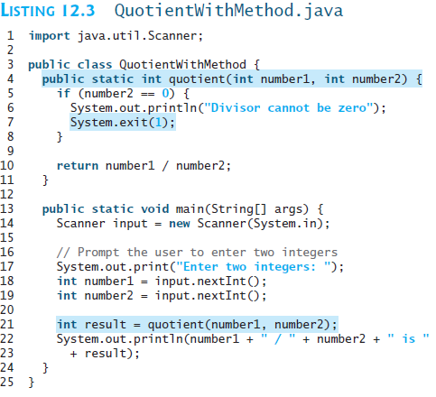
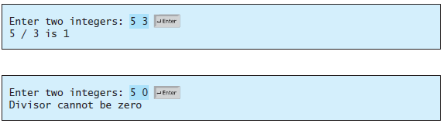

Slide 16
Exception Advantages
Now you see the advantages of using exception handling. It enables a method to throw an exception to its caller. Without this capability, a method must handle the exception or terminate the program.

Slide 17
Catching Exceptions
A method catches an exception using a combination of the try and catch keywords.
A try/catch block is placed around the code that might generate an exception.
Code within a try/catch block is referred to as protected code

Slide 18
Syntax
try
{
// Protected code
}
catch (ExceptionName e1)
{
// Catch block
}

Slide 19
The code which is prone to exceptions is placed in the try block.
Every try block should be immediately followed by a catch block.
A catch statement involves declaring the type of exception you are trying to catch.
If the type of exception that occurred is listed in a catch block, the exception is passed to the catch block

Slide 20
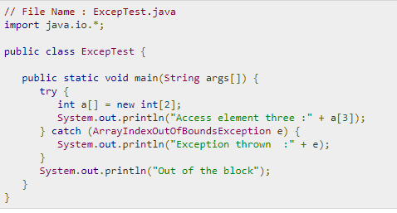


Slide 21
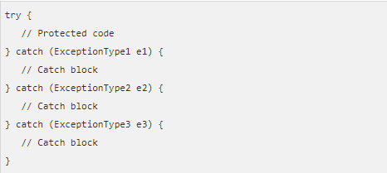
Multiple Catch Blocks

Slide 22
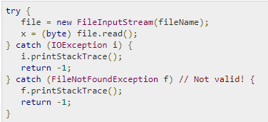

Slide 23
User-Defined Exceptions
The user should create an exception class as a subclass of Exception class. Since all the exceptions are subclasses of Exception class, the user should also make his class a subclass of it. This is done as:
class MyException extends Exception
We can write a default constructor in his own exception class.
MyException(){}

Slide 24
We can also create a parameterized constructor
MyException(String str)
{ super(str); }
To raise exception of user-defined type, we need to create an object to his exception class and throw it using throw clause,
MyException me = new MyException(“Exception details”);
throw me;

Slide 25
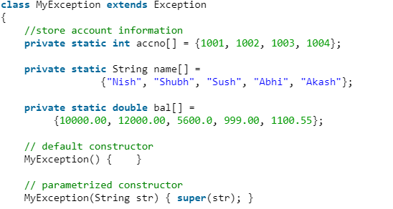
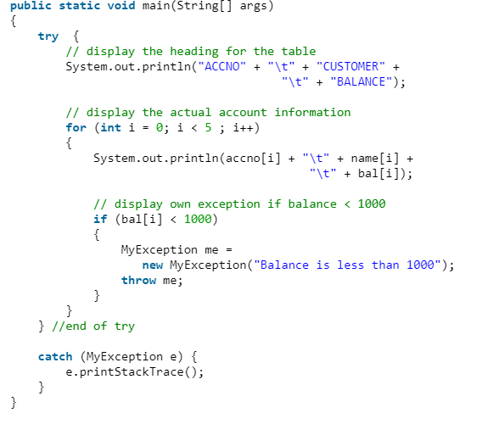

Slide 26

The Throw Keywords
We can define our own set of conditions or rules and throw an exception explicitly using throw keyword
For example, we can throw ArithmeticException when we divide number by 5, or any other numbers, what we need to do is just set the condition and throw any exception using throw keyword.

Slide 27
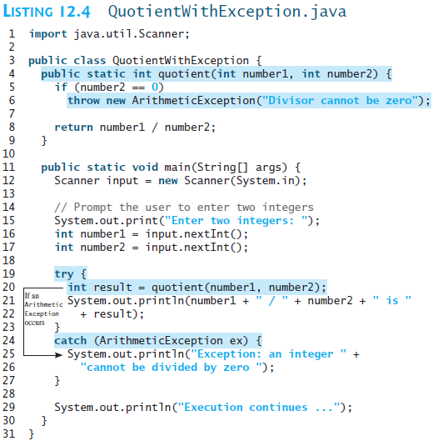

Slide 28



Slide 29
Handling InputMismatchException
By handling InputMismatchException, your program will continuously read an input until it is correct.

Slide 30
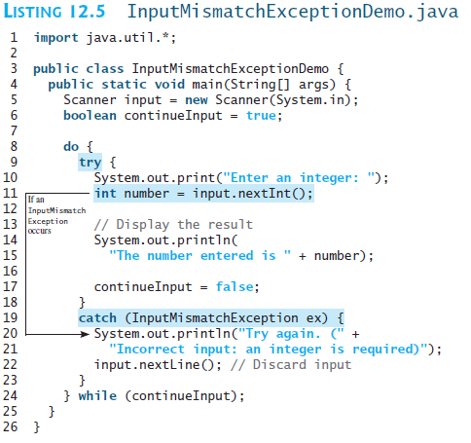


Slide 31

Exception Types

Slide 32
Unchecked Exceptions
Unchecked exception.

Slide 33

Declaring, Throwing, and Catching Exceptions

Slide 34
Declaring Exceptions
Throws keyword is used for handling checked exceptions . By using throws we can declare multiple exceptions in one go.
Every method must state the types of checked exceptions it might throw. This is known as declaring exceptions.
public void myMethod() throws IOException
public void myMethod() throws IOException, OtherException

Slide 35
Throwing Exceptions
When the program detects an error, the program can create an instance of an appropriate exception type and throw it. This is known as throwing an exception. Here is an example,
throw new TheException();
TheException ex = new TheException();
throw ex;

Slide 36
Throwing Exceptions Example
/** Set a new radius */
public void setRadius(double newRadius)
throws IllegalArgumentException {
if (newRadius >= 0)
radius = newRadius;
else
throw new IllegalArgumentException(
"Radius cannot be negative");
}

Slide 37

Catching Exceptions

Slide 38
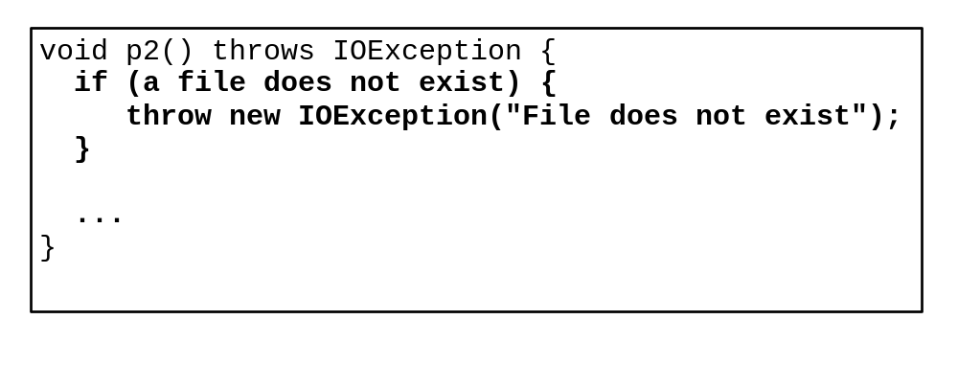
Catch or Declare Checked Exceptions
Suppose p2 is defined as follows:

Slide 39
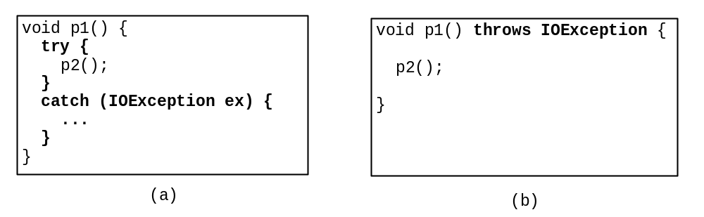
Catch or Declare Checked Exceptions
Java forces you to deal with checked exceptions. If a method declares a checked exception (i.e., an exception other than Error or RuntimeException), you must invoke it in a try-catch block or declare to throw the exception in the calling method. For example, suppose that method p1 invokes method p2 and p2 may throw a checked exception (e.g., IOException), you have to write the code as shown in (a) or (b).

Slide 40
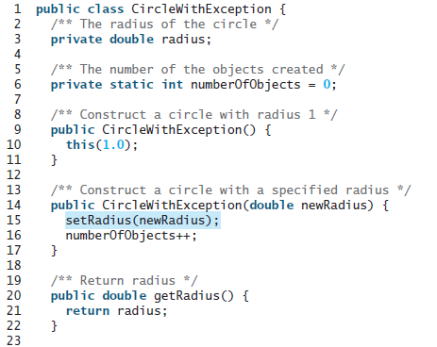

Slide 41
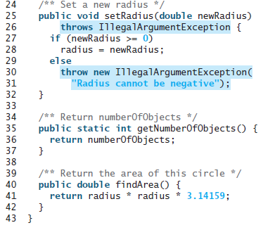

Slide 42
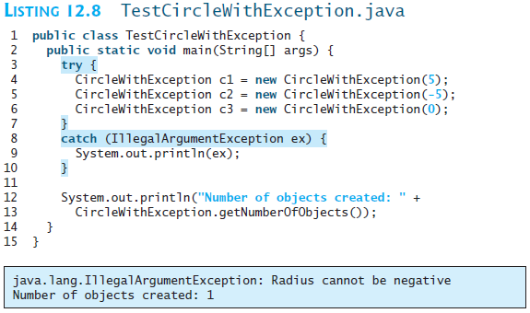

Slide 43
Rethrowing Exceptions
try {
statements;
}
catch(TheException ex) {
perform operations before exits;
throw ex;
}

Slide 44
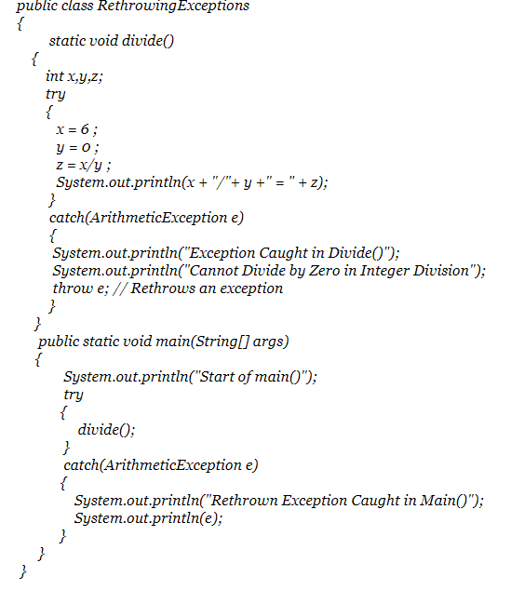

Slide 45
The finally Clause
try {
statements;
}
catch(TheException ex) {
handling ex;
}
finally {
finalStatements;
}

Slide 46
Trace a Program Execution
animation
Suppose no exceptions in the statements
try {
statements;
}
catch(TheException ex) {
handling ex;
}
finally {
finalStatements;
}
Next statement;

Slide 47
Trace a Program Execution
animation
The final block is always executed
try {
statements;
}
catch(TheException ex) {
handling ex;
}
finally {
finalStatements;
}
Next statement;

Slide 48
Trace a Program Execution
animation
Next statement in the method is executed
try {
statements;
}
catch(TheException ex) {
handling ex;
}
finally {
finalStatements;
}
Next statement;

Slide 49
Trace a Program Execution
animation
try {
statement1;
statement2;
statement3;
}
catch(Exception1 ex) {
handling ex;
}
finally {
finalStatements;
}
Next statement;
Suppose an exception of type Exception1 is thrown in statement2

Slide 50
Trace a Program Execution
animation
try {
statement1;
statement2;
statement3;
}
catch(Exception1 ex) {
handling ex;
}
finally {
finalStatements;
}
Next statement;
The exception is handled.

Slide 51
Trace a Program Execution
animation
try {
statement1;
statement2;
statement3;
}
catch(Exception1 ex) {
handling ex;
}
finally {
finalStatements;
}
Next statement;
The final block is always executed.

Slide 52
Trace a Program Execution
animation
try {
statement1;
statement2;
statement3;
}
catch(Exception1 ex) {
handling ex;
}
finally {
finalStatements;
}
Next statement;
The next statement in the method is now executed.

Slide 53
Trace a Program Execution
animation
try {
statement1;
statement2;
statement3;
}
catch(Exception1 ex) {
handling ex;
}
catch(Exception2 ex) {
handling ex;
throw ex;
}
finally {
finalStatements;
}
Next statement;
statement2 throws an exception of type Exception2.

Slide 54
Trace a Program Execution
animation
try {
statement1;
statement2;
statement3;
}
catch(Exception1 ex) {
handling ex;
}
catch(Exception2 ex) {
handling ex;
throw ex;
}
finally {
finalStatements;
}
Next statement;
Handling exception

Slide 55
Trace a Program Execution
animation
try {
statement1;
statement2;
statement3;
}
catch(Exception1 ex) {
handling ex;
}
catch(Exception2 ex) {
handling ex;
throw ex;
}
finally {
finalStatements;
}
Next statement;
Execute the final block

Slide 56
Trace a Program Execution
animation
try {
statement1;
statement2;
statement3;
}
catch(Exception1 ex) {
handling ex;
}
catch(Exception2 ex) {
handling ex;
throw ex;
}
finally {
finalStatements;
}
Next statement;
Rethrow the exception and control is transferred to the caller

Slide 57
The File Class
The File class is intended to provide an abstraction that deals with most of the machine-dependent complexities of files
path names in a machine-independent fashion.
The filename is a string.

Slide 58
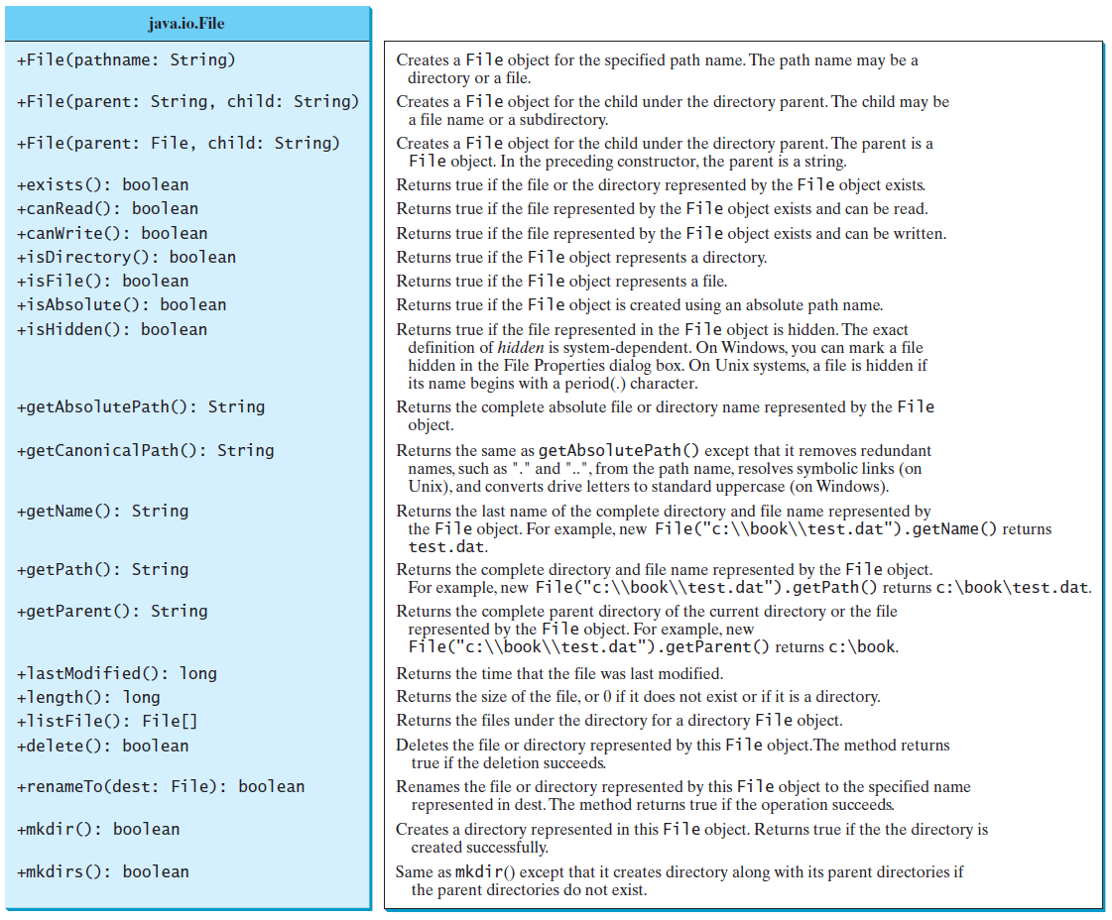
Obtaining file properties and manipulating file

Slide 59
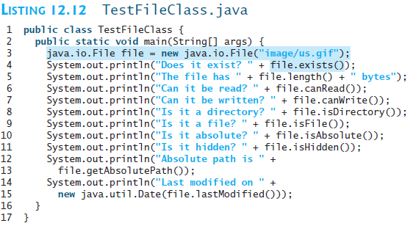

Slide 60
