Slide 1
Generics

Slide 2

Introductions
Java Generics were introduced in JDK 5.0 with the aim of reducing bugs and adding an extra layer of abstraction over types.
The Java Generics programming is introduced to deal with type-safe objects.

Slide 3
Why Generics?
Let's imagine a scenario where we want to create a list in Java to store Integer; we can be tempted to write:
  ArrayList list = new ArrayList ();
  list.add(new Integer(1));
  Integer i = list.get(0);
Surprisingly, the compiler will complain about the last line. It doesn't know what data type is returned. The compiler will require an explicit casting.
Integer i = (Integer) list.get(0);

Slide 4
Why compiler will complain about the last line
There is no contract that could guarantee that the return type of the list is an Integer. The defined list could hold any object. We only know that we are retrieving a list by inspecting the context. When looking at types, it can only guarantee that it is an Object, thus requires an explicit cast to ensure that the type is safe.
This cast can be annoying, we know that the data type in this list is an Integer. The cast is also cluttering our code. It can cause type-related runtime errors if a programmer makes a mistake with the explicit casting.

Slide 5
What is Generics?
It would be much easier if programmers could express their intention of using specific types
the compiler can ensure the correctness of such type.
This is the core idea behind generics.

Slide 6
What is Generics?
Let's modify the first line of the previous code snippet to:
ArrayList<Integer> list = new ArrayList<Integer>();
By adding the diamond operator <> containing the type, we narrow the specialization of this list only to Integer type i.e. we specify the type that will be held inside the list. The compiler can enforce the type at compile time.
In small programs, this might seem like a trivial addition, however, in larger programs, this can add significant robustness and makes the program easier to read.

Slide 7
Example
Let’s consider a problem where i’ll design a class called MyList class that will add, remove elements to an Arraylist.
  public class MyList {
  ArrayList <String> list = new ArrayList<String>();
  public void add(String element)
  {
  list.add(element);
  }
  public void remove(int ind)
  {
  list.remove(ind);
  }
  }

Slide 8
Main class
MyList list1 = new MyList();
list1.add("element1");
list1.add("element2");
System.out.println(list1);
MyList list2 = new MyList();
list1.add(new Integer(4));
list1.add(new Integer(4));
System.out.println(list2);

Slide 9
Generic class
public class MyList <T>{
ArrayList <T> list = new ArrayList();
public void add(T element)
{
list.add(element);
}
public void remove(int ind)
{
list.remove(ind);
}
}

Slide 10
Generic Method
public class TestGenerics{
public static < T > void printArray(T[] elements) {
for ( T element : elements){
System.out.println(element );
}
System.out.println();
}
public static void main( String args[] ) {
Integer[] intArray = { 10, 20, 30, 40, 50 };
Character[] charArray = { 'J', 'A', 'V', 'A', 'T','P','O','I','N','T' };
System.out.println( "Printing Integer Array" );
printArray( intArray );
Sstem.out.println( "Printing Character Array" );
printArray( charArray );
}
}

Slide 11
Bounded Generic Type
public static void main(String[] args ) {
Rectangle rectangle = new Rectangle(2, 2);
Circle circle = new Circle (2);
System.out.println("Same area? " + equalArea(rectangle, circle));
}
public static <E extends Shape> boolean
equalArea(E object1, E object2) {
return object1.getArea() == object2.getArea();
}

Slide 12
Raw Type and Backward Compatibility
// raw type
ArrayList list = new ArrayList();
This is roughly equivalent to
ArrayList<Object> list = new ArrayList<Object>();

Slide 13
Wildcards
Why wildcards are necessary? See this example.
WildCardNeedDemo
? unbounded wildcard
? extends T bounded wildcard
? super T lower bound wildcard
AnyWildCardDemo
SuperWildCardDemo

Slide 14
? (question mark) symbol
The ? (question mark) symbol represents the wildcard element. It means any type. If we write <? extends Number>, it means any child class of Number, e.g., Integer, Float, and double. Now we can call the method of Number class through any child class object.

Slide 15
What is the difference between using <T> and a wildcard <?>
If you want to enforce some relationship on the different types of method arguments, you can't do that with wildcards, you have to use type parameter
public static <T extends Number> void copy(List<T> dest, List<T> src)
  public static void copy(List<? extends Number> dest, List<? extends Number> src)
  In 2nd case, you can pass List<Integer> and List<Float> as destand src. So, moving elements from src to dest wouldn't be type safe anymore. If you don't need such kind of relation, then you are free not to use type parameters at all

Slide 16
What is the difference between using <T> and a wildcard <?>
Some other difference between using wildcards and type parameters are:
If you have only one parameterized type argument, then you can use wildcard, although type parameter will also work.
Type parameters support multiple bounds, wildcards don't.
Wildcards support both upper and lower bounds, type parameters just support upper bounds.

Slide 17
Upper Bounded Wildcards
The purpose of upper bounded wildcards is to decrease the restrictions on a variable.
It restricts the unknown type to be a specific type or a subtype of that type.
It is used by declaring wildcard character ("?") followed by the extends (in case of, class) or implements (in case of, interface) keyword, followed by its upper bound.
Syntax: List<? extends Number>

Slide 18
Upper Bounded Wildcards
private static Double add(ArrayList<? extends Number> num)
{ double sum=0.0;
for(Number n:num) {
sum = sum+ n.doubleValue();
}
return sum;
}

Slide 19
Upper Bounded Wildcards
public static void main(String[] args) {
ArrayList<Integer> l1=new ArrayList<Integer>();
l1.add(10);
l1.add(20);
System.out.println("displaying the sum= "+add(l1));
ArrayList<Double> l2=new ArrayList<Double>();
l2.add(30.0);
l2.add(40.0);
System.out.println("displaying the sum= "+add(l2));

Slide 20
Lower Bounded Wildcards
The purpose of lower bounded wildcards is to restrict the unknown type to be a specific type or a supertype of that type. It is used by declaring wildcard character ("?") followed by the super keyword, followed by its lower bound.
Syntax
List<? super Integer>

Slide 21
Lower Bounded Wildcards
public static void addNumbers(List<? super Integer> list)
{
for(Object n:list)
{
System.out.println(n);
}
}

Slide 22
Lower Bounded Wildcards
public static void main(String[] args)
{
List<Integer> l1=Arrays.asList(1,2,3);
System.out.println("displaying the Integer values");
addNumbers(l1);
List<Number> l2=Arrays.asList(1.0,2.0,3.0);
System.out.println("displaying the Number values");
addNumbers(l2);
}

Slide 23
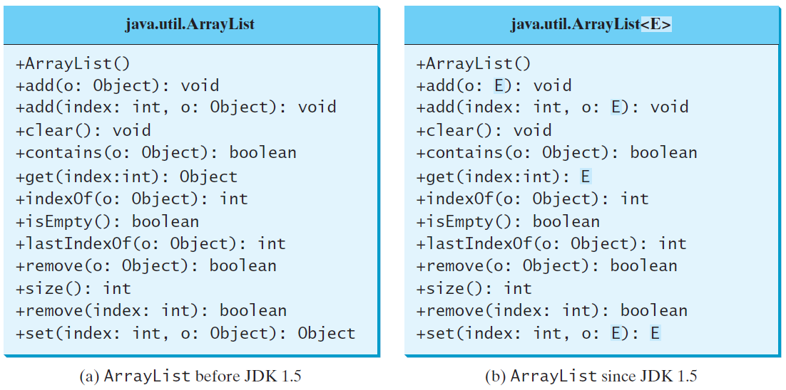
Generic ArrayList in JDK 1.5

Slide 24
Type-safety
: We can hold only a single type of objects in generics. It doesnot allow to store other objects.
Without Generics, we can store any type of objects.

Slide 25
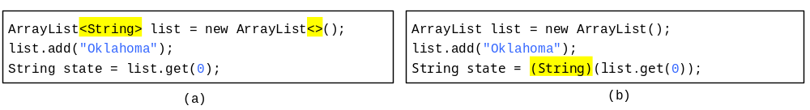
Compile Time Checking
For example, the compiler checks whether generics is used correctly for the following code in (a) and translates it into the equivalent code in (b) for runtime use. The code in (b) uses the raw type.

Slide 26
No Casting Needed
ArrayList<Double> list = new ArrayList<>();
list.add(5.5); // 5.5 is automatically converted to new Double(5.5)
list.add(3.0); // 3.0 is automatically converted to new Double(3.0)
Double doubleObject = list.get(0); // No casting is needed
double d = list.get(1); // Automatically converted to double

Slide 27
Restrictions on Generics
Restriction 1: Cannot Create an Instance of a Generic Type. (i.e., new E()).
Restriction 2: Generic Array Creation is Not Allowed. (i.e., new E[100]).
Restriction 3: A Generic Type Parameter of a Class Is Not Allowed in a Static Context.
Restriction 4: Exception Classes Cannot be Generic.

Slide 28
Designing Generic Matrix Classes
Objective: This example gives a generic class for matrix arithmetic. This class implements matrix addition and multiplication common for all types of matrices.
GenericMatrix

Slide 29
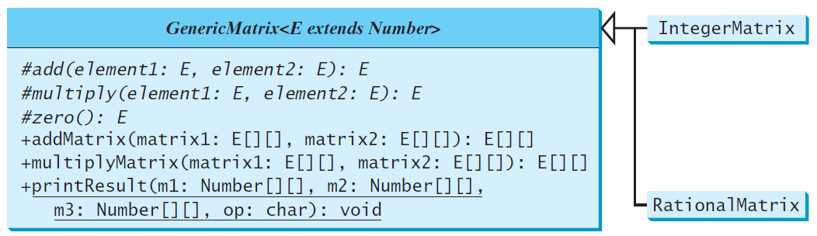
UML Diagram

