Slide 1
Inheritance and Polymorphism

Slide 2
Inheritance
Inheritance in Java is a mechanism in which one object acquires all the properties and behaviors of a parent object. It is an important part of OOPs (Object Oriented programming system).
The idea behind inheritance in Java is that you can create new classes that are built upon existing classes. When you inherit from an existing class, you can reuse methods and fields of the parent class. Moreover, you can add new methods and fields in your current class also.
Inheritance represents the IS-A relationship which is also known as a parent-child relationship.

Slide 3
Why use inheritance in java
For Method Overriding (so runtime polymorphism can be achieved).
For Code Reusability.

Slide 4
Terms used in Inheritance
Class: A class is a group of objects which have common properties. It is a template or blueprint from which objects are created.
Sub Class/Child Class: Subclass is a class which inherits the other class. It is also called a derived class, extended class, or child class.
Super Class/Parent Class: Superclass is the class from where a subclass inherits the features. It is also called a base class or a parent class.
Reusability: As the name specifies, reusability is a mechanism which facilitates you to reuse the fields and methods of the existing class when you create a new class. You can use the same fields and methods already defined in the previous class.

Slide 5
The syntax of Java Inheritance
class Subclass-name extends Superclass name
{
//methods and fields
}
The extends keyword indicates that you are making a new class that derives from an existing class. The meaning of "extends" is to increase the functionality.
In the terminology of Java, a class which is inherited is called a parent or superclass, and the new class is called child or subclass.

Slide 6
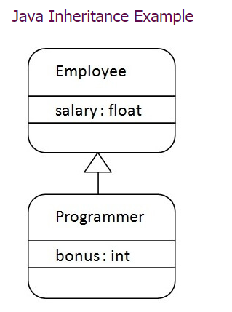

Slide 7
Example
class Employee{
float salary=40000;
}
class Programmer extends Employee{
int bonus=10000;
public static void main(String args[]){
Programmer p=new Programmer();
System.out.println("Programmer salary is:"+p.salary);
System.out.println("Bonus of Programmer is:"+p.bonus);
}
}
Output: Programmer salary is:40000.0
Bonus of programmer is:10000

Slide 8
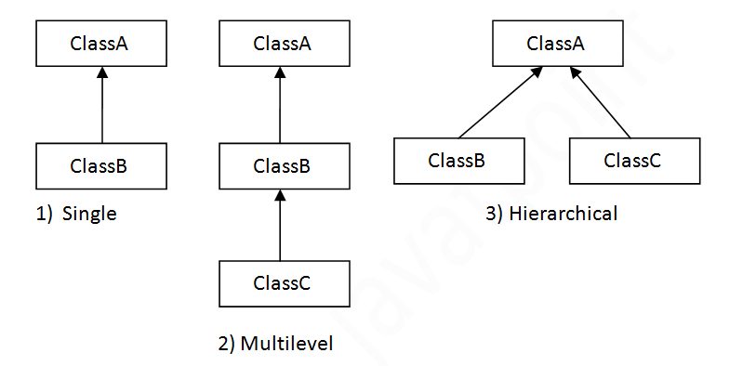
Types of inheritance in java

Slide 9
Single Inheritance Example
class Animal{
void eat(){System.out.println("eating...");}
}
class Dog extends Animal{
void bark(){System.out.println("barking...");}
}
class TestInheritance{
public static void main(String args[]){
Dog d=new Dog();
d.bark();
d.eat();
}}

Slide 10
Multilevel Inheritance Example
class Animal{
void eat(){System.out.println("eating...");}
}
class Dog extends Animal{
void bark(){System.out.println("barking...");}
}
class BabyDog extends Dog{
void weep(){System.out.println("weeping...");}
}
class TestInheritance2{
public static void main(String args[]){
BabyDog d=new BabyDog();
d.weep();
d.bark();
d.eat();
}}

Slide 11
Hierarchical Inheritance Example
class Animal{
void eat(){System.out.println("eating...");}
}
class Dog extends Animal{
void bark(){System.out.println("barking...");}
}
class Cat extends Animal{
void meow(){System.out.println("meowing...");}
}
class TestInheritance3{
public static void main(String args[]){
Cat c=new Cat();
c.meow();
c.eat();
}}

Slide 12

Superclasses and Subclasses
GeometricObject
CircleFromSimpleGeometricObject
RectangleFromSimpleGeometricObject
TestCircleRectangle
Run

Slide 13
class Vehicle {
protected String brand = "Ford";
public void honk() {
System.out.println("Tuut, tuut!");
}
}
class Car extends Vehicle {
private String modelName = "Mustang";
public static void main(String[] args) {
Car myFastCar = new Car();
myFastCar.honk();
System.out.println(myFastCar.brand + " " + myFastCar.modelName);
}
}

Slide 14
Protected Modifier
Did you notice the protected modifier in Vehicle?
We set the brand attribute in Vehicle to a protected access modifier. If it was set to private, the Car class would not be able to access it.

Slide 15
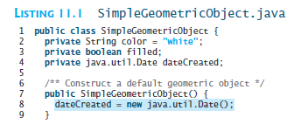
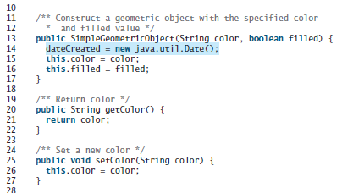

Slide 16
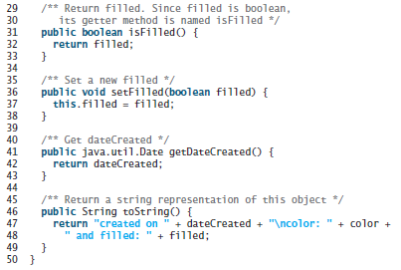

Slide 17
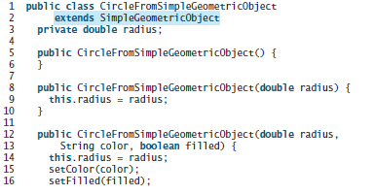


Slide 18
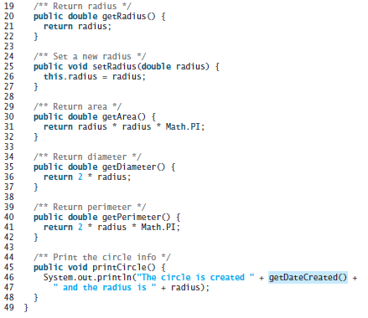

Slide 19
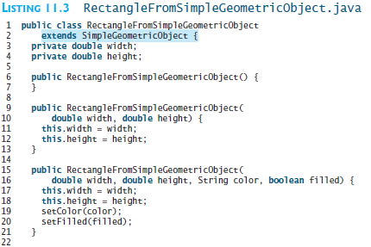

Slide 20
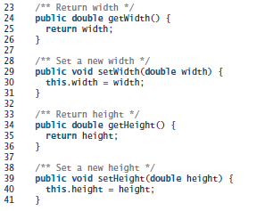
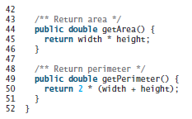

Slide 21
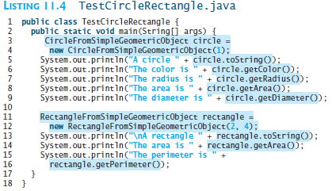
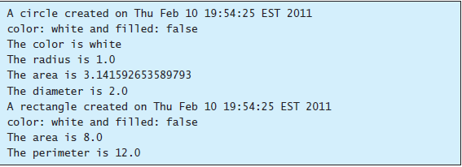

Slide 22
Are superclass’s Constructor Inherited?
No. They are not inherited.
They are invoked explicitly or implicitly.
Explicitly using the super keyword.
A constructor is used to construct an instance of a class. Unlike properties and methods, a superclass's constructors are not inherited in the subclass. They can only be invoked from the subclasses' constructors, using the keyword super. If the keyword super is not explicitly used, the superclass's no-arg constructor is automatically invoked.

Slide 23


Superclass’s Constructor Is Always Invoked
A constructor may invoke an overloaded constructor or its superclass’s constructor. If none of them is invoked explicitly, the compiler puts super() as the first statement in the constructor. For example,

Slide 24
Using the Keyword super
The keyword super refers to the superclass of the class in which super appears. This keyword can be used in two ways:
To call a superclass constructor
To call a superclass method
To call superclass variable

Slide 25
CAUTION
You must use the keyword super to call the superclass constructor. Invoking a superclass constructor’s name in a subclass causes a syntax error. Java requires that the statement that uses the keyword super appear first in the constructor.

Slide 26
Example on the Impact of a Superclass without no-arg Constructor
Find out the errors in the program:
public class Apple extends Fruit {
}
class Fruit {
public Fruit(String name) {
System.out.println("Fruit's constructor is invoked");
}
}

Slide 27
Defining a Subclass
A subclass inherits from a superclass. You can also:
  Add new properties
  Add new methods
  Override the methods of the superclass

Slide 28
Calling Superclass Methods
You could rewrite the printCircle() method in the Circle class as follows:
public void printCircle() {
System.out.println("The circle is created " +
super.getDateCreated() + " and the radius is " + radius);
}

Slide 29
Overriding Methods in the Superclass
A subclass inherits methods from a superclass. Sometimes it is necessary for the subclass to modify the implementation of a method defined in the superclass. This is referred to as method overriding.
public class Circle extends GeometricObject {
// Other methods are omitted
/** Override the toString method defined in GeometricObject */
public String toString() {
return super.toString() + "\nradius is " + radius;
}
}

Slide 30
NOTE
An instance method can be overridden only if it is accessible. Thus a private method cannot be overridden, because it is not accessible outside its own class. If a method defined in a subclass is private in its superclass, the two methods are completely unrelated.

Slide 31
NOTE
Like an instance method, a static method can be inherited. However, a static method cannot be overridden. If a static method defined in the superclass is redefined in a subclass, the method defined in the superclass is hidden.

Slide 32

Overriding vs. Overloading

Slide 33

The Object Class and Its Methods
Every class in Java is descended from the java.lang.Object class. If no inheritance is specified when a class is defined, the superclass of the class is Object.

Slide 34
The toString() method in Object
The toString() method returns a string representation of the object. The default implementation returns a string consisting of a class name of which the object is an instance, the at sign (@), and a number representing this object.
Loan loan = new Loan();
System.out.println(loan.toString());
The code displays something like Loan@15037e5 . This message is not very helpful or informative. Usually you should override the toString method so that it returns a digestible string representation of the object.

Slide 35
Polymorphism
Polymorphism means that a variable of a supertype can refer to a subtype object.
A class defines a type. A type defined by a subclass is called a subtype, and a type defined by its superclass is called a supertype. Therefore, you can say that Circle is a subtype of GeometricObject and GeometricObject is a supertype for Circle.
PolymorphismDemo
Run

Slide 36
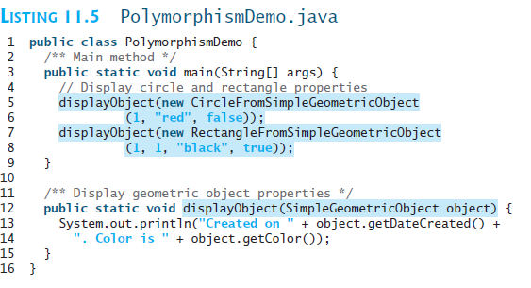


Slide 37

Polymorphism, Dynamic Binding and Generic Programming
Listing 11.6 DynamicBindingDemo.java
public class DynamicBindingDemo {
public static void main(String[] args) {
m(new GraduateStudent());
m(new Student());
m(new Person());
m(new Object());
}
public static void m(Object x) {
System.out.println(x.toString());
}
}
class GraduateStudent extends Student {
}
class Student extends Person {
public String toString() {
return "Student";
}
}
class Person extends Object {
public String toString() {
return "Person";
}
}
Method m takes a parameter of the Object type. You can invoke it with any object.
An object of a subtype can be used wherever its supertype value is required. This feature is known as polymorphism.
When the method m(Object x) is executed, the argument x’s toString method is invoked. x may be an instance of GraduateStudent, Student, Person, or Object. Classes GraduateStudent, Student, Person, and Object have their own implementation of the toString method. Which implementation is used will be determined dynamically by the Java Virtual Machine at runtime. This capability is known as dynamic binding.
Animation
DynamicBindingDemo
Run

Slide 38

Object
Person
Student
GraduateStudent

Slide 39

Dynamic Binding
Dynamic binding works as follows: Suppose an object o is an instance of classes C₁, C₂, ..., C_{n-1}, and C_{n}, where C₁ is a subclass of C₂, C₂ is a subclass of C₃, ..., and C_{n-1} is a subclass of C_{n}. That is, C_{n} is the most general class, and C₁ is the most specific class. In Java, C_{n} is the Object class. If o invokes a method p, the JVM searches the implementation for the method p in C₁, C₂, ..., C_{n-1} and C_{n}, in this order, until it is found. Once an implementation is found, the search stops and the first-found implementation is invoked.

Slide 40
Method Matching vs. Binding
Matching a method signature and binding a method implementation are two issues. The compiler finds a matching method according to parameter type, number of parameters, and order of the parameters at compilation time. A method may be implemented in several subclasses. The Java Virtual Machine dynamically binds the implementation of the method at runtime.

Slide 41
Generic Programming
public class PolymorphismDemo {
public static void main(String[] args) {
m(new GraduateStudent());
m(new Student());
m(new Person());
m(new Object());
}
public static void m(Object x) {
System.out.println(x.toString());
}
}
class GraduateStudent extends Student {
}
class Student extends Person {
public String toString() {
return "Student";
}
}
class Person extends Object {
public String toString() {
return "Person";
}
}
Polymorphism allows methods to be used generically for a wide range of object arguments. This is known as generic programming. If a method’s parameter type is a superclass (e.g., Object), you may pass an object to this method of any of the parameter’s subclasses (e.g., Student or String). When an object (e.g., a Student object or a String object) is used in the method, the particular implementation of the method of the object that is invoked (e.g., toString) is determined dynamically.

Slide 42
Casting Objects
You have already used the casting operator to convert variables of one primitive type to another. Casting can also be used to convert an object of one class type to another within an inheritance hierarchy. In the preceding section, the statement
  m(new Student());
assigns the object new Student() to a parameter of the Object type. This statement is equivalent to:
  Object o = new Student(); // Implicit casting
  m(o);
The statement Object o = new Student(), known as implicit casting, is legal because an instance of Student is automatically an instance of Object.

Slide 43
Why Casting Is Necessary?
Suppose you want to assign the object reference o to a variable of the Student type using the following statement:
  Student b = o;
A compile error would occur. Why does the statement Object o = new Student() work and the statement Student b = o doesn’t? This is because a Student object is always an instance of Object, but an Object is not necessarily an instance of Student. Even though you can see that o is really a Student object, the compiler is not so clever to know it. To tell the compiler that o is a Student object, use an explicit casting. The syntax is similar to the one used for casting among primitive data types. Enclose the target object type in parentheses and place it before the object to be cast, as follows:
  Student b = (Student)o; // Explicit casting

Slide 44
Casting from
Superclass to Subclass
Explicit casting must be used when casting an object from a superclass to a subclass. This type of casting may not always succeed.
  Apple x = (Apple)fruit;
  Orange x = (Orange)fruit;

Slide 45
The instanceof Operator
Use the instanceof operator to test whether an object is an instance of a class:
  Object myObject = new Circle();
  ... // Some lines of code
  /** Perform casting if myObject is an instance of Circle */
  if (myObject instanceof Circle) {
  System.out.println("The circle diameter is " +
  ((Circle)myObject).getDiameter());
  ...
  }

Slide 46
TIP
To help understand casting, you may also consider the analogy of fruit, apple, and orange with the Fruit class as the superclass for Apple and Orange. An apple is a fruit, so you can always safely assign an instance of Apple to a variable for Fruit. However, a fruit is not necessarily an apple, so you have to use explicit casting to assign an instance of Fruit to a variable of Apple.

Slide 47
Example: Demonstrating Polymorphism and Casting
This example creates two geometric objects: a circle, and a rectangle, invokes the displayGeometricObject method to display the objects. The displayGeometricObject displays the area and diameter if the object is a circle, and displays area if the object is a rectangle.
CastingDemo
Run

Slide 48
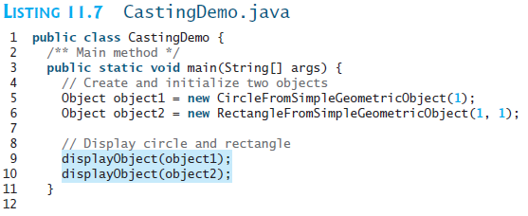
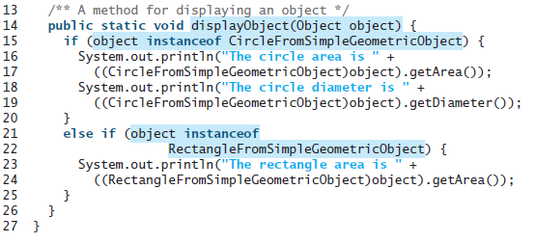

Slide 49


Slide 50
The equals Method
The equals() method compares the
contents of two objects. The default implementation of the equals method in the Object class is as follows:
public boolean equals(Object obj) {
return this == obj;
}
For example, the equals method is overridden in the Circle class.
public boolean equals(Object o) {
if (o instanceof Circle) {
return radius == ((Circle)o).radius;
}
else
return false;
}

Slide 51
NOTE
The == comparison operator is used for comparing two primitive data type values or for determining whether two objects have the same references.
The equals method is intended to test whether two objects have the same contents, provided that the method is modified in the defining class of the objects.
The == operator is stronger than the equals method, in that the == operator checks whether the two reference variables refer to the same object.

Slide 52

The ArrayList Class
You can create an array to store objects. But the array’s size is fixed once the array is created. Java provides the ArrayList class that can be used to store an unlimited number of objects.

Slide 53
Generic Type
ArrayList is known as a generic class with a generic type E. You can specify a concrete type to replace E when creating an ArrayList. For example, the following statement creates an ArrayList and assigns its reference to variable cities. This ArrayList object can be used to store strings.
ArrayList<String> cities = new ArrayList<String>();
ArrayList<String> cities = new ArrayList<>();
TestArrayList
Run

Slide 54

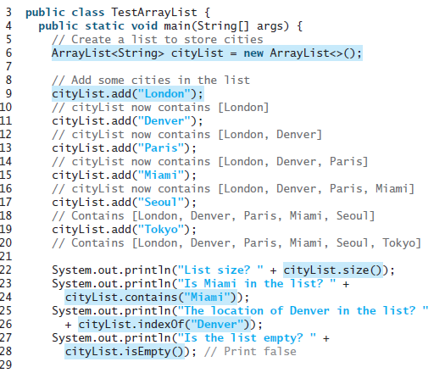

Slide 55
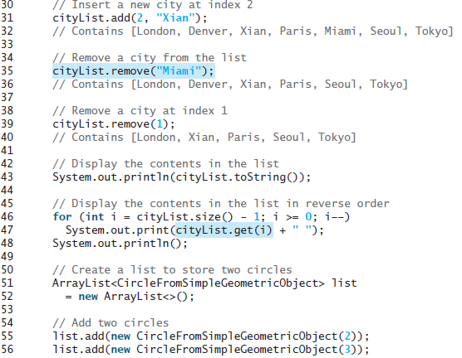

Slide 56
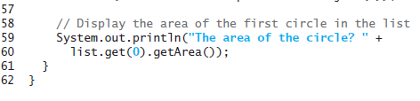
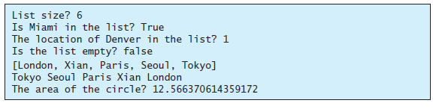

Slide 57

Differences and Similarities between Arrays and ArrayList
DistinctNumbers
Run

Slide 58
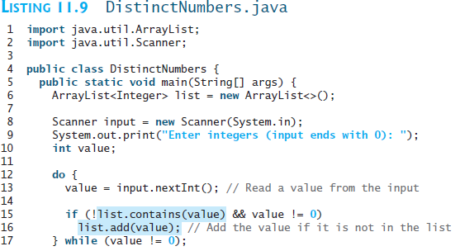
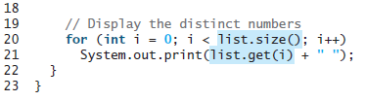

Slide 59


Slide 60
Array Lists from/to Arrays
Creating an ArrayList from an array of objects:
String[] array = {"red", "green", "blue"};
ArrayList<String> list = new ArrayList<>(Arrays.asList(array));
Creating an array of objects from an ArrayList:
String[] array1 = new String[list.size()];
list.toArray(array1);

Slide 61
max and min in an Array List
String[] array = {"red", "green", "blue"};
System.out.pritnln(java.util.Collections.max(
new ArrayList<String>(Arrays.asList(array)));
String[] array = {"red", "green", "blue"};
System.out.pritnln(java.util.Collections.min(
new ArrayList<String>(Arrays.asList(array)));

Slide 62
Shuffling an Array List
Integer[] array = {3, 5, 95, 4, 15, 34, 3, 6, 5};
ArrayList<Integer> list = new
ArrayList<>(Arrays.asList(array));
java.util.Collections.shuffle(list);
System.out.println(list);

Slide 63

The MyStack Classes
A stack to hold objects.
MyStack

Slide 64
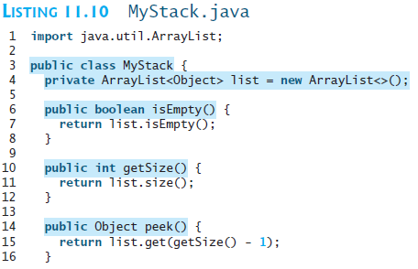
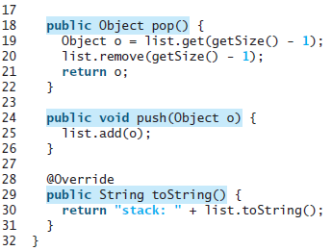

Slide 65

The protected Modifier
The protected modifier can be applied on data and methods in a class. A protected data or a protected method in a public class can be accessed by any class in the same package or its subclasses, even if the subclasses are in a different package.
private, default, protected, public

Slide 66

Accessibility Summary

Slide 67

Visibility Modifiers

Slide 68
A Subclass Cannot Weaken the Accessibility
A subclass may override a protected method in its superclass and change its visibility to public. However, a subclass cannot weaken the accessibility of a method defined in the superclass. For example, if a method is defined as public in the superclass, it must be defined as public in the subclass.

Slide 69
NOTE
The modifiers are used on classes and class members (data and methods), except that the final modifier can also be used on local variables in a method. A final local variable is a constant inside a method.

Slide 70
The final Modifier
The final class cannot be extended:
final class Math {
...
}
The final variable is a constant:
final static double PI = 3.14159;
The final method cannot be
overridden by its subclasses.

