Slide 1
String
Strings
Strings

Slide 2
1. Java Class Library
A class library is a collection of classes that we use when developing programs
The Java standard class library is part of any Java development environment
The library classes are not part of the Java language per se, but we rely on them heavily
Various library classes we've already used in our programs, such as System, Scanner, and Random
Other class libraries can be obtained through third party vendors, or you can create them yourself
Classes must be imported into the program

Slide 3
Packages
The classes of the Java standard class library are organized into packages
Some of the packages in the standard class library are:
Package
java.lang
java.util
java.applet
java.awt
javax.swing
java.net
javax.xml.parsers
Purpose
General support (Character, Math, System, Number, …)
Utilities (Date, Random, Calendar, …)
Creating applets for the web
Graphics and graphical user interfaces
Additional graphics capabilities
Network communication
XML document processing

Slide 4
import Declaration
When you want to use a class from a package, you could use its fully qualified name
java.util.Scanner
Or you can import the class, and then use just the class name
import java.util.Scanner;
To import all classes in a particular package, you can use the * wildcard character
import java.util.*; // wildcard

Slide 5
import Declaration
All classes of the java.lang package are imported automatically into all programs
It's as if all programs contain the following line:
import java.lang.*;
That's why we didn't have to import the System or String classes explicitly in earlier programs
The Scanner class, on the other hand, is part of the java.util package, and therefore must be imported

Slide 6
2. Class Math
The Math class is part of the java.lang package
The Math class contains methods (called class methods) that perform various mathematical functions:
  PI constant
  E (base of natural logarithms) constant
  Trigonometric Methods
  Exponent Methods
  Rounding Methods
  min, max, abs, and random Methods
Methods in the Math class are called static methods
Static methods can be invoked through the class name – no object of the Math class is needed
Double value = Math.cos(90) + Math.sqrt(delta);

Slide 7
Example
import java.util.Scanner;
public class Quadratic
{
public static void main (String[] args)
{
int a, b, c; // ax^2 + bx + c
double discriminant, root1, root2;
Scanner scan = new Scanner (System.in);
System.out.print ("Enter the coefficient of x squared: ");
a = scan.nextInt();
System.out.print ("Enter the coefficient of x: ");
b = scan.nextInt();
System.out.print ("Enter the constant: ");
c = scan.nextInt();
// Use quadratic formula to compute the roots.
discriminant = Math.pow(b, 2) - (4 * a * c);
root1 = ((-1 * b) + Math.sqrt(discriminant)) / (2 * a);
root2 = ((-1 * b) - Math.sqrt(discriminant)) / (2 * a);
System.out.println ("Root #1: " + root1);
System.out.println ("Root #2: " + root2);
}
}

Slide 8
Example
Output:
Enter the coefficient of x squared: 3
Enter the coefficient of x: 8
Enter the constant: 4
Root #1: -0.6666666666666666
Root #2: -2.0
Enter the coefficient of x squared: 2
Enter the coefficient of x: 4
Enter the constant: 8
Root #1: NaN
Root #2: NaN
NaN indicates undefined root due to square root of negative value (sqrt of b^2-4ac)

Slide 9
Trigonometric Methods
Examples:
Math.sin(0) returns 0.0
Math.sin(Math.PI/6) returns 0.5
Math.sin(Math.PI/2) returns 1.0
Math.cos(0) returns 1.0
Math.cos(Math.PI/2) returns 0
Math.cos(Math.PI/6) returns 0.866
sin(double a)
cos(double a)
tan(double a)
acos(double a)
asin(double a)
atan(double a)

Slide 10
Exponent Methods
exp(double a)
  Returns e raised to the power of a.
log(double a)
  Returns the natural logarithm of a.
log10(double a)
  Returns the 10-based logarithm of a.
pow(double a, double b)
  Returns a raised to the power of b.
sqrt(double a)
  Returns the square root of a.
Examples:
Math.exp(1) returns 2.71
Math.log(2.71) returns 1.0
Math.pow(2,3) returns 8.0
Math.pow(3,2) returns 9.0
Math.pow(3.5,2.5) returns 22.91765
Math.sqrt(4) returns 2.0
Math.sqrt(10.5) returns 3.24

Slide 11
Rounding Methods
double ceil(double x)
  x is rounded up to its nearest integer. This integer is returned as a double value.
double floor(double x)
  x is rounded down to its nearest integer. This integer is returned as a double value.
double rint(double x)
  x is rounded to its nearest integer. If x is equally close to two integers, the even one is returned as a double.
int round(float x)
  returns (int)Math.floor(x+0.5)
long round(double x)
  returns (long)Math.floor(x+0.5)

Slide 12
Rounding Methods Examples
Math.ceil(2.1) returns 3.0
Math.ceil(2.0) returns 2.0
Math.ceil(-2.0) returns –2.0
Math.ceil(-2.1) returns -2.0
Math.floor(2.1) returns 2.0
Math.floor(2.0) returns 2.0
Math.floor(-2.0) returns –2.0
Math.floor(-2.1) returns -3.0
Math.rint(2.1) returns 2.0
Math.rint(2.0) returns 2.0
Math.rint(-2.0) returns –2.0
Math.rint(-2.1) returns -2.0
Math.rint(2.5) returns 2.0 //returns even value as double
Math.rint(-2.5) returns -2.0
Math.round(2.6f) returns 3 //round returns integers
Math.round(2.0) returns 2
Math.round(-2.0f) returns -2
Math.round(-2.6) returns -3

Slide 13
Min(), max(), and abs()
Examples:
Math.max(2,3) returns 3
Math.max(2.5,3) returns 3.0
Math.min(2.5,3.6) returns 2.5
Math.abs(-2) returns 2
Math.abs(-2.1) returns 2.1
max(a,b)and min(a,b)
  Returns the maximum or minimum of two parameters.
abs(a)
  Returns the absolute value of the parameter.

Slide 14
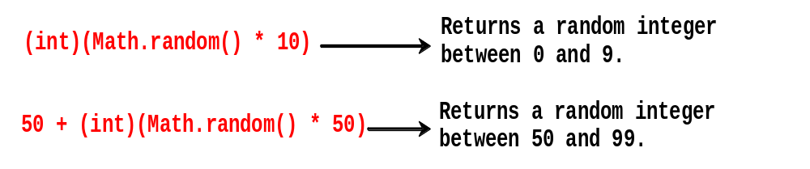
Method random()
Generates a random double value greater than or equal to 0.0 and less than 1.0 (0.0 <= Math.random() < 1.0)
Examples:
In general,

Slide 15
Generating Random Characters
Each character has a unique Unicode between 0 and FFFF in hexadecimal (65535 in decimal).
To generate a random character is to generate a random integer between 0 and 65535 using the following expression:
  (int)(Math.random() * (65535 + 1))
  Note:
  Since 0.0 <= Math.random() <1.0, you have to add 1 to 65535

Slide 16
Generating Random Characters
Lowercase letter: The Unicode for lowercase letters are consecutive integers starting from the Unicode for 'a', 'b', 'c', ..., and 'z'.
The Unicode for 'a' is (int)'a'
A random integer between (int)'a' and (int)'z‘ is
(int)((int)'a'+ Math.random()*((int)'z'-(int)'a'+1)
So, a random lowercase letter is:
(char)('a' + Math.random() * ('z' - 'a' + 1))
To generalize, a random character between any two characters ch1 and ch2 with ch1 < ch2 can be generated as follows:
(char)(ch1 + Math.random() * (ch2 – ch1 + 1))
See Appendix B, page 1266, for character set order.

Slide 17
3. Character Data Type
A char variable stores a single character.
Character literals are delimited by single quotes:
'a' 'X' '7' '$' ',' '\n' '\t'
Example declarations:
  char topGrade = 'A';
  char terminator = ';', separator = ' ';
Note the distinction between a primitive char variable, which holds only one character, and a String object, which can hold multiple characters.

Slide 18
Character Type - Revisited
char letter = 'A';
char numChar = '4';
char letter = '\u0041'; //Unicode for A
char numChar = '\u0034'; //Unicode for character 4
Four hexadecimal digits.
NOTE: The increment and decrement operators can also be used on char variables to get the next or preceding Unicode character. For example, the following statements display character b.
  char ch = 'c';
  ch = ch + 1;
  System.out.println(ch); //prints character d
  ch = ch - 2;
  System.out.println(ch); //prints character b

Slide 19

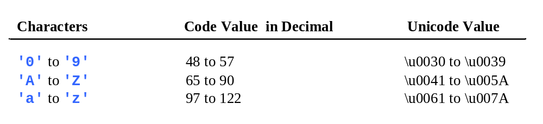
ASCII Code in Decimal

Slide 20
Casting char Type
int i = 'a'; //Same as int i = (int)'a'; which is 97
char ch = 97; //Same as char ch = (char)97; which is 'a'

Slide 21
Comparing char Type
if (ch >= 'A' && ch <= 'Z')
System.out.println(ch + " is an uppercase letter");
else if (ch >= 'a' && ch <= 'z')
System.out.println(ch + " is a lowercase letter");
else if (ch >= '0' && ch <= '9')
System.out.println(ch + " is a numeric character");

Slide 22
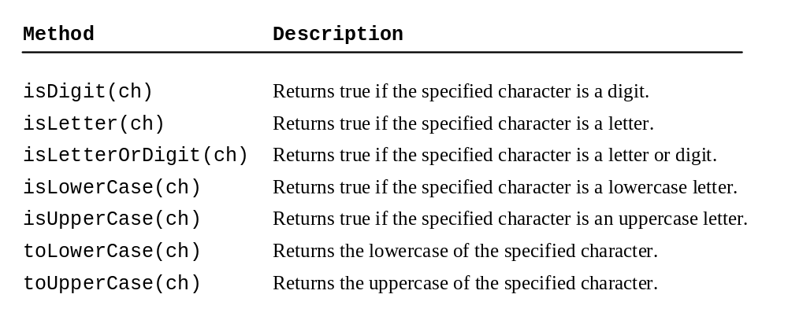
Class Character Methods

Slide 23
Class Character Methods
Character ch1 = new Character('b'); //object NOT char type
Character ch2 = new Character(‘9'); //object NOT char type
Character.isLowerCase(ch1) returns true
Character.isLetterOrDigit(ch1) returns true
Character.isDigit(ch1) returns false
Character.isDigit(ch2) returns true
Character.toUpperCase(ch1) returns B

Slide 24
Class Character Test
// Class Character Test
import java.util.Scanner;
public class CharacterTest
{
public static void main (String[] args)
{
Character ch1 = new Character('b'); //object NOT char type
Character ch2 = new Character('9'); //object NOT char type
System.out.println(Character.isLowerCase(ch1)); //returns true
System.out.println(Character.isLetterOrDigit(ch1)); //returns true
System.out.println(Character.isDigit(ch1)); //returns false
System.out.println(Character.isDigit(ch2)); //returns true
System.out.println(Character.toUpperCase(ch1)); //returns B
char ch3 = 'R'; // char type variable
char ch4 = '7'; // char type variable
char ch5 = '*'; // char type variable
System.out.println(Character.isLowerCase(ch3)); //returns false
System.out.println(Character.isLetterOrDigit(ch5)); //returns false
System.out.println(Character.isDigit(ch4)); //returns true
System.out.println(Character.isDigit(ch5)); //returns false
System.out.println(Character.toLowerCase(ch3)); //returns r
}
}

Slide 25
Escape Sequences
Description Escape Sequence Unicode
Backspace \b \u0008
Tab \t \u0009
Linefeed \n \u000A
Carriage return \r \u000D
------------------------------------------------------------------------
Backslash \\ \u005C
Single Quote \' \u0027
Double Quote \" \u0022

Slide 26
4. Class String
To create a String object, we need to declare a variables of type String:
String title = "Java Software Solutions";
Each string literal (enclosed in double quotes) represents a String object
Once a String object has been created, neither its value nor its length can be changed. Thus, String objects are immutable
The String type is not a primitive type. It is a class type and known as a object or reference type.

Slide 27
String Methods
However, several methods of the String class return new String objects that are modified versions of the original string
A String object is a sequence of characters (known as Single-Dimensional Array).
String courseName = "CS 2301";
0
1
2
3
4
5
6
C
S
2
3
0
1

Slide 28
String Index Values
It is occasionally helpful to refer to a particular character within a string
This can be done by specifying the character's numeric index (position)
The indexes begin at zero in each string
In the string "Hello", the character 'H' is at index 0 and the 'o' is at index 4

Slide 29
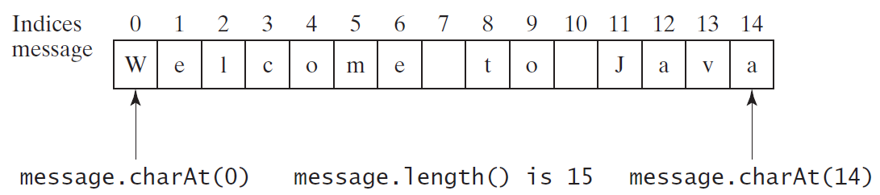
Getting Characters from a String
String message = "Welcome to Java";
char ch = message.charAt(0);
System.out.println("The first character in message is “ + ch);
String message = "Welcome to Java";
int messageLength = message.length();
System.out.println("The length of message is " + messageLength);

Slide 30
String Concatenation
// Three strings are concatenated
String message = "Welcome " + "to " + "Java";
// String Chapter is concatenated with number 2
String s = "Chapter" + 2; // s becomes Chapter2
// String Supplement is concatenated with character B
String s1 = "Supplement" + 'B'; // s1 becomes SupplementB

Slide 31
Example
public class StringMutation
{
// Prints a string and various mutations of it.
public static void main (String[] args)
{
String phrase = "Change is inevitable";
String mutation1, mutation2, mutation3, mutation4;
System.out.println ("Original string: \"" + phrase + "\"");
System.out.println ("Length of string: " + phrase.length());
mutation1 = phrase.concat(", except from vending machines.");
mutation2 = mutation1.toUpperCase();
mutation3 = mutation2.replace ('E', 'X');
mutation4 = mutation3.substring (3, 30); //excluding position 30
System.out.println ("Mutation #1: " + mutation1);
System.out.println ("Mutation #2: " + mutation2);
System.out.println ("Mutation #3: " + mutation3);
System.out.println ("Mutation #4: " + mutation4);
System.out.println ("Mutated length: " + mutation4.length());
}
}

Slide 32
Example
Output:
Original string: "Change is inevitable"
Length of string: 20
Mutation #1: Change is inevitable, except from vending machines.
Mutation #2: CHANGE IS INEVITABLE, EXCEPT FROM VENDING MACHINES.
Mutation #3: CHANGX IS INXVITABLX, XXCXPT FROM VXNDING MACHINXS.
Mutation #4: NGX IS INXVITABLX, XXCXPT F
Mutated length: 27

Slide 33
Other String Methods
String S1 = "Welcome";
String S2 = new String(char[]);
S2 = " Hello! ";
char ch = S1.charAt(index);
int length = S1.length();
int index = S1.indexOf(ch);
int index = S1.lastIndexOf(ch);
boolean b = S1.equals(S2);
boolean b = S1.equalsIgnoreCase(S2);
boolean b = S1.startsWith(S2);
Boolean b = S1.endsWith(S2);
String S = S1.toUpperCase();
String S = S2.toLowerCase();
String S = S2.substring(i); //from position i to last position
String S = S2.substring(i,j); //excluding j position
String S = S2.replace(ch1,ch2);
String S = S2.trim(); //returns "Hello!", no spaces

Slide 34
Reading Strings
Scanner input = new Scanner(System.in);
System.out.print("Enter three words separated by spaces: ");
String s1 = input.next();
String s2 = input.next();
String s3 = input.next();
System.out.println(“First word is " + s1);
System.out.println(“Second word is " + s2);
System.out.println(“Third word is " + s3);
Note: If we use
String s1 = input.nextLine();
s1 contains all typed characters until we press the "Enter" key.

Slide 35
Reading Characters
//Characters are read as strings
Scanner input = new Scanner(System.in);
System.out.print("Enter a character: ");
String s = input.nextLine(); //must press the Enter key
char ch = s.charAt(0);
System.out.println("The entered character is " + ch);

Slide 36
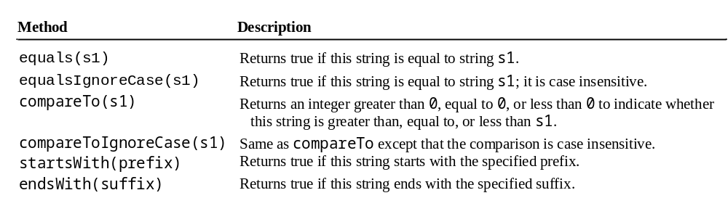
Comparing Strings

Slide 37
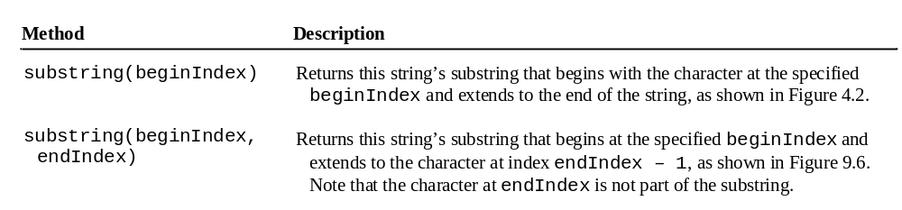
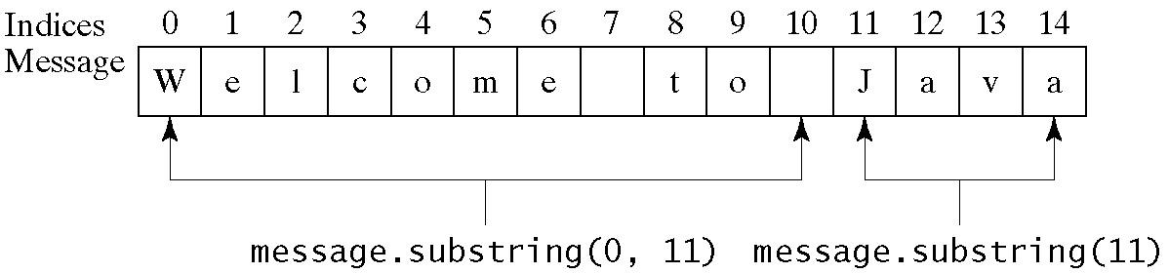
Obtaining Substrings

Slide 38
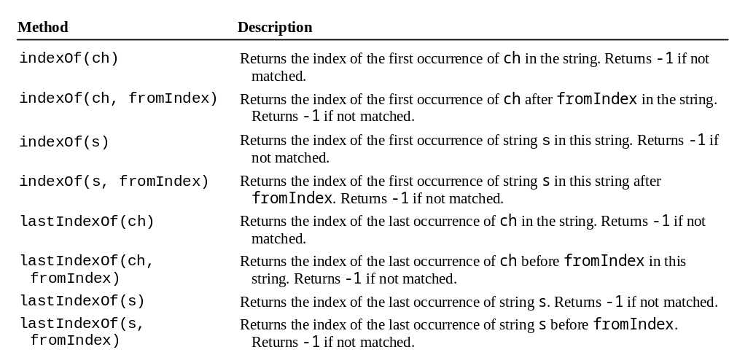
indexOf() method

Slide 39
Conversion of Strings/Numbers
You can convert strings of digits to numbers:
String intString = “123”;
int intValue = Integer.parseInt(intString);
String doubleString = “123.456”;
double doubleValue = Double.parseDouble(doubleString);
You can convert numbers to strings:
int number = 123456;
String s = "" + number; //gives "123456"

Slide 40
5. printf() Statement
Use the printf statement.
System.out.printf(format, items);
Where format is a string that may consist of substrings and format specifiers.
A format specifier specifies how an item should be displayed.
An item may be a numeric value, character, boolean value, or a string.
Each specifier begins with a percent (%) sign.

Slide 41
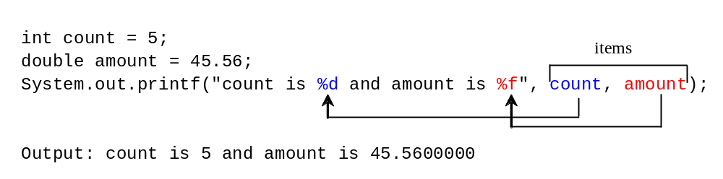
Frequently-Used Specifiers
Specifier Output Example .
%b a boolean value true or false
%c a character 'a'
%d a decimal integer 200
%f a floating-point number 45.4600000
%e a standard scientific notation 4.556000e+01
%s a string "Java is cool"
Homework: Type and run program FormatDemo, listing 4.6, page 148. It shows how to display tabulated outputs using printf() statement.

