Slide 1
Methods

Slide 2
Opening Problem
Find the sum of integers from 1 to 10, from 20 to 30, and from 35 to 45, respectively.

Slide 3
A Solution
int sum = 0;
for (int i = 1; i <= 10; i++)
sum = sum + i;
System.out.println("Sum from 1 to 10 is " + sum);
sum = 0;
for (int i = 20; i <= 30; i++)
sum = sum + i;
System.out.println("Sum from 20 to 30 is " + sum);
sum = 0;
for (int i = 35; i <= 45; i++)
sum = sum + i;
System.out.println("Sum from 35 to 45 is " + sum);

Slide 4
Repeated Code
int sum = 0;
for (int i = 1; i <= 10; i++)
sum = sum + i;
System.out.println("Sum from 1 to 10 is " + sum);
sum = 0;
for (int i = 20; i <= 30; i++)
sum = sum + i;
System.out.println("Sum from 20 to 30 is " + sum);
sum = 0;
for (int i = 35; i <= 45; i++)
sum = sum + i;
System.out.println("Sum from 35 to 45 is " + sum);

Slide 5
Solution Using Method sum
public class sumMethod {
public static void main(String[] args)
{
int result = sum(1, 10);
System.out.println("Sum from 1 to 10 is:\t" + result);
result = sum(20, 30);
System.out.println("Sum from 20 to 30 is:\t" + result);
result = sum(35, 45);
System.out.println("Sum from 35 to 45 is:\t" + result);
}
public static int sum (int num1, int num2)
{
int sum = 0;
for (int i = num1; i <= num2; i++)
sum = sum + i;
return sum;
}
}

Slide 6

What is a Method?
Think of a method as a black box that contains the detailed implementation for a specific task. The method may take use inputs (parameters) and may retune an out with a specific type.

Slide 7
Benefits of Methods
Write a method once and reuse it anywhere
Promotes Information hiding (hide the implementation from the user)
Facilitate modularity (break the code into manageable modules)
Reduce code complexity (better maintenance)

Slide 8

Defining Methods
A method has a header and a body.
=> The header is the method declaration.
=> The body is a a collection of statements grouped together to
perform an operation.

Slide 9
Method Signature
Method signature is the combination of the method name and the parameter list.

Slide 10
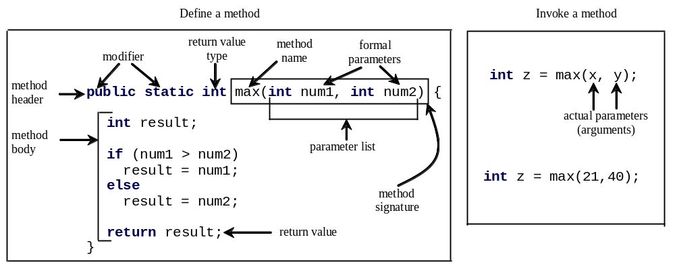
Formal Parameters
The variables defined in the method header are known as formal parameters.

Slide 11
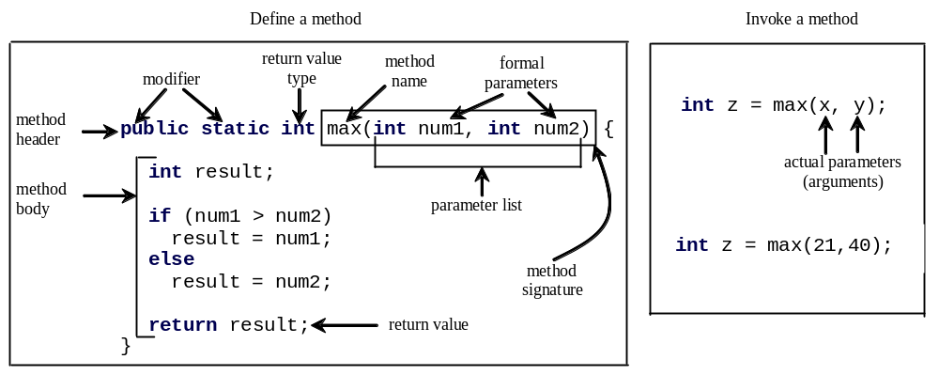
Actual Parameters
When a method is invoked, you pass a value to the parameter. This value is referred to as actual parameter or argument.

Slide 12
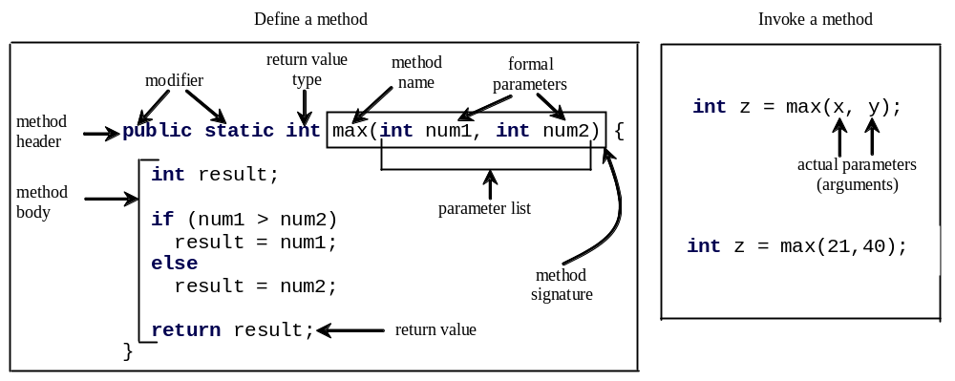
Return Value Type
A method may return a value. The returnValueType is the data type of the value the method returns. If the method does not return a value, the returnValueType is the keyword void.

Slide 13
Calling Methods
Testing method max
This program demonstrates calling method max to return the largest of two int values.

Slide 14
Calling Methods, cont.
animation
pass the value of i
pass the value of j
public static void main(String[] args) {
public static int max(int num1, int num2
) {
int i = 5;
int result;
int j = 2;
int k = max(i, j);
if (num1 > num2)
result = num1;
System.out.println(
else
"The maximum between " + i +
result = num2;
" and " + j + " is " + k);
}
return result;
}

Slide 15

Trace Method Invocation
animation
i is now 5

Slide 16
Trace Method Invocation
animation
j is now 2

Slide 17
Trace Method Invocation
animation
invoke max(i, j)

Slide 18
Trace Method Invocation
animation
invoke max(i, j)
Pass the value of i to num1
Pass the value of j to num2

Slide 19
Trace Method Invocation
animation
declare variable result

Slide 20
Trace Method Invocation
animation
(num1 > num2) is true since num1 is 5 and num2 is 2

Slide 21
Trace Method Invocation
animation
result is now 5

Slide 22
Trace Method Invocation
animation
return result, which is 5

Slide 23
Trace Method Invocation
animation
return max(i, j) and assign the return value to k

Slide 24
Trace Method Invocation
animation
Execute the print statement

Slide 25
Program TestMax
//class TestMax
public class TestMax
{
public static void main(String[] args) // main method
{
int i = 5;
int j = 2;
int k = max(i, j);
System.out.println("The maximum of " + i + " and " + j + " is " + k);
}
public static int max(int num1, int num2) // method max
{
int result;
if (num1 > num2)
result = num1;
else
result = num2;
return result;
}
}

Slide 26

CAUTION
A return statement is required for a value-returning method. The method shown below in (a) is logically correct, but it has a compilation error because the Java compiler thinks it is possible that this method does not return any value.
To fix this problem, delete if (n < 0) in (a), so that the compiler will see a return statement to be reached regardless of how the if statement is evaluated.

Slide 27
Reuse Methods from Other Classes
One of the benefits of methods is for reuse. The max method (being public method) can be invoked from any other class besides TestMax.
If you create a new class Test, you can invoke method max using ClassName.methodName (e.g., TestMax.max).
You need to compile both classes to be able call method max from class Test.
Remember? Math.pow(a,b); Math.sqrt(x);

Slide 28
Another Example
// illustration of methods in java
import java.util.*;
public class TestMethods {
public static void main (String[] arge)
{ int a = 10, b = 20;
int addResult = Add(a,b); //method call Add
System.out.println("Sum of a and b is " + addResult);
String myMessage = "Hello World!"; // call method PrintMessage
printMessage(myMessage);
}
// method definition
public static int Add(int x, int y)
{ return (x+y); }
// method definition
public static void printMessage(String message)
{
for (int i = 1; i <= 5; i++)
System.out.println(message);
}
}

Slide 29
Runtime Stack
A runtime stack is a structure used to keep track of active (currently running) methods in the program, and order of method calls.
Each active method has "activation record" on the stack. The record is the memory space for all local variables in the method.
The top activation record on the stack represents the currently running (active) method in the program.
The bottom activation record represents the main method often program.
Once a method is no longer active, it is removed from the stack (always the top record is removed).

Slide 30


Trace Call Stack
animation
i is declared and initialized

Slide 31
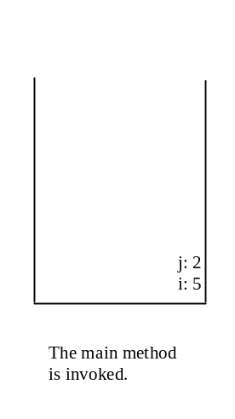
Trace Call Stack
animation
j is declared and initialized

Slide 32
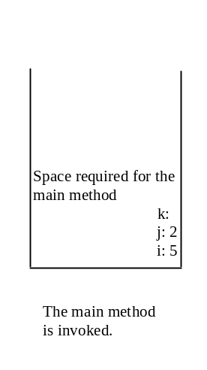
Trace Call Stack
animation
Declare k

Slide 33
Trace Call Stack
animation
Invoke max(i, j)

Slide 34
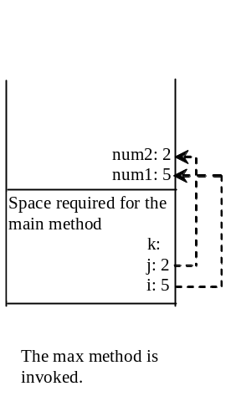
Trace Call Stack
animation
pass the values of i and j to num1 and num2

Slide 35
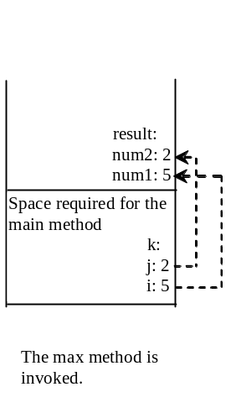
Trace Call Stack
animation
pass the values of i and j to num1 and num2

Slide 36
Trace Call Stack
animation
(num1 > num2) is true

Slide 37

Trace Call Stack
animation
Assign num1 to result

Slide 38
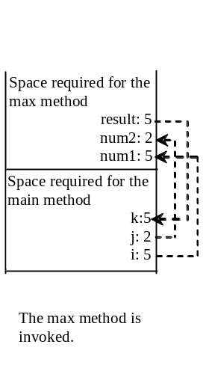
Trace Call Stack
animation
Return result and assign it to k

Slide 39
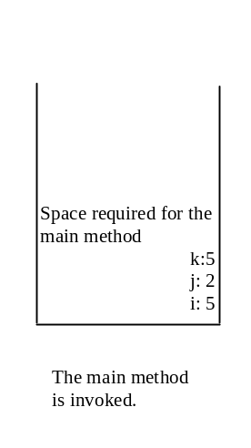
Trace Call Stack
animation
Execute print statement

Slide 40
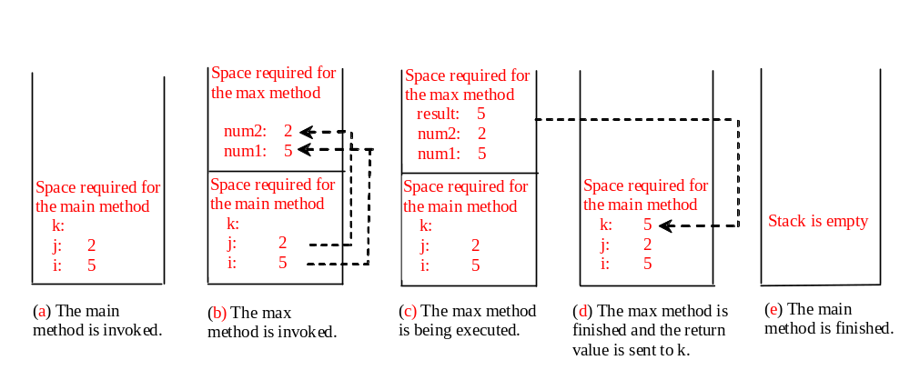
Call Stacks

Slide 41
void Method
This type of method does not return a value. The method performs some actions.
public static void Even_Odd(int n)
{
if ((n % 2) == 0)
System.out.println(n + “ is Even.”);
else
System.out.println(n + “ is Odd.”);
}
See Listing 6.2, page 209, for example method:
public static void printGrade(double score)

Slide 42
Passing Parameters
public static void nPrintln(String message, int n)
{
for (int i = 0; i < n; i++)
System.out.println(message);
}
Suppose you invoke the method using
  nPrintln(“Welcome to Java”, 5);
What is the output?
Suppose you invoke the method using
  nPrintln(“Computer Science”, 15);
What is the output?

Slide 43
Pass by Value
It means that the value of the actual parameter (when a variable) is copied into the formal parameter.
Whatever changes made to the formal parameter are local to the method and do not affect/change the value of the actual parameter.
Classic example: The Swap method.

Slide 44
Pass by Value Example
public class TestPassByValue {
public static void main (String[] arge){
int num1 = 1;
int num2 = 2;
System.out.println("Before calling Swap: num1 = " + num1 +
" num2 = " + num1 + "\n");
swap(num1, num2);
System.out.println("After calling Swap: num1 = " + num1 +
" num2 = " + num2 + "\n");
}
public static void swap(int n1, int n2){ // method swap
System.out.println("Inside swap, before Swapping : n1 = " +
n1 + " n2 = " + n1 + "\n");
int temp = n1;
n1 = n2;
n2 = temp;
System.out.println("Inside swap, after Swapping: n1 = " +
n1 + " n2 = " + n2 + "\n");
}
}

Slide 45
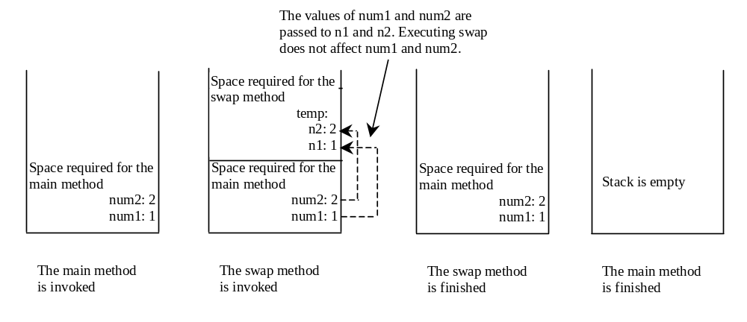
Pass by Value Runtime Stack

Slide 46
Modularizing Code
Modularization is software design concept that calls for writing code in modules.
Methods (as modules) can be used to reduce redundant coding and enable code reuse.
Methods can also be used to modularize code and improve the quality of the program.
Starting page 215, see listings 6.6 (GCD), 6.7 (Prime numbers), and 6.8 (converting decimal to hexadecimal). Each has at least one methods in addition to method main().

Slide 47
Overloading Methods
Overloading is making a method to work with different types of parameters.
Example: Overloading the max Method
public static int max(int num1, int num2)
{
if (num1 > num2)
return num1;
else
return num2;
}
public static double max(double num1, double num2)
{
if (num1 > num2)
return num1;
else
return num2;
}

Slide 48
Ambiguous Invocation
Sometimes there may be two or more possible matches for an invocation of a method, but the compiler cannot determine the most specific match. This is referred to as ambiguous invocation. Ambiguous invocation is a compilation error.

Slide 49
Ambiguous Invocation
public class AmbiguousOverloading {
public static void main(String[] args) {
System.out.println(max(1,2)); //Error
}
public static double max (int num1, double num2) {
if (num1 > num2)
return num1;
else
return num2;
}
public static double max (double num1, int num2) {
if (num1 > num2)
return num1;
else
return num2;
}
}

Slide 50
Scope of Local Variables
Local variable: a variable defined inside a method.
Scope: the part of the program where the variable can be referenced (accessible).
The scope of a local variable (also known as life-time) starts from its declaration point and continues to the end of the block that contains the variable. A local variable must be declared before it can be used.
Java Rule:
You can declare a local variable with the same name multiple time in different non-nesting blocks in a method, but you cannot declare
a local variable twice in nested blocks.

Slide 51
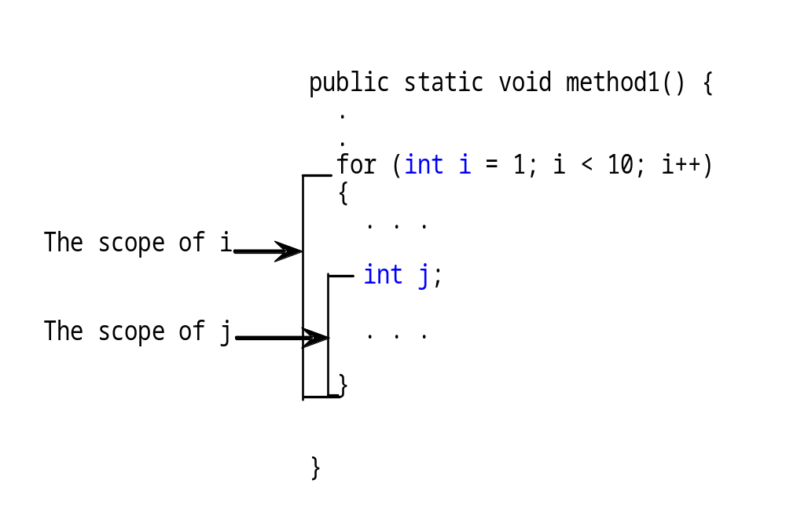
Scope of Local Variables, cont.

Slide 52
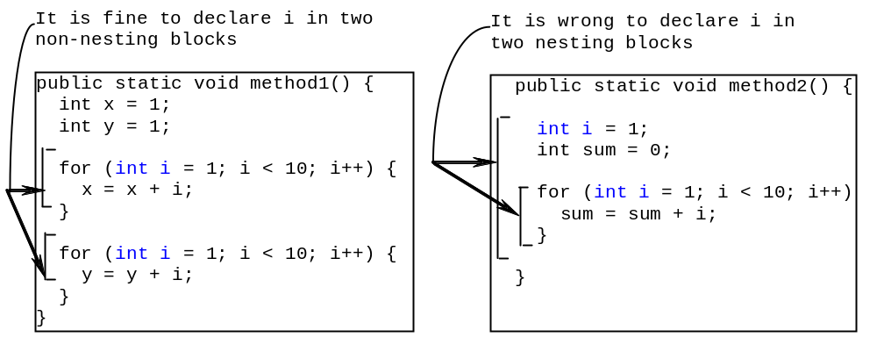
Scope of Local Variables, cont.

Slide 53
Scope of Local Variables, cont.
// Homework: code with errors, can you find them?
public static void incorrectMethod()
{
int x = 1;
int y = 1;
for (int i = 1; i < 10; i++)
{
int x = 0;
int t = 0;
x = x + i;
}
i = i + 10;
y = y + 10;
t = t + 10;
}

