Slide 1
Multi-Dimensional Arrays

Slide 2
1-Dimentional and 2-Dimentional Arrays
In the previous chapter we used 1-dimensional arrays to model linear collections of elements.
Now think of each element in the array to be a 1-dimentional array. This gives us a matrix.
myArray:
6
4
1
9
7
3
2
8
1
4
1
5
7
1
8
8
5
4
3
9
1
3
3
5
3
5
2
5
0
7
4
3
9
7
1
9
9
8
6
2

Slide 3
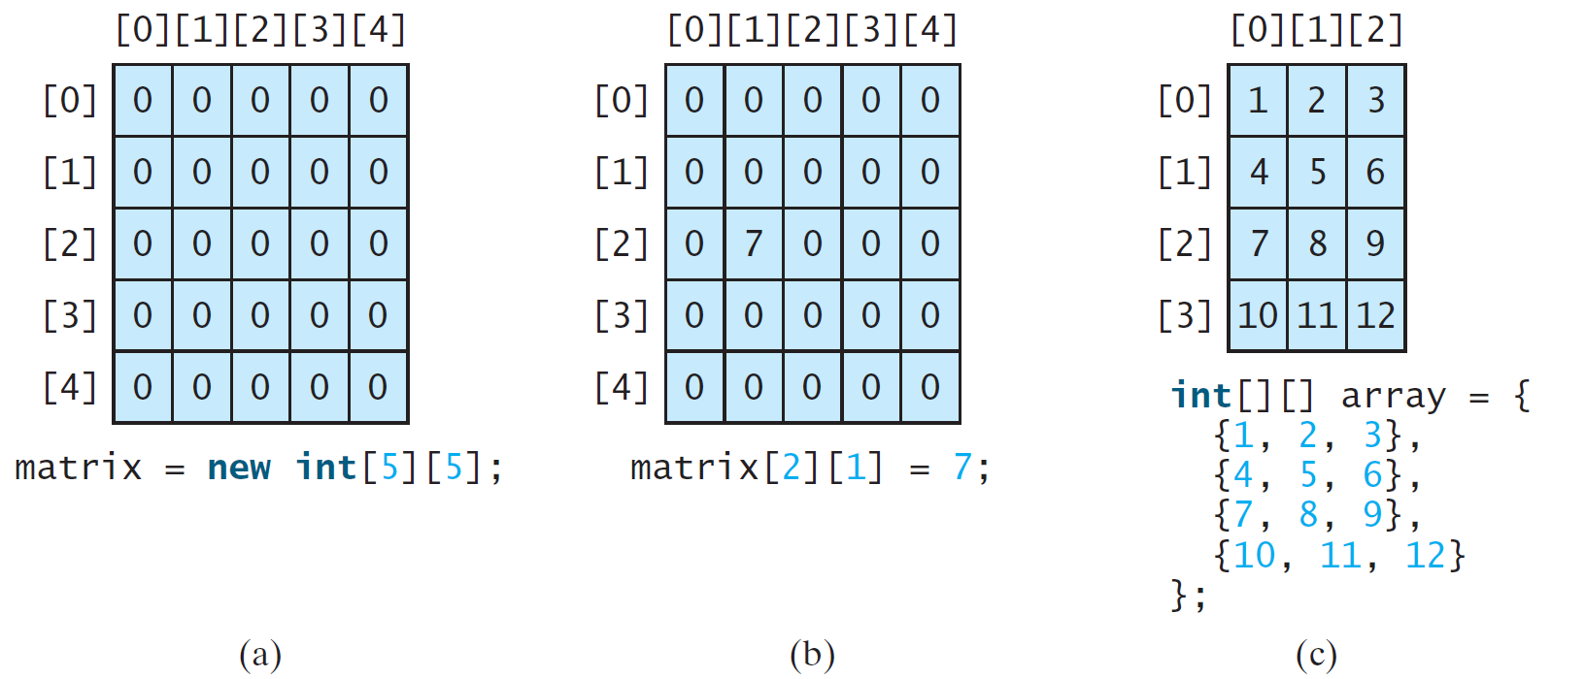
Two-dimensional Array Illustration
matrix.length? 5
matrix[0].length? 5
array.length? 4
array[0].length? 3

Slide 4
Declare/Create Two-dimensional Arrays
// Declare array reference variable
dataType[][] refVar; //each [] represents one dimension
// Create array and assign its reference to variable
refVar = new dataType[10][10];
// Combine declaration and creation in one statement
dataType[][] refVar = new dataType[10][10];
// Alternative syntax
dataType refVar[][] = new dataType[10][10];

Slide 5
Code Examples
// Note that a matrix has rows and columns. First index
// is for rows and second index for columns.
double[][] distance; //declare matrix distance
distance[0][0] = 295; //assign 295 to position [0,0]
int[][] grades = new int[10][10]; //declare & create
for (int i = 0; i < grades.length; i++) //rows
for (int j = 0; j < grades[i].length; j++) //columns
grades[i][j] = (int)(Math.random() * 100);
for (int i = 0; i < 10; i++) //process rows
{ for (int j = 0; j < 10; j++) //process columns
System.out.print (" " + grades[i][j]);
System.out.println();
}

Slide 6
Initialization Using Shorthand Notations
You can also use an array initializer to declare, create and initialize a two-dimensional array. For example,
int[][] array = {
{1, 2, 3},
{4, 5, 6},
{7, 8, 9},
{10, 11, 12}
};
int[][] array = new int[4][3];
array[0][0] = 1; array[0][1] = 2; array[0][2] = 3;
array[1][0] = 4; array[1][1] = 5; array[1][2] = 6;
array[2][0] = 7; array[2][1] = 8; array[2][2] = 9;
array[3][0] = 10; array[3][1] = 11; array[3][2] = 12;
Same as

Slide 7
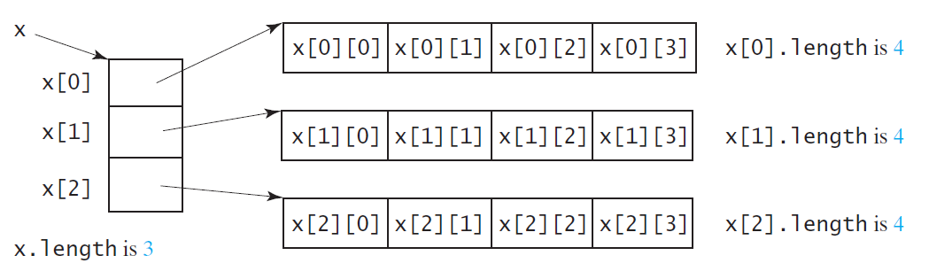
Lengths of Two-dimensional Arrays
int[][] x = new int[3][4];

Slide 8
Lengths of Two-dimensional Arrays
int[][] array = {
{1, 2, 3},
{4, 5, 6},
{7, 8, 9},
{10, 11, 12}
};
array.length
array[0].length
array[1].length
array[2].length
array[3].length
Runtime Error:
array[4].length; //ArrayIndexOutOfBoundsException

Slide 9
Ragged Arrays
Each row in a two-dimensional array is itself an array. So, the rows can have different lengths. Such an array is known as ragged array. For example,
int[][] matrix = {
{1, 2, 3, 4, 5},
{2, 3, 4, 5},
{3, 4, 5},
{4, 5},
{5}
};
matrix.length is 5
matrix[0].length is 5
matrix[1].length is 4
matrix[2].length is 3
matrix[3].length is 2
matrix[4].length is 1

Slide 10
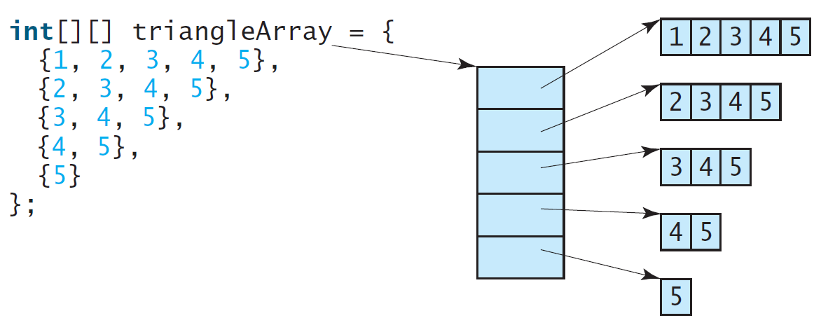
Ragged Arrays, cont.

Slide 11
Processing Two-Dimensional Arrays
See the examples in the text.
Initializing arrays with input values
Printing arrays
Summing all elements
Summing all elements by column
Which row has the largest sum
Finding the smallest index of the largest element
Random shuffling

Slide 12
Initializing arrays with input values
java.util.Scanner input = new Scanner(System.in);
int[][] grades = new int[10][10];
System.out.println("Enter " + grades.length + " rows
and " + grades[0].length + " columns: ");
for (int row = 0; row < grades.length; row++) {
for (int column = 0; column < grades[row].length; column++)
{
grades[row][column] = input.nextInt();
}
}

Slide 13
Initializing arrays with random values
for (int row = 0; row < grades.length; row++) {
for (int column = 0; column < gardes[row].length; column++)
{
grades[row][column] = (int)(Math.random() * 100);
}
}

Slide 14
Printing arrays
for (int row = 0; row < grades.length; row++) {
for (int column = 0; column < grades[row].length; column++)
{
System.out.print(grades[row][column] + " ");
}
System.out.println();
}

Slide 15
Summing all elements
int total = 0;
for (int row = 0; row < grades.length; row++) {
for (int column = 0; column < grades[row].length; column++)
{
total = total + grades[row][column];
}
}

Slide 16
Summing elements by column
for (int column = 0; column < matrix[0].length; column++)
{
int total = 0;
for (int row = 0; row < matrix.length; row++)
total = total + matrix[row][column];
System.out.println("Sum for column " + column + " is "
+ total);
}

Slide 17
Random shuffling
for (int i = 0; i < matrix.length; i++) {
for (int j = 0; j < matrix[i].length; j++) {
int i1 = (int)(Math.random() * matrix.length);
int j1 = (int)(Math.random() * matrix[i].length);
// Swap matrix[i][j] with matrix[i1][j1]
int temp = matrix[i][j];
matrix[i][j] = matrix[i1][j1];
matrix[i1][j1] = temp;
}
}

Slide 18
Passing Two-Dimensional Arrays to Methods
import java.util.Scanner;
public class PassTwoDimensionalArray {
public static void main(String[] args) {
int[][] table = getArray(); // call method getArray()
// Display sum of elements
System.out.println("\nSum of all elements is " + sum(table));
}
public static int[][] getArray() {
Scanner input = new Scanner(System.in);// Create a Scanner
int[][] m = new int[3][4];// declare and create array m
System.out.println("Enter " + m.length + " rows and " +
m[0].length + " columns: "); //prompt
for (int i = 0; i < m.length; i++)
for (int j = 0; j < m[i].length; j++)
m[i][j] = input.nextInt();
return m;
}
// code continues next slide

Slide 19
Passing Two-Dimensional Arrays to Methods
// code continues from previous slide
public static int sum(int[][] matrix)
{
int total = 0;
for (int row = 0; row < matrix.length; row++)
{
for (int column = 0; column < matrix[row].length; column++)
{
total = total + matrix[row][column];
}
}
return total;
}
}

Slide 20
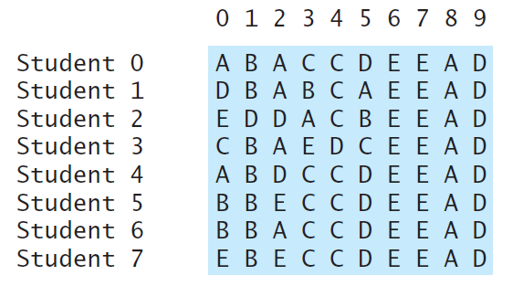
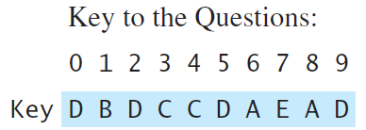
Problem: Grading Multiple-Choice Test
Students’ answer
Objective: write a program that grades multiple-choice test.

Slide 21
Problem: Grading Multiple-Choice Test
public class GradeExam {
public static void main(String args[])
{ // Students' answers to the questions
char[][] answers = {
{'A', 'B', 'A', 'C', 'C', 'D', 'E', 'E', 'A', 'D'},
{'D', 'B', 'A', 'B', 'C', 'A', 'E', 'E', 'A', 'D'},
{'E', 'D', 'D', 'A', 'C', 'B', 'E', 'E', 'A', 'D'},
{'C', 'B', 'A', 'E', 'D', 'C', 'E', 'E', 'A', 'D'},
{'A', 'B', 'D', 'C', 'C', 'D', 'E', 'E', 'A', 'D'},
{'B', 'B', 'E', 'C', 'C', 'D', 'E', 'E', 'A', 'D'},
{'B', 'B', 'A', 'C', 'C', 'D', 'E', 'E', 'A', 'D'},
{'E', 'B', 'E', 'C', 'C', 'D', 'E', 'E', 'A', 'D'}};
// Key to the questions
char[] keys = {'D','B','D','C','C','D','A','E','A','D'};
// code continue next slide

Slide 22
Problem: Grading Multiple-Choice Test
// code continues from previous slide
// Grade all students
for (int i = 0; i < answers.length; i++)
{
// Grade one student
int correctCount = 0; // reset count for each student
for (int j = 0; j < answers[i].length; j++)
{
if (answers[i][j] == keys[j])
correctCount++;
}
System.out.println("Student " + i + "'s correct
count is " + correctCount);
}
}
}

Slide 23
Multidimensional Arrays
Occasionally, we need to represent n-dimensional data structures.
In Java, you can create n-dimensional arrays for any integer n.
The way to declare two-dimensional array variables and create two-dimensional arrays can be generalized to declare n-dimensional array variables and create n-dimensional arrays for n >= 3.

Slide 24
Problem: Calculating Total Scores
Objective: write a program that calculates the total score for students in a class. Suppose the scores are stored in a three-dimensional array named scores. The first index in scores refers to a student, the second refers to an exam, and the third refers to the part of the exam. Suppose there are 7 students, 5 exams, and each exam has two parts--the multiple-choice part and the programming part. So, scores[i][j][0] represents the score on the multiple-choice part for the i’s student on the j’s exam.
The program displays the total score for each student.

Slide 25
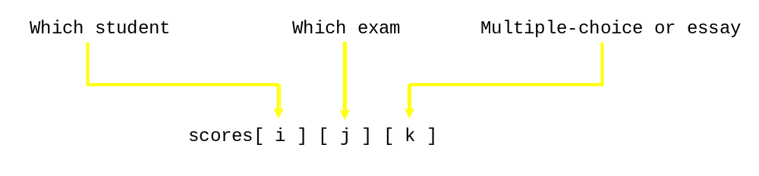
3-Dimensional Arrays
double[][][] scores =
{
{{7.5, 20.5}, {9.0, 22.5}, {15, 33.5}, {13, 21.5}, {15, 2.5}},
{{4.5, 21.5}, {9.0, 22.5}, {15, 34.5}, {12, 20.5}, {14, 9.5}},
{{6.5, 30.5}, {9.4, 10.5}, {11, 33.5}, {11, 23.5}, {10, 2.5}},
{{6.5, 23.5}, {9.4, 32.5}, {13, 34.5}, {11, 20.5}, {16, 7.5}},
{{8.5, 26.5}, {9.4, 52.5}, {13, 36.5}, {13, 24.5}, {16, 2.5}},
{{9.5, 20.5}, {9.4, 42.5}, {13, 31.5}, {12, 20.5}, {16, 6.5}}
};

Slide 26
Problem: Calculating Total Scores
public class TotalScore
{
//Main method
public static void main(String args[]) {
double[][][] scores =
{ { {7.5, 20.5}, {9.0, 22.5}, {15, 33.5}, {13, 21.5}, {15, 2.5} },
{ {4.5, 21.5}, {9.0, 22.5}, {15, 34.5}, {12, 20.5}, {14, 9.5} },
{ {6.5, 30.5}, {9.4, 10.5}, {11, 33.5}, {11, 23.5}, {10, 2.5} },
{ {6.5, 23.5}, {9.4, 32.5}, {13, 34.5}, {11, 20.5}, {16, 7.5} },
{ {8.5, 26.5}, {9.4, 52.5}, {13, 36.5}, {13, 24.5}, {16, 2.5} },
{ {9.5, 20.5}, {9.4, 42.5}, {13, 31.5}, {12, 20.5}, {16, 6.5} },
{ {1.5, 29.5}, {6.4, 22.5}, {14, 30.5}, {10, 30.5}, {16, 6.0} } };
// Calculate and display total score for each student
for (int i = 0; i < scores.length; i++) {
double totalScore = 0;
for (int j = 0; j < scores[i].length; j++)
for (int k = 0; k < scores[i][j].length; k++)
totalScore = totalScore + scores[i][j][k];
System.out.println("Student " + i + "'s score is " + totalScore);
}
}
}
See Listing 8.5 for another example - Weather data (day/hour/temperature/Humidity

