Slide 1
Objects and Classes

Slide 2
OO Programming in Java
Other than primitive data types (byte, short, int, long, float, double, char, boolean), everything else in Java is of type object.
Objects we already worked with:
String: String name = new String("John Smith");
Scanner: Scanner input = new Scanner(System.in);
Random: Random generator = new Random(100);

Slide 3
OOP in Java
The programming paradigm where everything is represented as an object is known as a truly object-oriented programming language.
Simula is considered the first object-oriented programming language.
Smalltalk is considered the first truly object-oriented programming language.
The popular object-oriented languages are Java, C#, PHP, Python, C++, etc.

Slide 4
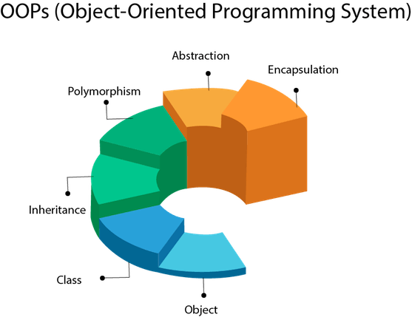
OOPS

Slide 5
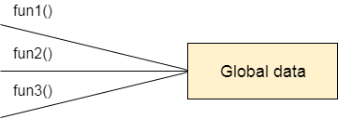
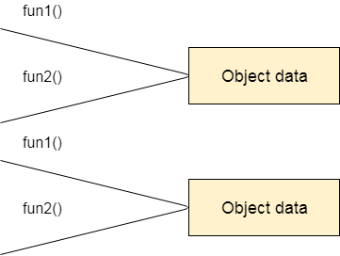
Advantage of OOPs over Procedure-oriented programming language
1) OOPs makes development and maintenance easier whereas in a procedure-oriented programming language it is not easy to manage if code grows as project size increases.
2) OOPs provides data hiding whereas in a procedure-oriented programming language a global data can be accessed from anywhere.

Slide 6
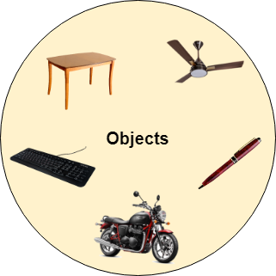
What is an Object?
An object represents an entity in the real world that can be distinctly identified. For example, student, desk, circle, button, person, course, etc…
For instance, an object might represent a particular employee in a company. Each employee object handles the processing and data management related to that employee.

Slide 7
Object Representation
An object has a unique identity, state, and behaviors.
The state of an object consists of a set of data fields (instance variables or properties) with their current values.
The behavior of an object is defined by a set of methods defined in the class from which the object is created.
A class describes a set of similar objects.
In OO programming (e.g., Java), an object is associated with a memory space referenced by the object name.
The memory space is allocated when using the new operator to create the object.
The memory space holds the values of the data fields (instance variables) of the object.

Slide 8
What is a Class?
A class is the blueprint (template) that defines objects of the same type, a set of similar object, such as students.
The class uses methods to define the behaviors of its objects.
The class that contains the main method of a Java program represents the entire program
A class provides a special type of methods, known as constructors, which are invoked to construct (create) objects from the class.
Multiple objects can be created from the same class.

Slide 9
Example
A class
(the concept)
An object
(the realization)
John’s Bank Account
Balance: $7,890
State
Bank Account
OwnerName
Balance
ID
Behavior
Amy’s Bank Account
Balance: $298,987
Deposit()
Withdraw()
CheckBalance()
Ed’s Bank Account
Balance: $860,883
Multiple objects
from the same class

Slide 10
Writing Classes
The programs we’ve written in previous examples have used classes defined in the Java standard class library.
Now, we will begin to design programs that rely on classes that we write ourselves.
The class that contains the main method is just the starting point of a program.

Slide 11
Writing Classes
A class can contain data declarations and method declarations.
BankAccount
String ownerName;
double balance;
Data declarations
Deposit()
Withdraw()
Method declarations
CheckBalance()

Slide 12
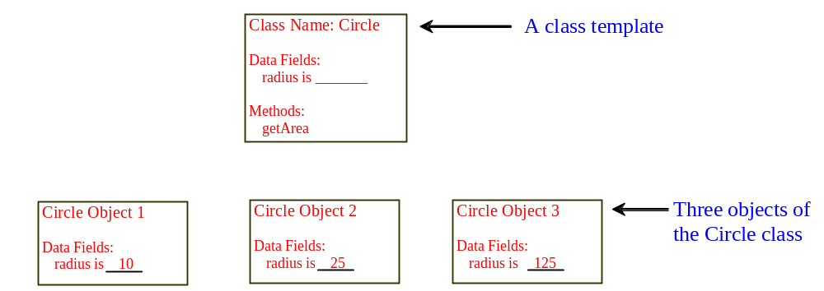
Another Example
A class has both date fields (attributes/variables) and methods. The data fields represent the state of an object; while the methods represent the behavior of that object.

Slide 13
Constructor Methods
The contractor method creates the object in the memory with the help of the Operating System.
Constructors are invoked using the new operator when an object is created. Constructors play the role of initializing objects.
A class can have multiple versions of the constructor method, allowing the user to create the class object in different ways.
The constructor method must have same name as the class name.
Constructors do not have a return type, not even void.
A constructor with no parameters is called no-arguments constructor.

Slide 14
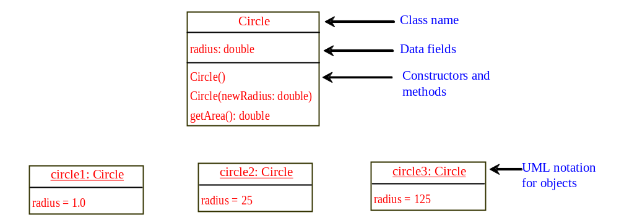
UML Class Diagram

Slide 15
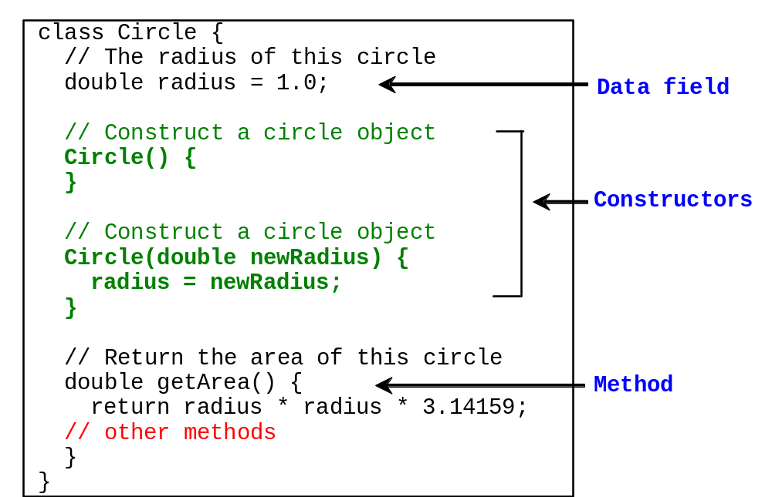
Class Circle Constructors

Slide 16
Creating Objects
To reference an object, assign the object to a reference variable.
To declare a reference variable, use the syntax:
ClassName objectRefVar;
Example:
Circle myCircle1, myCircle2; //reference variables
myCircle1 = new Circle(); //calls first constructor
myCircle2 = new Circle(5.0); //calls second constructor
OR
Circle myCircle1 = new Circle();
Circle myCircle2 = new Circle(5.0);

Slide 17
Default Constructor
A class may be declared without constructors.
This constructor, called a default constructor, is provided automatically only if no constructors are explicitly declared in the class.

Slide 18
Accessing the Object
Referencing the object’s data:
objectRefVar.data
double myRadius = myCircle.radius; //data field
Invoking the object’s method:
objectRefVar.methodName(arguments)
double myArea = myCircle.getArea(); //class method

Slide 19
Trace Code
animation
Declare myCircle
Circle myCircle = new Circle(5.0);
Circle yourCircle = new Circle();
yourCircle.radius = 100;
myCircle
no value

Slide 20

Trace Code, cont.
animation
Circle myCircle = new Circle(5.0);
Circle yourCircle = new Circle();
yourCircle.radius = 100;
myCircle
no value
Create a circle

Slide 21
Trace Code, cont.
animation
Circle myCircle = new Circle(5.0);
Circle yourCircle = new Circle();
yourCircle.radius = 100;
myCircle
reference value
Assign object reference to myCircle

Slide 22
Trace Code, cont.
animation
Circle myCircle = new Circle(5.0);
Circle yourCircle = new Circle();
yourCircle.radius = 100;
myCircle
reference value
yourCircle
no value
Declare yourCircle

Slide 23

Trace Code, cont.
animation
Circle myCircle = new Circle(5.0);
Circle yourCircle = new Circle();
yourCircle.radius = 100;
myCircle
reference value
yourCircle
no value
Create a new Circle object

Slide 24

Trace Code, cont.
animation
Circle myCircle = new Circle(5.0);
Circle yourCircle = new Circle();
yourCircle.radius = 100;
myCircle
reference value
yourCircle
reference value
Assign object reference to yourCircle

Slide 25

Trace Code, cont.
animation
Circle myCircle = new Circle(5.0);
Circle yourCircle = new Circle();
yourCircle.radius = 100;
myCircle
reference value
yourCircle
reference value
Change radius in yourCircle

Slide 26
Caution
Recall that we used
  Math.methodName(arguments)
  (e.g., Math.pow(3, 2.5))
to invoke a method in the Math class.
Can you invoke getArea() using Circle1.getArea()?
All the methods defined in the Math class are static (defined using the static keyword). However, method getArea() is non-static. It must be invoked from an object using this syntax:
  objectRefVar.methodName(arguments)
  (e.g., myCircle.getArea())

Slide 27
Reference Data Fields
The data fields can be of reference types.
If a data field of a reference type does not reference any object, the data field holds a special literal value null (or null pointer) .
For example, Class Student contains a data field name of the type String (an array of characters).
public class Student {
// data fields
String name; //default value null.
int age; //default value 0
boolean isScienceMajor; //default value false
char gender; //default value '\u0000', prints out as 00
}

Slide 28
Default Value for a Data Field
public class Test {
public static void main(String[] args) {
Student student1 = new Student(); //create student object
System.out.println("name? " + student1.name);
System.out.println("age? " + student1.age);
System.out.println("isScienceMajor? " + student1.isScienceMajor);
System.out.println("gender? " + student1.gender);
}
}
Output:
name? null
age? 0
isScienceMajor? false
gender? 00

Slide 29
Default Values Inside Methods
Rule: Java assigns no default values to local variables inside a method. A method's local variables must be initialized.
public class Test {
public static void main(String[] args) {
int x; // x has no default value
String y; // y has no default value
System.out.println("x is " + x);
System.out.println("y is " + y);
}
}
Compilation error: variables not initialized

Slide 30
Primitive Type vs. Object Type
Primitive type
int i = 1 i
1
Object type
Circle c
c
reference
c: Circle
radius = 1
Created using: myCircle = new Circle(1.0);

Slide 31
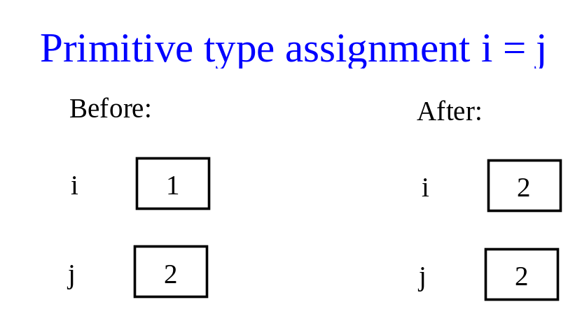
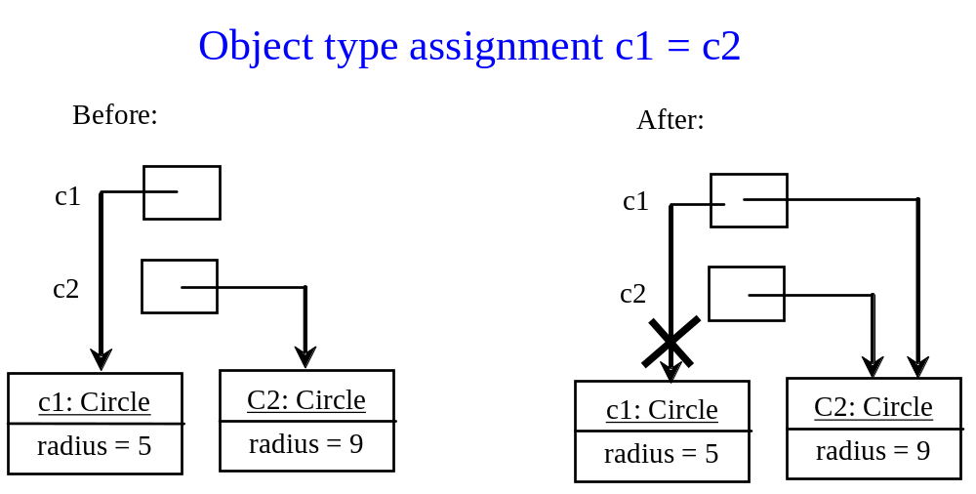
Primitive Type vs. Object Type

Slide 32
Garbage Collection
On the previous slide, after the assignment statement
c1 = c2; //circle objects
c1 points to the same object referenced by c2.
The object previously referenced by c1 is no longer referenced/accessible (i.e., garbage). Garbage is automatically collected by JVM.
TIP: If you know that an object is no longer needed, you can explicitly assign null to a reference variable for the object. The JVM will automatically collect the space if the object is not referenced by any variable in the program.

Slide 33
Static Variables, Constants, and Methods
Static variables are shared by all the objects of the class.
Static methods are not tied to a specific object, applied to all objects of the class.
Static constants (final variables) are shared by all the objects of the class.
To declare static variables, constants, and methods, use the static modifier.

Slide 34
Java static variable
If you declare any variable as static, it is known as a static variable.
The static variable can be used to refer to the common property of all objects (which is not unique for each object), for example, the company name of employees, college name of students, etc.
The static variable gets memory only once in the class area at the time of class loading.

Slide 35
Java static variable
class Counter{
int count=0;//will get memory each time when the instance is created
Counter(){
count++;//incrementing value
System.out.println(count);
}
public static void main(String args[]){
//Creating objects
Counter c1=new Counter();
Counter c2=new Counter();
Counter c3=new Counter();
}

Slide 36
Java static method
A static method belongs to the class rather than the object of a class.
A static method can be invoked without the need for creating an instance of a class.
A static method can access static data member and can change the value of it.

Slide 37
class Student{
int rollno;
String name;
static String college = "ITS";
//static method to change the value of static variable
static void change(){
college = "BBDIT";
}
//constructor to initialize the variable
Student(int r, String n){
rollno = r;
name = n;
}
//method to display values
void display(){System.out.println(rollno+" "+name+" "+college);}
}

Slide 38
public class TestStaticMethod{
public static void main(String args[]){
Student.change();//calling change method
//creating objects
Student s1 = new Student(111,"Karan");
Student s2 = new Student(222,"Aryan");
Student s3 = new Student(333,"Sonoo");
//calling display method
s1.display();
s2.display();
s3.display();
}
}

Slide 39
The static method can not use non static data member or call non-static method directly.
this and super cannot be used in static context.
class A{
int a=40;//non static
public static void main(String args[]){
System.out.println(a);
}
}

Slide 40
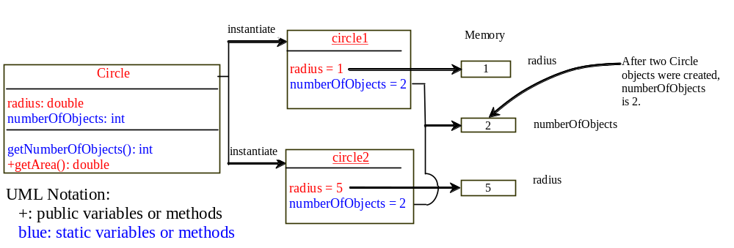
Static Variables, Constants, and Methods

Slide 41
Visibility Modifiers
By default, a class variable or method can be
accessed by any class in the same package, but not other packages.
Public:
The class, data, or method is visible to any class in any package.
Private:
The data or method can be accessed only by the declaring class.
The get and set methods are used to read and modify private variables (better security).

Slide 42


Visibility Modifiers Example - 1
The private modifier restricts access to within a class.
The default modifier restricts access to within a package.
The public modifier enables unrestricted access.

Slide 43
Visibility Modifiers Example - 2

Slide 44
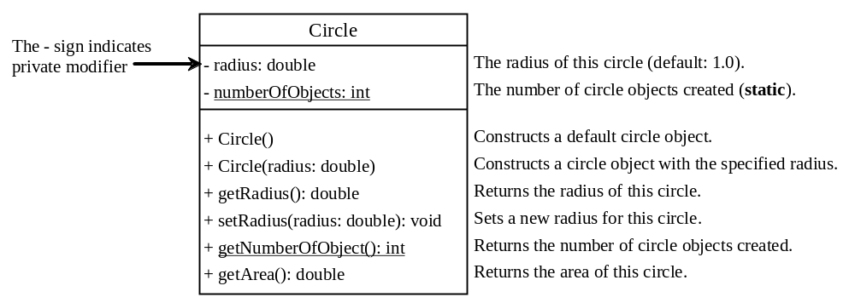
Data Field Encapsulation
Encapsulation is the idea of hiding the class internal details that are not required by clients/users of the class.
Why? To protect data and to make classes easy to maintain and update.
How? Always use private variables!

Slide 45
Java Package
A java package is a group of similar types of classes, interfaces and sub-packages.
Package in java can be categorized in two form, built-in package and user-defined package.
There are many built-in packages such as java, lang, awt, javax, swing, net, io, util, sql etc.
Here, we will have the detailed learning of creating and using user-defined packages.

Slide 46
Advantage of Java Package
1) Java package is used to categorize the classes and interfaces so that they can be easily maintained.
2) Java package provides access protection.
3) Java package removes naming collision.

Slide 47
Simple example of java package
The package keyword is used to create a package in java.
//save as Simple.java
package mypack;
public class Simple{
public static void main(String args[]){
System.out.println("Welcome to package");
}
}

Slide 48
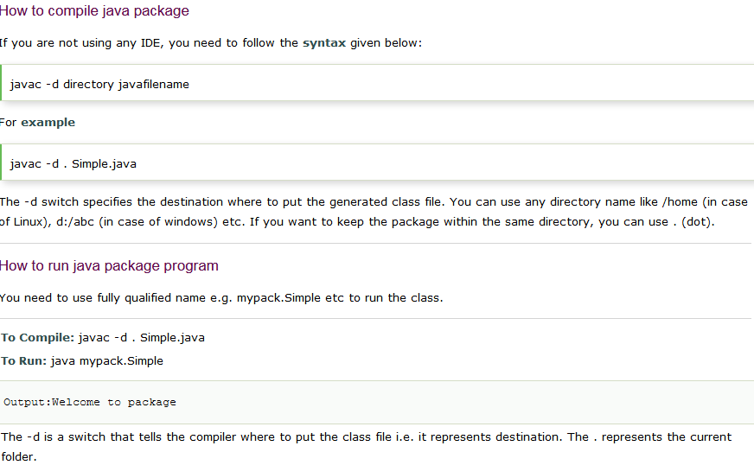

Slide 49
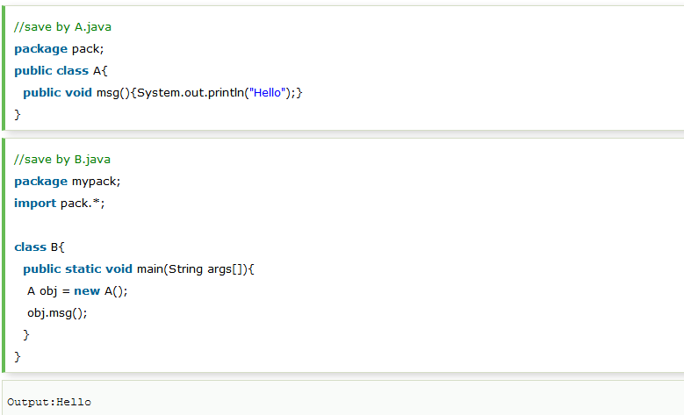
Example of package that import the packagename.*

Slide 50
Access Modifiers in java
There are 4 types of java access modifiers:
private
default
protected
public

Slide 51
Visibility Modifiers - Comments - 1
Class members (variables or methods) that are declared with public visibility can be referenced/accessed anywhere in the program.
Class members that are declared with private visibility can be referenced/accessed only within that class.
Class members declared without a visibility modifier have default visibility and can be referenced/accessed by any class in the same package.
Public variables violate encapsulation because they allow class clients to “reach in” and modify the values directly. Therefore instance variables should not be declared with public visibility.

Slide 52
Visibility Modifiers - Comments - 2
Methods that provide the object's services must be declared with public visibility so that they can be invoked by clients (users of the object).
Public methods are also called service methods.
A method created simply to assist a service method is called a support method.
Since a support method is not intended to be called by a client, it should be declared with private visibility.

Slide 53
Example - 1
public class CircleWithPrivateDataFields
{
private double radius = 1;
private static int numberOfObjects = 0;
public CircleWithPrivateDataFields() { numberOfObjects++; }
public CircleWithPrivateDataFields(double newRadius) {
radius = newRadius;
numberOfObjects++;
}
public double getRadius() { return radius; }
public void setRadius(double newRadius) {
radius = (newRadius >= 0) ? newRadius : 0; //no negative radius
}
public static int getNumberOfObjects() {return numberOfObjects; }
public double getArea() {return radius*radius*Math.PI; }
}

Slide 54
public class TestCircleWithPrivateDataFields {
public static void main(String[] args) { // Main method
// Create a Circle with radius 10.0
CircleWithPrivateDataFields myCircle =
new CircleWithPrivateDataFields(10.0);
System.out.println("The area of the circle of radius "
+ myCircle.getRadius() + " is " + myCircle.getArea());
// Increase myCircle's radius by 10%
myCircle.setRadius(myCircle.getRadius() * 1.1);
System.out.println("The area of the circle of radius "
+ myCircle.getRadius() + " is " + myCircle.getArea());
}
}
Note: variable radius cannot be directly accessed.
Only through the class methods!
Output:
The area of the circle of radius 10.0 is 314.1592653589793
The area of the circle of radius 11.0 is 380.132711084365

Slide 55
Passing Objects to Methods
Remember,
Passing by value for primitive types: the actual value is copied into the formal parameter. Change to the actual parameters is local to the method.
Passing by value for reference types: the reference value (memory address) is passed (copied) to the actual parameter, not the object itself. Any changes to the passed reference will be reflected on the object outside the method (similar to passing strings and arrays).

Slide 56
public class TestPassObject {
public static void main(String[] args) {
CircleWithPrivateDataFields myCircle = new CircleWithPrivateDataFields(1);
// Print areas for radius 1, 2, 3, 4, and 5.
int n = 5;
printAreas(myCircle, n);
// See myCircle.radius and times.
System.out.println("\n" + "Radius is " + myCircle.getRadius());
System.out.println("n is " + n);
}
// Print a table of areas for radius.
public static void printAreas(CircleWithPrivateDataFields c,
int times) {
System.out.println("Radius\t\tArea");
while (times >= 1) {
System.out.println(c.getRadius() + "\t\t" + c.getArea());
c.setRadius(c.getRadius() + 1);
times = times -1;
}
}
}

Slide 57
Array of Objects
Consider:
Circle[] circleArray = new Circle[10];
An array of objects is actually an array of reference variables.
Thus, invoking circleArray[1].getArea() involves two levels of referencing:
circleArray references the entire array
circleArray[1] references a Circle object
See next slide.

Slide 58

Array of Objects
Circle[] circleArray = new Circle[10];
Memory space for the array
Heap space for the objects

Slide 59
Example
public class TotalArea {
public static void main(String[] args) {
CircleWithPrivateDataFields[] circleArray; //Declare circleArray
circleArray = createCircleArray();//Create circleArray
//Print circleArray and total areas of the circles
printCircleArray(circleArray);
}
//Create an array of Circle objects
public static CircleWithPrivateDataFields[] createCircleArray() {
CircleWithPrivateDataFields[] circleArray =
new CircleWithPrivateDataFields[5];
for (int i = 0; i < circleArray.length; i++) {
circleArray[i] =
new CircleWithPrivateDataFields(Math.random() * 100);
}
return circleArray; //Return Circle array
}
// next slide

Slide 60
//Print an array of circles and their total area
public static void printCircleArray(
CircleWithPrivateDataFields[] circleArray)
{
System.out.println("Radius" + "\t\t\t\t" + "Area");
for (int i = 0; i < circleArray.length; i++) {
System.out.println(circleArray[i].getRadius() + "\t\t" +
circleArray[i].getArea());
}
System.out.println("-----------------------------------------");
//Compute and display the result
System.out.println("The total areas of circles is\t" +
sum(circleArray));
}
public static double sum( //Static method to add circle areas
CircleWithPrivateDataFields[] circleArray) {
double sum = 0; //Initialize sum
for (int i = 0; i < circleArray.length; i++)//Add areas to sum
sum = sum + circleArray[i].getArea();
return sum;
}
}

Slide 61
Output:
----jGRASP exec: java TotalArea
Radius Area
0.049319 0.007642
81.879485 21062.022854
95.330603 28550.554995
92.768319 27036.423936
46.794917 6879.347364
-----------------------------------------
The total areas of circles is 83528.356790
----jGRASP: operation complete.

Slide 62
Immutable Objects and Classes
If the contents of an object cannot be changed once it is created, the object is called an immutable object and its class is called an immutable class.
For example, If you delete the set method in the Circle class in Listing 8.10, the class would be immutable (not changeable) because radius is private and cannot be changed without a set method.
A class with all private data fields and without mutators (set methods) is not necessarily immutable. For example, the following class Student has all private data fields and no mutators, but it is mutable (changeable).

Slide 63
Immutable Object Example
public class Student {
private int id;
private BirthDate birthDate;
public Student(int ssn,
int year, int month, int day) {
id = ssn;
birthDate = new BirthDate(year,
month, day);
}
public int getId() { return id; }
public BirthDate getBirthDate() {
return birthDate;
}
}
public class BirthDate {
private int year;
private int month;
private int day;
public BirthDate(int newYear,
int newMonth, int newDay) {
year = newYear;
month = newMonth;
day = newDay;
}
public void setYear(int newYear)
{ year = newYear; }
}
public class Test {
public static void main(String[] args) {
Student student = new Student(111223333, 1970, 5, 3);
BirthDate date = student.getBirthDate();
date.setYear(2010); // Now the student birth year is changed!
}
}

Slide 64
What Class is Immutable?
For a class to be immutable, it must mark all data fields (variables) private and provide no mutator (set) methods and no accessor (get) methods that would return a reference to a mutable (changeable) data field object.

Slide 65
Scope of Variables - Revisited
The scope of instance and static variables is the entire class. They can be declared anywhere inside a class.
The scope of a local variable starts from its declaration and continues to the end of the block that contains the variable. Example, int i=0; in a for loop.
A local variable must be initialized explicitly before it can be used.

Slide 66
The this Keyword
The this keyword is the name of a reference that refers to an object itself. One common use of this keyword is referencing a class’s hidden data fields.
Another common use of the this keyword to enable a constructor to invoke another constructor of the same class.

Slide 67

Referencing the Hidden Data Fields

Slide 68
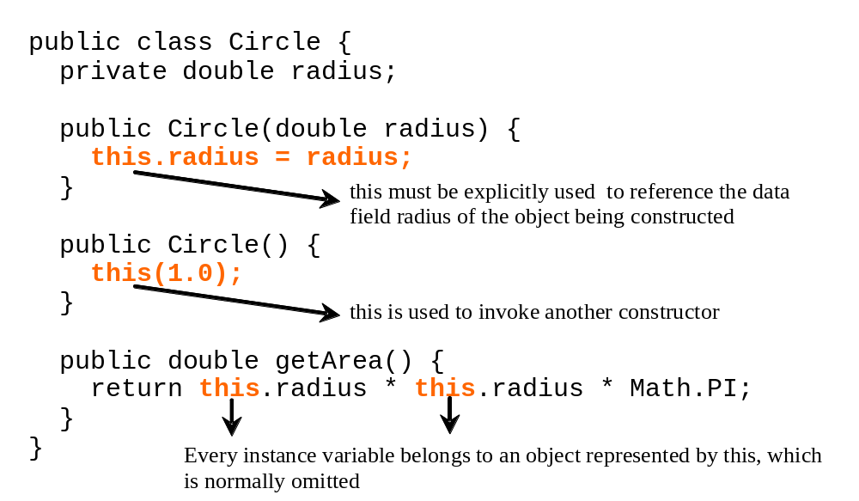
Calling Overloaded Constructors

Slide 69
Class Date - Revisited
Java provides a system-independent encapsulation of date and time in the java.util.Date class.
You can use the Date class to create an instance/object for the current date and time and use the class toString method to return the date and time as a string.
Example:
  java.util.Date date = new java.util.Date();
  System.out.println(date.toString());
Output:
Sat Nov 08 12:31:11 EST 2014

Slide 70
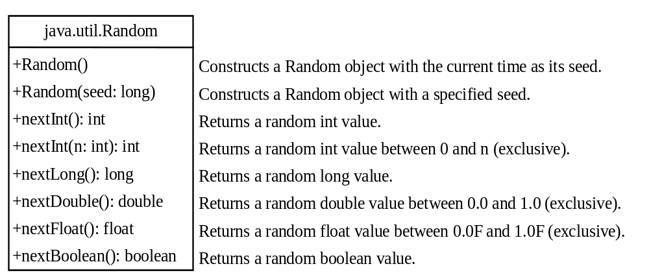
Class Random - Revisited
You have used Math.random() method to obtain a random double value between 0.0 and 1.0 (excluding 1.0).
A more useful random number generator is provided in the java.util.Random class.

Slide 71
Class Random - Revisited
Be Careful! If two Random objects have the same seed, they will generate identical sequences of numbers.
Example: create two Random objects with the same seed 3.
Random random1 = new Random(3); //seed value is 3
System.out.print("From random1: ");
for (int i = 0; i < 10; i++)
System.out.print(random1.nextInt(1000) + " ");
Random random2 = new Random(3); //seed value is 3
System.out.print("\nFrom random2: ");
for (int i = 0; i < 10; i++)
System.out.print(random2.nextInt(1000) + " ");
From random1: 734 660 210 581 128 202 549 564 459 961
From random2: 734 660 210 581 128 202 549 564 459 961

Slide 72
Class Random - Revisited
To avoid that, simply use the current time as the seed value.
Random random1 = new Random(); //current time is the seed
System.out.print("From random1: ");
for (int i = 0; i < 10; i++)
System.out.print(random1.nextInt(1000) + " ");
Random random2 = new Random(); //current time is the seed
System.out.print("\nFrom random2: ");
for (int i = 0; i < 10; i++)
System.out.print(random2.nextInt(1000) + " ");
From random1: 957 496 459 198 84 788 33 254 441 101
From random2: 583 672 320 735 261 122 956 489 303 120

Slide 73
End of Chapter 9

