Slide 1

Bangladesh Army University of Engineering and Technology (BAUET)
Qadirabad Cantonment, Natore-6431
Department of Computer Science and Engineering (CSE)
SUBMITTED BY
NAME :
Md Arik Rayhan,
Fathma Khatun Mim,
Samia Rahman Nova,
Sadia Haq Tamanna,
Md Tanvir Ahmed Tagim
ID : 33,02,52,55,07
SECTION : A
SESSION : 2020-2021
SUBMITTED TO
Ananya Sarkar
Assistant Professor, Dept. of CSE, BAUET
Harun Or Rashid
Lecturer, Dept. of CSE, BAUET
Mini Project Report Course Code: CSE-2104
Course Title: Data Structures and Algorithms-I Submission Date: 18-09-2021

Slide 2
Project Name : Vaccine Regulation
Environment :
To complete the project we have used windows operating system and as ide we have used visual studio code. We have written the project in c (c17 version) and for the compiling we used mingw17. Furthermore, we used the standard library of c to write the code so the code will have faster execution time with less memory and also if the new version of c comes it will not effect the program.

Slide 3
Problem description :
During this pandemic, ensuring that every citizen of the country gets the vaccine is a really important job. But maintaining the record of the citizens who got the vaccine and who did not is quite a difficult task. Although online registration is possible for many but not for everyone. By not for everyone, I mean people who don’t have access to Internet (remote area), people who don’t know have access to technology in General. Also, sometimes it can be difficult to complete the registration of mass people as the servers will be busy.

Slide 4
Solution :
For this reason, we have come up with the idea of offline vaccine regulation system. It works most similarly like the online version but it works offline and faster.
At first citizen will be able to complete their registration with National ID card. After registration there will be some test question for whether they can take the vaccine or not. If they can take the vaccine, they will be shown the available vaccine list and choose one from there. Then the program will have the vaccine name to their profile and give them the date for second dose. When the citizen will come for second-dose the program will be able to tell which vaccine to take.

Slide 5
START
MENU
TAKE VACCINE
RESGISTRATION
NO
SAVE INFORMATION TO DATABASE
YES
SHOW VACCINE & SELECT VACCINE
END
SHOW NEXT VACCINE DATE
FIG: Vaccine Registration and Take Flowchart

Slide 6
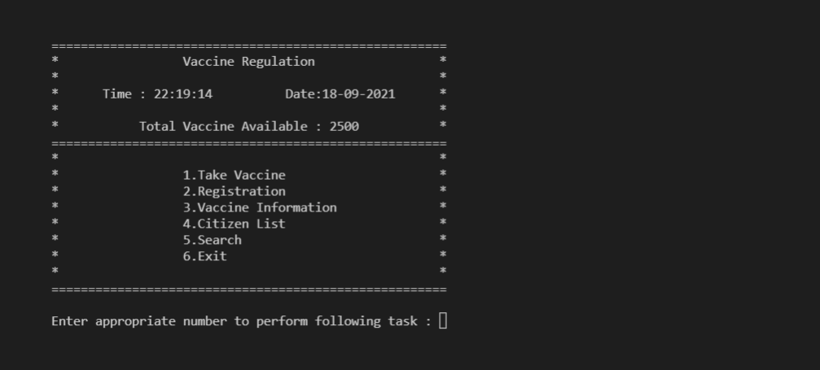
Result and discussion:
Here are some inputs and outputs of how out program will work. Not all features are shown here but the important ones are.
This is the menu of our program as you can see it will be able to show time and date and
how many vaccine are available here.

Slide 7
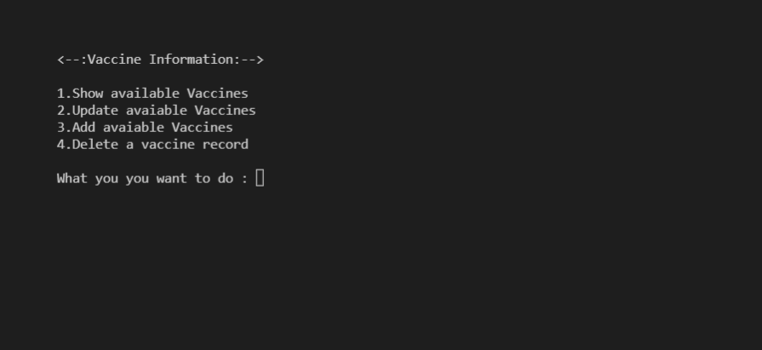
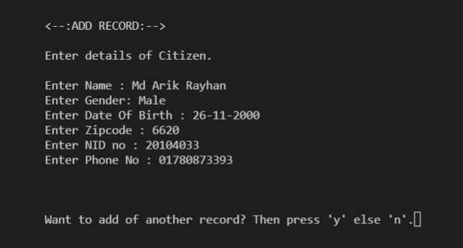
We can add the vaccine information such
as name and quantity from this menu.
Also we will be able to update, show
and delete any vaccine record.
From menu when we go to registration
this forum will appear to fill up.

Slide 8
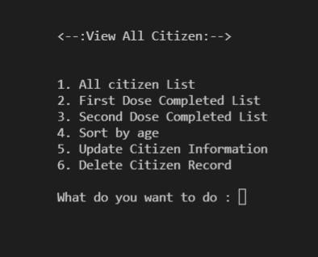
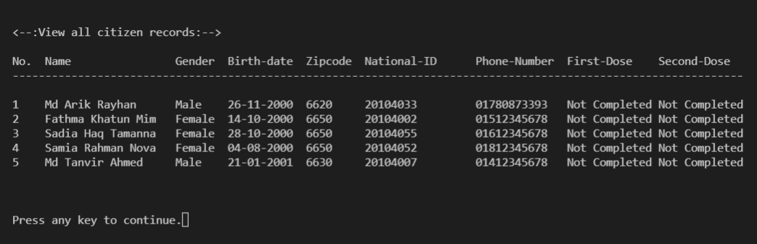
Then we can go to Citizen list to view all registration
As you can see there are several citizen registered on the database but no one has taken a vaccine

Slide 9
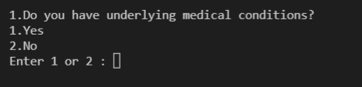
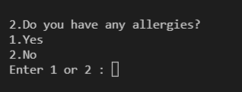
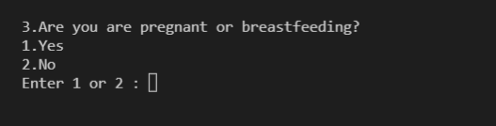
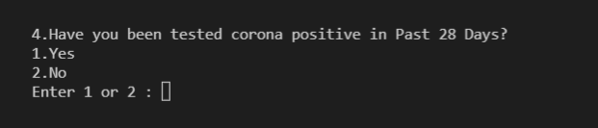
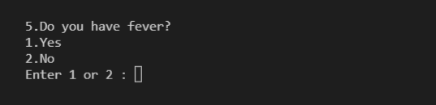
To take vaccine one needs to enter NID card number , if there NID is registered then they will be
asked this 5 questions . If they Pass the questions then they will be shown the available vaccine list.

Slide 10
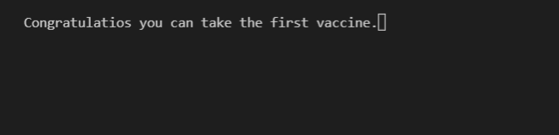
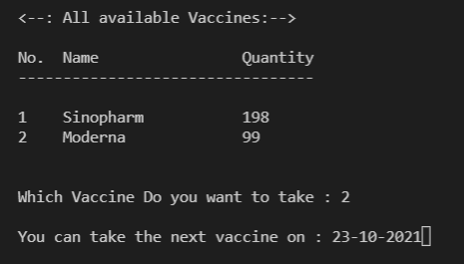
Here the programs that they can take the vaccine
This menu is showed for the list of available vaccine. User can select which vaccine they want to take.
The vaccine will be added to their information.
The program will then tell the user when they can take the second vaccine

Slide 11
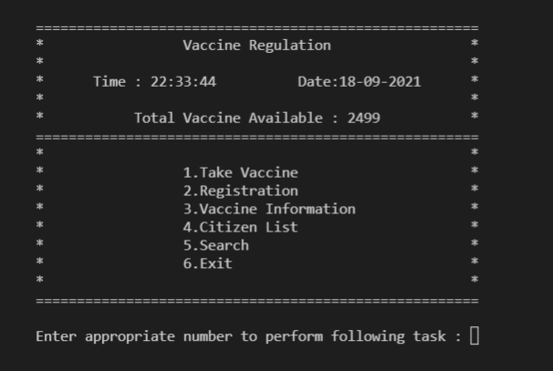
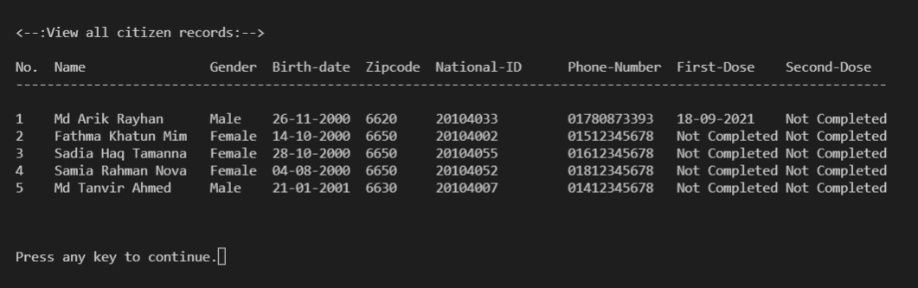
As we can see when the user has taken a vaccine the total vaccine number is reduced by 1 automatically.
And when we go to all citizen list we can see the date when the user took the first vaccine. This vaccine date
add and the dynamic management of vaccine is done automatically.

Slide 12
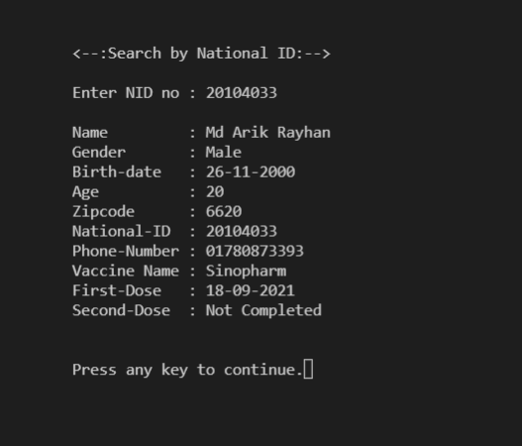
Here is a example of when we search an individual by their NID or Phone Numbers. We will have some
additional information about them such as their age and which vaccine they took which is not shown in
All citizen List . There are some addition features to the code such as sort people by age , first dose or
second dose. Or Update and delete both citizen and vaccine information.
For sorting and searching purposes we have used linear search The data structure that is used here is also
linear data structure, Meaning every data is written after another.

Slide 13
Conclusion :
Overall, our program can work offline and keep all the records of vaccine distribution. Its very small in size(400KB) and works with as little as 1 MB of R.A.M. So, the system requirement is very low and almost any machine would be able to run this program. Moreover this programs saves the data to file ,so the data can be sync with any other software of the online anytime which will be very helpful for Vaccine Regulation.
The further plan for this app is to make the app cross platform with graphics ui so that user will have more friendly experience. And also connect govt database api for nid card verification.

