Slide 1

Bangladesh Army University of Engineering & Technology (BAUET)
Qadirabad, Natore-6431
Department of Computer Science and Engineering
Course Code: CSE-3200
Course Title: Integrated Design Project / Capstone Project
Project Presentation on “Custom ROM”
SUBMITTED BY | SUBMITTED TO
Name: Fathma Khatun Mim | Mohammed Golam Sarwar Bhuyan
ID:20104002 | Professor & Head, Dept of CSE, BAUET
Name: Gourob Roy | Bristi Rani Roy
ID:20104027 | Lecturer, Dept. of CSE, BAUET
Name: Md. Arik Rayhan
ID:20104033
Batch: 11th
Year: 4th
Semester: 1st
Session: 2020-2021

Slide 2
Table of Contents
Introduction
Problem Statement
Motivation
Objectives
Background Study
Existing System
Comparative Analysis
Challenges
Requirement specification
Design Specification
Impact on Society
Environment & Sustainability
Future Work
Conclusion
Reference

Slide 3


Introduction
A custom ROM is a modified version of the Android operating system.
Custom ROMs can:
Enhance performance and overall speed
Bring an old device up to date
Allow user to focus on privacy and security
Give your phone a whole new look
Xiaomi MIUI
Lineage OS

Slide 4

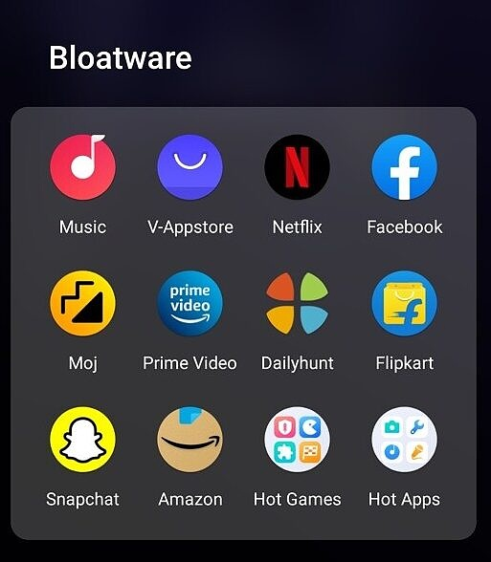

Problem Statement
A custom ROM is a modified version of the Android operating system.
Problems of stock ROM:
Privacy and Security
Bloatware and unwanted apps
Unrestricted access to apps and websites
Less control over OS

Slide 5
Motivation
Motivation behind our project:
To make a custom tailored ROM for Parental Control.
Develop a custom ROM that focus on the privacy of its users.
ROM for a specific group of people for their work.
Demand in the current Market Place.

Slide 6
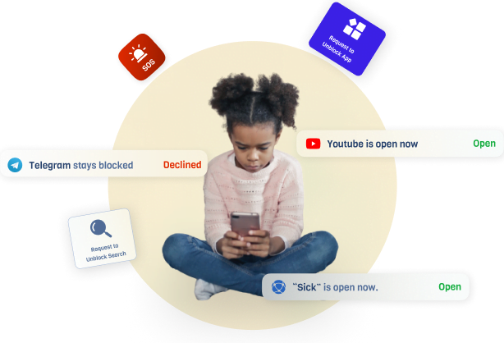
Objectives
Objective of our project:
Installation control mechanisms.
Privacy-focused OS
Speed improvement
Block Advertisement
Block Data Leak

