Slide 1


Employee Management System
Welcome to the world of Django!
This project aims to streamline employee data management.
by Mohammad Arman
Roll no:- 2101331540063
Branch:- CSE-Data Science “A”

Slide 2
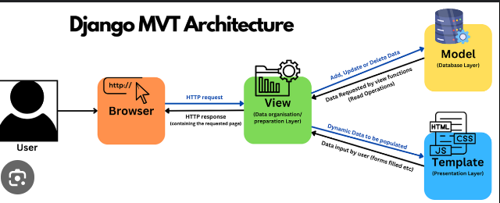
"Managing employees is not just about data, it's about people. Remember, the right management can unlock the full potential of your team and drive business success. Implementing an effective employee management system can be the key to unlocking a happier, more productive workforce."
Project Structure
Django App
Templates
Static
Contains models, views, and URL patterns.
HTML files defining the front-end interface.
CSS, JavaScript, and images for styling and functionality.

Slide 3
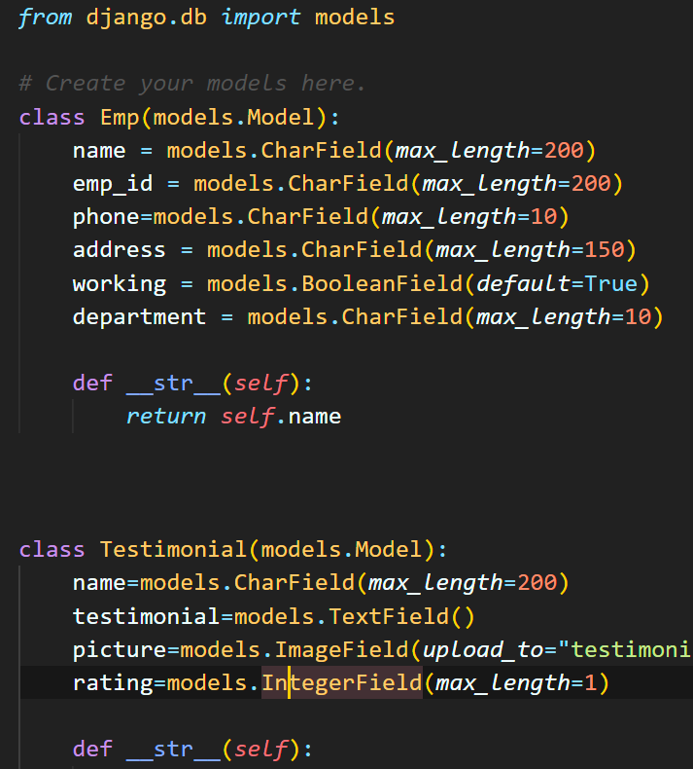
Models
1
Employee
Stores essential information about employees.
2
Department
Organizes employees into specific work units.
3
Role
Defines the responsibilities and authority of employees.

Slide 4
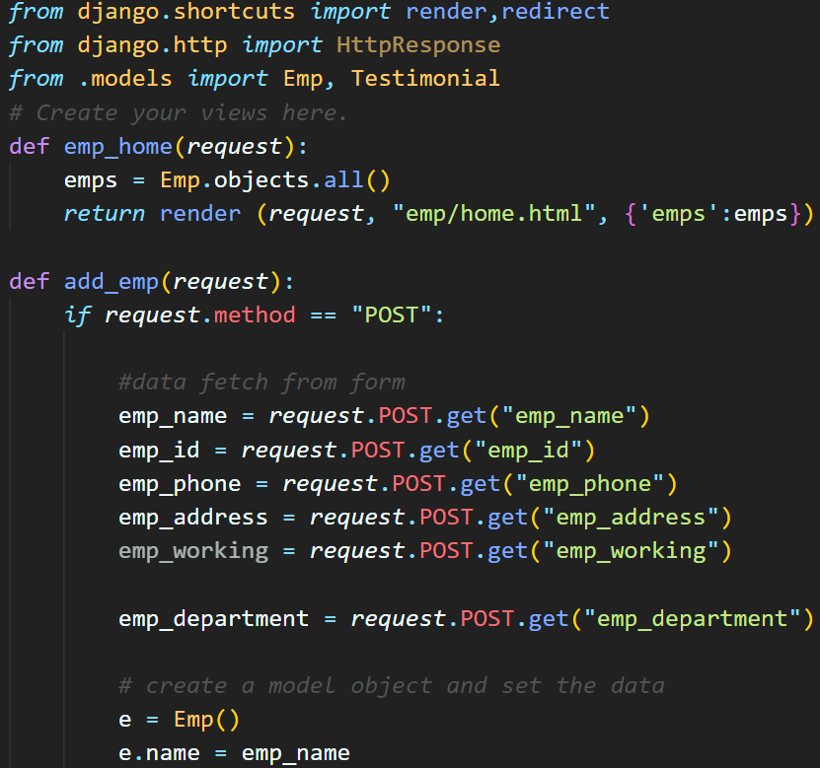
Views
1
Retrieving Data
Fetching employee information from the database.
2
Processing Logic
Applying business rules and calculations.
3
Rendering Templates
Displaying data in user-friendly formats.

Slide 5
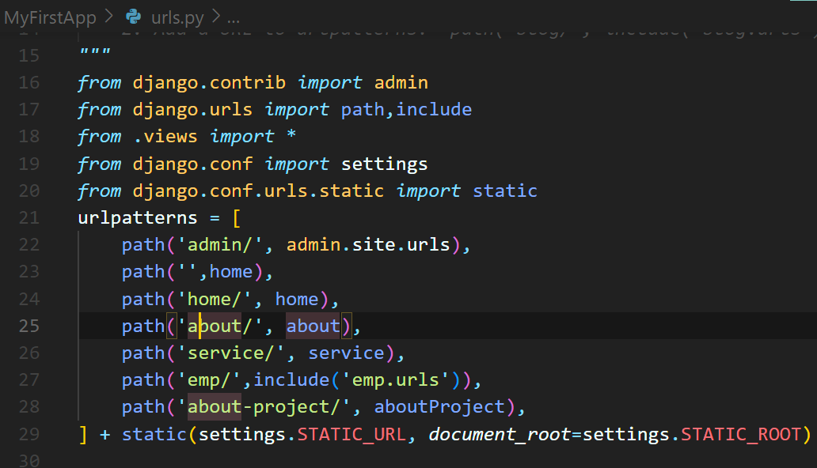
URL Patterns
Employee Listing
Displays a list of all employees.
Employee Details
Provides detailed information about a specific employee.
Employee Creation
Enables adding new employees to the system.
Employee Updates
Allows modification of existing employee data.

Slide 6
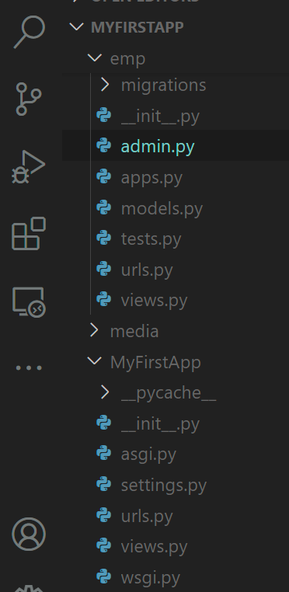
Templates
HTML
Defines the structure of the web pages.
Bootstrap
Provides responsive design and styling elements.
Django Templating
Enables dynamic content rendering from Python data.

Slide 7
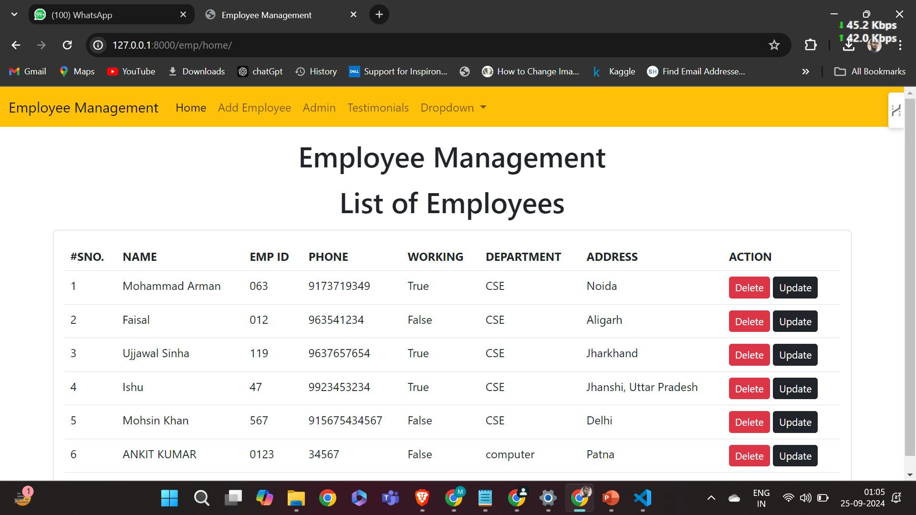

Slide 8
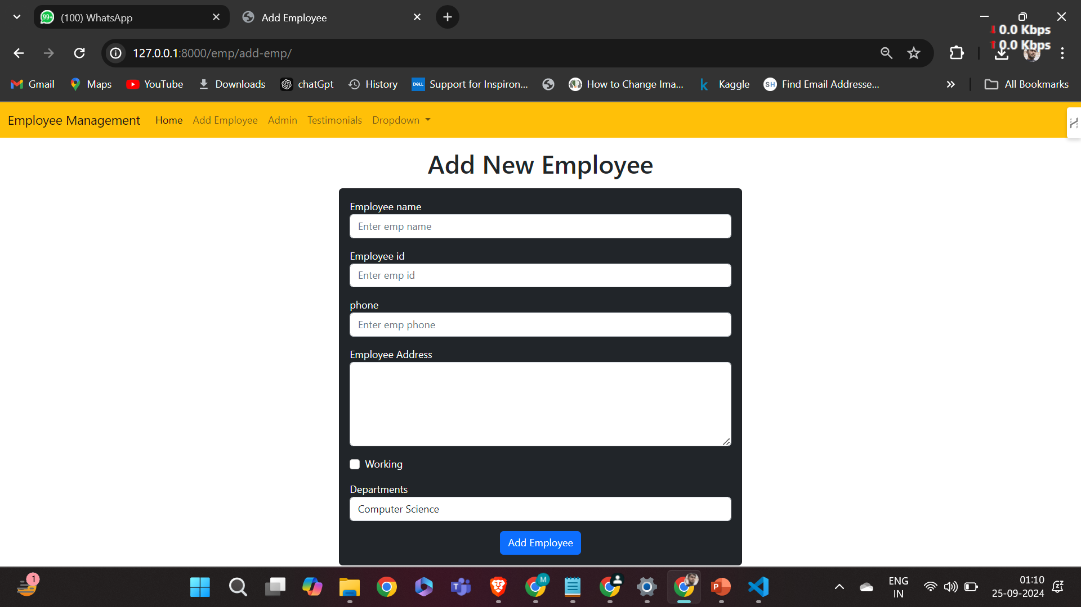

Slide 9
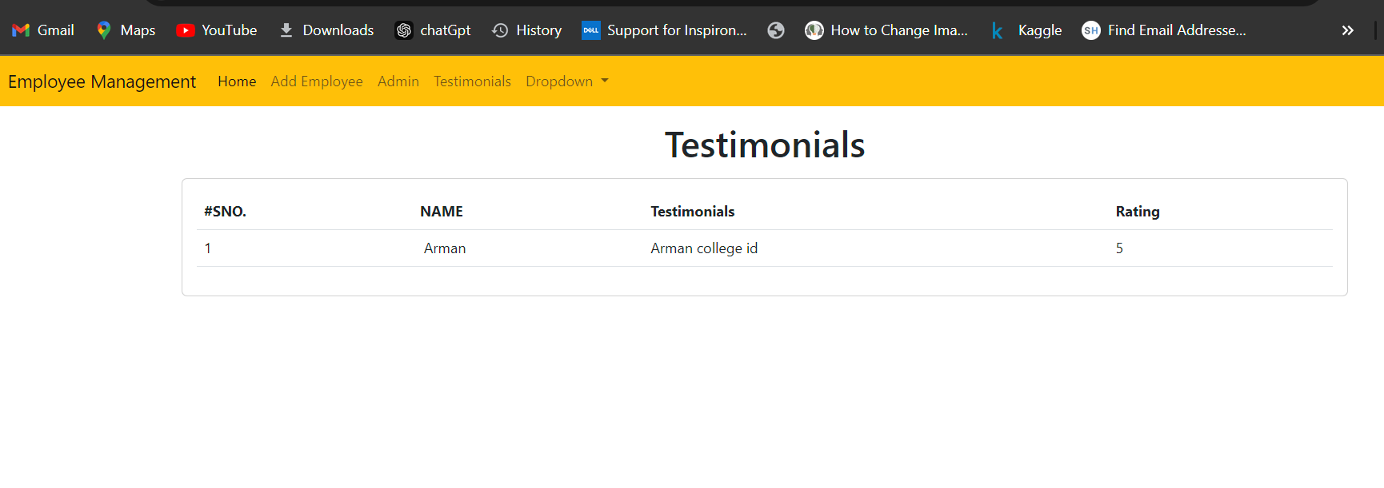
A testimonial is a customer review that praises a company's products or services. Testimonials can be a powerful way to build trust and credibility with potential customers.

Slide 10
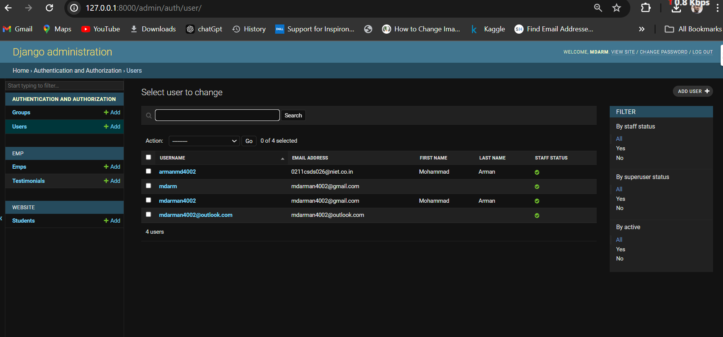

Slide 11
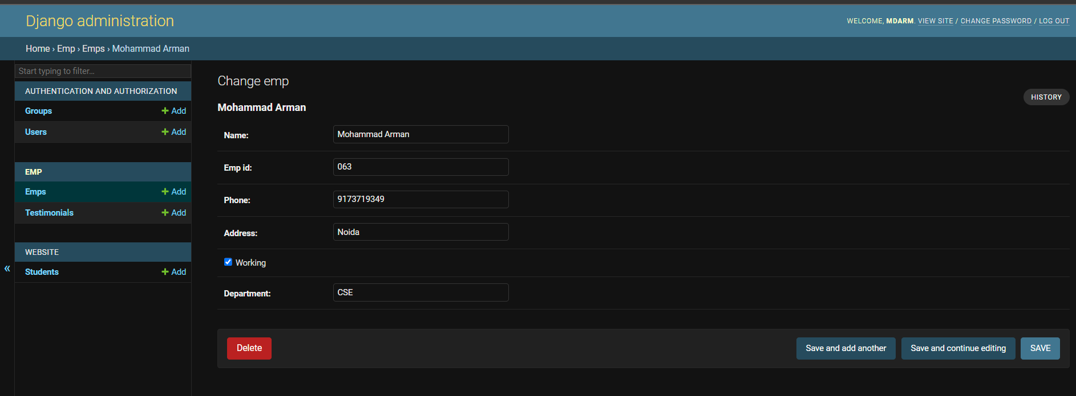
Admin can update and check the history of the user.

Slide 12
Thank You

