Slide 1
TITANIC SURVIVOR PREDICTION
Presented By:
Mohammad Arman
2101331540063

Slide 2
INTRODUCTION
In 1912, the Titanic sank, and its survival predictions were grim due to insufficient lifeboats, icy waters, and limited rescue options. Despite these challenges, some individuals survived through luck, bravery, and rescue efforts.
In particular, we ask you to apply the tools of Machine Learning to predict which passengers survived the tragedy.

Slide 3
SOFTWARE REQUIRED
TOOLS USED
1. Anaconda Navigator
2. Jupyter Notebook
LIBRARY USED
1.Analyzing: Numpy, Pandas, Sci-kit Learn
2. Visualization: Matplotlib, Seaborn

Slide 4
GOALS AND OBJECTIVE
The purpose of this project is to document the process I went through to create my predictions for Titanic Survivor Prediction.
The objective of this project was to build a classification model that could successfully determine whether a Titanic passenger lived or died.
Achieve a minimum accuracy of 80%.

Slide 5
IMPLEMENTATION
Importing the necessary libraries.
Importing the dataset.
Cleaning and analysing the dataset.
Building the model.
Using logistic regression for making prediction

Slide 6
PROJECTS
TITANIC SURVIVAL PREDICTION
https://github.com/mdarman4002/Codsoft/blob/main/Titanic_Survival.ipynb

Slide 7
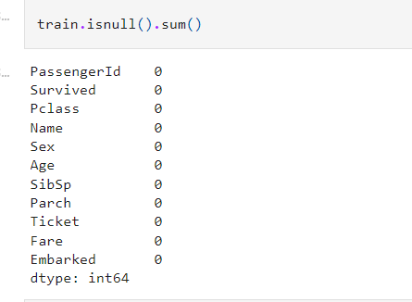
AFTER CLEANING THE DATA

Slide 8
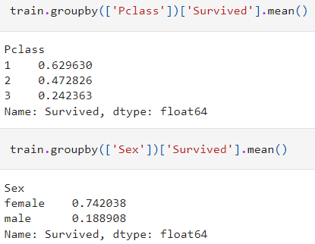
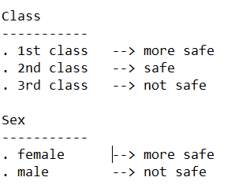
PROBABLITY TO SAFE

Slide 9
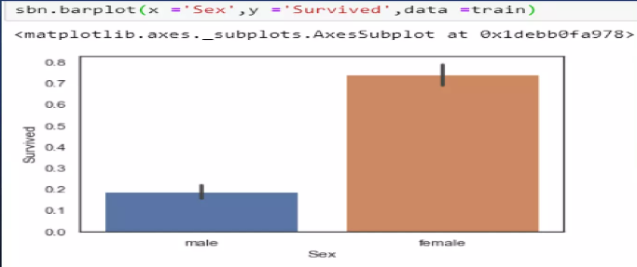
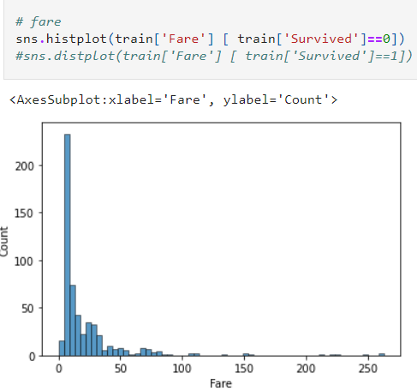
DATA VISUALIZATION

Slide 10
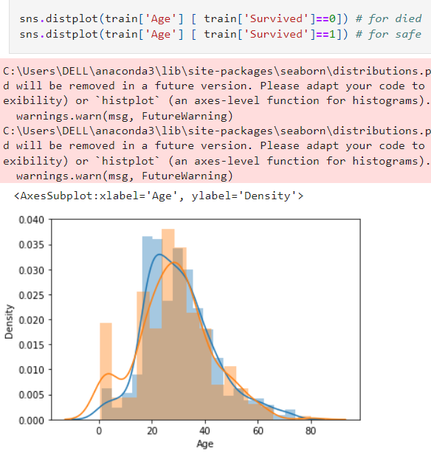

DATA VISUALIZATION

Slide 11
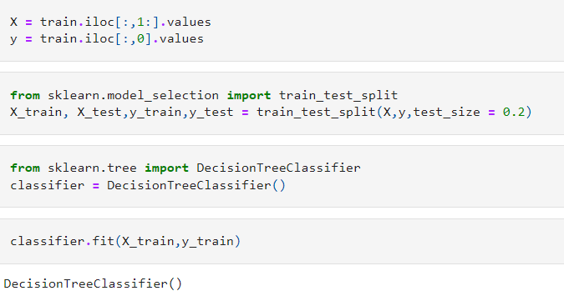

BUILDING THE MODEL

Slide 12
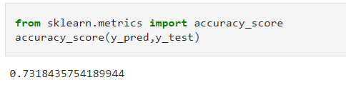
PREDICTION & ACCURACY

Slide 13
CONCLUSION
I have removed variables like “Passenger Id”, “Name”, “Ticket”, “Fare” and “Cabin” as they are not effecting the target variable much.
“Women”, “Children” and “First Class Passengers” as well as people with a small family had a better chance to survival.
I am getting an accuracy of 73.18%.

Slide 14
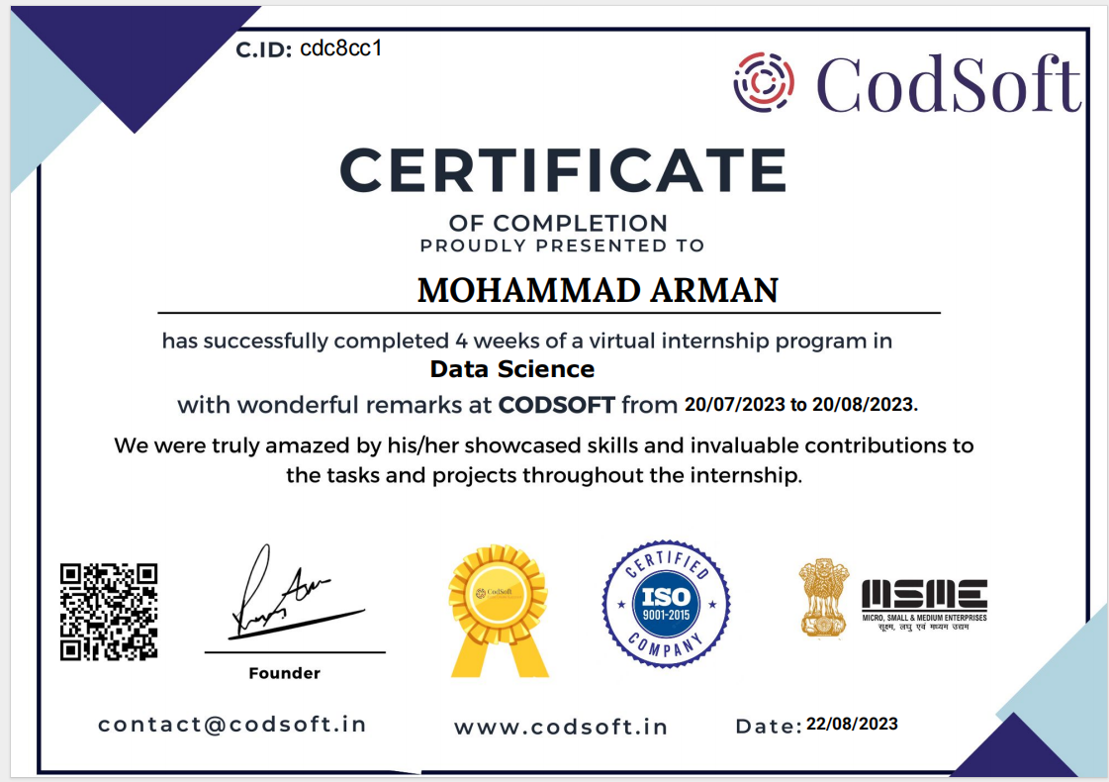

Slide 15
THANK YOU

