Slide 1
Michael dart – t2a2 Marketplace project
MICKEY’s MODELS

Slide 2
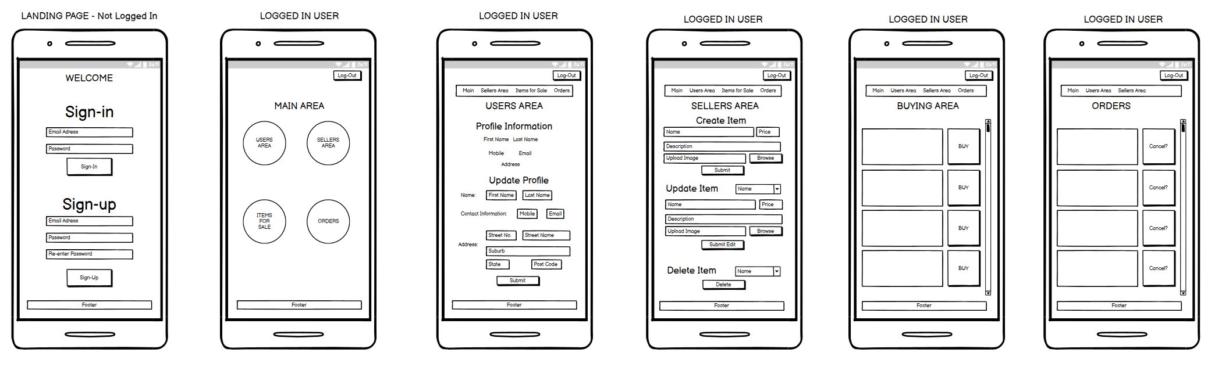
Michael Dart – T2A2 – Marketplace Project | WIREFRAMES – Mobile

Slide 3
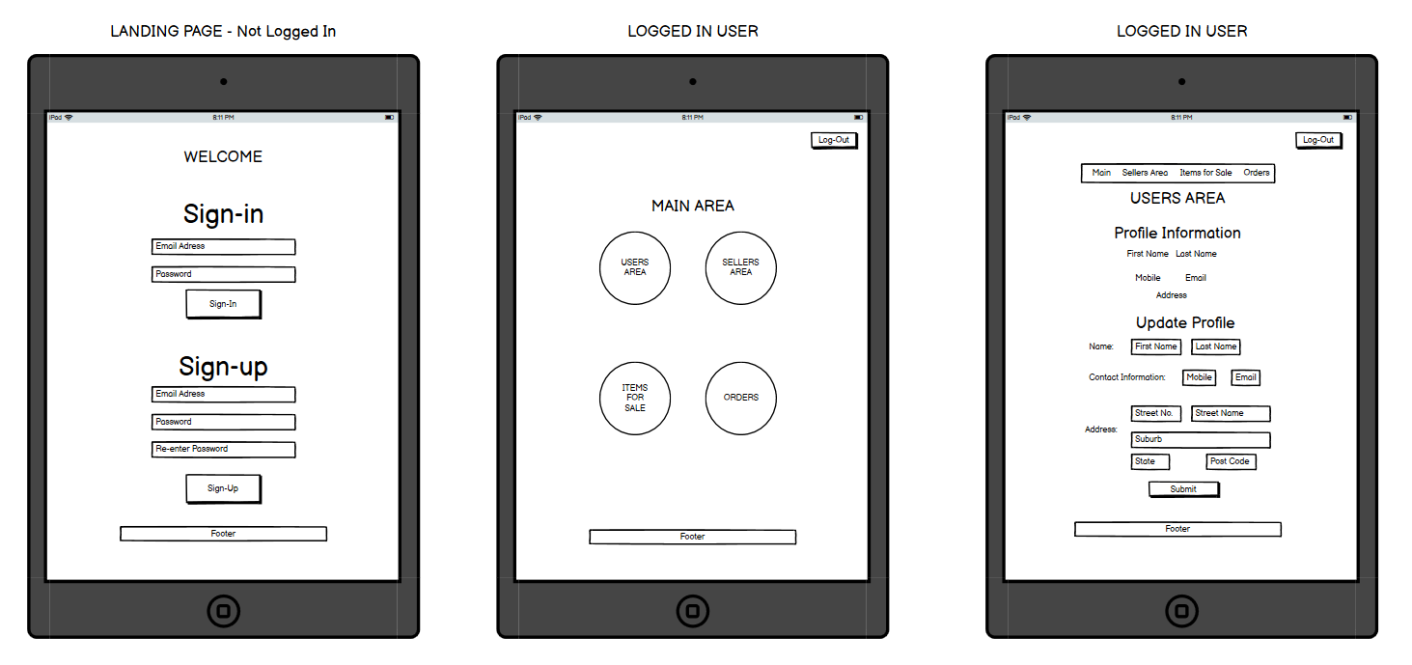
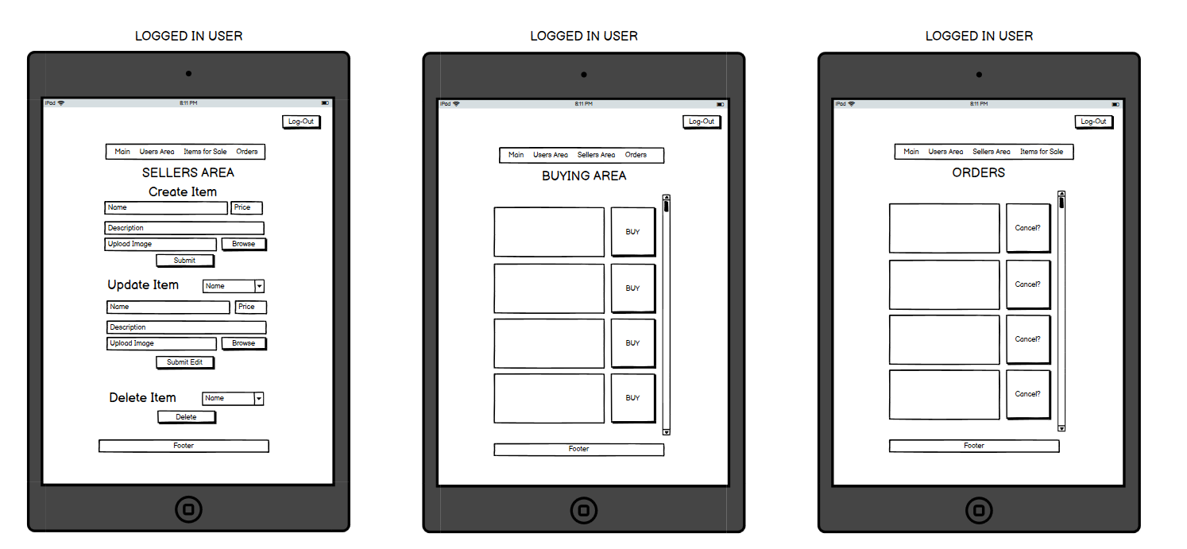
Michael Dart – T2A2 – Marketplace Project | WIREFRAMES – Tablet

Slide 4
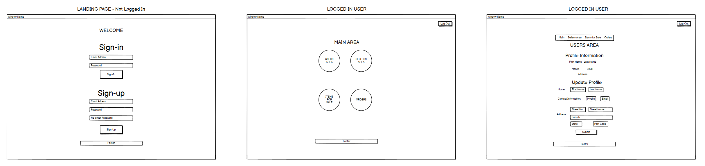
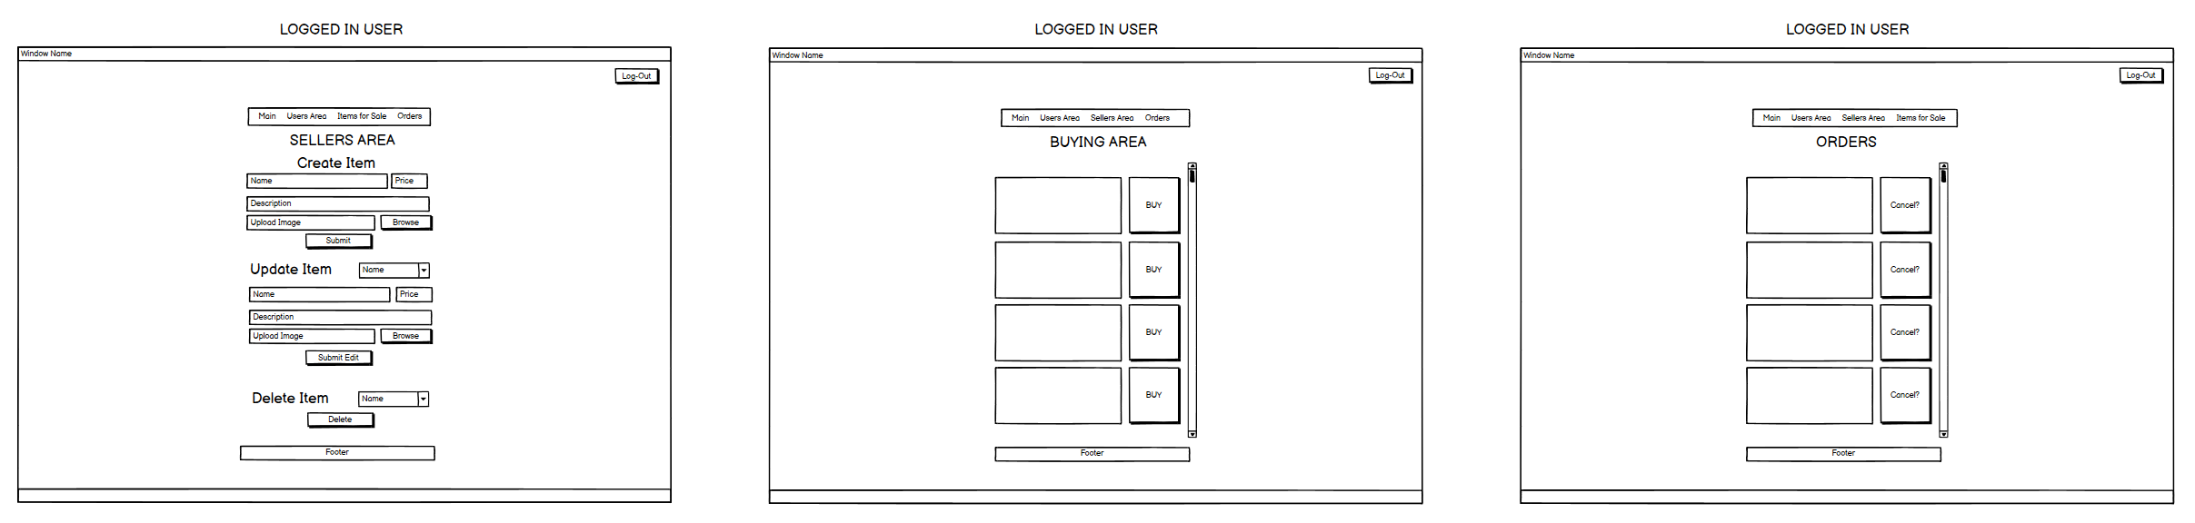
Michael Dart – T2A2 – Marketplace Project | WIREFRAMES – Desktop

Slide 5
Michael Dart – T2A2 – Marketplace Project | Why this application?
Through the use of authentication and authorisation, the users can trust that their information and products are secure and only able to be altered or removed if that user has the authorisation.
This application was developed to provide a safe way for aviation enthusiasts to sell and buy aircraft models.
Payments are processed using a third party provider with a robust and safe tool that is PCI compliant

Slide 6
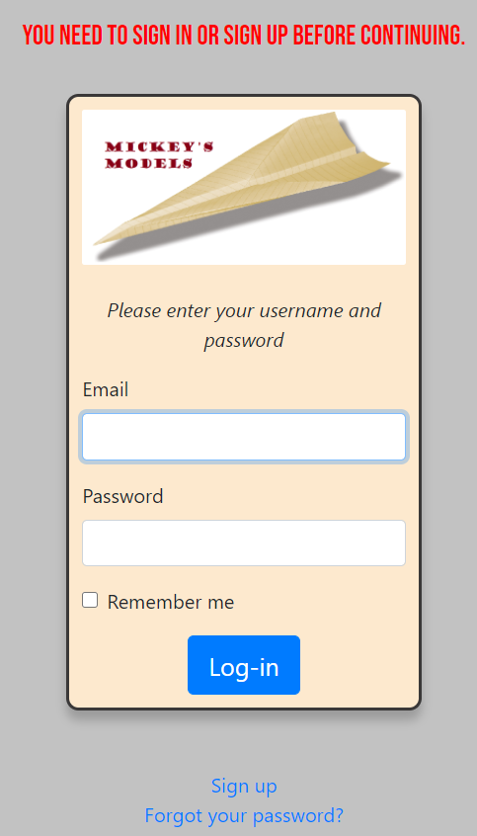
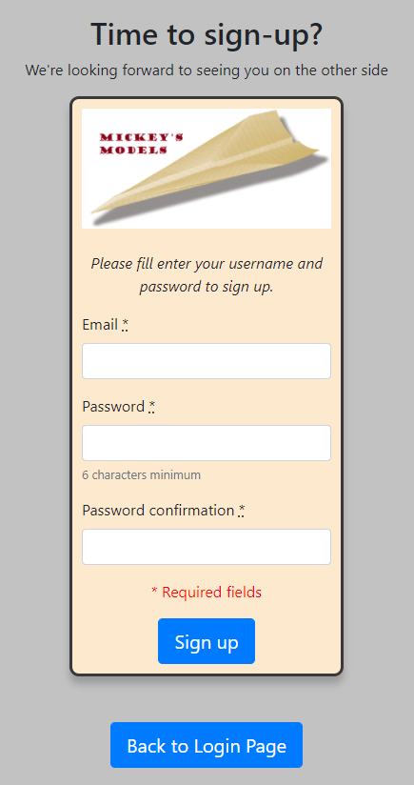
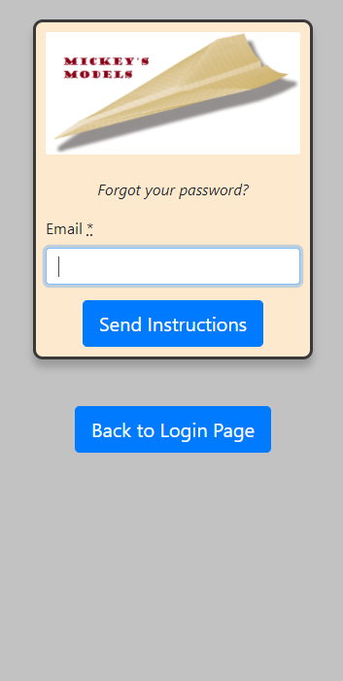
Michael Dart – T2A2 – Marketplace Project | The Application - Authentication
Messages to the audience to identify parts where a user is required
Ability for the User to Sign up with only a username and password needed
“Forgot your password” function
Main Login – Can enter Email Address and Password to Login with the ability to remember the user
Authentication has been implemented with the use of a third party provider – Devise
Sign Up and Forgot Your Password functions
Back to Login Page (Main Page) function for other authentication processes

Slide 7
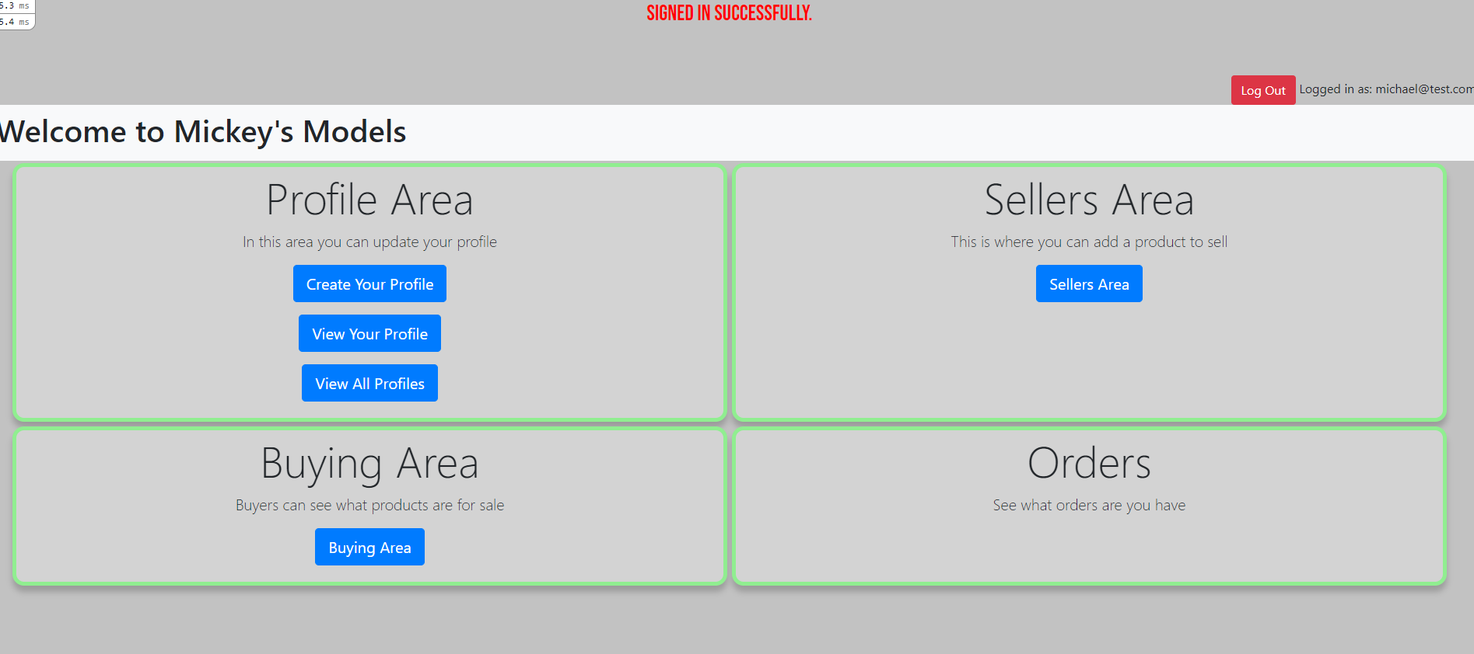
Michael Dart – T2A2 – Marketplace Project | The Application – Main Dashboard
Further messages provided with the help of a third party tool - Devise
Log-Out function | Display to the user of who is logged in
User can create and view their profile
Authorisation Implemented on the Main Dashboard through the use of roles (see difference on next slide)
All users can access areas that are not sensitive

Slide 8
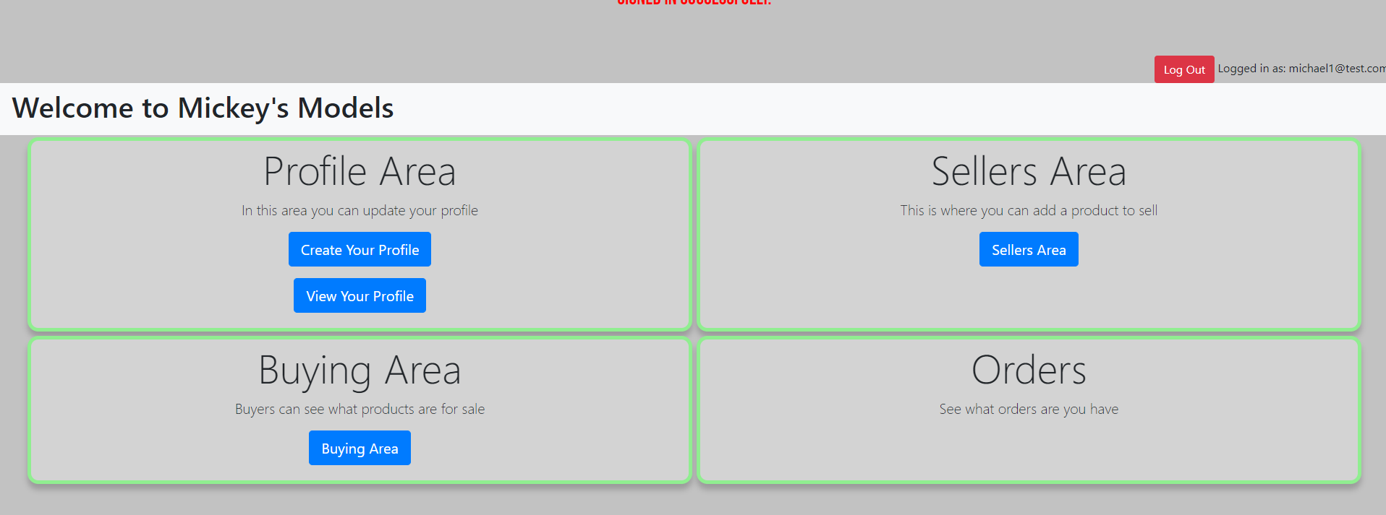
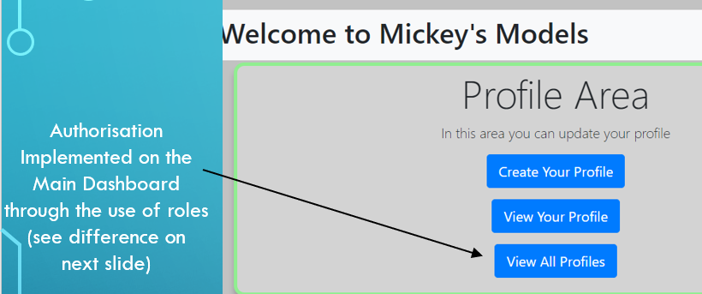
Michael Dart – T2A2 – Marketplace Project | The Application – Main Dashboard
To verify different authorisation abilities, you can see it is a different user
Normal User vs. Admin User (using Roles)
Authorisation has been implemented with the use of a third party provider – Rolify
View All Profiles Function has been removed for any unauthorised users

Slide 9
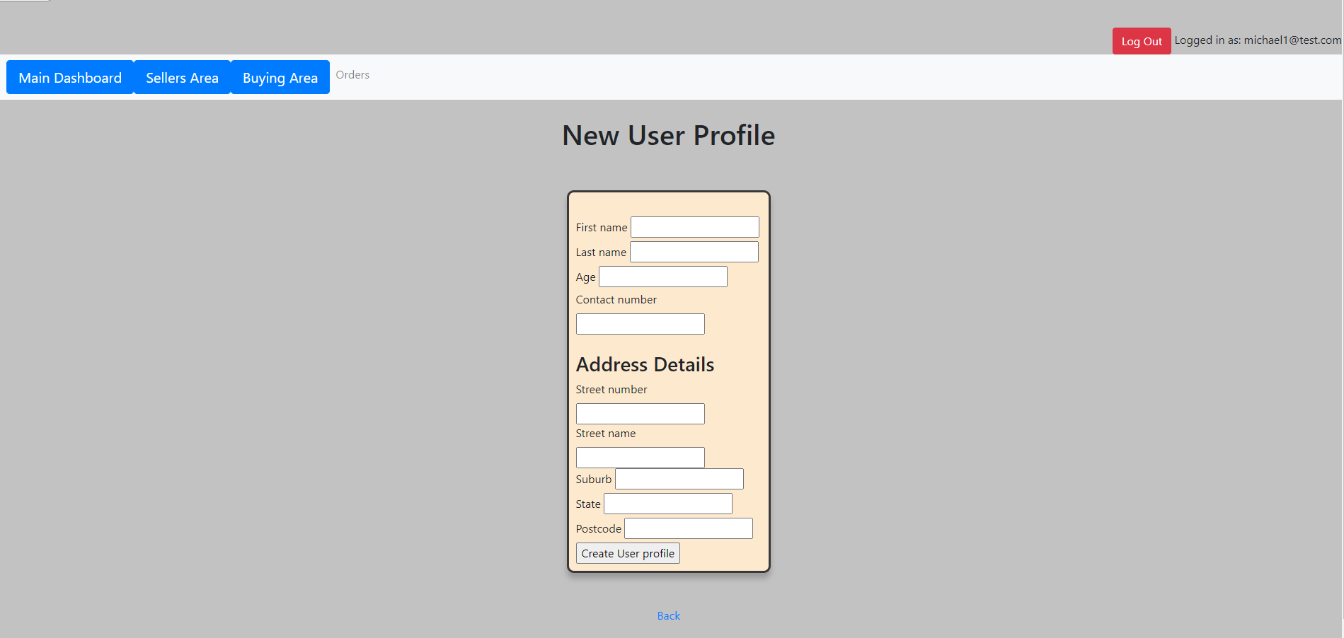
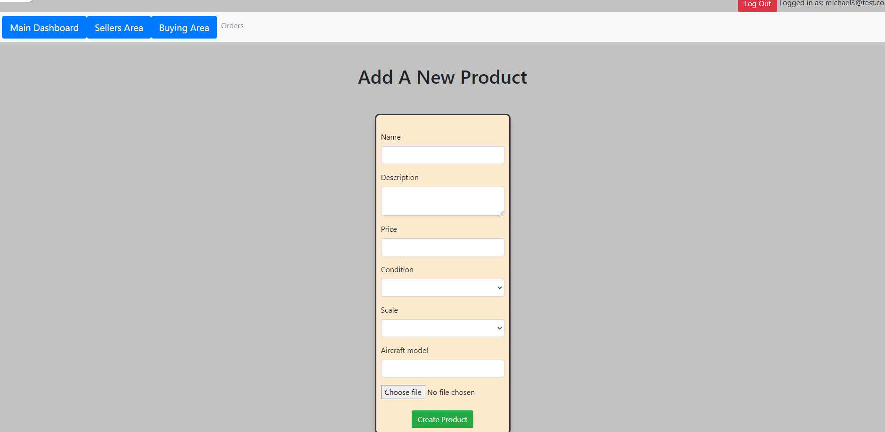
Michael Dart – T2A2 – Marketplace Project | The Application
Creating Profiles and Products
User’s can create a profile or a product to sell, making use of the CRUD functionality, CREATE
Images can be uploaded along with the product details and stored in the cloud using a third party service provider
Cloud storage has been implemented with the use of a third party provider – Cloudinary
Images are kept secure by encrypting any API and Secret Keys – the file is kept away from remote repositories

Slide 10
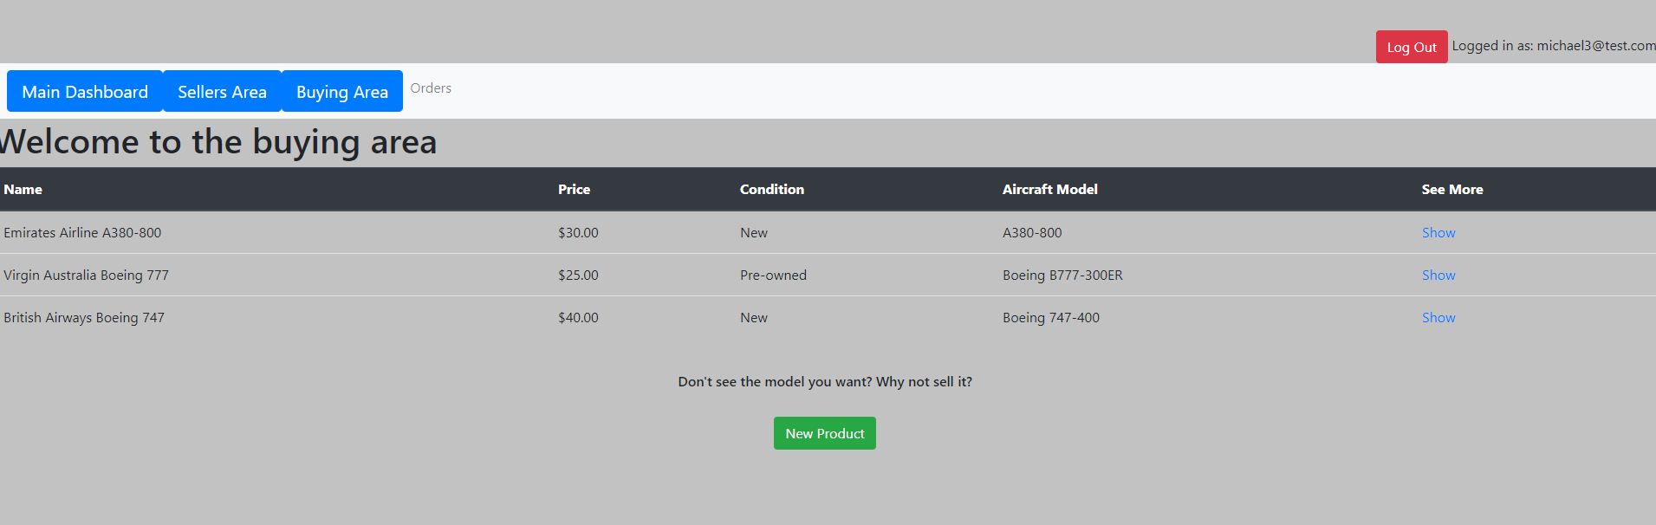
Michael Dart – T2A2 – Marketplace Project | The Application – Buying Area
Main Product Listings Page
Users can view more details of the product – through a CRUD functionality, READ
Ability to add a product from the buyers page Making use of the CRUD functionality, CREATE

Slide 11
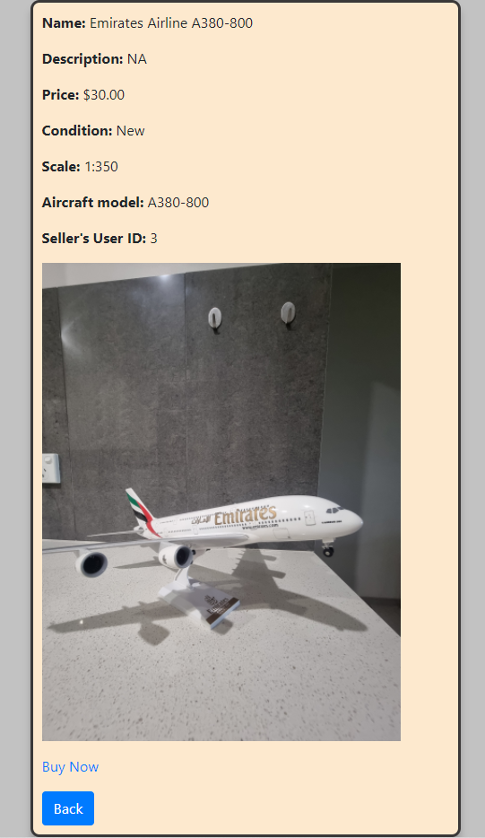
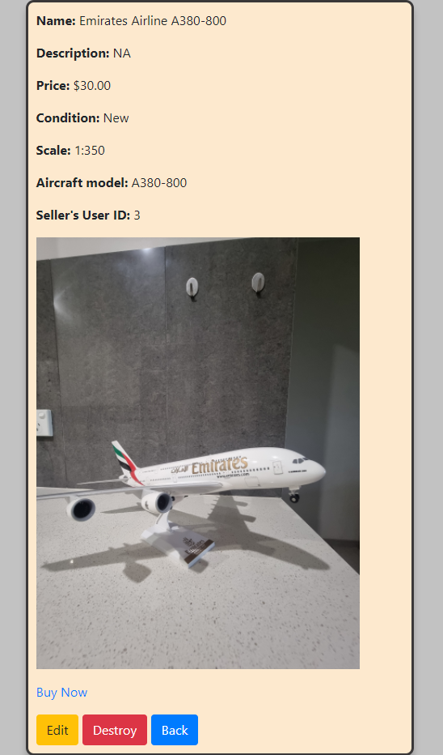
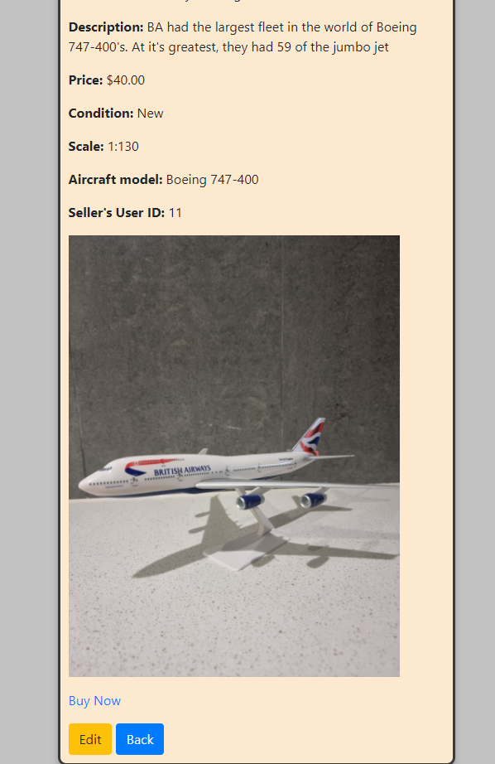
Michael Dart – T2A2 – Marketplace Project | The Application – Individual Product View
Authorisation has been used to limit CRUD functionality
Admin’s are permitted to UPDATE and DESTROY
User’s who CREATED a product are permitted to UPDATE
All users can READ an item
Buy Now – gives the user the ability to purchase the item
Payment services has been implemented (to cover PCI compliance) with the use of a third party provider
– Stripe
Ability to delete a product – making use of the CRUD functionality - DESTROY
Ability to edit a product – making use of the CRUD functionality - UPDATE

Slide 12
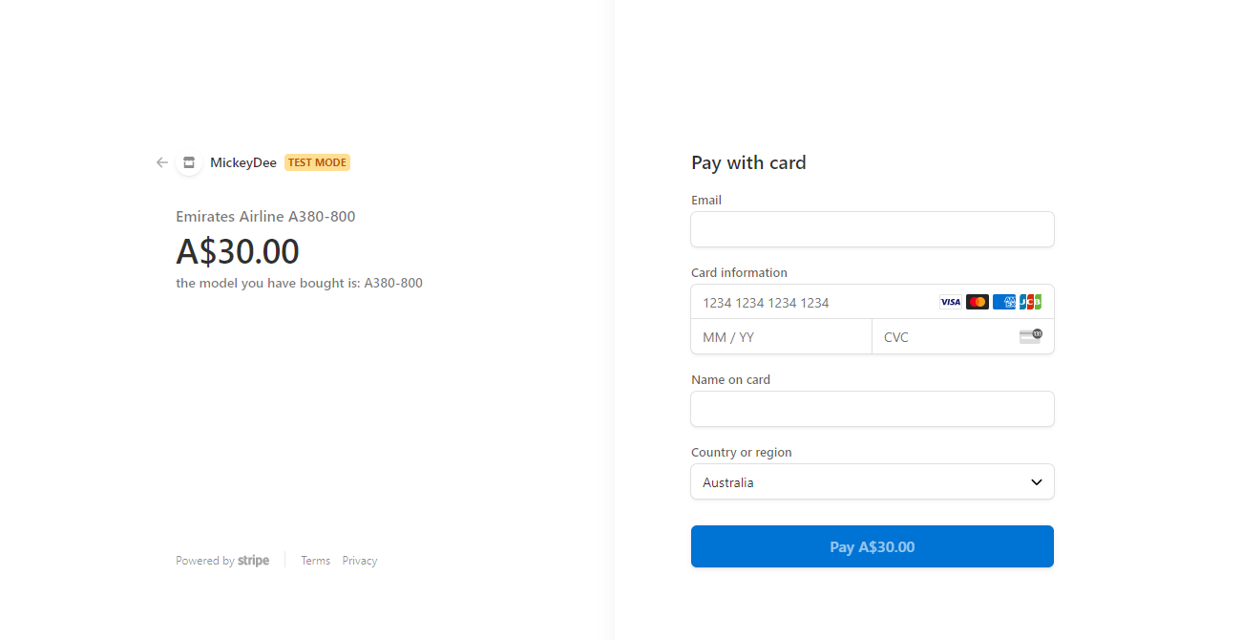
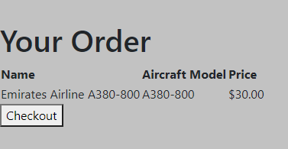
Michael Dart – T2A2 – Marketplace Project | The Application – Individual Product View
The user is then directed to Stripe via the API where the payment is processed, external to the application and relieving it of any PCI responsibility
After clicking on “Buy Now”, the user can select “Checkout” to confirm their order, which some details are displayed to the user, confirming their items for purchase
Stripe’s Public and Secret Keys are secured by storing in an encrypted file – the file is kept away from remote repositories

Slide 13
THANK YOU -
Let’s go see it in action!

