Slide 1
Welcome to My Presentation Presented By Md Asaduzzaman Shamim

Slide 2
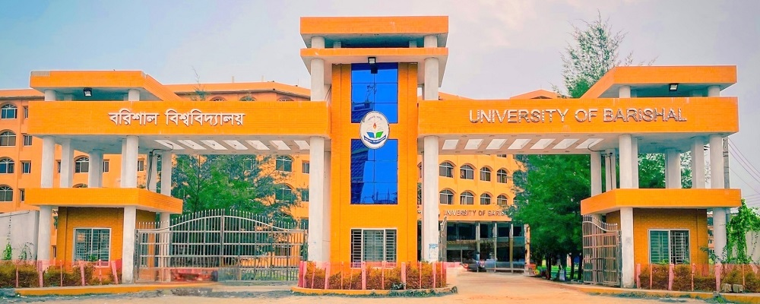
Barishal University
University of Barishal is situated in the district of Barishal under Barishal Division. It is located at Karnakathi on the eastern bank of the Kirtonkhola river beside the Barishal-Patuakhali highway about 2 kilometers from the center of Barishal City. The university campus is spread over 50 acres of land.
The university was established in 2011.
It is the country's 33rd public university.

Slide 3
Student Information
Science Faculty
Arts faculty
Business Faculty
LAW Faculty

Slide 4
Student Number

Slide 5
Thank You

