Slide 1
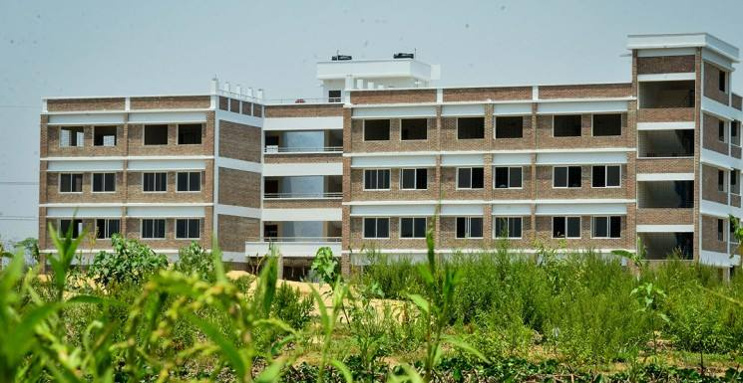
Welcome all of you to Leading University First & Largest Private University in Sylhet.
Permanent Campus Kamal Bazar

Slide 2

Welcome to Leading University Computer CLUB

Slide 3
Activities Of
Leading University Computer Club

Slide 4

TECH STORM-2016

Slide 5
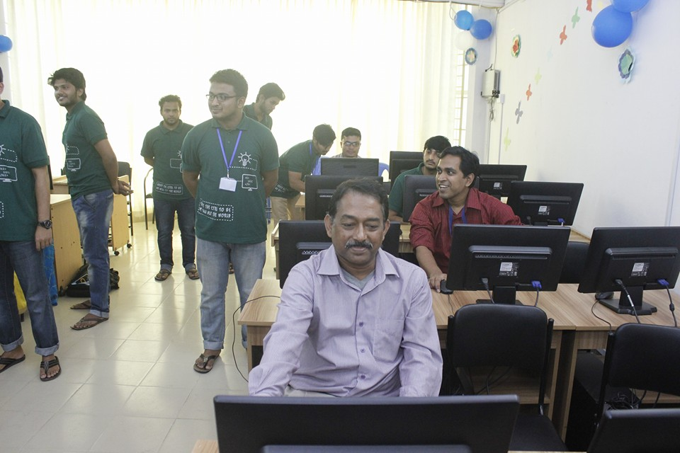
Guest On TECH STORM
Leading University Computer Club organized a program called TECH STORM where Chief Guest and our Club Advisor .

Slide 6
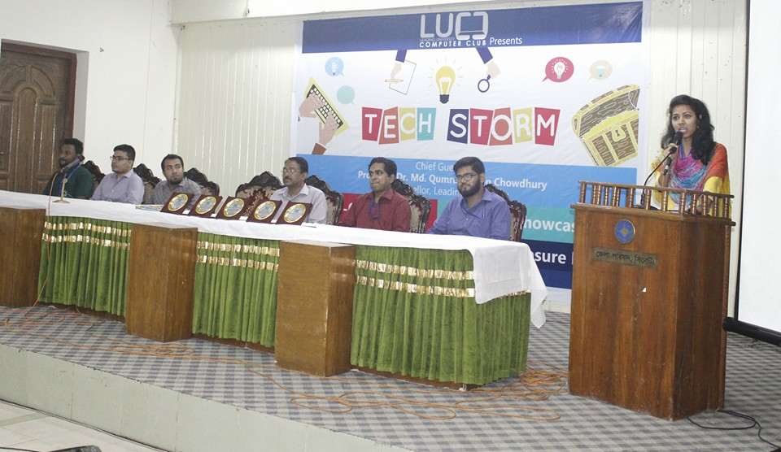
Guest s On TECH STORM
In Prize Giving Ceremony Our Chief Guest & Advisor along with other Guest
in TECH STORM-2016.

Slide 7
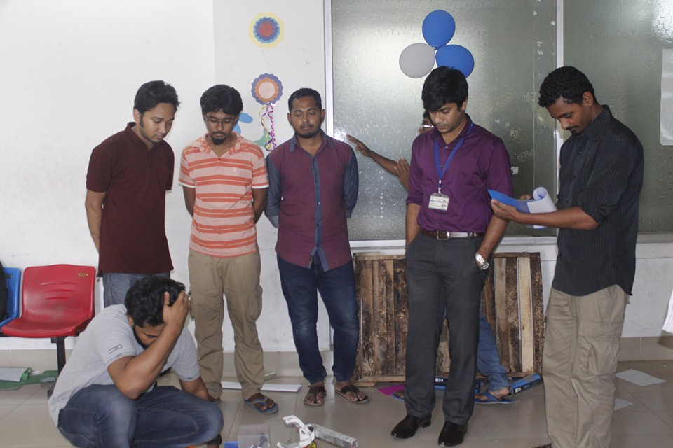
Judge on TECH STORM in Project Showcasing

Slide 8
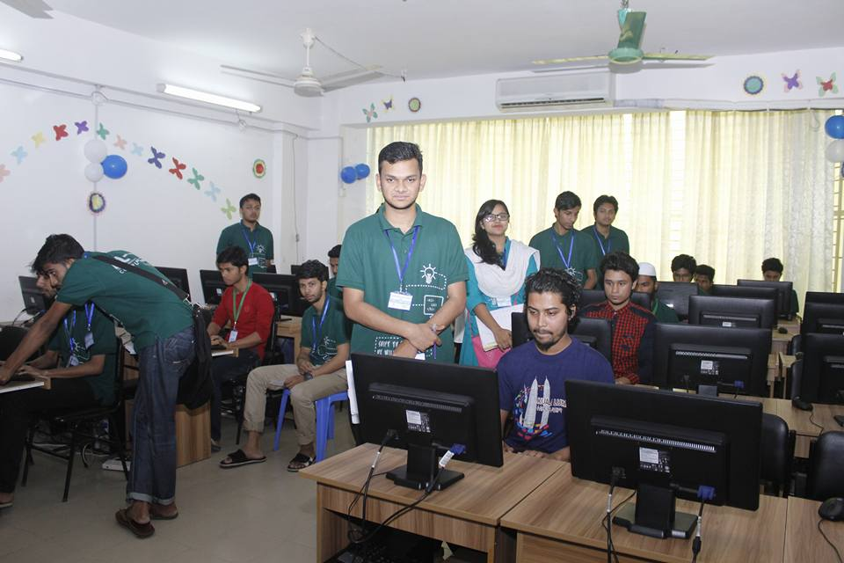
Participant on Typing Speed in TECH STORM-2016

Slide 9
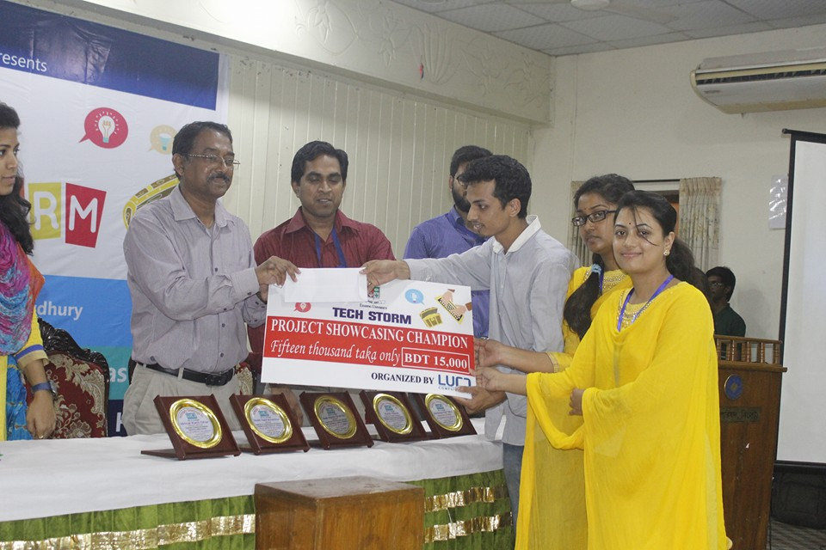
Champion On TECH STORM
Champion Team of Project Showcasing receiving Prize from Guests.

Slide 10
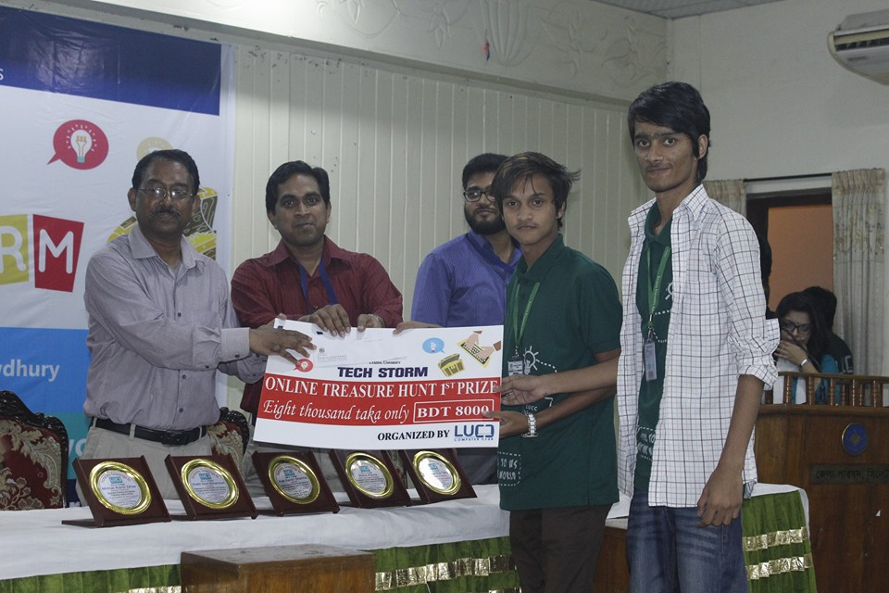
Champion on TECH STORM
Champion Team of Online Treasure Hunt receiving Prize from Guests.

Slide 11

JIUPC & SEMINAR TRIO
A mega event organized by Leading University Computer Club

Slide 12

JIUPC & SEMINAR TRIO
JIUPC a battle as Team for Programming

Slide 13
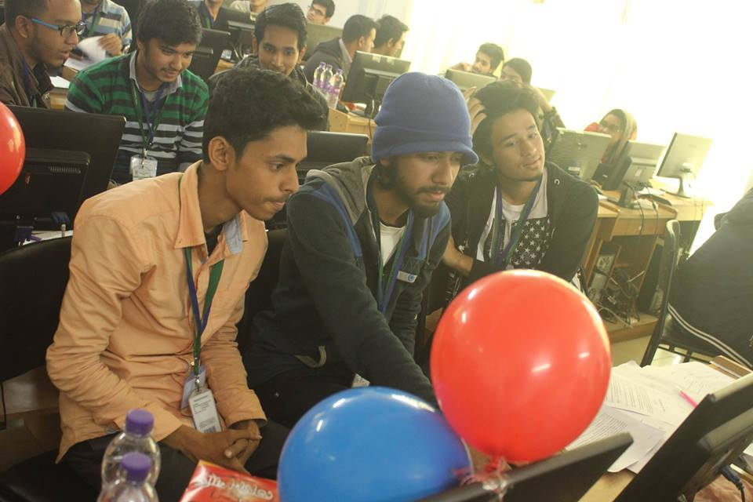
JIUPC & SEMINAR TRIO
Programing Contest Contestant on
JIUPC &SEMINAR TRIO

Slide 14
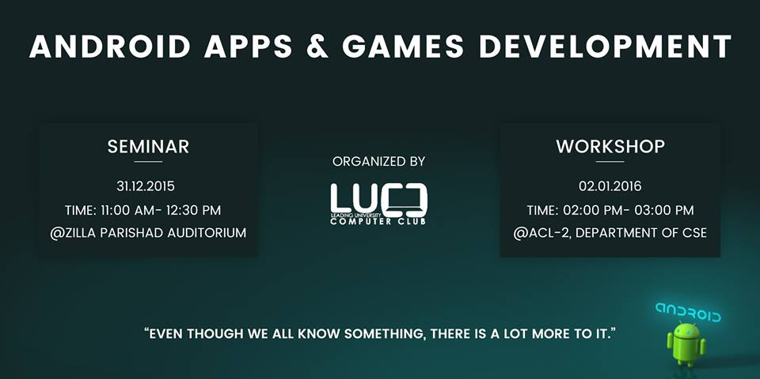
ANDROID APPS & GAMES DEVELOPMENT

Slide 15
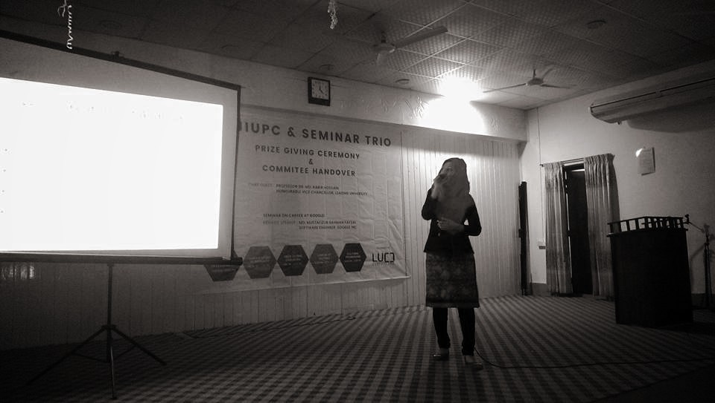
SEMINAR ON ANDROID APPS & GAME DEVEOPMENT

Slide 16
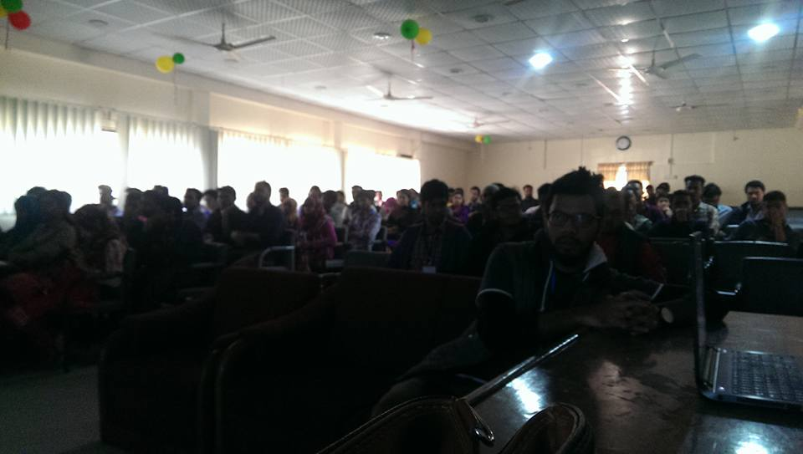
WORKSHOP ON ANDROID APPS & GAME DEVEOPMENT

Slide 17

Career Opportunity in Bangladesh for CSE Students

Slide 18
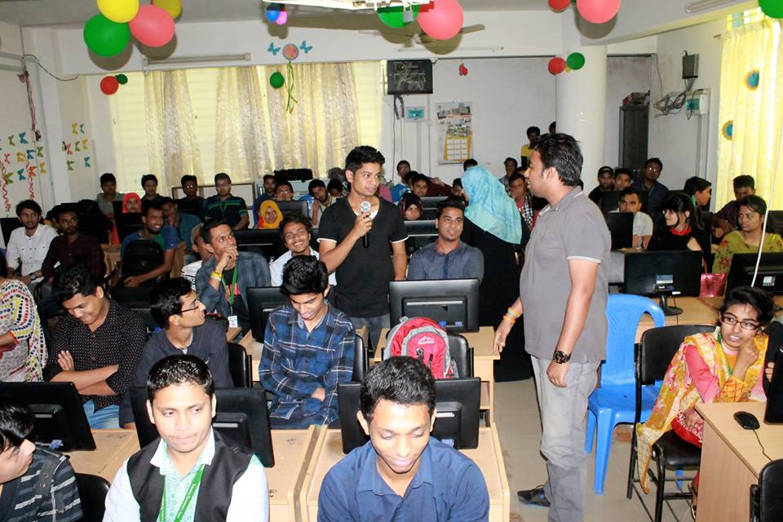
Career Opportunity in Bangladesh for CSE Students

Slide 19
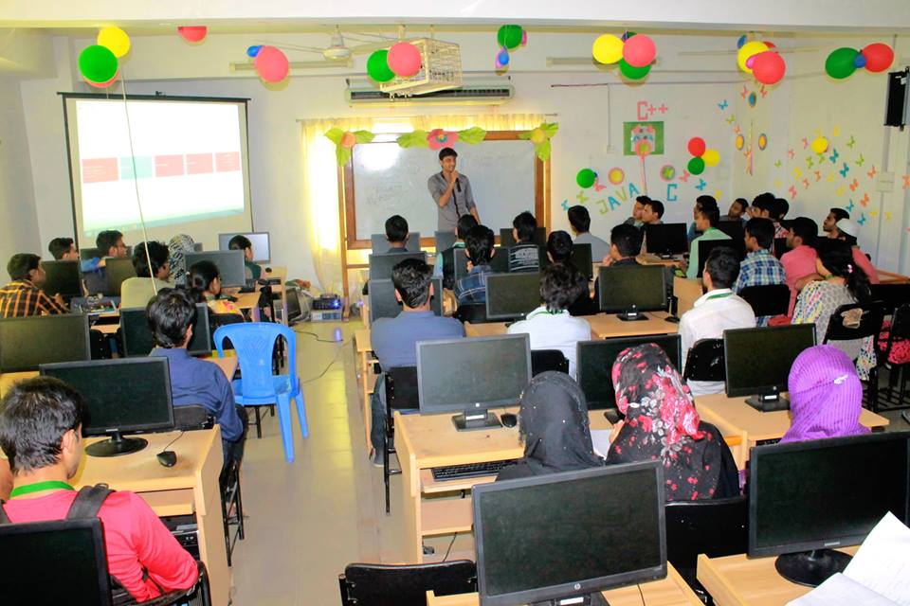
Career Opportunity in Bangladesh for CSE Students

Slide 20

LU GAMING CONTEST-2014

Slide 21
LU GAMING CONTEST-2014
Gaming Contest -2014 Participant
organized by
Leading University Computer Club

Slide 22
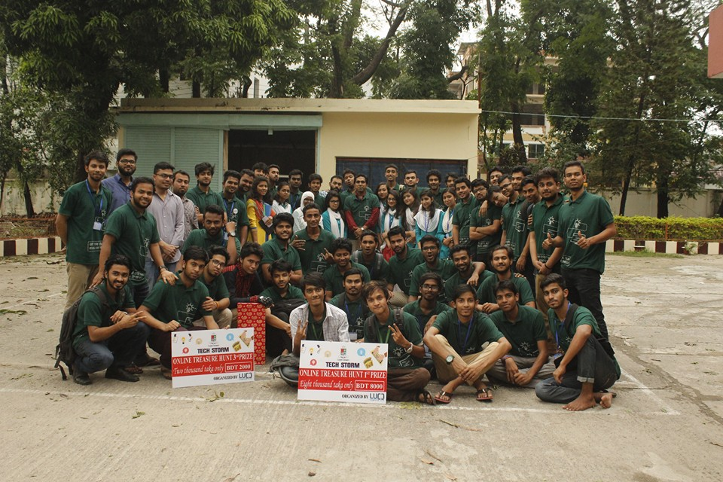
LEADINg University Computer Club Family

