Slide 1
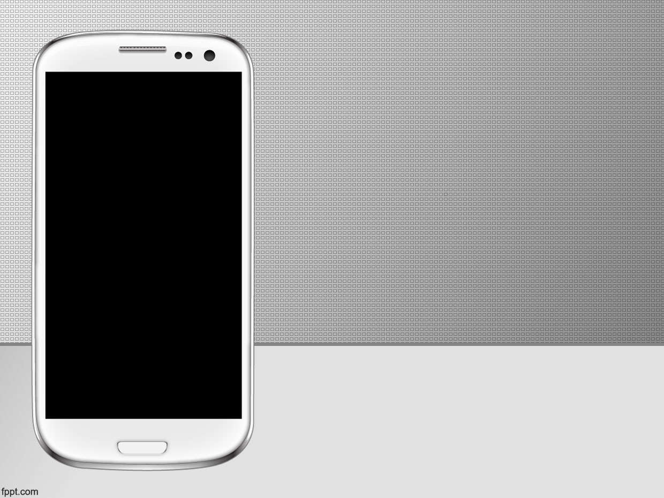

Welcome To Our Presentation

Slide 2

Presentation on
android based apps
Sylhet View

Slide 3

Project Supervisor
Selina Sharmin
Senior Lecturer
Submitted by
Jannatul Ferdousi Tarin(1412020006)
Md. Rafsun(1412020014)
Susmita Dutta Piya(1412020037)
35th batch, Section A
Department of Computer Science & Engineering
Leading University, Sylhet

Slide 4
Introduction
Use of smart phones has rapidly increased
People love to do & also love to get all technically.
Sylhet city is famous for its beautiful sceneries
With this motive to represented this city in the whole world
we have made an effort to implement a android based
app “Sylhet View”.

Slide 5

User Requirements
Internet connection availability
Android OS supported smart phone

Slide 6
Software and hardware Requirements
Java JDK
Language : Java, xml.
Operating System: Windows 7, 8, 10.
IDE: Android studio V2.0

Slide 7
Key Features
All institution’s information with picture ,contact
number & also website
Different types of emergency number.
Example: Hospitals, Fire stations, RAB etc.
Apps will be work offline.
Calling option & going website option.
Attractive visiting place information.
List view or Grid view icon display.

Slide 8

Why need this System?
People can help to get institutions website, address & also contact number
This System helps people to know about Sylhet city
To get emergency number when you have emergency

Slide 9
Why need this System?
Almost users friendly interface.
Easy to use & handle
get to know current Location, distance & time

Slide 10
How to use this System?
This System can be described easily by Android Interfaces

Slide 11
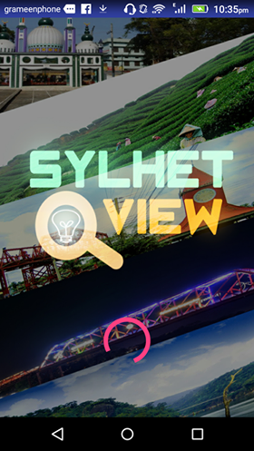
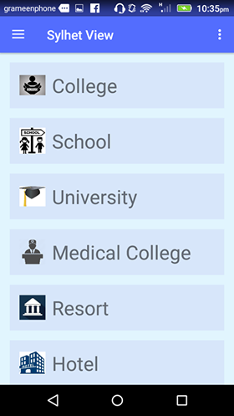

Android Interfaces
Here is the
android
interfaces.

Slide 12
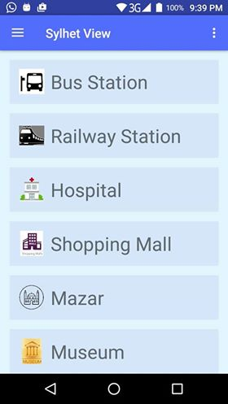
Main Custom List part
It is the home page
of Sylhet View. Here
we add several
options like College,
School etc. Clicking
here you can get
its detail.

Slide 13
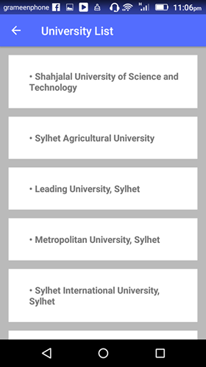
University List
Let’s see for
university.Here
we put all university
information.From
there we can choose
specific one.

Slide 14
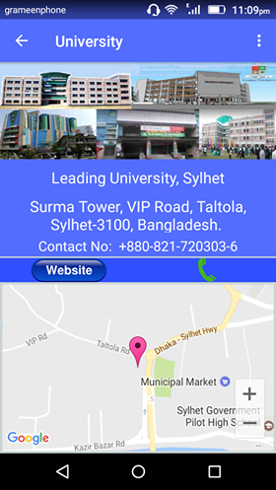

Leading University
Here we can
see Leading
University
In detail.

Slide 15
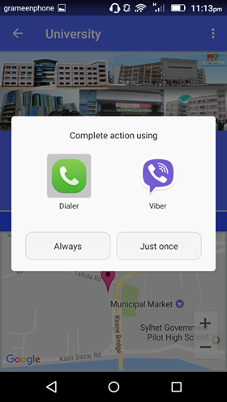
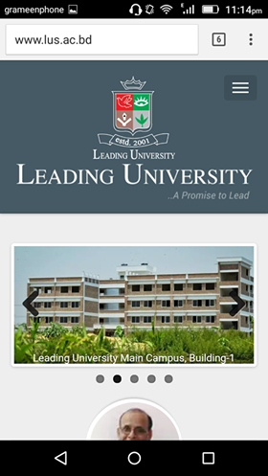

Button & Website Activity
If you choose call
button, it will go for
Dialing and if you
choose website
button it will go
for visiting
Website.

Slide 16
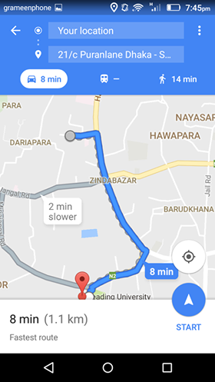
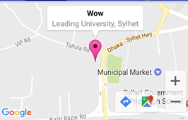

Google map & Current Location
add google maps for
viewing location.
can see our current
location
Distance & time

Slide 17
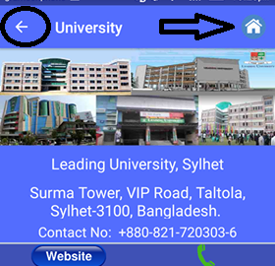
Back Option
Back Button
option
Coming in Home
page

Slide 18
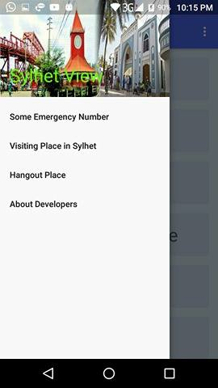
Navigation Bar
It is the
Navigationbar.
Here are
Some
emergency
number and
also some
places.

Slide 19
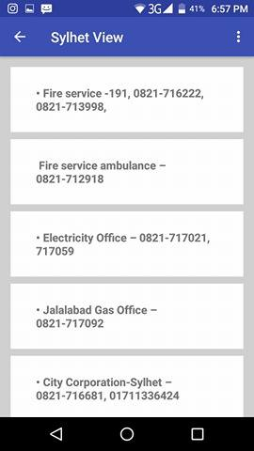
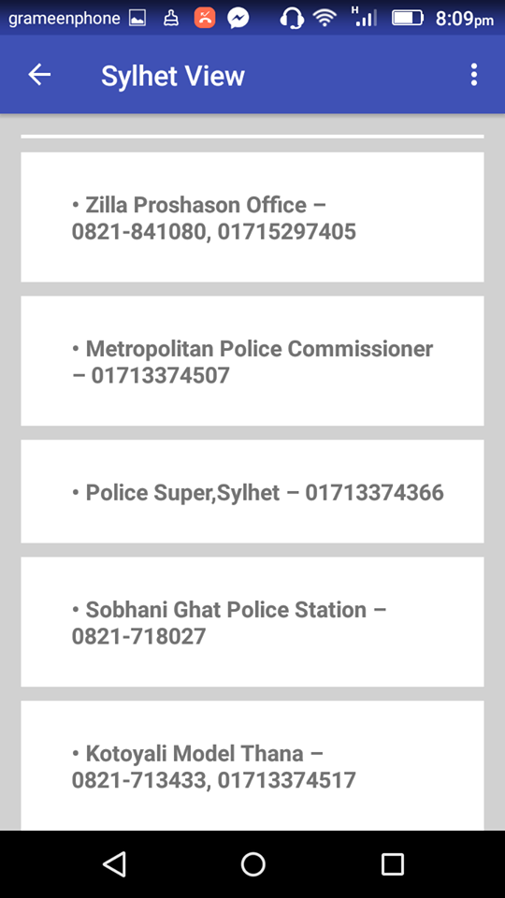
Some Emergency Number
Here we keep
Some emergency
number. So that
you can contact
when you are in
emergency.

Slide 20
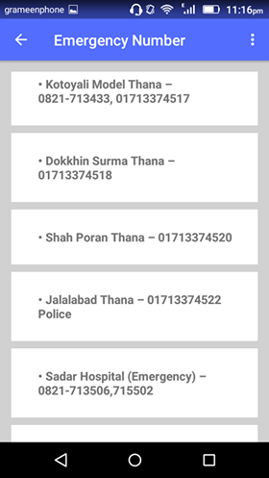
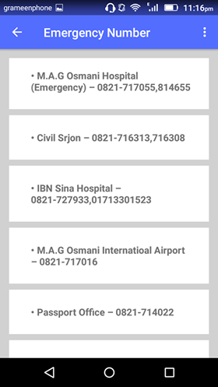

Some Emergency Number

Slide 21
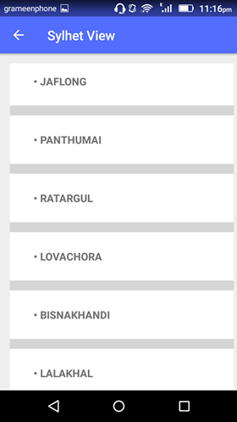
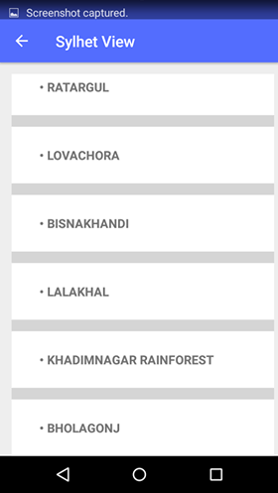

Some Tourist Place
Here we add some
Tourist places.So that
people can get
knowlegde about seeing
them. Clicking Here,
They can know about
it’s detail.Let’s see.

Slide 22
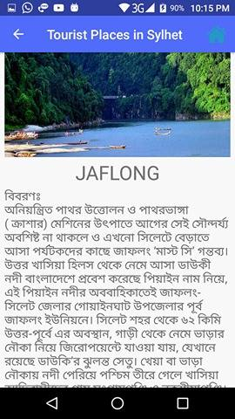
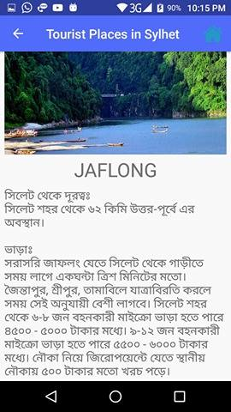
Bholagonj & khadimnagar
Here we add details.
So That people cannot
have to face any
problem to go.

Slide 23
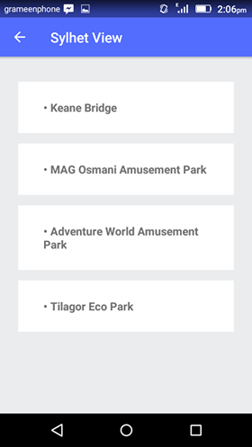
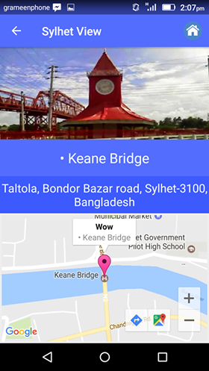

Hangout Place
Here we add some
hangout laces..
So That people can
visit in Afternoon.

Slide 24
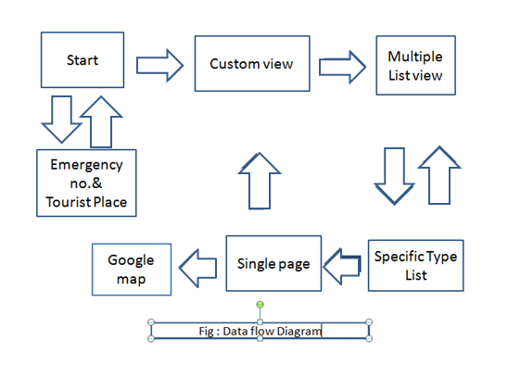
How does the system works ?

Slide 25
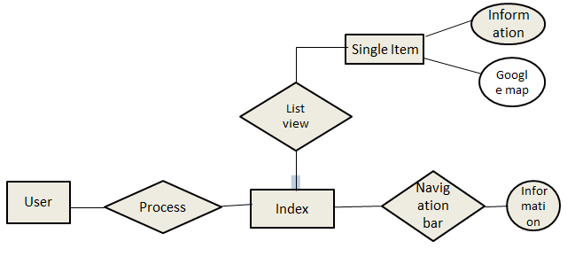
ER Diagram
Fig:ER diagram

Slide 26
Conclusion
In conclusion we want to say that this system is really very helpful for people.
In upcoming days we can implement this system for all city in Bangladesh

Slide 27
Thank You
Please would you like to ask any question?

