Slide 1

SEASONAL AGRICULTURE PERFORMANCE ANALYSIS
AICTE STU ID : STU6a68ea3ba40ec1785260603
Student Name: MOHAMMED ASHWAQ
College name: sree chaitanya college of engineering

Slide 2

PROBLEM STATEMENT
Agricultural activities are influenced by seasonal variations in:
Environmental conditions
Farming practices
Resource availability
Irrigation methods
Crop characteristics
Market conditions
As a result, agricultural performance may differ from one season to another.
The raw agricultural data does not clearly explain how agricultural performance changes across seasons or what important patterns can be observed.

Slide 3
Project Description
The Seasonal Agriculture Performance Analysis project analyzes agricultural activities across different seasons, geographical areas and farming conditions.
The dataset contains information about:
Farm characteristics
Crop types
Seasons
Environmental conditions
Soil conditions
Fertilizer and pesticide usage
Irrigation methods
Crop yield
Production
Revenue
Cost
Profit
Water usage
Water-use efficiency
Disease and pest risk

Slide 4

WHO ARE THE END USERS?
🌾 Farmers
Can understand seasonal crop performance, yield differences and resource efficiency.
🏢 Agricultural Planners
Can use seasonal trends to support agricultural planning and resource allocation.
👨‍🔬 Agricultural Researchers
Can investigate relationships between environmental conditions, farming practices and agricultural outcomes.
💧 Resource Management Teams
Can analyze irrigation and water-use efficiency.
💰 Agricultural & Market Analysts
Can examine revenue, costs and profitability across seasons and crops.
🏛️ Government & Agricultural Organizations
Can use data-driven findings to support evidence-based agricultural policies and planning.

Slide 5

Technology Used
Programming Language
Python
Libraries
Pandas
NumPy
Matplotlib
Seaborn
Development Environment
Visual Studio Code
Command Prompt
Data Analysis Techniques
Data Cleaning
Exploratory Data Analysis
Statistical Analysis
Feature Engineering
Data Visualization
Correlation Analysis

Slide 6
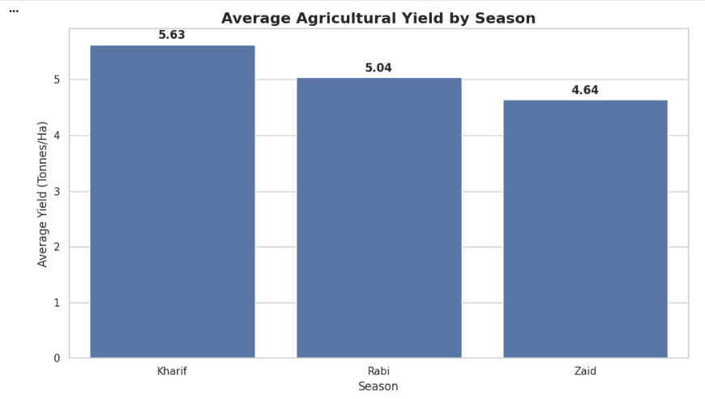
RESULTS
Explanation:
Kharif records the highest average agricultural yield, followed by Rabi and Zaid. This indicates that agricultural productivity varies across different seasons in the dataset.

Slide 7
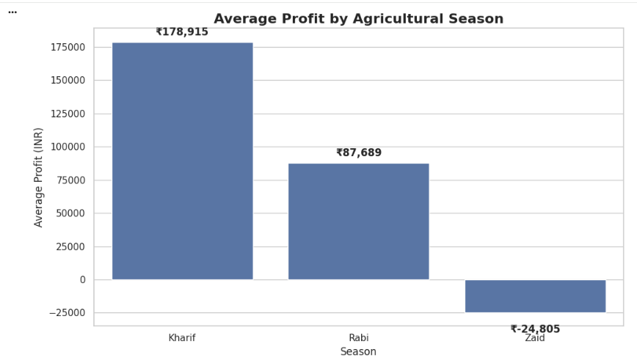
RESULTS
Explanation:
Kharif demonstrates the highest average profit, while Zaid records a negative average profit. This indicates significant differences in economic performance across agricultural seasons.

Slide 8
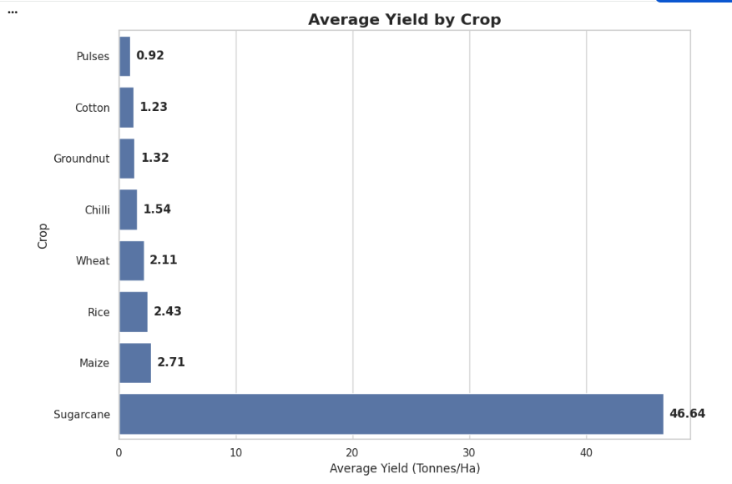
RESULTS
Explanation:
Sugarcane shows a substantially higher average yield than the other crops, while Pulses records the lowest average yield. This demonstrates significant differences in crop productivity within the dataset.

Slide 9
RESULTS
Explanation:
Kharif records the highest average agricultural yield, followed by Rabi and Zaid. This indicates that agricultural productivity varies across different seasons in the dataset.

Slide 10
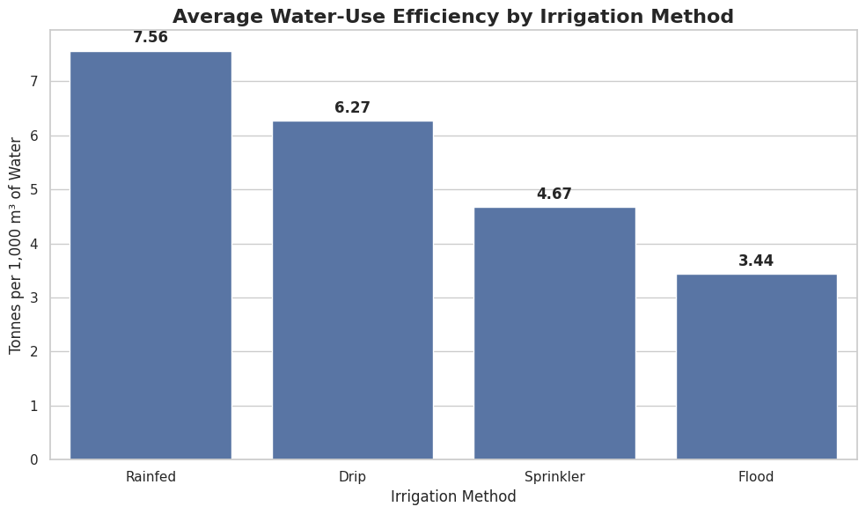
RESULTS
Explanation:
Rainfed and Drip irrigation show higher average water-use efficiency than Sprinkler and Flood methods in this dataset. This highlights differences in resource efficiency across irrigation practices.

Slide 11
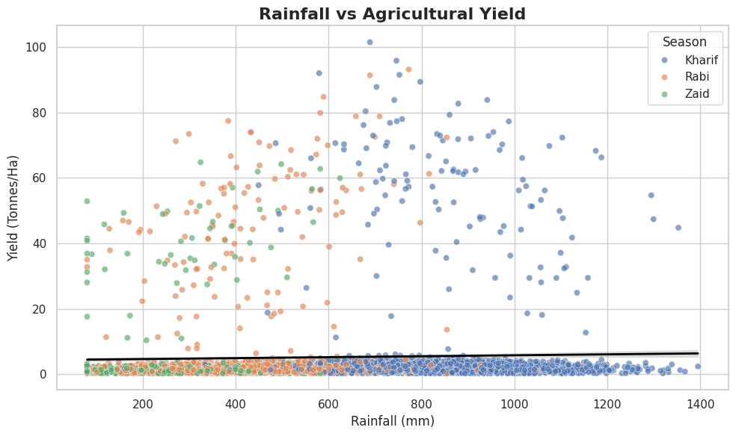
RESULTS
Explanation:
Rainfall shows a very weak linear relationship with agricultural yield in the dataset. This suggests that rainfall alone does not strongly explain yield variation and that other agricultural, environmental and management factors should also be considered.

Slide 12
Future scope
1. Advanced Statistical Analysis
Perform hypothesis testing and regression analysis to investigate agricultural relationships in greater depth.
2. Regional Analysis
Compare agricultural performance across different states and districts.
3. Crop-Specific Analysis
Study individual crop performance across seasons and regions.
4. Predictive Analytics
Future versions could use machine learning to predict crop yield and profitability.
5. Weather Integration
Additional weather data such as temperature, rainfall patterns and extreme weather events could be incorporated.
6. Resource Optimization
Further analysis can focus on optimizing water, fertilizer and pesticide usage.
7. Interactive Dashboard
The analysis could later be transformed into an interactive Power BI or Tableau dashboard.

Slide 13
GitHub Link
https://github.com/mdashwaq0557-cmd/seasonal-agriculture-performance-analysis-project.git

Slide 14
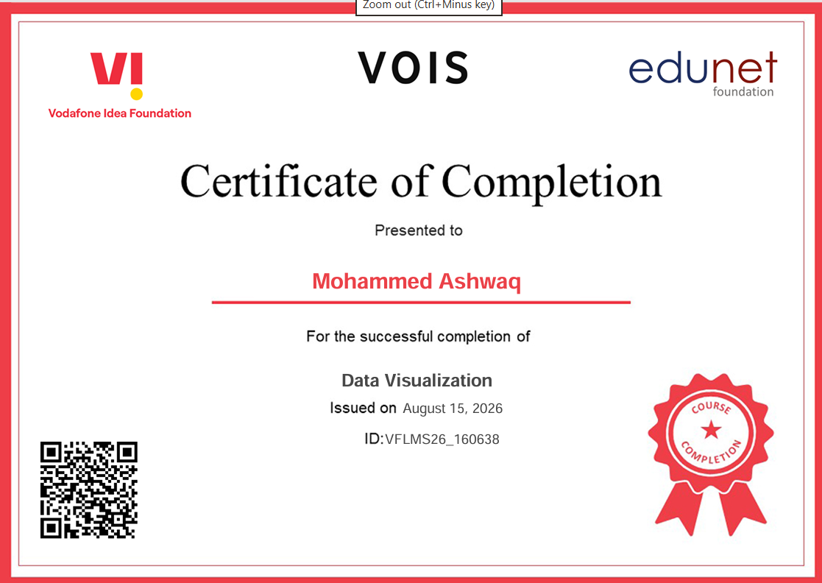
VOIS Course completion certificate - Course name- Data Visualization

Slide 15
Thank you
.
.

