Slide 1

Andhra Loyola Institute Of Engineering And Technology Department of Electronics and Communication Engineering
Project title : Early Detection of Autism Spectrum Disorder Using Machine Learning Techniques
Batch Members:
20HP1A04C1 ( S.SIVA SHANKAR REDDY)
21HP5A0414 (Ch.P.SURYA PRAKASH)
20HP1A04A9 (MD ASIF SHAREIF)
Project Guide: Mr. Md. Baig Mohammad
M. Tech, (Ph. D)

Slide 2
ABSTRACT :
In this project we propose Autism Spectrum Disorder (ASD) poses significant challenges to the affected individuals` daily lives, making early intervention crucial for mitigating its severity. we present a comprehensive framework aimed at evaluating various Machine Learning (ML) techniques for the early detection of ASD) with a focus on real-time prediction through a user-friendly graphical user interface (GUI).These strategies are applied to feature -scaled datasets, which are then subjected to classification using eight ML algorithms: Ada Boost (AB), Random Forest (RF), k-Nearest Neighbors (KNN), Gaussian Naive Bayes (GNB), Logistic Regression (LR), Support Vector Machine (SVM), and Linear Discriminant Analysis (LDA).
We conduct experiments on four standard ASD datasets representing different age groups (Toddlers, Adolescents, Children and Adults). To evaluate the classification outcomes, we employ various statistical measures such as Accuracy, Receiver Operating Curve (ROC) curve, F1 score, Specificity, Sensitivity Through this analysis, we identify the best-performing classification methods for each ASD dataset. Overall, our purposed framework Demonstrates promising results compared to existing approaches for the early detection of ASD.

Slide 3
WHAT IS AUTISM SPECTRUM DISORDER (ASD)
Definition : ASD encompasses a range of conditions characterized by challenges in social interaction, communication, and behavior. It's often diagnosed in early childhood and lasts throughout a person's life
Impact: ASD affects individuals differently, influencing their ability to interact socially, communicate effectively, and adapt to change. It can lead to difficulties in forming relationships, succeeding in school or work, and navigating everyday situations
Significance of Early Intervention : Timely intervention is pivotal in improving outcomes for individuals with ASD. Early detection enables access to tailored interventions and support services, fostering skill development, enhancing social communication, and addressing behavioral challenges. Intervening during critical developmental periods can positively influence long-term prognosis and quality of life

Slide 4
Introduction to Machine Learning (ML)
Definition: Machine Learning (ML) is a subfield of artificial intelligence (AI) that focuses on the development of algorithms and models capable of learning from data to make predictions or decisions without being explicitly programmed
Core Concept: ML algorithms learn patterns and relationships from labeled or unlabeled data, allowing them to generalize and make predictions on unseen data
Applications: ML techniques are widely applied across various domains, including healthcare, finance, marketing, and natural language processing. In healthcare, ML is used for disease diagnosis, treatment planning, and personalized medicine

Slide 5
Why Machine Learning for Early Detection of ASD?
Machine learning algorithms can analyze large datasets to identify patterns associated with ASD
This can aid in developing more accurate and efficient screening tools.
Early detection of ASD leads to earlier intervention, improving a person's quality of life.
ML algorithms analyze individual characteristics and behaviors to personalize risk assessments. This tailors screening and interventions, enhancing accuracy and effectiveness.
ML models continuously learn from new data, refining ASD detection methods over time This iterative process ensures improved accuracy and reliability in early detection efforts

Slide 6
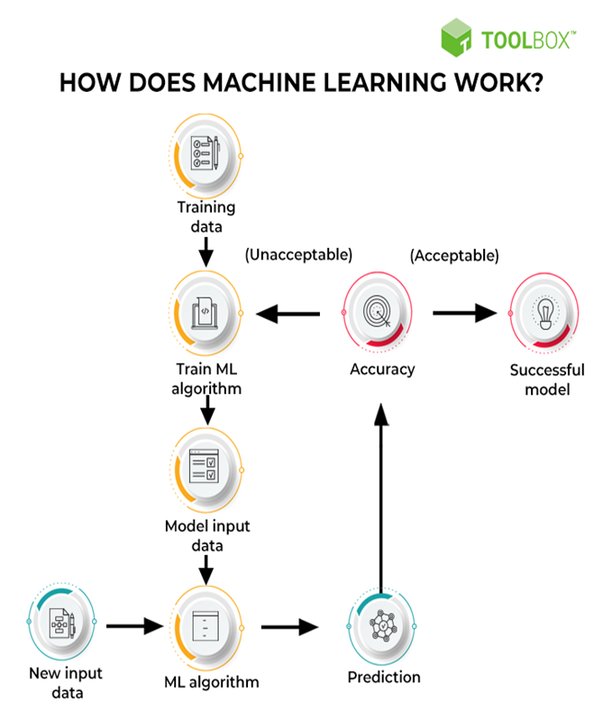
Machine learning (ML) is a type of artificial intelligence that allows computers to learn without explicit programming. ML algorithms can analyze large datasets of data to identify patterns that may be associated with ASD. This information can then be used to develop more accurate and efficient screening tools for ASD. Early detection of ASD is crucial for getting appropriate interventions that can improve a person's quality of life

Slide 7
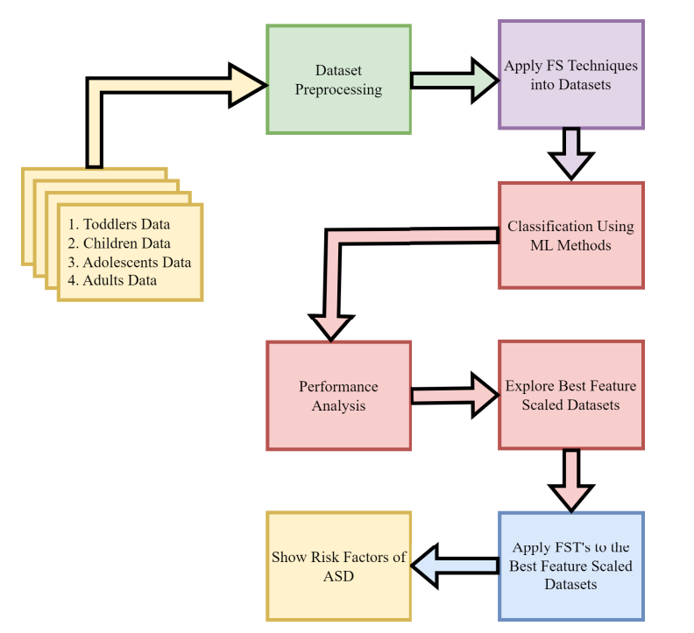
Sequential workflow for detecting ASD at an early stage

Slide 8
Why Python for Machine Learning?
Python, introduced by Guido van Rossum in 1991, is a high-level programming language known for its simplicity and dynamic semantics. It allows developers to express concepts concisely and is widely used in domains like web development, data science, and artificial intelligence
Python's rich library ecosystem, including Scikit-learn, TensorFlow, and PyTorch, provides robust tools for machine learning tasks
Python's active community support and ease of integration with other technologies make it the ideal language for rapid prototyping, experimentation, and deployment of ML solutions.

Slide 9
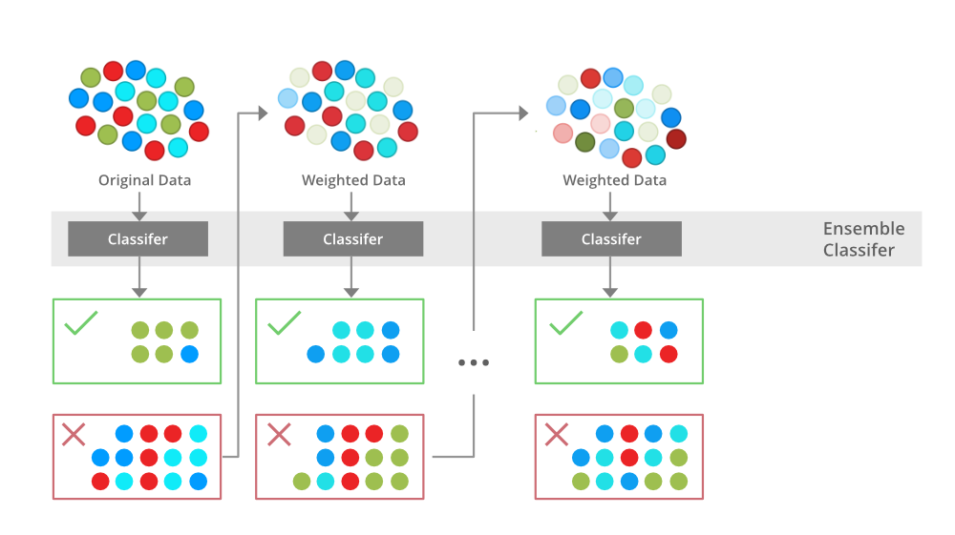
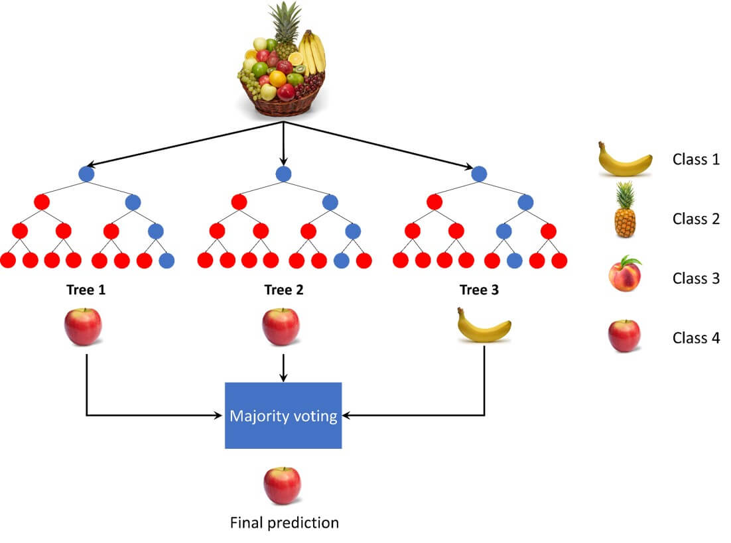
ML algorithms used in this projects
1.Ada Boost (AB): Ensemble learning method combining weak classifiers for robust classification. Effective for handling complex datasets and skewed distributions
2.Random Forest (RF): Ensemble learning method using multiple decision trees to reduce overfitting. Robust to outliers and noise, performs well on large datasets

Slide 10

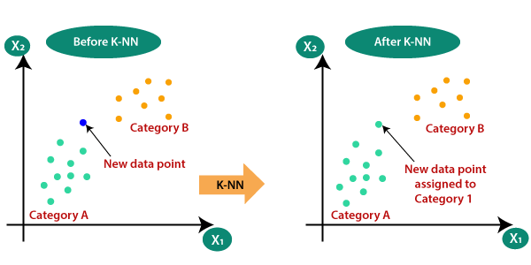
3.Decision Tree (DT): Simple and interpretable algorithm splitting data based on significant attributes. Easy to interpret and visualize, suitable for small to medium-sized datasets
4.K-Nearest Neighbors (KNN): Instance-based learning classifying new instances based on proximity to neighbors. Effective for complex decision boundaries and suitable for both classification and regression tasks

Slide 11
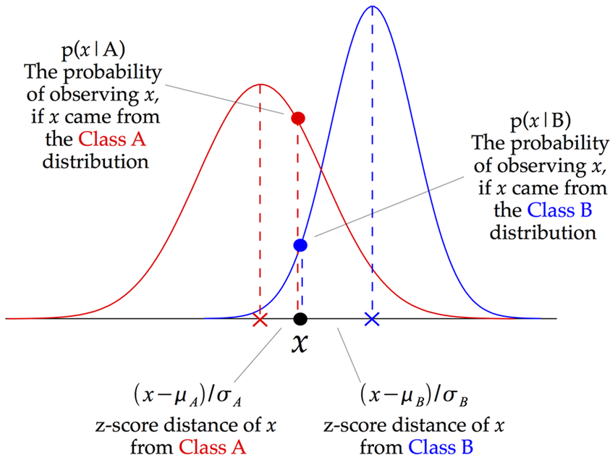
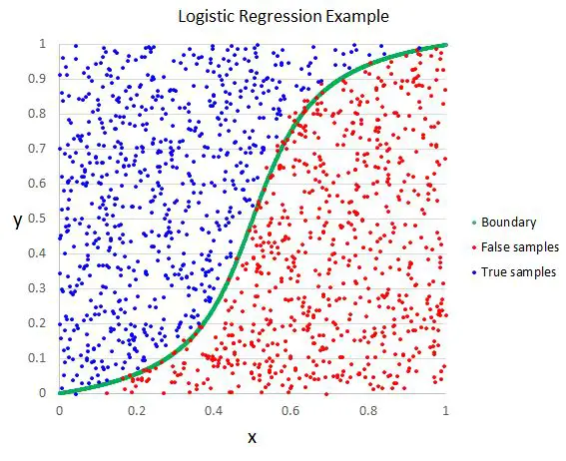
5.Gaussian Naïve Bayes (GNB): Probabilistic classification assuming feature independence. Computationally efficient and performs well on continuous feature datasets
6.Logistic Regression (LR): Linear classification modeling probability of binary outcomes. Widely used in binary classification tasks and serves as a baseline model

Slide 12
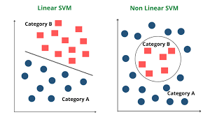
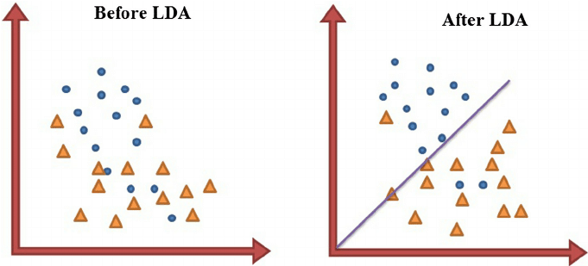
7.Support Vector Machine (SVM): Constructs hyperplanes for maximum margin separation. Effective in high-dimensional spaces and suitable for datasets with complex structures
8.Linear Discriminant Analysis (LDA): Dimensionality reduction and classification maximizing class separation. Useful for visualizing data in lower-dimensional spaces and reducing computational complexity

Slide 13
Performance Evaluation Metrics
Accuracy:
Accuracy is a measure of how well the model correctly predicts the outcomes of the data. It is calculated as the ratio of the number of correct predictions to the total number of predictions made by the model
Accuracy is a commonly used metric, but it may not be the most appropriate measure for imbalanced datasets, where one class is much more prevalent than the others.
Confusion Matrix:
A confusion matrix is a table that is used to evaluate the performance of a classification model. It summarizes the predictions made by the model on a test dataset, comparing them to the actual true values.
It consists of four components: True Positive (TP), True Negative (TN), False Positive (FP), and False Negative (FN)

Slide 14


3.Sensitivity (True Positive Rate or Recall):
Sensitivity measures the proportion of actual positive cases that were correctly identified by the model
It is calculated as the ratio of True Positives to the sum of True Positives and False Negatives
4.Specificity (True Negative Rate):
Specificity measures the proportion of actual negative cases that were c correctly identified by the model
It is calculated as the ratio of True Negatives to the sum of True Negatives and False Positives

Slide 15

5.F1 Score:
F1 Score is the harmonic mean of precision and recall. It provides a balance between precision and recall
6.Area Under the ROC Curve (AUC-ROC):
AUC-ROC measures the area under the Receiver Operating Characteristic (ROC) curve.
ROC curve is a graphical plot that illustrates the performance of a binary classifier system as its discrimination threshold is varied.
AUC-ROC provides an aggregate measure of performance across all possible classification thresholds

Slide 16
THE PERSONS DATA IN THIS PROJECT
Toddlers: Dataset focusing on ASD diagnosis in toddlers, typically aged between 1 to 3 years old. Contains features relevant to early developmental milestones and behavioral patterns
Children: Dataset targeting ASD diagnosis in children, covering a broader age range from preschool to pre-adolescent years. Includes features related to social interaction, communication skills, and behavioral traits
Adolescents: Dataset specifically designed for ASD diagnosis in adolescents, typically aged between 12 to 18 years old. Features may include cognitive abilities, adaptive functioning, and emotional regulation
Adults: Dataset focusing on ASD diagnosis in adults, typically aged 18 years and above. Features encompass various aspects of adult life, such as employment, relationships, and independent living skills

Slide 17
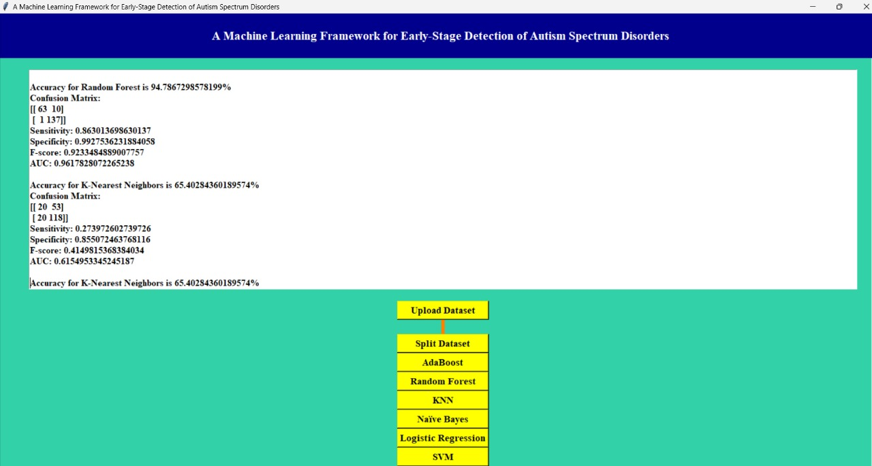
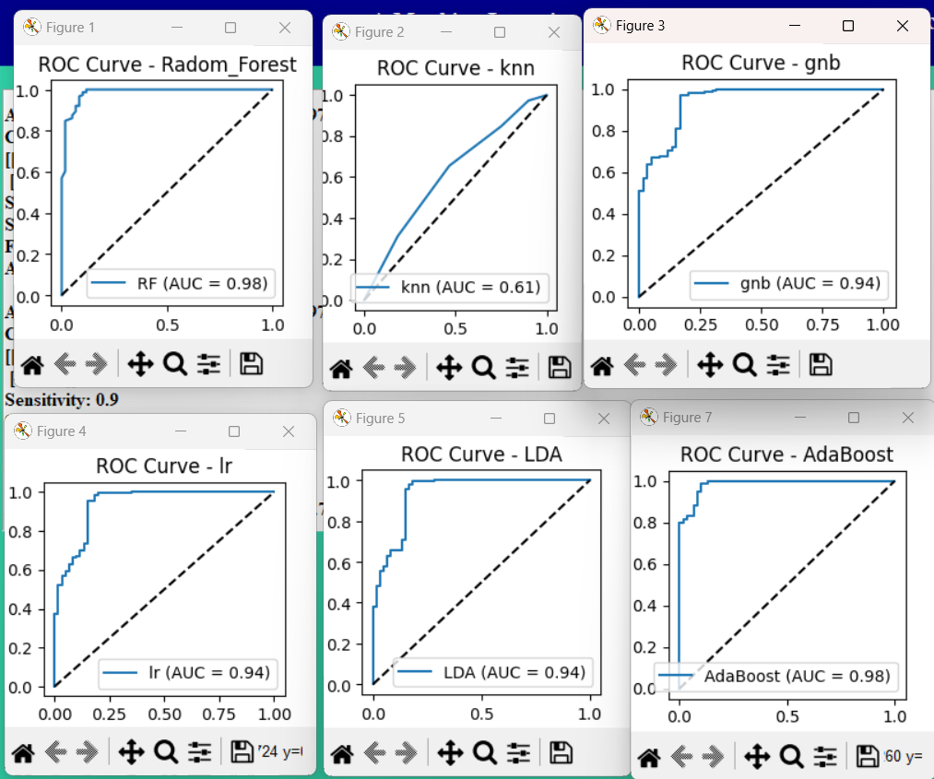
OUTPUT RESULTS:

Slide 18
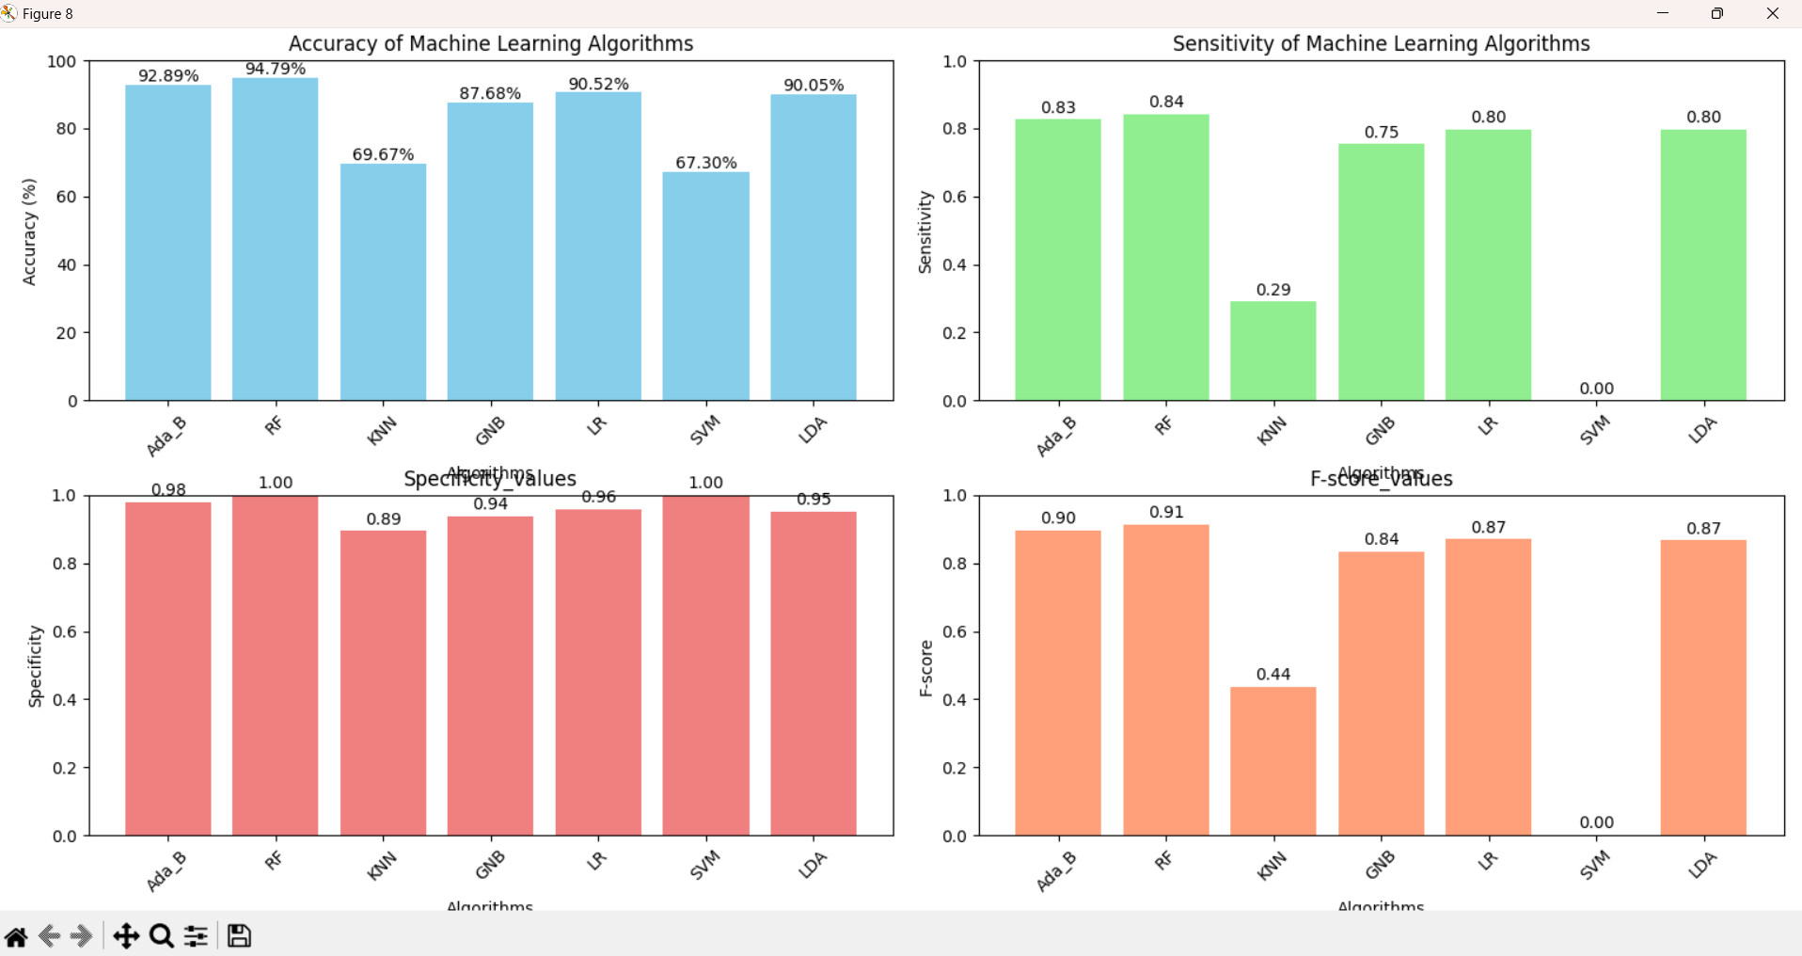

Slide 19
ADVANTAGES
Early Detection: Early intervention can significantly improve outcomes for individuals with ASD.
High Accuracy: Achieving high accuracy rates in predicting ASD, aiding in early diagnosis.
Versatility: The proposed framework accommodates various Machine Learning techniques and datasets of different age groups, making it adaptable to diverse populations.
Feature Importance Analysis: Detailed feature importance analysis helps in identifying critical factors contributing to ASD, aiding healthcare practitioners in decision-making

Slide 20
Disadvantages:
Data Availability: Limited availability of comprehensive ASD datasets may affect the generalizability of the results.
Model Complexity: Some Machine Learning algorithms used in the framework may be complex and computationally intensive.
Interpretability: Complex models might lack interpretability, making it challenging to understand the underlying factors contributing to ASD prediction.
Ethical Considerations: There may be ethical considerations regarding the use of predictive models in healthcare, particularly concerning privacy and consent.

Slide 21
Future Scope:
Enhanced Feature Selection Techniques: Further research could explore more advanced feature selection techniques to improve model performance and interpretability.
Integration of Multi-Modal Data: Incorporating multi-modal data such as genetic, imaging, and behavioral data could enhance the accuracy and robustness of ASD prediction models.
Longitudinal Studies: Conducting longitudinal studies to track individuals with ASD over time could provide insights into the progression of the disorder and the effectiveness of interventions.
Clinical Implementation: The framework could be further developed for practical implementation in clinical settings, potentially leading to the development of decision support systems for healthcare practitioners.
Ethical Guidelines: Establishing ethical guidelines for the use of predictive models in ASD diagnosis and intervention to address concerns regarding privacy, consent, and algorithmic bias

Slide 22
CONCLUSION
Our purpose early detection of Autism Spectrum Disorder (ASD) through Machine Learning (ML) techniques, coupled with a user-friendly graphical user interface (GUI), exhibits promising results. By employing feature-scaled datasets and applying eight different ML algorithms—Ada Boost (AB), Random Forest (RF), k-Nearest Neighbors (KNN), Gaussian Naive Bayes (GNB), Logistic Regression (LR), Support Vector Machine (SVM), and Linear Discriminant Analysis (LDA)—we conducted experiments on four standard ASD datasets representing various age groups. Through rigorous evaluation using statistical measures such as Accuracy, Receiver Operating Curve (ROC) curve, F1 score, Specificity, and Sensitivity, we identified the best-performing classification methods for each dataset. The outcomes indicate the effectiveness of our framework in early ASD detection, surpassing existing approaches. This underscores the significance of leveraging ML techniques for timely intervention and management of ASD, potentially improving the quality of life for affected individuals

Slide 23
REFERANCE :
[1] M. Bala, M. H. Ali, M. S. Satu, K. F. Hasan, and M. A. Moni, ‘‘Efficient machine learning models for early stage detection of autism spectrum disorder,’’ Algorithms, vol. 15, no. 5, p. 166, May 2022.
[2] D. Pietrucci, A. Teofani, M. Milanesi, B. Fosso, L. Putignani, F. Messina, G. Pesole, A. Desideri, and G. Chillemi, ‘‘Machine learning data analysis highlights the role of parasutterella and alloprevotella in autism spectrum disorders,’’ Biomedicines, vol. 10, no. 8, p. 2028, Aug. 2022.
[3] R. Sreedasyam, A. Rao, N. Sachidanandan, N. Sampath, and S. K. Vasudevan, ‘‘Aarya—A kinesthetic companion for children with autism spectrum disorder,’’ J. Intell. Fuzzy Syst., vol. 32, no. 4, pp. 2971–2976, Mar. 2017.
[4] J. Amudha and H. Nandakumar, ‘‘A fuzzy based eye gaze point estimation approach to study the task behavior in autism spectrum disorder,’’ J. Intell. Fuzzy Syst., vol. 35, no. 2, pp. 1459–1469, Aug. 2018. \
[5] H. Chahkandi Nejad, O. Khayat, and J. Razjouyan, ‘‘Software development of an intelligent spirography test system for neurological disorder detection and quantification,’’ J. Intell. Fuzzy Syst., vol. 28, no. 5, pp. 2149–2157, Jun. 2015. [6] F. Z. Subah, K. Deb, P. K. Dhar, and T. Koshiba, ‘‘A deep learning approach to predict autism spectrum disorder using multisite resting-state fMRI,’’ Appl. Sci., vol. 11, no. 8, p. 3636, Apr. 2021

Slide 24
[6] F. Thabtah, F. Kamalov, and K. Rajab, ‘‘A new computational intelligence
approach to detect autistic features for autism screening,’’ Int. J. Med.
Inform., vol. 117, pp. 112–124, Sep. 2018.
[7] Kaggle. (2022). Autism Spectrum Disorder Detection Dataset for Toddlers.
[Online]. Available: https://www.kaggle.com/fabdelja/autism-screeningfor-toddlers
[8] UCI. (2022). UCI Machine Learning Repository: Autistic Spectrum Disorder Screening Data for Adolescent Data Set. [Online]. Available:
https://shorturl.at/fhxCZ
[9] UCI. (2022). UCI Machine Learning Repository: Autism Screening Adult Data Set. [Online]. Available: https://archive.ics.uci.edu/
ml/datasets/Autism+Screening+Adult
[10] UCI. (2022). UCI Machine Learning Repository: Autistic Spectrum
Disorder Screening Data for Children Data Set. [Online]. Available:
https://shorturl.at/fiwLU

