Slide 1
E-COMMERCE WEBSITE
Group - 3
Name | ID
Md. Asif Zaman | 1420374042
Sourav Das Shuvho | 1632227642
Md. Shamim Mia | 1722001042
Nusrat Ameen Barsha | 1731689042

Slide 2
Introduction
A web based ecommerce application where buyer and seller can connect with each other, and buy or sell their desired products.

Slide 3
Solution
In our website, we will make a rule for seller to avoid this. When a seller uploads a product s/he will have to upload original photos and an unboxing video of the product.
Problem 1 : Fake Products
A lot of the e-commerce websites that are present today contain many fake products and are full of scammers. Hence, buyers have a hard time distinguishing between fake products and original products.

Slide 4
Solution
Most of the e-commerce sites use third party delivery system. We will control the delivery system. After getting order, we will collect products from seller and deliver it to the customer. We can build warehouses in city area and can store most of the common items to reduce delivery time.
Problem 2: Delivery Time
Delivery time is too long for most of the e-commerce sites in our country.

Slide 5
Solution
We will be transparent and will not hide our policy. We will accept return of products within 2 days after getting complaint from customer.
Problem 3: Return and Refund
A survey by comScore and UPS, showed 63% of American consumers check the return policy before making a purchase. Same in our country. Here return and refund Policy is not clear. Even, most of the e-commerce sites don’t give refund properly.

Slide 6
Solution
Talking is the best way to convince a person. We will call our customer after placement of his/her order and tell them about delivery and also call them after products are delivered to know his/her feedback.
Problem 4: Customer Loyalty
It can cost up to 5 times more to acquire a new customer than retaining an existing one. The success rate of selling to a current customer is 60-70% compared to only 5-20% success rate of selling to a new customer but most of the sites cannot hold up their exciting customer.

Slide 7
Daraz, one of the first e-commerce site in Bangladesh started out its journey in September 2013. They became popular and they sell all types of products.
Evaly, one of the fastest-growing digital commerce startups in Bangladesh started its journey in December 2018 but now they are criticized for their poor delivery service.
Another famous site is chaldal.com which sells grocery items.
There are many more sites like Bagdoom, Othoba PriyoShop, Rokomari, priyoshop and so on.

Slide 8
Application Features
Login And Registration.
Shopping Cart and Checkout Process.
Wishlist
Search bar
Payment system
Category wise products showcase
Shipping form
Review section
Dashboard and customer management
Application Features

Slide 9
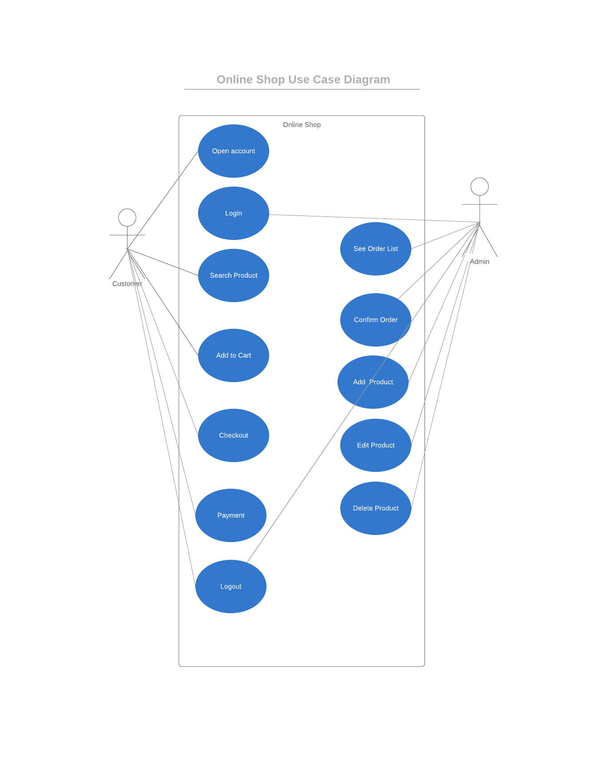
Application Features

Slide 10
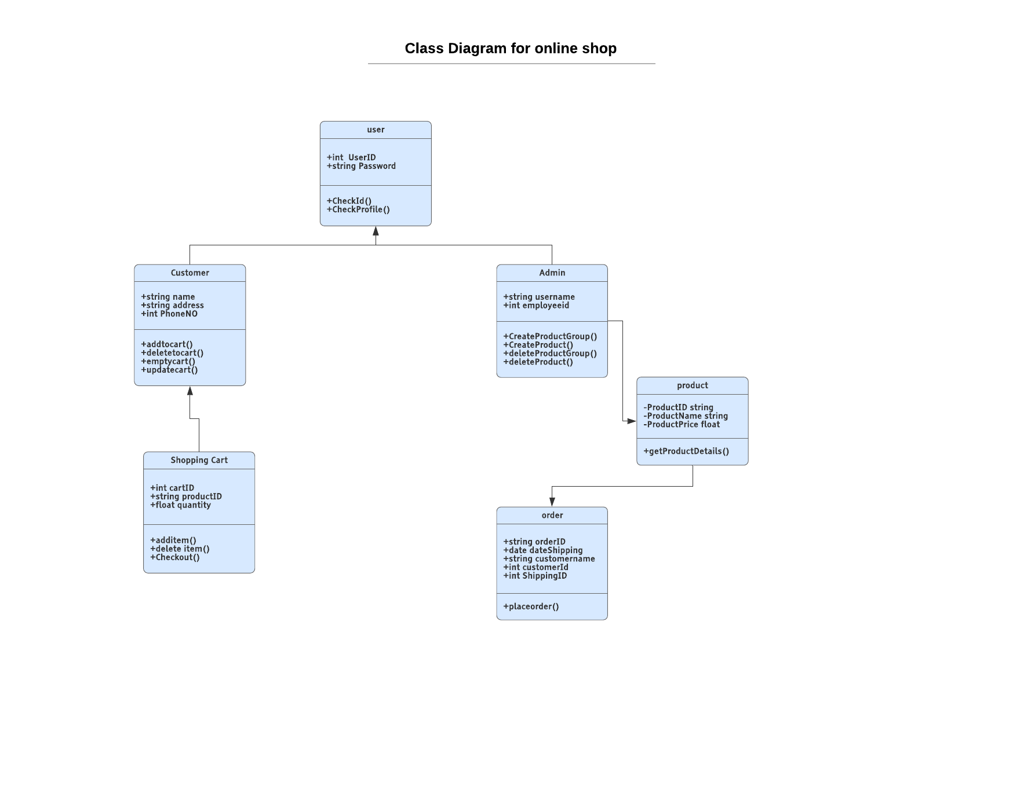
Application Features

Slide 11
Programming Languages
Front-end
Back-end
Application Features
Laravel
PHP
MYSQL
HTML
CSS
Bootstrap
Javascript
React

Slide 12
Gannt Chart (3 months Activities) | July |  |  |  | August |  |  |  | September
 | Week 01 | Week 02 | Week 03 | Week 04 | Week 01 | Week 02 | Week 03 | Week 04 | Week 01 | Week 02 | Week 03 | Week 04
Individual Presentation
Group Presentation
Planning & Design
Front End
Back End
Report
Final Presentation
individual
Everyone
Everyone
Asif and Nusrat
Shamim and Sourav
Everyone
Everyone
Everyone

