Slide 1
Stesheton 5
Interactive 3D surface

Slide 2
Created by:
Martin Datsev 11B
Telerik Arsov 11B

Slide 3
Use cases
Education
Mathematics
Long distance relationships
Play
Sorting items
Interactive table

Slide 4


1. How it works
Motors 5V Mini slider screw stepper motor 2-phase 4-wire
Driver Allegro’s A4988 DMOS Microstepping Driver
Arduino
Arduion mega
Software Scalable, customisable software

Slide 5
2. Advantages
In comparison to other products:
Scalable
Efficient
Cheap
Available
Open source
Hackable

Slide 6
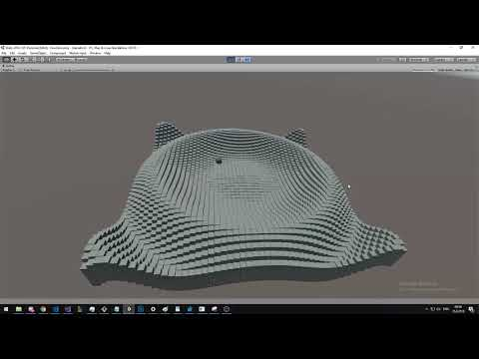
Demo.
Mathematical function:
sin(10(x² + y²) + t)

Slide 7
What people are saying
This app help me a lot with teaching!
Bladi LilTea CEO, CA
Pistons moving automatically feels like magic
Pe6o Hacker, NYC
Stesheton5 has inspired me to make my dreams come true
Antonion Driver, NYC
Quotes for illustration purposes only

Slide 8
Good luck!
We hope you’ll use this project in production!
You can see the source code at github.com/mdatsev/Stesheton5
For more about making your dreams come true, check out our github

