Slide 1

Time Series Forecasting
Matthew Davis, Data Science Manager
Ironside Boston, MA
This Photo by Unknown author is licensed under CC BY-ND.

Slide 2
Objectives
General Overview of time series forecasting
Introduction to ARIMA / SARIMA
Introduction to Prophet
Introduction to Temporal Fusion Transformers

Slide 3
What is Time Series Forecasting?
Supervised Statistical Technique to predict future values along a time sequence, or time series
Times Series Data: measurement of a continuous variable over-time (usually at regular time intervals)
Forecast Horizon: number of time periods ahead you plan to predict
Granularity Level: Time generally a time frequency (daily or monthly, etc…)
Seasonality: recurrent patterns that have a fixed period.
Exogenous Data: External Factors that are know to influence future values of the time sequence
Metrics: RMSE, R2_Score, Correlation, MAPE, Logloss
Overview of time series forecasting: https://medium.com/analytics-vidhya/time-series-forecasting-a-complete-guide-d963142da33f

Slide 4
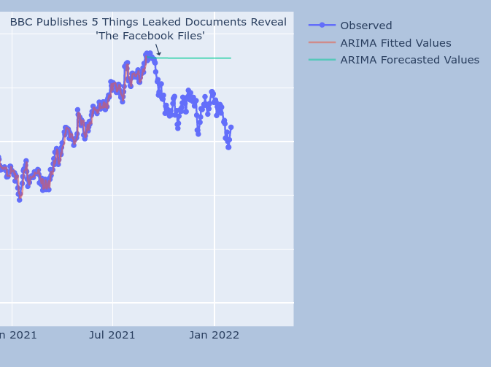
ARIMA / SARIMA
Time series forecasting involved carefully picking by hand 7 parameters:
p: The number of lag observations the model will use (ACF Plot)
d: The number of times that the raw observations are differenced. (stationarity)
q: The size of the moving average window. (PACF Plot)
For seasonal data we need to add also the following:
P: The number of seasonal lag observations the model will use
D: The number of times that the seasonal observations are differenced
Q: The size of the seasonal moving average window.
m: The number of observations of 1 season
Rules for picking parameters: https://people.duke.edu/~rnau/arimrule.htm
Source: https://predictivehacks.com/arima-model-in-python/

Slide 5
ISSUES with ARIMA / SARIMA
Difficult to automate, yes you can 'for loop' through it but nonsense can result
Doesn’t handle multiple seasonality well
Treats every time sequence individually
Doesn’t handle missing data, or irregular time intervals well
Needs refitting when new data is available
External regressors must be known for future prediction dates

Slide 6
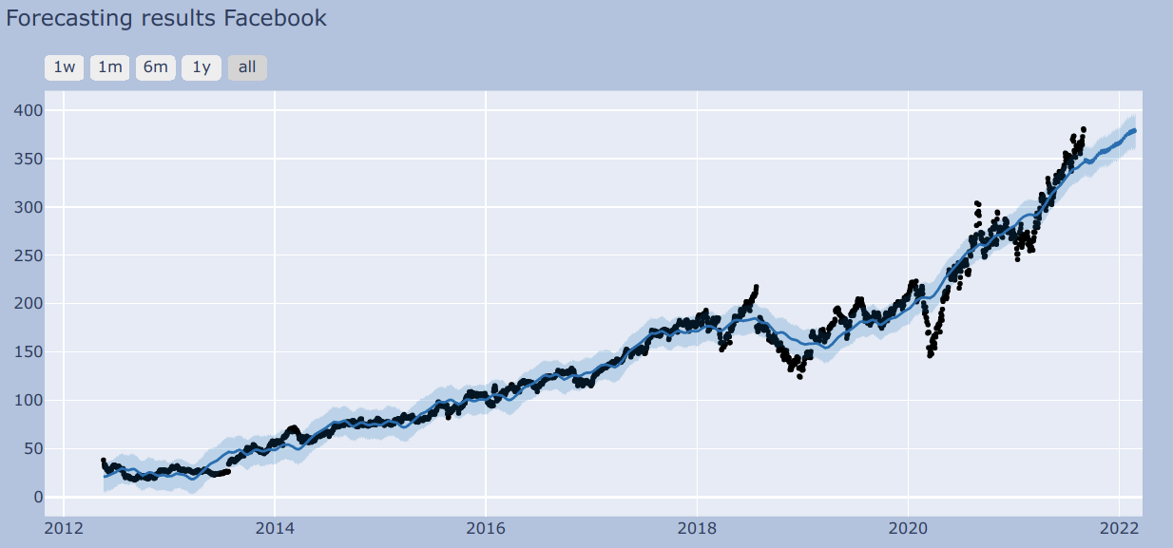
Prophet Forecasting tool
Develop by Facebook (Meta) for the purposes of automating individual time series forecasting
Handels natively holidays, and multi frequency data with daily/weekly/ monthly, seasonality
Has change point detection
Code: https://github.com/facebook/prophet
Original paper: https://peerj.com/preprints/3190.pdf

Slide 7
Issues with Prophet
Needs refitting when new data is available, but can warm start.
Very sensitive to change point parameters
External regressors must be known for future prediction dates
Sensitive to trend and seasonality controls

Slide 8
Temporal Fusion Transformers
Neural Network Approach, implemented in torch.
Handels multiple time series in a single model
Allows for meta data, as well as exogenous variables
Natively built in uncertainty in forecast method
Code https://pytorch-forecasting.readthedocs.io/en/stable/tutorials/stallion.html
Original paper: https://arxiv.org/pdf/1912.09363.pdf

Slide 9
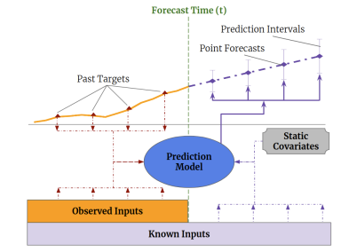
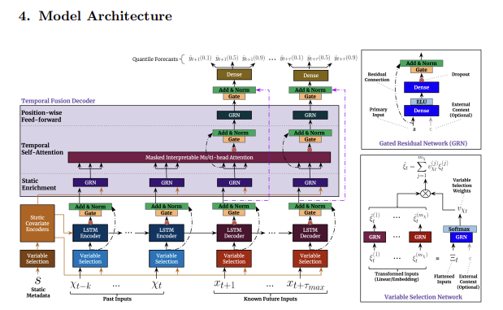
TFT Architecture
Source: https://arxiv.org/pdf/1912.09363.pdf

Slide 10
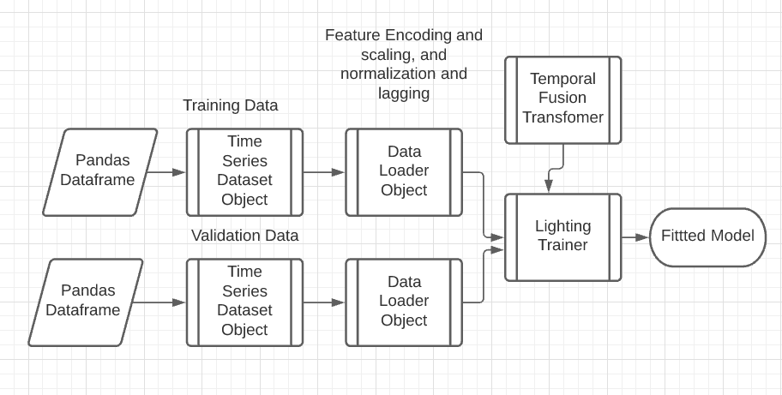
TFT Fitting
TFT leverage TimeSeriesDataset Objects to automatically lag, encode and normalized data.
TimeSeriesDataset Objects are used to create data loaders that back in data.
Pytorch lighting trainer trains the TFT model using data loaders as inputs

Slide 11
Issues with TFTs
Neural Net can easily give nonsense results
Not robust to outliers, sparsity
Large search required to optimize parameters

Slide 12
Questions?

