Slide 1
VISG Workshop
25 October 2012
Analysis of Copy Number Variation in NGS Data
Mik Black, Tony Merriman, Hoang Tan Nguyen
University of Otago

Slide 2
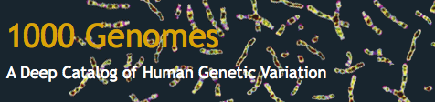
1,000 Genomes Project
http://www.1000genomes.org
International collaboration
Launched January 2008
Detailed catalogue of human variation
2,500 genomes
Funding
Wellcome Trust Sanger Institute
Beijing Genomics Institute
National Human Genome Research Institute

Slide 3
1000 genomes project
Pilot studies:
Low coverage: 180 samples @ 2-4x
High coverage: two trios @ 20-60x
Targeted: 1000 genes, 900 samples @ 50x
Main project data also available.
Data available online:
EBI: ftp://ftp.1000genomes.ebi.ac.uk/vol1/ftp/
NCBI: ftp://ftp-trace.ncbi.nih.gov/1000genomes/ftp/

Slide 4
1000 Genomes data
Data available:
fastq files: reads + quality scores
Aligned reads
Currently (as of 21/10/12):
sequence data available for 1998 individuals
alignment data available for 1587 individuals
Platforms: ABI (11%), Illumina (85%), Roche (4%)

Slide 5
Sequencing Centres (21 Oct 2012)
Centre Code | Centre | Samples (%)
454MSC | Roche | 0.2
ABI | Life Technologies | 2.9
BCM | Baylor College of Medicine | 10.6
BGI | BGI-Shenzhen | 6.8
BI | Broad Institute | 57.2
ILLUMINA | Illumina | 0.8
MPIMG | Max Planck Institute for Mol Genetics | 1.6
SC | The Sanger Institute | 13.4
WUGSC | Washington University in St Louis | 6.6

Slide 6
1000 Genomes Populations(21 Oct 2012)
Pop Code | Population | Samples
CHB | Han Chinese | 147
JPT | Japanese | 131
CHS | Southern Han Chinese | 100
CDX | Dai Chinese | 100
KHV | Kinh Vietnamese | 100
CHD | Denver Chinese | 123
CEU | CEPH (Utah) | 104
TSI | Tuscan (Italy) | 107
GBR | British (England & Scotland) | 103
FIN | Finnish | 100
IBS | Spanish (Iberian in Spain) | 100
YRI | Yoruba (Nigeria) | 141
LWK | Luhya (Kenya) | 121
GWD | Gambian
MSL | Mende (Sierra Leone)
ESN | Esan (Nigeria)
ASW | African-American SW | 62
ACB | African-Caribbean | 79
MXL | Mexican-American | 70
PUR | Puerto Rican | 70
CLM | Colombian | 70
PEL | Peruvian | 70
GIH | Gujarati (Indian in Houston) | 100
PJL | Punjabi
BEB | Bengali
STU | Sri Lankan
ITU | Indian

Slide 7
Reference Genome
Reads are aligned to reference genome:
Currently using GRCh37 (Genome Reference Consortium, human build 37)
Next version of NCBI Build 36 (hg18)
Need to know reference used for alignment when performing further analysis, using viewers, etc…

Slide 8
Alignment
1000 Genomes Project provides alignments based on:
MOSAIK, ssaha (454)
BWA (Illumina)
Corona Lite, bFast (SOLiD)
Alignment data stored in binary version (BAM) of Sequence Alignment Map (SAM) format.

Slide 9
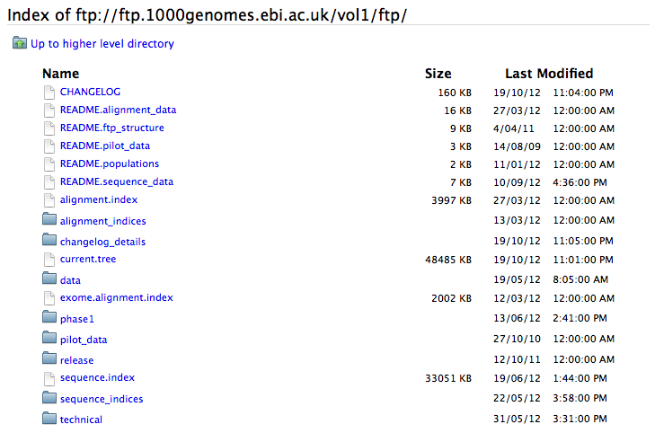
“Top” level of EBI ftp site:

Slide 10
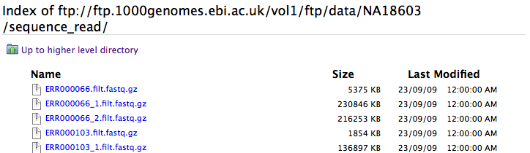
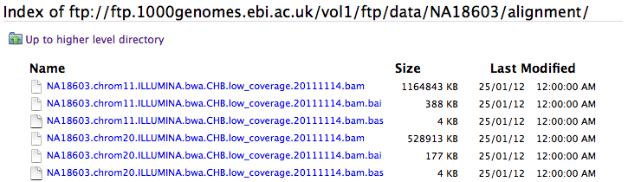
Sequence data (NA018603):
Alignment data (NA018603):

Slide 11
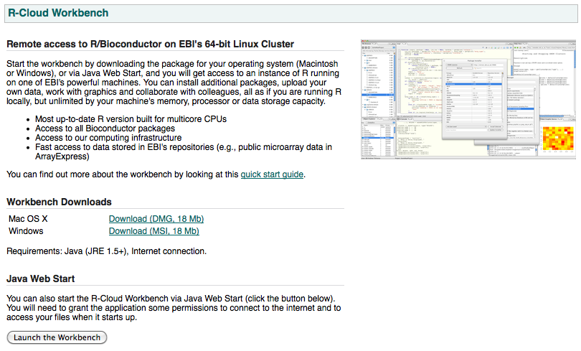
http://www.ebi.ac.uk/Tools/rcloud/

Slide 12
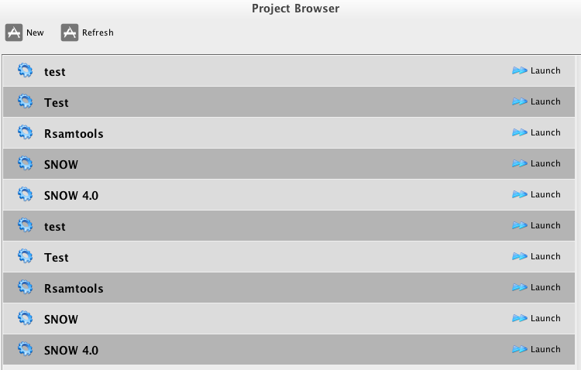
EBI R/Bioconductor workbench

Slide 13
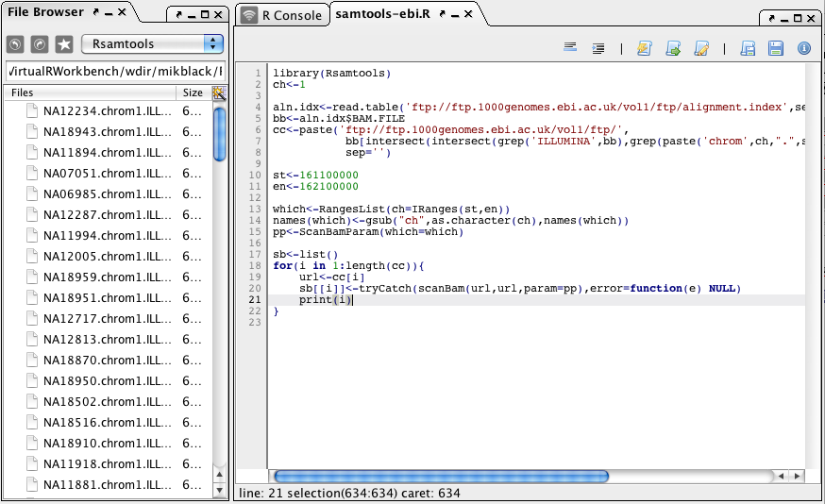
EBI R/Bioconductor workbench

Slide 14
Data from the 1000 genomes project
Suppose we are interested in a particular region of chromosome one (the FCGR locus).
Use SAMtools to extract data (or Rsamtools from within R), and then analyze in R.

Slide 15
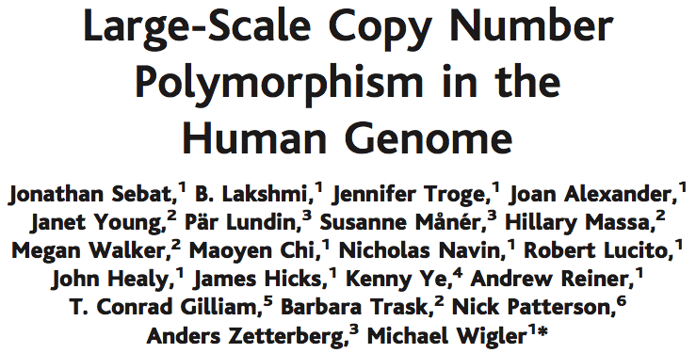
Large amounts of copy number variation in human genome.
Previous technologies able to determine copy number, but not necessarily identify breakpoints.

Slide 16

NGS and Copy Number
Next generation sequencing technologies have already been used to study CNV in the human genome.

Slide 17
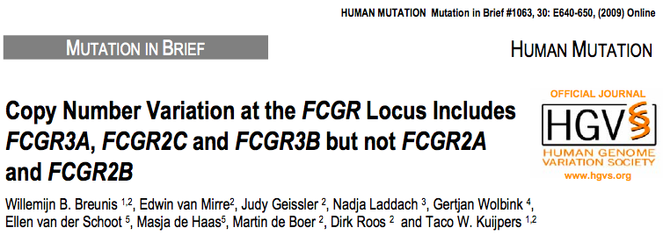
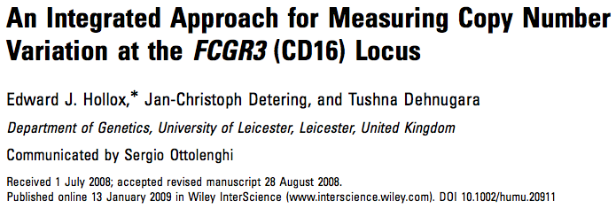
CNV at the FCGR locus

Slide 18
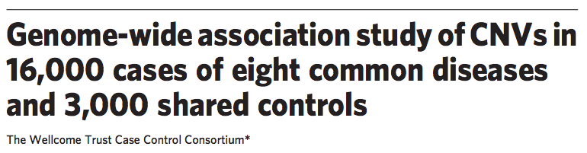
WTCCC publication:
“We conclude that common CNVs that can be typed on existing platforms are unlikely to contribute greatly to the genetic basis of common human diseases.”
Included FCGR3B locus…

Slide 19
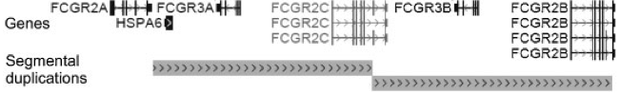
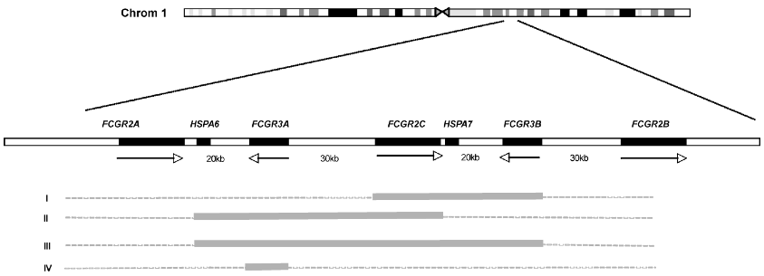
The FCGR Locus
Fig 1: Hollox et al. (2009) Human Mutation, 30(3): 477-484.
Fig. 2: Breunis et al. (2009) Human Mutation, 30(5): E640-650.

Slide 20
1000 Genomes data for FCGR: “pre-Hoang”
Alignments for 507 individuals used
SAMtools used to extract mapped reads for FCGR locus (1Mb) from BAM files.
Sliding window approach (1kb) used to generate counts across the region.
Copy number analysis
Standardization applied across samples.
Circular binary segmentation (DNAcopy).

Slide 21
1000 Genomes populations
Code | Population | Illumina Samples (July 2010)
ASW | African Ancestry in Southwest US | 24
CEU | Utah: Northern and Western European ancestry | 88
CHB | Han Chinese in Beijing, China | 61
CHS | Han Chinese South | 10
GBR | British from England and Scotland | 9
JPT | Japanese in Tokyo, Japan | 77
LWK | Luhya in Webuye, Kenya | 58
MXL | Mexican Ancestry in Los Angeles, CA | 11
TSI | Toscani in Italia | 94
YRI | Yoruba in Ibadan, Nigeria | 75

Slide 22
SAMtools to retrieve data
# Use samtools to download region from BAM file
samtools view –b ftp.1000genomes.ebi.ac.uk/vol1/ftp/data/NA18603/alignment/NA18603.mapped.ILLUMINA.bwa.CHB.low_coverage.20111114.bam 1:161,100,000-162,100,000 > NA18603.chrom1.ILLUMINA.bwa.CHB.low_coverage.fcgr.bam
# Index the BAM file
samtools index NA18603.chrom1.ILLUMINA.bwa.CHB.low_coverage.fcgr.bam

Slide 23
Rsamtools to retrieve data
# specify URL for BAM file
url<-'ftp://ftp.1000genomes.ebi.ac.uk/vol1/ftp/data/NA18603/alignment/NA18603.mapped.ILLUMINA.bwa.CHB.low_coverage.20111114.bam’
# specify chromosome and position of interest
ch<-1
st<-161100000
en<-162100000
# use Rsamtools to retrieve data
library(Rsamtools)
which<-RangesList(ch=IRanges(st,en))
names(which)<-gsub("ch",as.character(ch),names(which))
pp<-ScanBamParam(which=which)
sb<-scanBam(url,url,param=pp)

Slide 24
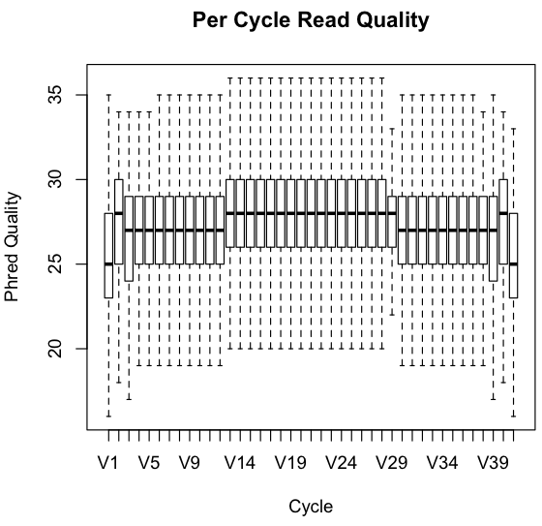
Plot phred scores
# Extract quality scores
qual<-FastqQuality(sb[[1]]$qual)
# PROBLEM – can’t deal with ragged
# array (variable length reads):
# Extract subset of equal length
# reads (kludge).
qualx<-qual[width(qual)==min(width(qual))]
# convert scores to matrix
readM <- as(qualx, "matrix")
# Create boxplot for each column
boxplot(as.data.frame((readM)), outline = FALSE, main="Per Cycle Read Quality", xlab="Cycle", ylab="Phred Quality”)

Slide 25
Count reads in 1000 base “bins”
# walk across region in 1000 base steps
# count number of reads with start position in each
# interval.
cnt<-c()
for(i in 1:1000){
cnt[i]<-sum(sb[[1]]$pos>(st+1000*(i-1)+1) & sb[[1]]$pos<=(st+1000*i),na.rm=T)
}
# Number of reads in first 10 intervals (bins)
> cnt[1:10]
[1] 84 98 55 63 73 79 81 70 67 72

Slide 26
Plot read counts across region
# specify gene positions
genes<-data.frame(fcgr3b=c(161592990,161601158), fcgr2b=c(161632940,161647951), fcgr2c=c(161551129,161570031), fcgr2a =c(161475205,161489359),fcgr3a=c(161511553,161520413))
# set up plot (blank plot – colour set to ‘white’)
plot(seq(st,en,l=1000),cnt,type='l',col='white', xlab='Chromosome 1 Position (HG19/GRCh37 assembly)',ylab='Read Count')
# add gene positions and names to plot
yl<-c(25,355)
for(k in 1:ncol(genes)) rect(genes[1,k],yl[1],genes[2,k],yl[2],col=gray(0.8),border=NA)
for(k in 1:ncol(genes)) text(mean(genes[,k]),0.9*yl[2],gsub("fcgr","",names(genes)[k]),cex=0.75)
# add count data on top of other plot objects
lines(seq(st,en,l=1000),cnt,type='l')

Slide 27
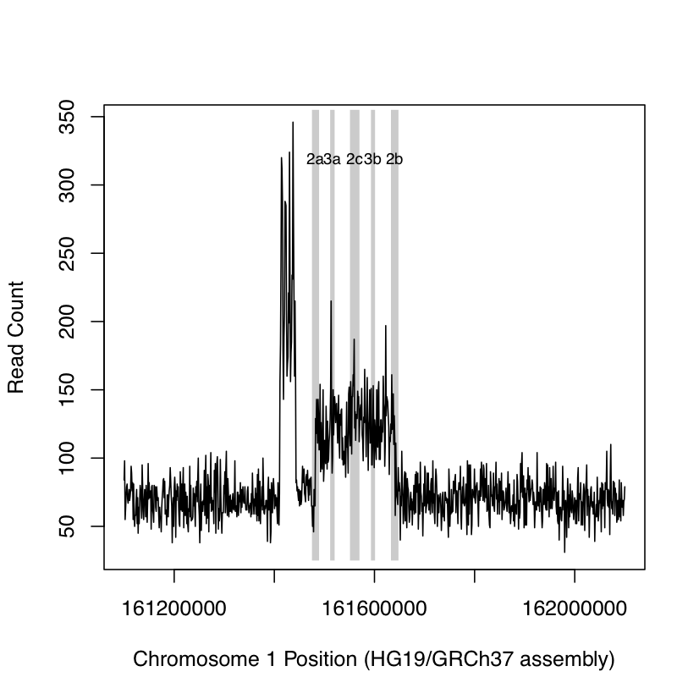
Read counts: sample NA18603

Slide 28
Using DNAcopy to detect CNV
Methodology for detecting change points in DNA “abundance” across the genome.
Able to detect copy number variation (CNV) at a particular locus – loss or gain of DNA relative to “ploidy” level of genome (humans are diploid, so ploidy level is “2”).
Design for use with microarray-based studies, but can also be used with NGS data.

Slide 29
Using DNAcopy to detect CNV
# load library and standardize counts
library(DNAcopy)
cnt.std<-(cnt-median(cnt))/sd(cnt)
# create “CNA” object for use with DNAcopy
cna.obj<-CNA(cnt.std,chrom=rep(1,length(cnt.std)),seq(st,en,l=length(cnt.std)),data.type="logratio",sampleid=‘NA18603')
# perform segmentation analysis & extract output
cna.seg<-segment(cna.obj)
cna.out<-cna.seg$output
# Filter object to capture “substantial” deviations (>1 SD)
filt.cna.out<-cna.out[abs(cna.out$seg.mean)>1,]

Slide 30
Using DNAcopy to detect CNV
> cna.out
ID chrom loc.start loc.end num.mark seg.mean
1 NA18603 1 161100000 161410310 311 -0.1306
2 NA18603 1 161411311 161442342 32 4.0390
3 NA18603 1 161443343 161473373 31 0.1256
4 NA18603 1 161474374 161481381 8 -0.3234
5 NA18603 1 161482382 161640541 159 1.3764
6 NA18603 1 161641542 162100000 459 -0.0987
> filt.cna.out
ID chrom loc.start loc.end num.mark seg.mean
2 NA18603 1 161411311 161442342 32 4.0390
5 NA18603 1 161482382 161640541 159 1.3764

Slide 31
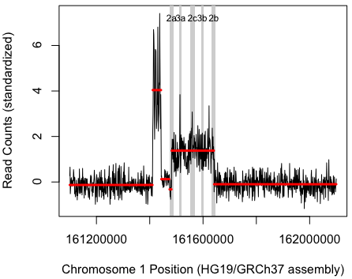
Unfiltered DNAcopy results
for(i in 1:nrow(cna.out))
lines(cna.out[i,3:4],rep(cna.out[i,6],2),col='red',lwd=3)

Slide 32
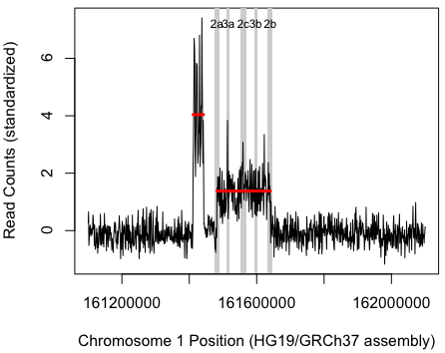
Filtered DNAcopy results
for(i in 1:nrow(filt.cna.out))
lines(filt.cna.out[i,3:4],rep(filt.cna.out[i,6],2),col='red',lwd=3)

Slide 33
More samples…
This process has been undertaken for 507 (Illumina) samples from the 1000 Genomes Project.
Additional step of standardizing across samples at each base (gets around issues with repetitive regions of DNA).

Slide 34
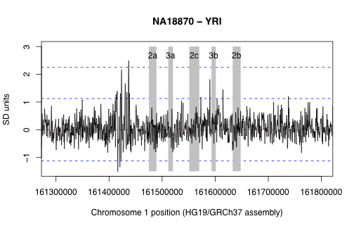
FCGR region: no CNV

Slide 35
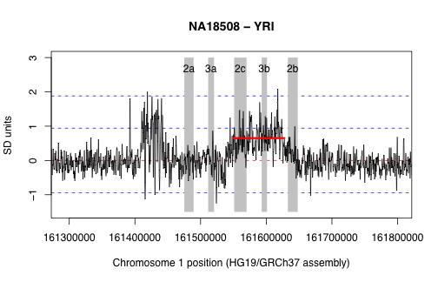
FCGR copy number gain

Slide 36
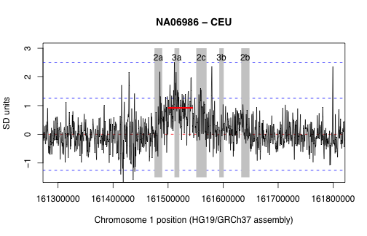
FCGR copy number gain

Slide 37
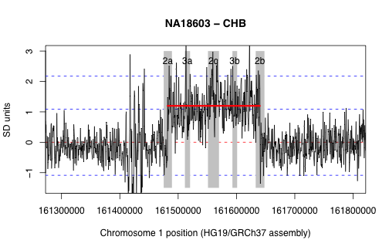
FCGR copy number gain

Slide 38
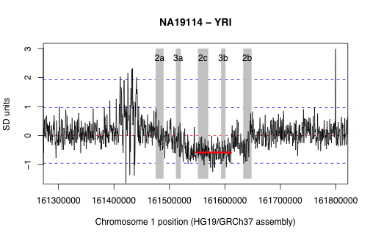
FCGR copy number loss

Slide 39
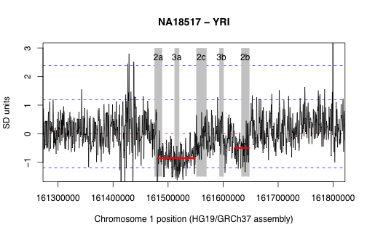
FCGR copy number loss

Slide 40
Can we find SNPs that tag a CNV?
If SNP (single nucleotide polymorphism) found within the CNV region, could get “perfect” tag.
Allele frequencies would be “non-standard” – unlikely to be in existing databases.
Need to do novel variant detection, with relaxed parameters.

Slide 41
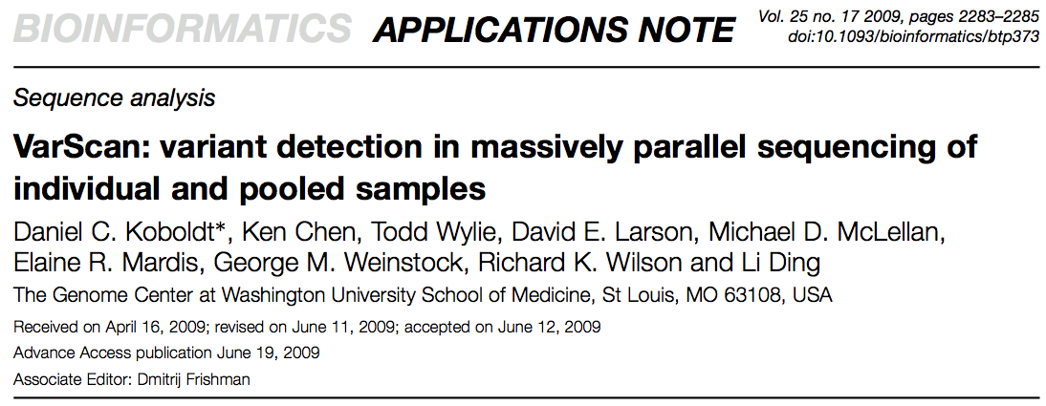
VarScan used to identify potential SNPs in each sample.
SNP genotypes examined across samples, in conjunction with CNV calls.

Slide 42
Top hit (all populations)
SNP Genotype | No CNV | CNV
AA | 1 | 0
CA | 4 | 13
CC | 422 | 67
For heterozygote:
C:A read ratio was 120:80 = 3:2

Slide 43
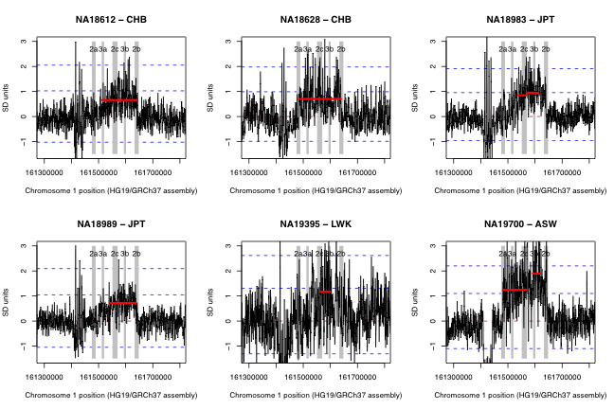

Slide 44
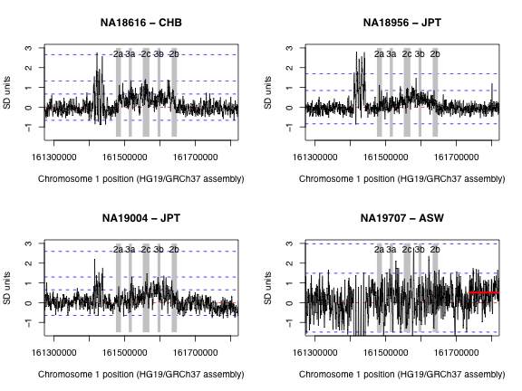

Slide 45
Summary of early work
Proof of principle
Can identify CNV in low coverage samples.
80/507 samples with CNV detected
Breakpoints & tagging SNPs
No success (yet) with breakpoint detection
SNPs able to tag some CNVs

Slide 46
Next steps – improving the process
CNVrd (Copy Number Variation read depth) package developed by Hoang.
Package can be used to:
Measure copy-number counts of genes.
Find tagSNPs for duplication or deletion of genes.

