Slide 1
VISG Workshop
25 October 2012 Genome-wide expression analysis
Part III: analysis of gene expression data in R/Bioconductor
Mik Black, University of Otago
Marcus Davy, Plant and Food Research

Slide 2
Bioconductor project
Open source software project for the analysis and comprehension
of high-throughput genomic data
Packages written in R Primarily for Microarray and Sequence data
Started in 2001 by
Robert Gentleman et al
Bioconductor: Open software development for computational biology
and bioinformatics R. Gentleman, V. J. Carey, D. M. Bates, B.Bolstad, M.
Dettling, S. Dudoit, B. Ellis, L. Gautier, Y. Ge, and others 2004,
Genome Biology, Vol. 5, R80.

Slide 3

Bioconductor goals
The broad goals of the project are to:
Enable sound and powerful statistical analyses in genomics
Provide a computing platform that allows the rapid design and deployment of high-quality software
Develop a computing environment for both biologists and statisticians
Promote high-quality dynamic documentation and reproducible research (pdf’s and vignettes)

Slide 4
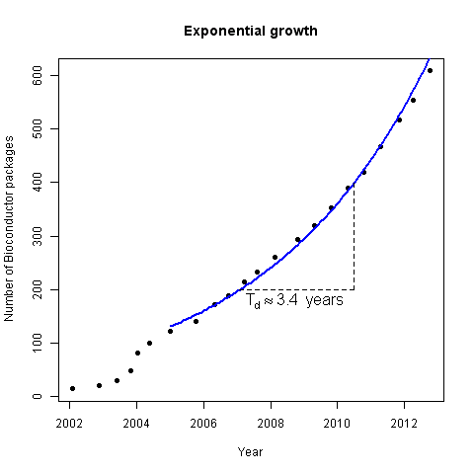
Project growth
Number of contributed packages each bi-annual software release
Bioconductor mailing list statistics
http://www.bioconductor.org/about/annual-reports/AnnRep2012.pdf

Slide 5
Journal Citations
Pubmed searches for Bioconductor 2003-2011
Google Scholar citations for Bioconductor packages
http://www.bioconductor.org/about/annual-reports/AnnRep2012.pdf

Slide 6
Installing Bioconductor
Installing packages on the R terminal using http://
## Set the repository
options(repos="http://cran.stat.auckland.ac.nz")
## Download biocLite() from the internet
source("http://bioconductor.org/biocLite.R")
## Install core packages
biocLite()
## Install a specific package
biocLite("limma")
## Install several packages
biocLite(c("GenomicFeatures", "AnnotationDbi"))
Using biocLite() auto magically resolves packages and their dependences from both Bioconductor and CRAN

Slide 7
Installing Bioconductor...
Automatically install a package if it cannot be loaded on a machine
## Package ‘getopt’ is in CRAN, ‘limma’ is in Bioconductor
packages <- c("getopt","limma")
## Load or install and load required packages
for (pck in packages){
if (suppressPackageStartupMessages(!require(pck,character.only=TRUE)) ){
## Install biocLite the first time only
if(.Platform$OS.type == "windows") setInternet2(TRUE)
if(match(pck, packages) == 1) source("http://www.bioconductor.org/biocLite.R")
biocLite(pck, suppressUpdates = TRUE)
suppressPackageStartupMessages(require(pck,character.only=TRUE))
}
}

Slide 8

Getting help using Bioconductor
Vignette documentation
## List of help documentation
vignette()
Mailing lists
http://www.bioconductor.org/help/mailing-list/
Workshop course material from many previous events
http://www.bioconductor.org/help/course-materials/
HT Sequence Analysis with R and Bioconductor
http://manuals.bioinformatics.ucr.edu/home/ht-seq

Slide 9
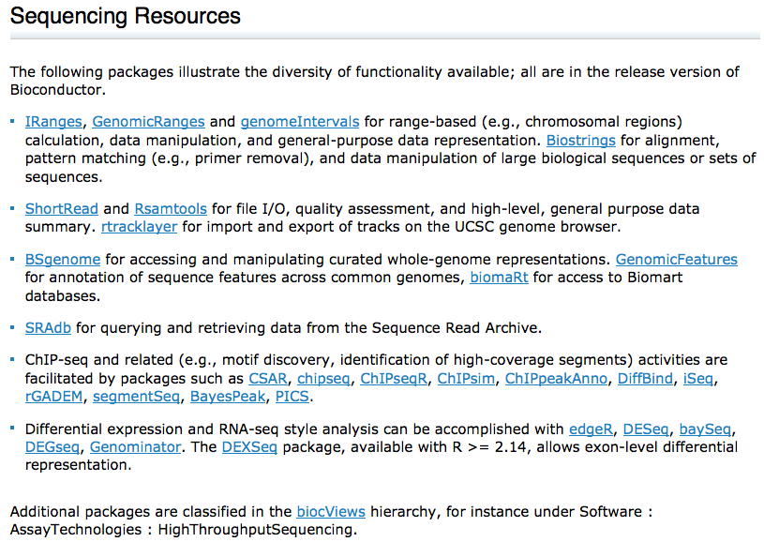
http://bioconductor.org/help/workflows/high-throughput-sequencing/

Slide 10
Affymetrix microarray data
• Output is stored in “.CEL” files,.
• Bioconductor packages exist specifically to deal with Affymetrix data.
• We’ll focus on the Affy package (some additional Bioconductor packages are also required: Biobase and reposTools).

Slide 11
Data normalization
Various normalization options exist for Affymetrix arrays.
Each of the various approaches to normalization takes the probe set for each gene and attempts to return an intensity value relating to that gene’s expression level.
Once the data has been normalized, the limma package can be used to analyse the data.

Slide 12
Benchmarking
A website has been set up to benchmark the various normalization methods (affycomp.biostat.jhsph.edu), along with a Bioconductor package which provides similar functionality (affycomp).
The benchmark is based on a set of “spike-in” experiments, and assesses each normalization method’s ability to correctly identify the fold-changes for the spiked genes.
The various RMA-based normalization approaches tend to work best (although there are some caveats...)

Slide 13
RMA normalization
Consists of three steps:
Background adjustment (optional)
Quantile normalization
Per gene summaries
For arrays with PM-MM probe pairs, there is still an argument for not performing background correction.
Benchmarks suggest that RMA performs better when no background correction is applied.

Slide 14
Normalization with affy
library(affy)
ff<-readLines("files.txt")
Data<-ReadAffy(filenames=ff)
eset<-rma(Data)
.CEL” files are read in using the ReadAffy command.
This produces an object containing a gp × a matrix, where g is the number of genes, p is the size of each probe set, and a is the number of arrays.
RMA normalization is performed using the rma command, which produces an object containing a g × a matrix, with one intensity per gene per array.
The matrices listed above is located within the “exprs” slot of each object (see below for details).

Slide 15
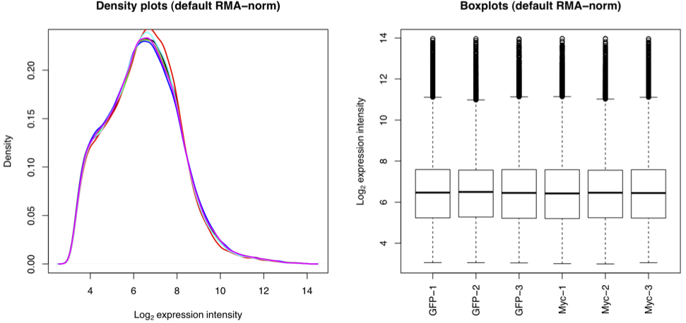
Post RMA normalization plots
par(mfrow=c(1,2))
plot(density(mat.rma[,1]),main="Density plots (default RMA-
norm)",xlab=expression(Log[2]~expression~intensity),lwd=2)
for(i in 2:6) lines(density(mat.rma[,i]),col=i,lwd=2)
boxplot(mat.rma~col(mat.rma),las=3,names=sn,ylab=expression(Log[2] ~expression~intensity),main="Boxplots (default RMA-norm)")

Slide 16
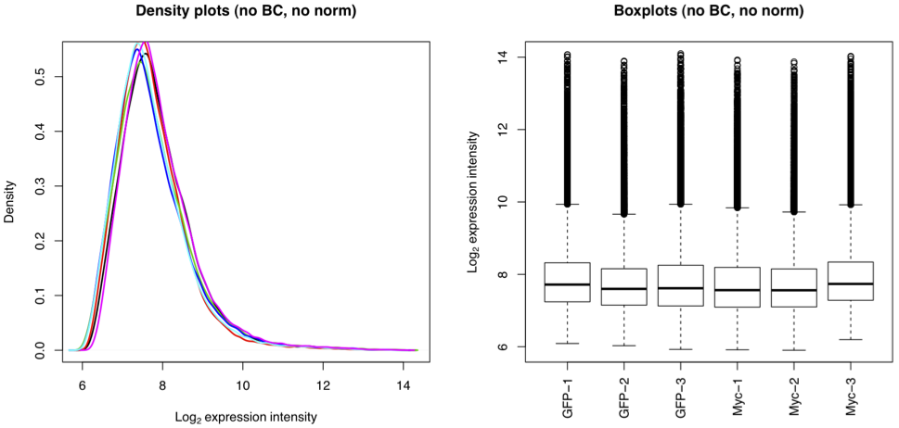
Same data without normalization or background correction

Slide 17
Limma - Linear Models for Microarrays
The Limma package is available as part of Bioconductor.
Developed by Gordon Smyth and colleagues at the Walter and Eliza Hall Institute in Melbourne: http://bioinf.wehi.edu.au/limma/
Provides tools for spotted array and RNA-seq normalization, and for applying linear models to microarray and RNA-seq data for detecting differentially expressed genes.

Slide 18
Analysis with limma
Once the Affymetrix data has been normalized, limma can be used to detect genes undergoing differential expression.
Working on the log scale with two groups, we are simply interested in the difference between two means for each gene.

Slide 19
Without limma: two sample t-test
Read in Affymetrix data for cell line experiment (normal cells versus cells overexpressing Myc gene)
ff<-readLines(’files-all.txt’)
sn<-unlist(lapply(strsplit(ff,"_"),function(x) x[4]))
library(affy)
dat<-ReadAffy(filenames=ff,sampleNames=sn)
• Normalize via RMA:
dat.rma<-rma(dat)
mat.rma<-exprs(dat.rma)
mat.rma is a matrix of data (54675 rows by 20 columns) - 54675 probes and 20 arrays (10 GFP, 10 Myc).

Slide 20
Without limma: two sample t-test
The function t.test performs a two sample t-test in R.
Perform t-test on first gene in data set (first row of matrix:first ten values are GFP, second ten are Myc):
group<-rep(c("GFP","Myc"),c(10,10))
t.test(mat.rma[1,]~group)
Welch Two Sample t-test
data: mat.rma[1, ] by group
t = 4.5776, df = 17.992, p-value = 0.0002337
alternative hypothesis: true difference in means is not equal to 0
95 percent confidence interval:0.1407471 0.3795475
Sample estimates:
mean in group GFP mean in group Myc
11.40666 11.14652

Slide 21
Without limma: two sample t-test
Very first gene on array (Probe ID: 1007_s_at) appears to be highly differentially expressed between the two cell lines:
t.test(mat.rma[1,]~group)$p.value
0.0002337217
How big is the change?
2^(11.41-11.15)1.197479
Expression is 20% lower in cells overexpressing Myc.

Slide 22
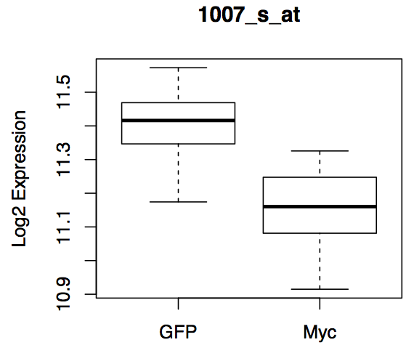
Without limma: two sample t-test
Examine expression graphically using a boxplot:
boxplot(mat.rma[1,]~group,main=rownames(mat.rma)[1],ylab=’Log2 Expression’)

Slide 23
Multiple t-tests for array data
P-values for multiple genes (first 10):
pvalues<-c()
for(i in 1:10) pvalues[i]<-t.test(mat.rma[i,]~group)$p.value
sort(round(pvalues,4))
0.0000 0.0002 0.0020 0.0178 0.1682
0.2480 0.2777 0.2965 0.4191 0.6515
Use p.adjust to apply correction (default is Holm: FWER)
round(p.adjust(sort(pvalues)),4)
0.0000 0.0021 0.0158 0.1249 1.0000
1.0000 1.0000 1.0000 1.0000 1.0000
round(p.adjust(sort(pvalues),"BH"),4)
# BH is FDR method
0.0000 0.0012 0.0066 0.0446 0.3365
0.3706 0.3706 0.3706 0.4657 0.6515

Slide 24
Detecting differential expression with limma
The limma package takes a linear models approach to detecting genes which have undergone differential expression.
After the data have been normalized, a linear model is fit to the expression values to determine which genes underwent significant changes.
Although a standard t statistic can be used to assess differential expression, limma goes a little bit further...

Slide 25
Empirical Bayes analysis
Limma uses Empirical Bayes methods to produce a modified test statistic.
The goal is to modify the denominator of a standard t test statistic, by making large standard errors smaller, and small standard errors larger.
This is known as shrinkage estimation.

Slide 26
Shrinkage estimation
The underlying assumption is that the gene-specific variances follow a standard distribution (e.g., a gamma distribution) with some fixed parameters.
This provides us which information about the underlying spread of the gene-specific variances.
When we see extreme values from this distribution, we would like to moderate them, so that they don’t have a major effect on our results (i.e., want to make large standard errors smaller, and small standard errors larger).

Slide 27
Shrinkage estimation
To accomplish this, a weighted variance is calculated, based on the observed gene-specific variance, and the characteristics of the underlying distribution.
This has the effect of pulling the extreme value towards the centre of the observed (empirical) distribution of gene-specific variances.

Slide 28
Why is it empirical Bayes?
The procedure is considered Bayesian because by assuming an underlying distribution, we are effectively adding a priori knowledge to our problem by imposing a prior distribution on the gene-specific variances.
This particular approach is empirical Bayes because it uses the data from the empirical (observed) distribution of gene-specific variances to estimate the parameters of the prior distribution.

Slide 29
Back to limma
Once limma has fit a linear model to the normalized data (using lmFit), a second function (eBayes) is used to calculate moderated t-statistics based on shrunken estimates of the per-gene variances.
The moderated t-statistics can be quite different than the standard t-statistics, especially for small sample sizes.
In general, the moderated t-statistics make it more likely that significant genes will have a large fold change, and a small variance, rather than a small fold-change and a tiny variance.

Slide 30
Determining differential expression
Limma also reports the log odds of differential expression.
This quantity has a more Bayesian “feel” to it, providing a measure of how likely it is for a gene to have undergone differential expression, relative to the null hypothesis of no differential expression.
Genes with high (positive) log odds are considered likely to have undergone differential expression.

Slide 31
Limma: detecting differential expression
Fit linear model:
design <- model.matrix(~group)
colnames(design) <- c("GFP","MYCvsGFP")
fit <- lmFit(mat.rma, design)
fit <- eBayes(fit)
tt<-topTable(fit, coef="MYCvsGFP", adjust="BH",n=nrow(mat.rma))
tt[1:5,]
ID logFC AveExpr t P.Value adj.P.Val B
202431_s_at 3.228 11.402 53.600 3.958165e-26 2.164127e-21 40.076
1555339_at -7.261 10.072 -33.491 2.222291e-21 6.075187e-17 34.660
213418_at 3.280 7.297 31.927 6.702150e-21 1.221467e-16 33.968
1555340_x_at -8.316 9.668 -30.486 1.939587e-20 2.651173e-16 33.279
117_at 1.463 7.395 24.754 2.272477e-18 2.484953e-14 29.913
sum(tt$adj.P.Val<0.05) # Count number of significant genes
7282
7282 “genes” found to be differentially expressed using default FDR criterion.

Slide 32
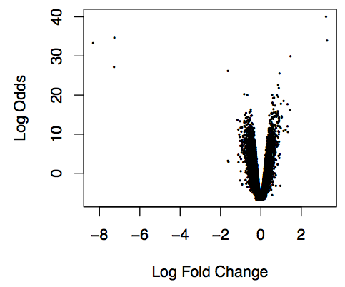
Volcano Plot
Plot log fold-change versus Lod odds (i.e., likelihood of differential expression:
volcanoplot(fit, coef="MYCvsGFP")

Slide 33
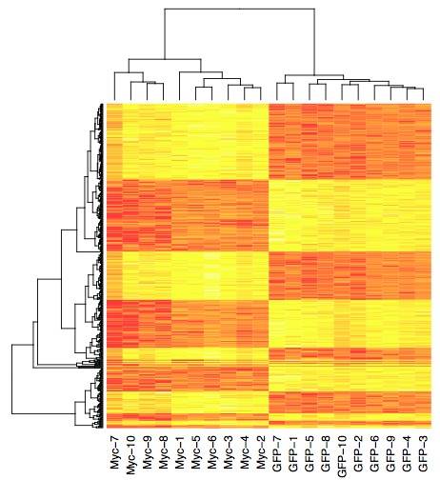
Heatmap
Choose top 500 genes:
top500.dat<-mat.rma[match(tt$ID[1:500],rownames(mat.rma)),]
Generate a heatmap (with clustering) for these genes:
heatmap(top500.dat,labRow=’’)

Slide 34
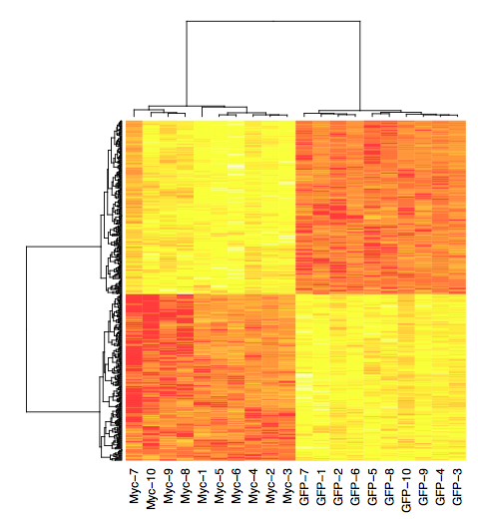
Heatmap
Switch to correlation distance:
heatmap(top500.dat,distfun=function(x)
as.dist(1-cor (t(x))), labRow=’’)

Slide 35
Useful statistical tools for data analysis
There are a number of standard statistical techniques that are frequently used in the analysis of data in microarray studies.
This includes data derived from both the microarrays themselves, and also the clinicopathological data that describes patients and tumours.
We’re not going to cover the theory behind these methods, instead we’ll look at how they are applied in a microarray setting.

Slide 36
Breast cancer data
We’ll use a publicly available breast cancer data set (Pawitan et al, 2005) to illustrate some of these techniques.
159 women
Clinicopathological and Affymetrix microarray data for each woman and primary tumour
Want to investigate the relationship between variables we can measure at the time of diagnosis/surgery, and time to cancer recurrence.

Slide 37
Statistical methods
Contingency tables.
Survival analysis.
Unsupervised clustering (hierarchical and k-means clustering).

Slide 38
Clinicopathological data
Variable names:
names (clin)
[1] "LN.status" "ER.status" "Grade" "Proliferation"
[5] "Subtype" "Rec.event" "Rec.time”
Summarize a categorical variable (e.g., tumour grade):
G1 G2 G3
28 58 61
attach(clin)
table(Grade)

Slide 39
Contingency tables
Summarize relationship between two variables:
prop.table(table(Grade,Rec.event),1)
Rec.event
Grade 0 1
G1 0.9286 0.0714
G2 0.7586 0.2414
G3 0.6393 0.3607
Test for independence
fisher.test(table(Grade,Rec.event))
Fisher's Exact Test for Count Data
data: table(Grade, Rec.event)
p-value = 0.01142
alternative hypothesis: two.sided

Slide 40
Estrogen receptor status
Estrogen receptors can promote cell proliferation
Overexpressed in 70% of breast tumours.
ER+ tumours can be targeted with anti-estrogen therapy (e.g., tamoxifen).
Such therapies are less effective on ER− tumours.
ER− tumours often associated with poor outcome:
table(ER.status,Rec.event)
Rec.event
ER.status 0 1
ER+ 101 29
ER- 18 11
although there are many interacting factors that need to be considered.

Slide 41
Survival analysis
What if we aren’t just interested in whether the cancer recurs or not, but how long it takes to return?
Now dealing with a continuous variable (time from diagnosis until event) and an event that only occurs in some patients.
Survival analysis allows the analysis of such “time to event” data, in the presence of “censoring”this reflects that a patient may relapse after the time at which they were last observed.
e.g., a patient may still have been disease free at the end of the study (say, after 10 years), but their disease status is unknown (i.e., “censored”) after that time.

Slide 42
Survival analysis
Survival analysis is a huge area of statistics, and we are not going to cover it in detail here.
The survival package (part of base R) provides functions for performing various types of survival analyses in R.
First step is to create a survival object using the event and time-to-event variables:
library(survival)
Surv(Rec.time,Rec.event)
[1] 8.48+ 5.55+ 5.75+ 4.51+ 1.26 2.79 8.40+ 8.32+ 6.13+...
“+” signs indicate censored data - here patients who were still disease free at the last follow up time (in years).

Slide 43
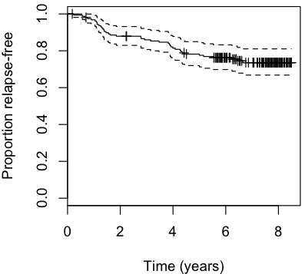
Computing survival curves: survfit
The survfit can to used to compute survival curves based on various estimation methods - most common method is the Kaplan-Meier approach (default option for survfit).
plot(survfit(Surv(Rec.time,Rec.event) ~ 1), xlab="Time (years)",ylab="Proportion relapse-free”)

Slide 44
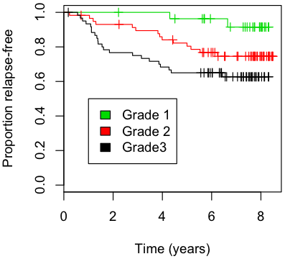
Survival curves - multiple groups
The survfit function can also produce curves to represent the survival characteristics associated with different groups.
plot(survfit(Surv(Rec.time,Rec.event) ~ Grade), xlab="Time (years)",ylab="Proportion relapse-free", col=3:1)
legend(1,0.5,fill=3:1,c("Grade 1","Grade 2","Grade3"))

Slide 45
Multiple survival curves - testing for differences
The survdiff function allows you to test for differences across multiple curves (like ANOVA, test is “at least one is different”):
survdiff(Surv(Rec.time,Rec.event) ~ Grade)
Call:
survdiff(formula = Surv(Rec.time, Rec.event) ~ Grade)
n=147, 12 observations deleted due to missingness.
N Observed Expected (O-E)^2/E (O-E)^2/V
Grade=G1 28 2 8.31 4.789 6.141
Grade=G2 58 14 15.44 0.135 0.228
Grade=G3 61 22 14.25 4.218 6.765
Chisq= 9.2 on 2 degrees of freedom, p= 0.0102
This is most often referred to as the logrank test, or sometimes the Mantel-Cox test.

Slide 46
Microarray data
The same statistical techniques can be used in conjunction with microarray data.
A simple example involves splitting samples into two groups, based on low (below median) or high (above median) expression levels of a single gene:

Slide 47
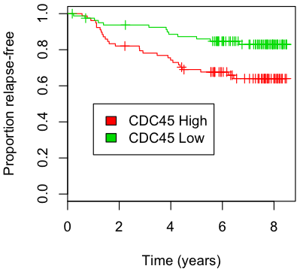
Survival plot – single gene
cdc45<-as.numeric(bc[match('204126_s_at',rownames(bc)),])
cdc45.hilo<-ifelse(cdc45>median(cdc45),"hi","lo")
plot(survfit(Surv(Rec.time,Rec.event) ~ cdc45.hilo),xlab="Time (years)",ylab="Proportion relapse-free", col=2:3)
legend(1,0.5,fill=2:3,c("CDC45 High","CDC45 Low"))

Slide 48
Heatmap

Slide 49
Dendrogram (tree diagram) of samples
The dendrogram provides a graphical representation of the distances between the samples.

Slide 50
Splitting the dendrogram
The cutree command can be used to split samples into n groups, based on the branching order of the dendrogram.
Here the first split creates two major groups.
Can investigate the survival characteristics of these groups.

Slide 51
Other non-supervised clustering: k-means
k-means clustering splits samples into k groups based on minimizing and maximizing within and between group distances.
Important to remember that the k-means algorithm uses randomized starting centroids, so can produce different answers across multiple runs.

Slide 52
R for RNA-seq data
A number of Bioconductor packages are available for analysing RNA-seq data:
Limma/edgeR
DESeq
baySeq
DEXSeq
DEGseq
We’ll look at “two” here: limma/edgeR and DESeq.

Slide 53
Limma/edgeR
Once data have been suitably normalized, the linear models component of limma can be used to detect differentially expressed genes.
The edgeR package provides the necessary normalization machinery.

Slide 54
Yeast data: limma/edgeR
# Load data and define groups
Counts<-read.csv('yeast-counts-allchroms.csv',row.names=1)
GType<-rep(c("WT","MT"),c(3,3))
# Check all genes have a count of at least one
min(apply(yeast,1,sum))
# Load limma and edgeR packages and perform normalization
library(limma)
library(edgeR)
nf <- calcNormFactors(Counts)
design <- model.matrix(~GType)
y <- voom(Counts,design,plot=TRUE,lib.size=colSums(Counts)*nf)

Slide 55
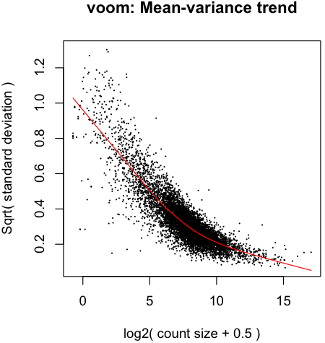
Voom plot ☺

Slide 56
Yeast data: limma/edgeR
# Fit linear model and produce table of ranked genes
fit <- lmFit(y,design)
fit <- eBayes(fit)
options(digits=3)
topTable(fit,coef=2,n=16)#[,-c(3,5,6,7,8)]
tt<-topTable(fit,coef=2,n=nrow(Counts),adjust.method='bonferroni')
# Count number of FDR significant genes
sum(tt$adj.P.Val<0.05)
4184

Slide 57
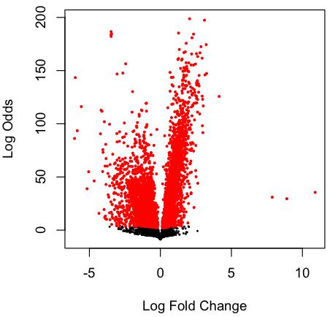
Volcano Plot
# Make volcano plot and mark significant genes
volcanoplot(fit,coef=2)
sig<-tt$adj.P.Val<0.05
points(tt$logFC[sig],tt$B[sig],pch=20,col='red',cex=0.5)

Slide 58
Yeast data: DESeq
library(DESeq)
cds <- newCountDataSet( Counts, GType )
cds <- estimateSizeFactors( cds )
sizeFactors( cds )
WT1 WT2 WT3 MT1 MT2 MT3
0.851 0.861 0.981 1.124 1.111 1.137
cds <- estimateDispersions( cds )
res <- nbinomTest( cds, "WT", "MT" )

Slide 59
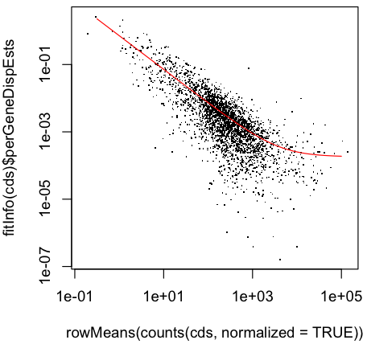
Yeast data: DESeq
plotDispEsts <- function( cds ) {
plot(rowMeans( counts( cds, normalized=TRUE ) ),
fitInfo(cds)$perGeneDispEsts,
pch = '.', log="xy" )
xg <- 10^seq( -.5, 5, length.out=300 )
lines( xg, fitInfo(cds)$dispFun( xg ), col="red" )
}
plotDispEsts( cds )

Slide 60
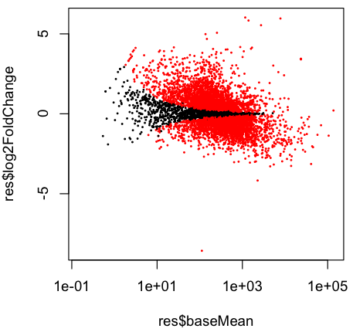
Yeast data: DESeq
plotDE <- function( res ) {
plot(res$baseMean,
res$log2FoldChange,
log="x", pch=20, cex=.3,
col = ifelse( res$padj < .1, "red","black" ) )
}
plotDE( res )

Slide 61
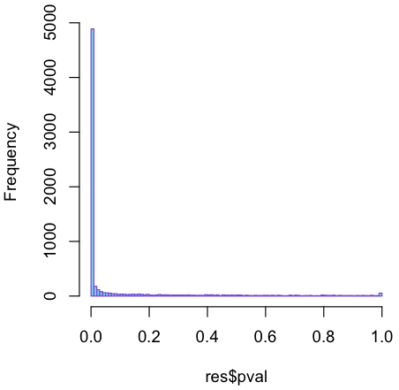
Yeast data: DESeq
hist(res$pval, breaks=100, col="skyblue",
border="slateblue", main="")

Slide 62
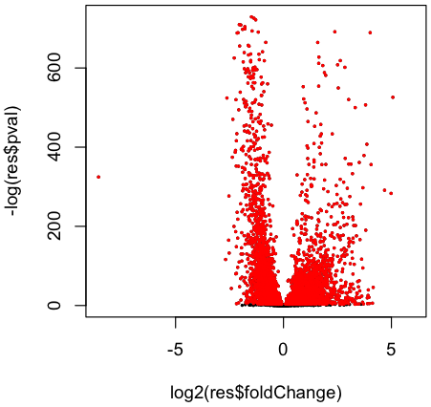
Yeast data: DESeq
# DESeq "volcano plot"
plot(log2(res$foldChange),-log(res$pval),pch=20,cex=0.4)
sig<-res$padj<0.05
points(log2(res$foldChange[sig]),-log(res$pval[sig]), pch=20,cex=0.4,col='red')

Slide 63
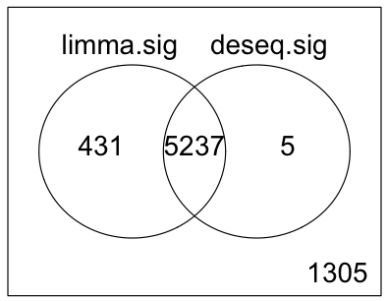
Yeast data: limma vs DESeq
# Compare limma and DESeq
limma.sig<-ifelse(p.adjust(fit$p.value[,2],"BH")<0.05,1,0)
deseq.sig<-ifelse(p.adjust(res$pval,"BH")<0.05,1,0)
vennDiagram(cbind(limma.sig,deseq.sig))

Slide 64
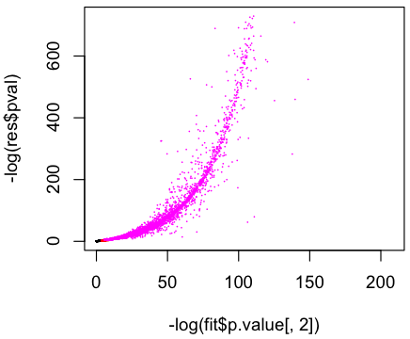
Yeast data: limma vs DESeq
plot(-log(fit$p.value[,2]),-log(res$pval),col=rgb(limma.sig,rep(0,nrow(Counts)),deseq.sig),pch=16,cex=0.6)

