Slide 1
VISG Workshop
25 October 2012 Genome-wide expression analysis
Part II: analysis of microarray data using GenePattern Mik Black, University of Otago
Marcus Davy, Plant and Food Research

Slide 2
Gene expression microarrays
Gene expression microarrays were the first technology to facilitate cost-effective genome-wide expression studies across multiple samples.
INCREDIBLY popular technology
Massive use in human health applications
Huge amounts of publicly available data

Slide 3
Affymetrix microarrays
The first, and most successful, proprietary microarray manufacturer was Affymetrix, based in California.
Affymetrix sells a complete analysis system: arrays, scanner and analysis software.
Rather than spotting genetic material (e.g., early DIY microarray approaches), Affymetrix builds short sequences (oligonucleotides) on the surface of the array.

Slide 4
Affymetrix arrays
The Affymetrix arrays utilize a technique called photolithography to construct sequences on the array itself.
Obviously one of the limitations is that you need to know the sequences of the oligonucleotides that are to be included on the array - luckily we’re getting good at sequencing entire genomes.
The process is expensive, and therefore lends itself to mass-production.
It is also very precise, and allows extremely high density “spots”.

Slide 5
Affymetrix experimental process
Probe design/selection.
Array fabrication.
Hybridization.
Data analysis.

Slide 6
Probe selection
For a given target sequence, probe selection aims to optimize hybridization, and maintain probe specificity.
Affymetrix uses 25-mer sequences (i.e., strings of 25 bases) as probes. This is very short compared to spotted oligonucleotide arrays.
On spotted arrays, each gene is represented by a single probe sequence.
Affymetrix uses multiple (11-20) probes to represent each gene, and only one probe is present at each “spot”.
The collection of all probes associated with a specific gene sequence is referred to as a probe set.

Slide 7
Affymetrix – old vs new
The most distinctive feature of “early” Affymetrix arrays was their “matching probe” approach.
Generated Perfect Match (PM) and Mismatch (MM) probes for each sequence.
Used MM probes to adjust for background effects.
More recent Affymetrix arrays only utilize PM probes.
Greatly increases (useful) information content of arrays.

Slide 8
Matching pairs (older arrays)
Each probe in a collection representing a gene is referred to as a “perfect match” (PM) probe, since it’s sequence is exactly complementary to part of the target gene.
Each PM probe is paired with a mismatch (MM) probe, which is identical, except for a single homomeric base change (i.e., A ↔ T , G ↔ C ) at the middle (13th) position.
The idea is to control for non-specific hybridization by comparing the PM probe to the MM probe.

Slide 9
Array layout (older arrays)
The arrays are designed so that probe pairs for a particular probe set are spread across the array to control for spatial variation.
Each probe is represented on the array by a cell - cell size is 5-20 microns (newer arrays have smaller cells).
Using 12 PM-MM pairs per probe set, and 11 micron cells the HGU133 Plus 2 GeneChip represents the human genome on a single array ( ∼1.3 million cells per array representing ∼54,000 probe sets: ∼47,000 transcripts from ∼38,500 genes).

Slide 10
Array fabrication
Multiple identical arrays are constructed simultaneously on a quartz wafer (kind of like CPU manufacture).
Array fabrication proceeds in a step-wise manner, with chains of bases being formed one base at a time.
At each step, photolithographic masks containing windows corresponding to the cell size are placed over the wafer.
UV light shining through the open windows exposes linkers which will bond to a nucleotide.

Slide 11
Array fabrication
The desired nucleotide is then added and linking occurs.
This is then repeated using different masks, until the desired chains of nucleotides have been constructed.
Careful design is used to minimize the required number of masks.
A single wafer will yield between 50 and 400 arrays (depending on the number of genes represented).

Slide 12
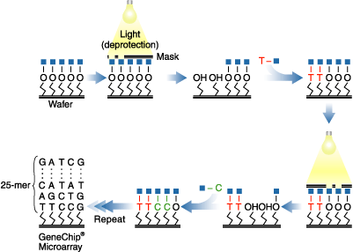
Photolithography process

Slide 13
Hybridization and scanning
Once the arrays are constructed, mRNA extraction, isolation and labeling (biotin) is performed.
One sample is hybridized to each array.
Arrays are then scanned using an Affymetrix scanner.
Produces a “CEL” file for each sample, containing expression intensity information for each probe.
These files are then imported into a software package for normalization and further analysis.
End result is a matrix (or spreadsheet) of intensity values: probes as rows, and samples as columns.

Slide 14
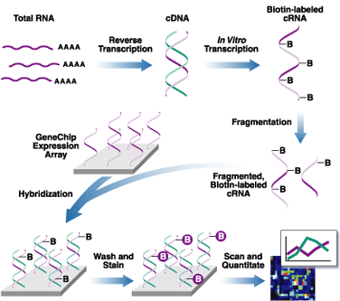
Hybridization and scanning

Slide 15
Public microarray data
Large amounts of public microarray data exist, particularly at NCBI GEO:
http://www.ncbi.nlm.nih.gov/geo/
Much of this data has been generated using Affymetrix microarray technology.

Slide 16
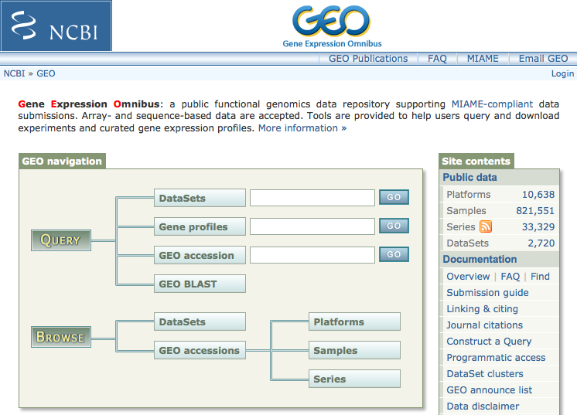
http://www.ncbi.nlm.nih.gov/geo/

Slide 17
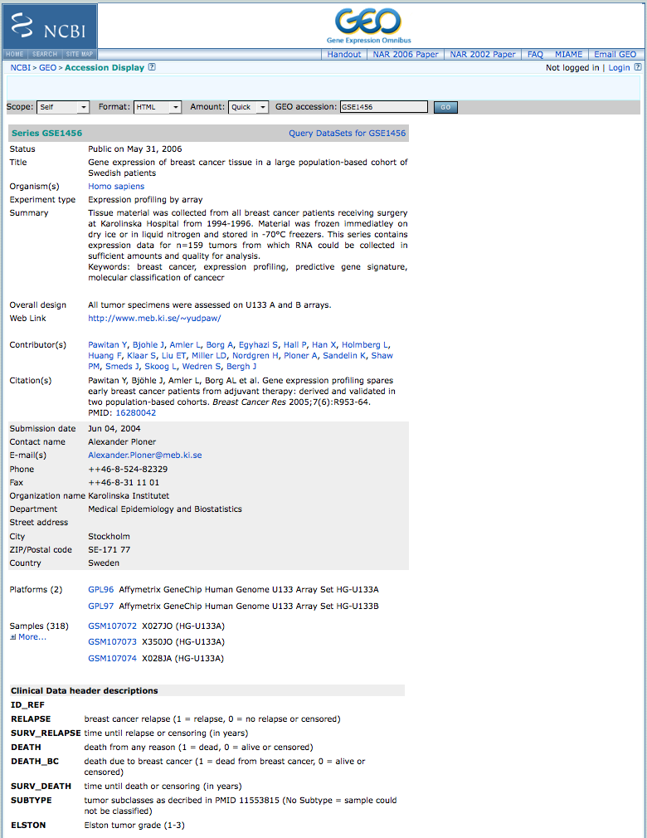

Slide 18
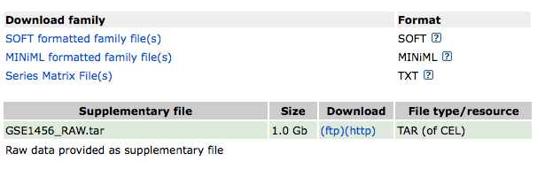

Slide 20
GEO: “series matrix file”

Slide 21
Analysing data from GEO
Once you’ve identified an interesting data set in GEO, how do you analyse it?
LOTS of tools are available.
GenePattern is a web-based interface (one of many) that provides tools for microarray data analysis.

Slide 22
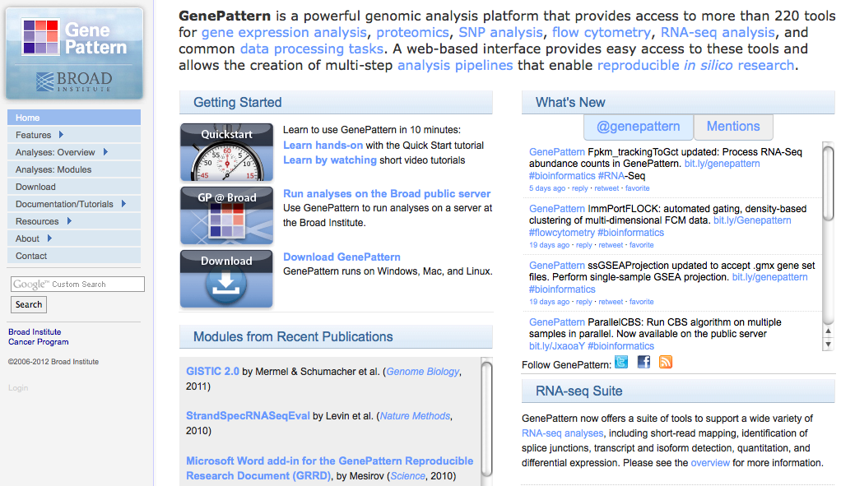
http://www.broadinstitute.org/cancer/software/genepattern/
Reich M, Liefeld T, Gould J, Lerner J, Tamayo P, Mesirov JP GenePattern 2.0 Nature Genetics 38 no. 5 (2006): pp500-501

Slide 23
Using GenePattern
User friendly
Third year bioinformatics course at Otago.
“Point and click”.
Guided analysis
Facilitates use of standard analysis methods.
Pipeline creation and “versioned” analysis.
Access to public data: GEO interface.

Slide 24
Background: data formats
Microarray data are generally arranged as a matrix:
Rows represent genes
Columns represent samples
Files often contain some additional information in the first few rows.
GenePattern follows this convention.

Slide 25
Common GenePattern files
.gct : microarray data
Rows are genes, columns are samples
.cls : class file
Specifies class (e.g., ER status) of each sample.
.txt : general purpose
Today we’ll use it for additional sample information.

Slide 26
GenePattern: .gct file

Slide 27
GenePattern: .cls file

Slide 28
GenePattern: .txt file

Slide 29
Common analysis tasks
Basic data analysis/exploration:
Heatmap creation
Hierarchical clustering
Identifying differentially expressed genes
Probe annotation
Survival analysis
GenePattern provides these tools in a modular format.

Slide 30
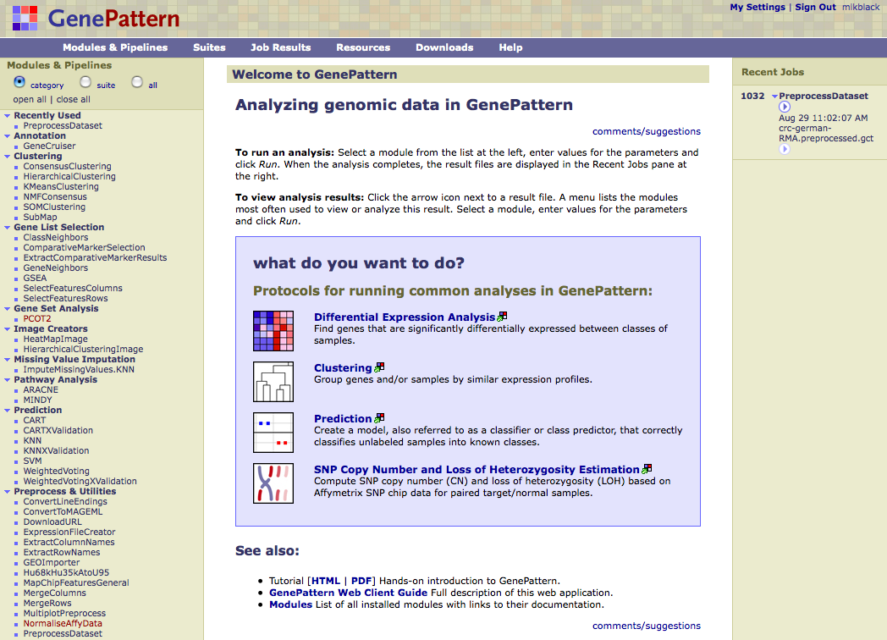
M o d u l e s

Slide 31
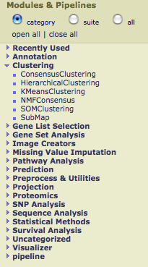

Slide 32
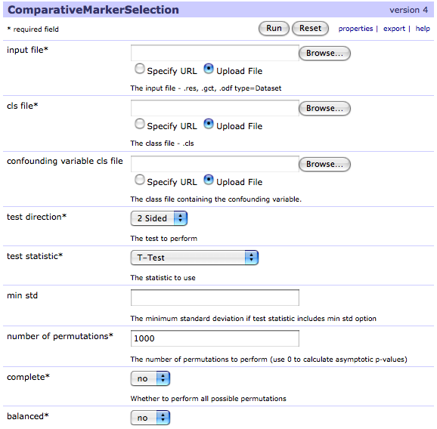

Slide 33
GenePattern output
GenePattern stores the results of an analysis (a “job”) on the server.
These results can be saved, as well as being used as input in additional analysis modules.
GenePattern also provides a number of tools for visualizing job results.

Slide 34
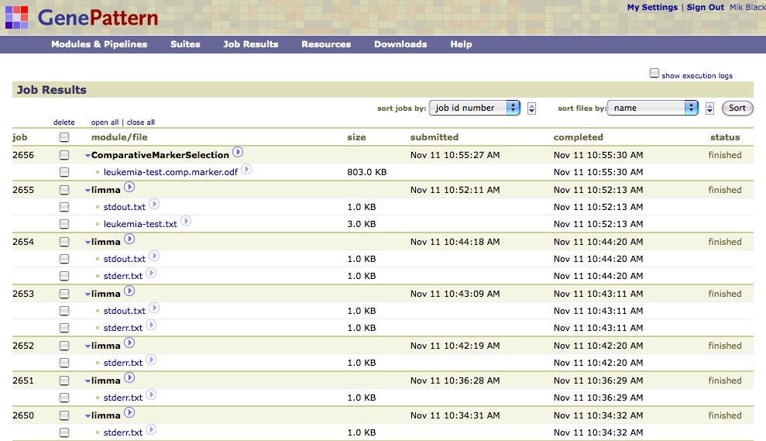

Slide 35
GEO and GenePattern
For a “quick fix”, the GEO “series matrix file(s)” are almost the right format for analysis with GenePattern.
GenePattern can also retrieve data directly from GEO, as well as create .gct files from zip archives of .CEL files:
WARNING – this can be stupidly slow!

Slide 36
GEO and GenePattern
Affymetrix data in the GEO series matrix files are normalized using the MAS5 algorithm.
There are better normalization algorithms available, but this is fine for exploratory analysis.
Use of alternate normalization methods requires access to .CEL files.

Slide 37
Example data set
Breast cancer data: GSE 1456
159 samples on Affymetrix HG-U133A/B chips.
22,283 probe sets of “A” chip (22,268 used here): distilled to 12,936 gene symbols.
Clinical data: ER, lymph node, grade…
Molecular data: subtypes, proliferation…

Slide 38
GenePattern modules (for today)
Preprocessing/Annotation:
PreprocessDataset
GeneCruiser
SelectFeaturesColumns/SelectFeaturesRows
Detecting differential expression:
ComparativeMarkerSelection
ComparativeMarkerSelectionViewer
ExtractComparativeMarkerResults
Data visualization:
VennDiagram
HeatMapViewer
HierarchicalClustering
HierarchicalClusteringViewer
Survival analysis
SurvivalCurve
SurvivalDifference

Slide 39
Preprocessing/Annotation:
PreprocessDataset: filter/transform data and/or save on server.
GeneCruiser: annotate data (based on Affymetrix probe IDs).
SelectFeaturesColumns: create new data set from subset of samples. SelectFeaturesRows: create new data set from subset of rows.

Slide 40
Detecting differential expression:
ComparativeMarkerSelection (CMS): detect differential expression between groups of samples.
ComparativeMarkerSelectionViewer: view output from CMS module.
ExtractComparativeMarkerResults: create new data set from gene subset based on CMS results.

Slide 41
Data visualization
VennDiagram: compare overlap across two or three gene lists.
HeatMapViewer: display a heatmap of the data. Can add annotation, and sort rows/columns.
HierarchicalClustering: perform hierarchical clustering on the data set (genes and samples).
HierarchicalClusteringViewer: view heatmap of clustered data. Can add annotation.

Slide 42
Survival analysis
SurvivalCurve: generate a Kaplan-Meier survival plot based on a discrete variable.
SurvivalDifference: perform logrank test to assess significance of association between discrete variable (e.g., ER status) and survival (e.g., time to relapse).

