Slide 1
Bioconductor project
Open source software project for the analysis and comprehension
of high-throughput genomic data
Packages written in R Primarily for Microarray and Sequence data
Started in 2001 by
Robert Gentleman et al
Bioconductor: Open software development for computational biology
and bioinformatics R. Gentleman, V. J. Carey, D. M. Bates, B.Bolstad, M.
Dettling, S. Dudoit, B. Ellis, L. Gautier, Y. Ge, and others 2004,
Genome Biology, Vol. 5, R80

Slide 2

Bioconductor goals
The broad goals of the project are to:
Enable sound and powerful statistical analyses in genomics
Provide a computing platform that allows the rapid design and deployment of high-quality software
Develop a computing environment for both biologists and statisticians
Promote high-quality dynamic documentation and reproducible research (pdf’s and vignettes)

Slide 3
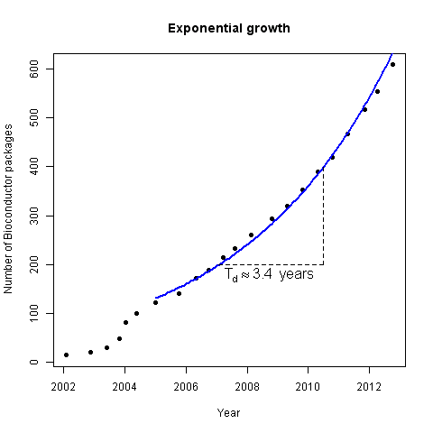
Project growth
Number of contributed packages each bi-annual software release
Bioconductor mailing list statistics
http://www.bioconductor.org/about/annual-reports/AnnRep2012.pdf

Slide 4
Journal Citations
Pubmed searches for Bioconductor 2003-2011
Google Scholar citations for Bioconductor packages
http://www.bioconductor.org/about/annual-reports/AnnRep2012.pdf

Slide 5
Installing Bioconductor
Installing packages on the R terminal using http://
## Set the repository
options(repos="http://cran.stat.auckland.ac.nz")
## Download biocLite() from the internet
source("http://bioconductor.org/biocLite.R")
## Install core packages
biocLite()
## Install a specific package
biocLite("limma")
## Install several packages
biocLite(c("GenomicFeatures", "AnnotationDbi"))
Using biocLite() auto magically resolves packages and their dependences from both Bioconductor and CRAN

Slide 6
Installing Bioconductor...
Automatically install a package if it cannot be loaded on a machine
## Package ‘getopt’ is in CRAN, ‘limma’ is in Bioconductor
packages <- c("getopt","limma")
## Load or install and load required packages
for (pck in packages){
if (suppressPackageStartupMessages(!require(pck,character.only=TRUE)) ){
## Install biocLite the first time only
if(.Platform$OS.type == "windows") setInternet2(TRUE)
if(match(pck, packages) == 1) source("http://www.bioconductor.org/biocLite.R")
biocLite(pck, suppressUpdates = TRUE)
suppressPackageStartupMessages(require(pck,character.only=TRUE))
}
}

Slide 7

Getting started using Bioconductor
Vignette documentation
## List of help documentation
vignette()
Mailing lists
http://www.bioconductor.org/help/mailing-list/
Workshop course material from many previous events
http://www.bioconductor.org/help/course-materials/
HT Sequence Analysis with R and Bioconductor
http://manuals.bioinformatics.ucr.edu/home/ht-seq

