Slide 1
Large genomic data set manipulation

Slide 2
Why are large datasets a problem?
More difficult to manage
Potential parsing issues if data not derived from automated data acquisition sources
Computational constraints memory / disk
Potential visualization, statistical summary interpretation issues
Scalable?

Slide 3
Next generation sequencing context
Many thousands of records containing short sequencing reads
From a single experiment/sample/lane
Amount of NGS sequence information is growing exponentially over time

Slide 4
Information growth rate
Exponential increase
Doubling time since 2004 is four to six months
Contrast with Moores law
The number of transistors that can be placed inexpensively on an integrated circuit has doubled approximately every two years
“The cost of genome sequencing is now decreasing several times faster than the cost of storage, promising that at some time in the not too distant future it will cost less to sequence a base of DNA than to store it on a hard disk.” Lincoln Stein
Need automated analysis methods to handle the growth rate

Slide 5

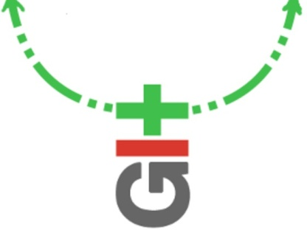

General approach
Ideally use a Collaborative analysis framework
Independent reproducibility/validation of results
Transparency of workflow
Work in a way to promote input form one to many researchers

Slide 6
Prototyping
In order to work with large datasets a good approach is to break down the amount of information into a manageable amount for testing
Sequentially sample ~1% of the data using head/tail (available in unix and in R)
Randomly sample records for prototyping
Batch processing can then run in
seconds/minutes/hours
Processes taking > 1 day is too long – loose your train of thought

Slide 7
Sampling example using ShortRead
Code snippet in R;
library(ShortRead)
## Documentation
help(FastqSampler)
sp <- SolexaPath(system.file('extdata', package='ShortRead'))
fl <- file.path(analysisPath(sp), "s_1_sequence.txt")
f <- FastqSampler(fl, 50)
rfq <- yield(f) # sample of size n=50
sread(rfq)
A DNAStringSet instance of length 50
width seq
[1] 36 GATTTTATTGGTATCAGGGTTAATCGTGCCAAGAAA
[2] 36 GATTTCTTACCTATTAGTGGTTGAACAGCATCGGAC
[3] 36 GTATGCCGCATGACCTTTCCCATCTTGGCTTTCTTG
[4] 36 GGTAAAAATTTTAATTTTTGCCGCTGAGGGGTTGAC
[5] 36 GGTTATTAAAGAGATTATTTGTCTCCAGCCACTTAA
[6] 36 GTTGAAATGGTAATAAGACGACCAATCTGACCAGCC
[7] 36 GTACGCTGGACTTTGTAGGATACCCTCGCTTTCCTT
[8] 36 GACATTATGGGTCTGCAAGCTGCTTATGCTAATTTT
[9] 36 GTTCTGGCGCTCGCCCTGGTCGTCCGCAGCCGTTGG
... ... ...
Eliminate any potential spatial effects

Slide 8
Sanity checking
Assumptions in workflow can propagate errors
Think of an independent validation every few steps of programming to sanity check your work
e.g. Sanity check if file with .sam extension exists
$ ls -l | grep \\.sam$

