Slide 1
Samtools
John McCallum
Marcus Davy
Samantha Baldwin

Slide 2

SAMtools
SAM Tools provides command line tools for manipulating alignments in the SAM format.
Binary BAM file support for efficient storage
Including sorting, merging, indexing and generating alignments in a per-position format.
Open source cross platform project on sourceforge
http://samtools.sourceforge.net/
Li H.*, Handsaker B.*, Wysoker A., Fennell T., Ruan J., Homer N., Marth G., Abecasis G., Durbin R. and 1000 Genome Project Data Processing Subgroup (2009) The Sequence alignment/map (SAM) format and SAMtools. Bioinformatics, 25, 2078-9. [PMID: 19505943]
SAM BAM

Slide 3
De facto standard for alignment data
Aligners natively generating SAM
BFAST, `Blat-like Fast Accurate Search Tool' for Illumina and SOLiD reads.
Bowtie. Highly efficient short read aligner. Natively support SAM output in recent version. A convertor is also available in samtools-C.
BWA, Burrows-Wheeler Aligner for short and long reads.
GEM library. Short read aligner. Convertor provided by the developers.
Karma, the K-tuple Alignment with Rapid Matching Algorithm.
LASTZ, aligner for both short and long reads.
Mosaik. The latest version support SAM output.
Novoalign. An accurate aligner capable of gapped alignment for Illumina short reads. Academic free binary. Convertor is also available in samtools.
SNP-o-matic, short read aligner and SNP caller.
SOLiD BaseQV Tool. Developed by Applied Biosystems for converting SOLiD output files.
SSAHA2 (since v2.4). Classical aligner for both short and long reads.
Stampy, by Gerton Lunter. An accurate read aligner capable of gapped alignment for Illumina short reads. Used for indel discovery on the 1000 genomes data.
TopHat for mapping short RNA-seq reads bridging exon junctions.
http://samtools.sourceforge.net/swlist.shtml

Slide 4
De facto standard for alignment data…
Programs processing SAM/BAM
BAMTools, C++ APIs (not based on C APIs) for processing BAM files.
BamView, BAM alignment viewer. It can be integrated to Artemis.
BEDTools, a software package for manipulating BED files, with some utilities working with BAM. Built upon BAMTools.
BreakDancer, structural variation caller for paired-end data.
DNAA, DNA Analysis package including various post-alignment processing.
Gambit, graphical BAM alignment viewer.
GAP5, sequence assembly viewer, editor and analyzer. Capable of importing BAM files and outputing SAM.
GATK, the Genome Analysis Toolkit. Rich funtionality including an accurate SNP caller. Built upon Picard.
GBrowse, generic genome browser. Experimental SAM/BAM alignment viewing. Built upon Perl APIs.
GenomeView, a Java based genome browser.
IGB, the Integrated Genome Browser for various data formats.
IGV, the Integrative Genomics Viewer, supporting multiple tracks and genome annotations. Built upon Picard.
LookSeq, web-based alignment/annotation viewer.
MagicViewer, graphical BAM alignment viewer.
samToBed by Aaron Quinlan. Converting alignments in the SAM format to the BED format.
Savant, a Java based genome browser.
Tablet, alignment viewer. It also supports tons of other alignment/assembly formats.
Vancouver Short Read Analysis Package (in particular FindPeaks), post alignment processing of new sequencing data.
VarScan, variant caller for short sequence reads.
http://samtools.sourceforge.net/swlist.shtml

Slide 5
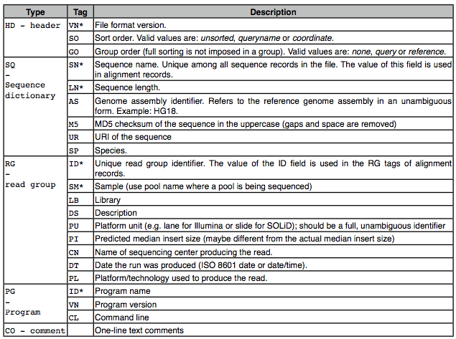
Header fields
Lines begin with character ‘@’ followed by a two-letter record type code.
TAB delimited lookup table of the form TAG:TYPE:VALUE
Tags with ‘*’ are required
when the TYPE is present
e.g.
@HD VN:1.3 SO:coordinate
@SQ SN:ref LN:45

Slide 6
Alignment fields
TAB delimited fields in the body of the format
http://samtools.sourceforge.net/SAM1.pdf

Slide 7
Flag field
Binary lookup table
Bitwise flag allows filtering using samtools view
e.g.
Unaligned reads = 4
Decimal to binary conversion;
SAMtool bitwise flag meaning explained
Picard flag conversion tool

Slide 8
The cigar string
The aligned sequence or reference may have additional/missing bases (INDELS)
The CIGAR string is a sequence of base lengths and the associated operation to
indicate which;
bases align (either a match/mismatch) with the reference
bases are deletions from the reference
insertions that are not in the reference
e.g. 20M6I10M = 20 matches, 6 reference inserts, 10 matches

Slide 9
SAMtools documentaion
Usage: samtools <command> [options]
Type samtools in the shell terminal command prompt for help
$ samtools
Program: samtools (Tools for alignments in the SAM format)
Version: 0.1.18 (r982:295)
Usage: samtools <command> [options]
Command: view SAM<->BAM conversion
sort sort alignment file
mpileup multi-way pileup
depth compute the depth
faidx index/extract FASTA
tview text alignment viewer
... ...
Manual pages: http://samtools.sourceforge.net/samtools.shtml

Slide 10

Rsamtools
Rsamtools is a Bioconductor package
http://www.bioconductor.org/packages/2.10/bioc/html/Rsamtools.html
The package provides an interface for R to efficiently access and import BAM les into R
Facility for file access such as record counting, index file creation, and filtering to create new files containing subsets of the original.
Rsamtools is as a starting point for creating R objects suitable for a diversity of workfows, e.g. AlignedRead objects in the ShortRead package
Help documentation (vignette) in R;
library(Rsamtools)
vignette("Rsamtools-Overview")

