Slide 1
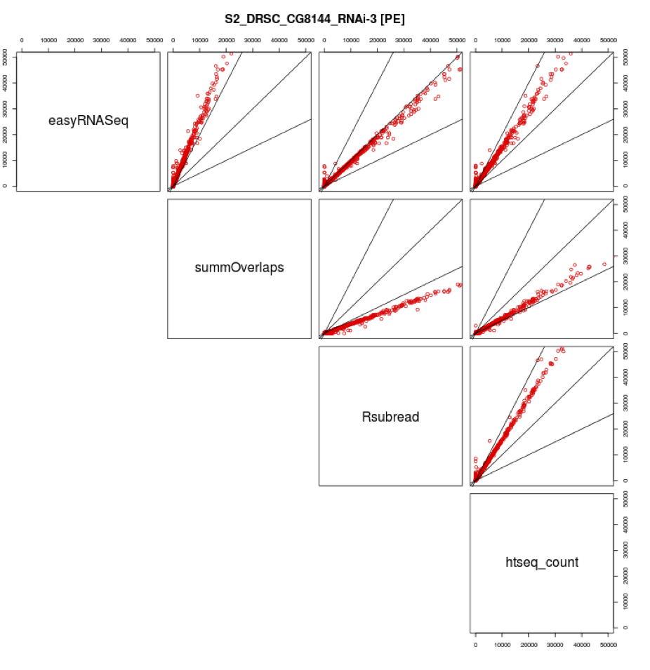
Counting paired end sequences
Methods actively
being developed
Biases between
different count methods
filtering singletons , unmapped mates
Htseq-count treated as defacto standard
http://www-huber.embl.de/users/anders/HTSeq/doc/overview.html
http://permalink.gmane.org/gmane.science.biology.informatics.conductor/43506

Slide 2
Counting reads in features
A feature is an interval
range of positions on a
Chromosome or union
of intervals
Typically genes or exons
Problem: Reads that
Overlap more than one
feature
http://www-huber.embl.de/users/anders/HTSeq/doc/count.html#count

