Slide 1
Built in utility commands
Syntax;
utility_name[-a][-b][-c option_argument]
[-d|-e][-foption_argument][operand...]
The utility_name is followed by options, option-arguments, and operands.
Elements within square brackets are optional!
http://pubs.opengroup.org/onlinepubs/009696699/basedefs/xbd_chap12.html

Slide 2

Finding help for utility commands
$ man [command] – online documentation
$ info [command] – hypertext linked information
$ apropos [command] – search ‘whatis’ database for strings
$ ./[command] --help ‘optional’ argument to invoke help
$ help [bash built in]
e.g. ls –help | less
search using keywords like ‘tutorial, usage, howto’

Slide 3
Searching for content on the file system
locate database to find filenames quickly
e.g. $ locate “*.R” ## locate R files
find to search filenames
e.g. $ find / –name “*.R$” –print
grep to print lines matching a pattern
$ alias grepc
alias grepc='grep --color=auto -iRnH‘
Searching recursively for content within files
e.g. $ grepc “^library” *.R

Slide 4
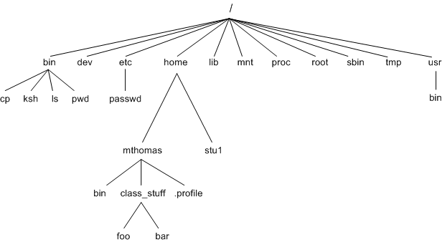
Unix filesystem
Relationship between
directories and files is a rooted tree
Utility ‘ls’ lists directory contents
Wildcards “* ? []” etc are
alpha numerically sorted as;
[0-9A-Za-z] (numbers before capitals before lower case)
The utility ‘cd’ changes the current directory to dir

Slide 5
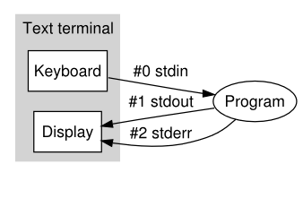
Standard input, output, and error
Text from the keyboard is;
stdin (standard input)
Program displays text outout to;
Stdout (standard output)
If a program crashes debugging information goes to;
stderr (standard error)
Note :output may be from stdout or stderr, must use redirection of output streams to distinguish
e.g. Redirect stderr to a file
$ command1 2> file1

