Slide 1
Project 2: Automated Application Deployment using Ansible
Create 3 EC2 instances on Amazon Web Services
Create Ansible inventory for control and target nodes
Install Java and Tomcat using Ansible playbook
Start and enable Tomcat service
Pull WAR file from GitHub
Deploy application to Tomcat webapps directory
Validate deployment

Slide 2
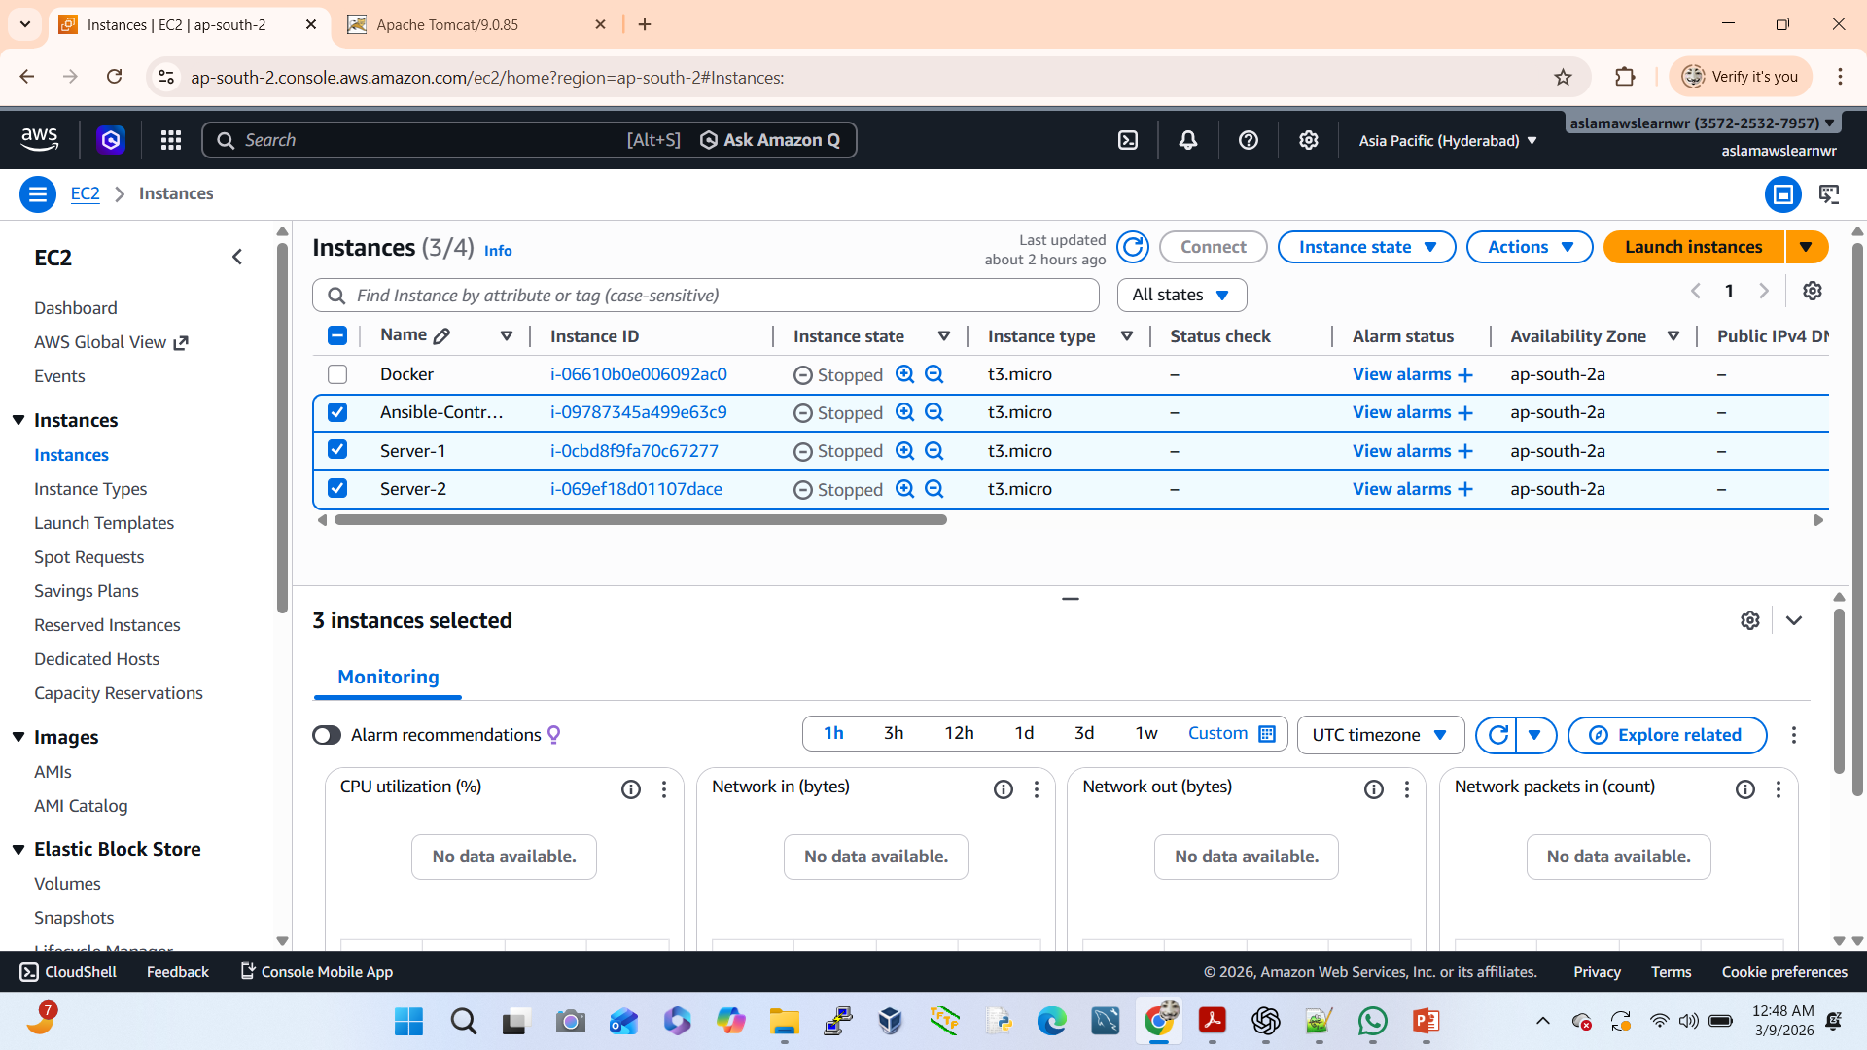
Create 3 EC2 instances on Amazon Web Services
Go to AWS Console:- open EC2 instance
Instance type: t3.micro (Free Tier)
Create or select Key Pair
Go to EC2 → Launch Instance
Security Group:
✔Allow SSH (22) from anywhere
✔ Allow HTTP (80) from anywhere
✔ Allow customize port (8000-9000) from anywhere

Slide 3
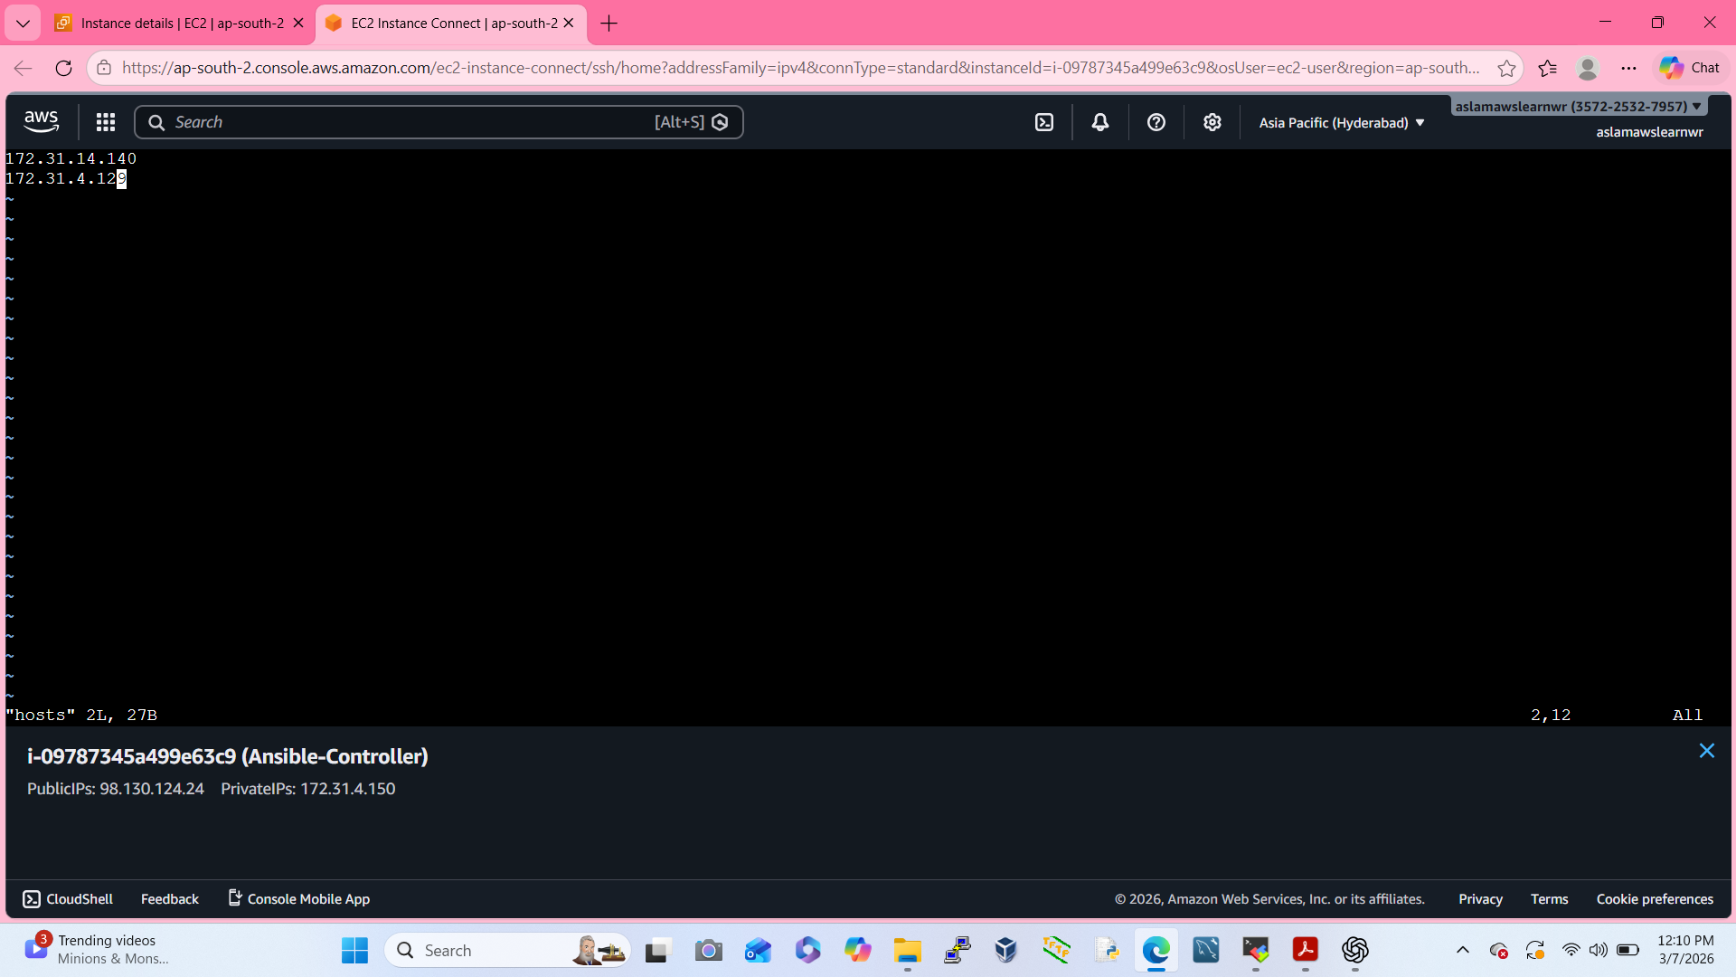
Create Ansible inventory for control and target nodes
Go to Ansible-Controller & open terminal
Create new user for command:
✔ # adduser Ansible
✔ #passwd Ansible
Go to the Change directory
✔ $ cd /etc/ansible
✔ $ sudo vi hosts

Slide 4
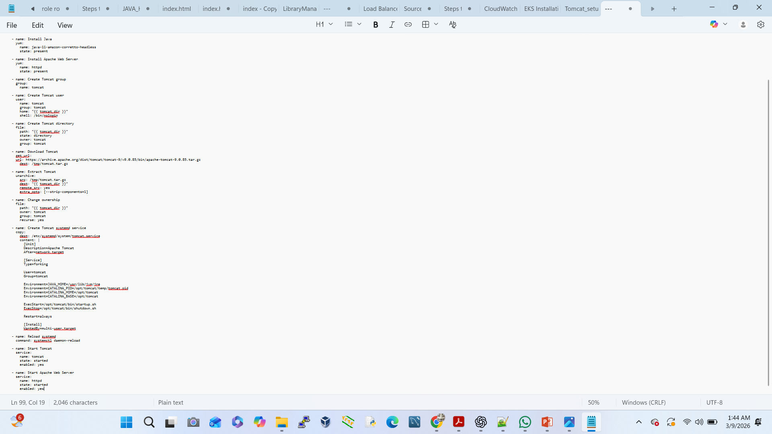
Ansible Playbook Code
Login Ansible-Controller terminal (Ansible)
✔ $ cd /etc/ansible
✔ $ sudo vi install_tomcat.yml
After open vi editor then paste Ansible Playbook code
Now use One Ansible command:
✔ $ ansible-playbook install_tomcat.yml

Slide 5
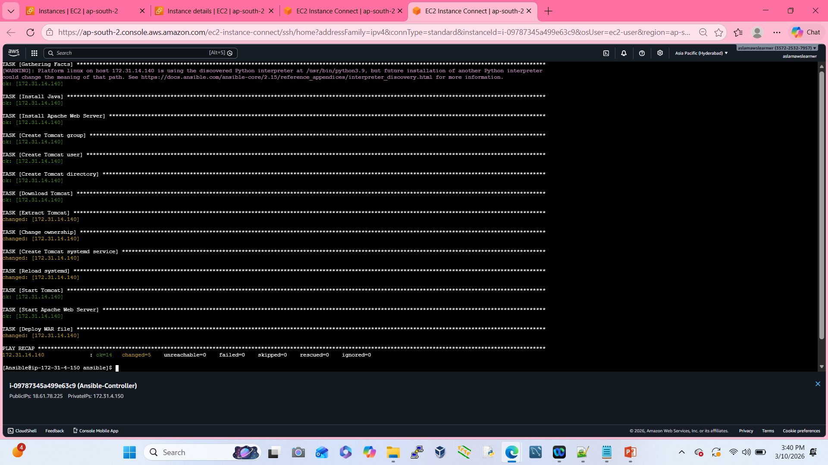
Install Java and Tomcat using Ansible playbook
Login Ansible-Controller terminal
✔ # su - ansible
✔ $ cd /etc/ansible
✔ $ sudo vi install_tomcat.yml
After open vi editor then paste Ansible Playbook module
Now use Executable Ansible command:
✔ $ ansible-playbook install_tomcat.yml

Slide 6
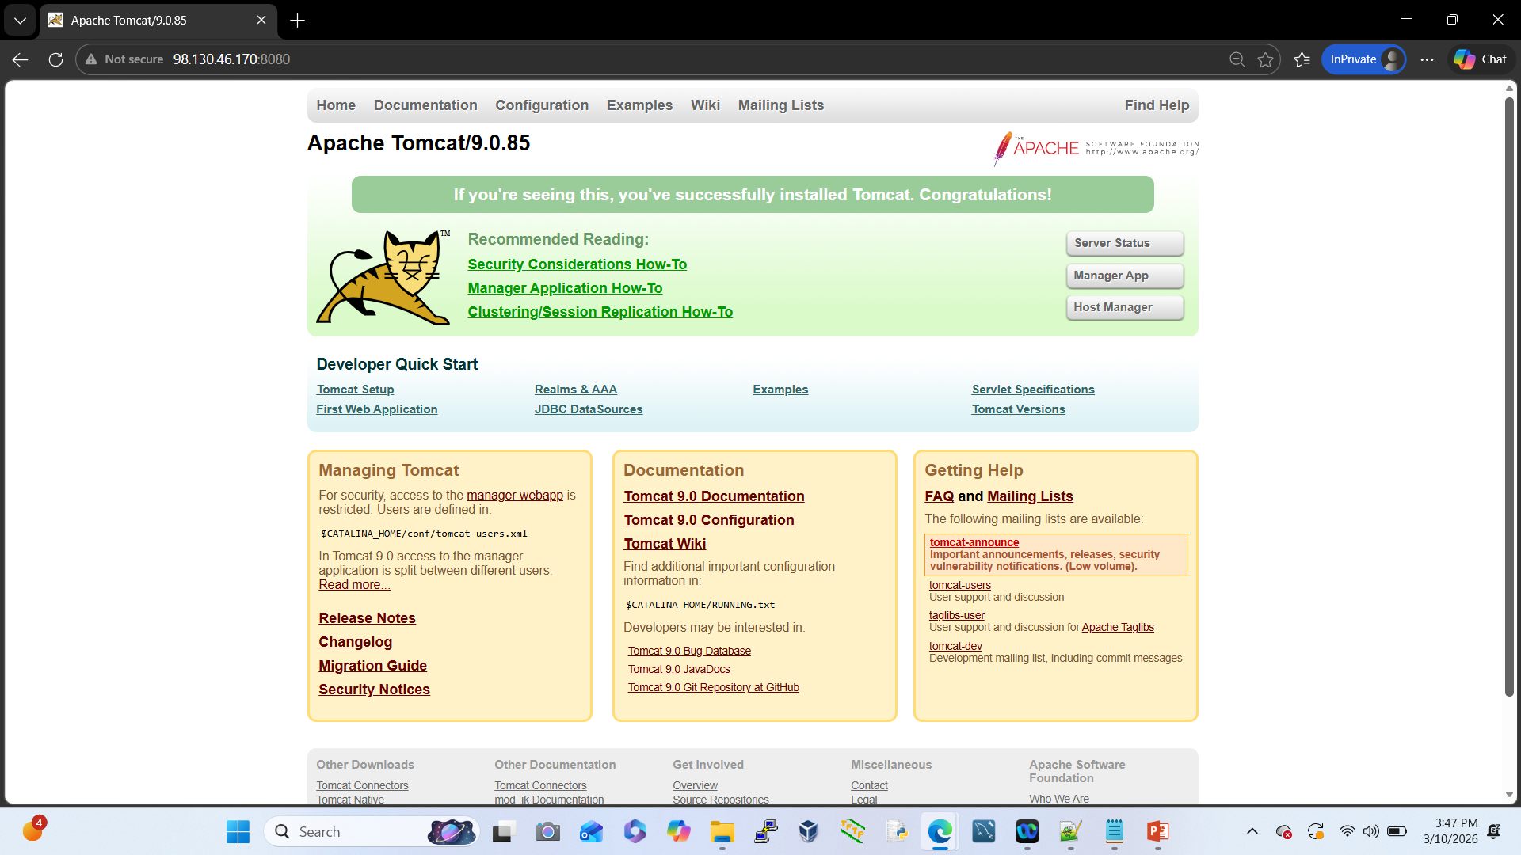
Start and enable Tomcat service & Login Tomcat
We are use Automate Ansible playbook Module.
✔Start tomcat service
✔Enable tomcat service
We are copy our server-1 public ip:
Go to chrome browser open new tab
✔http://98.130.46.170:8080

Slide 7
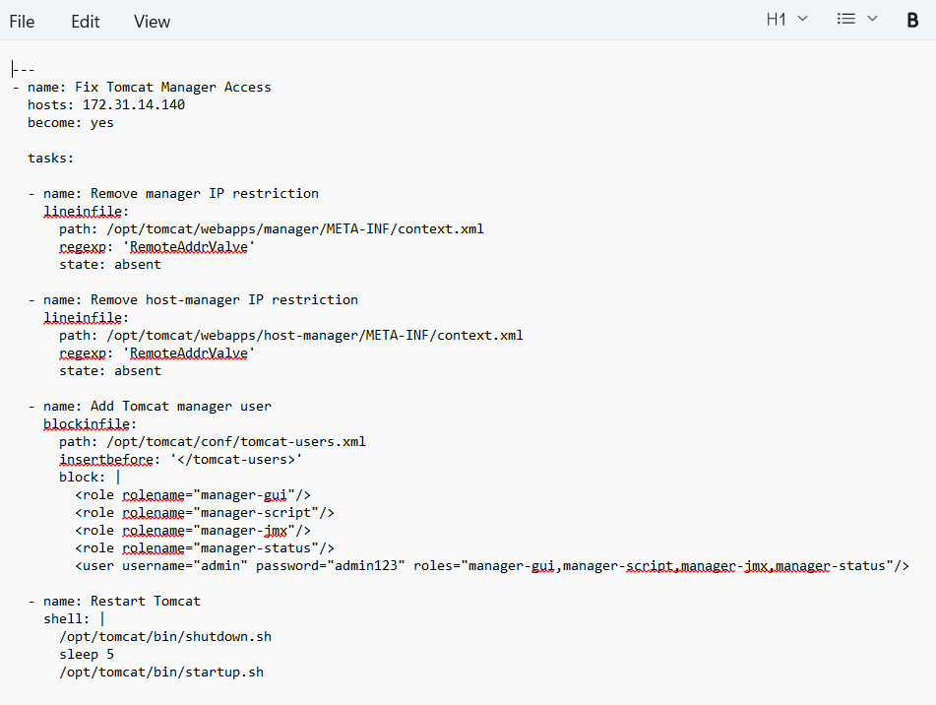
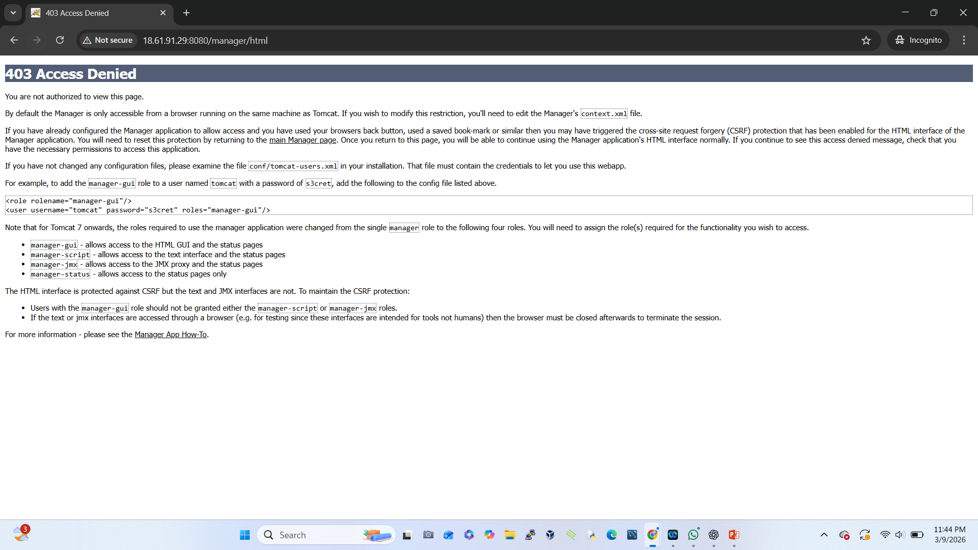
To Fix Tomcat Manager Access

Slide 8
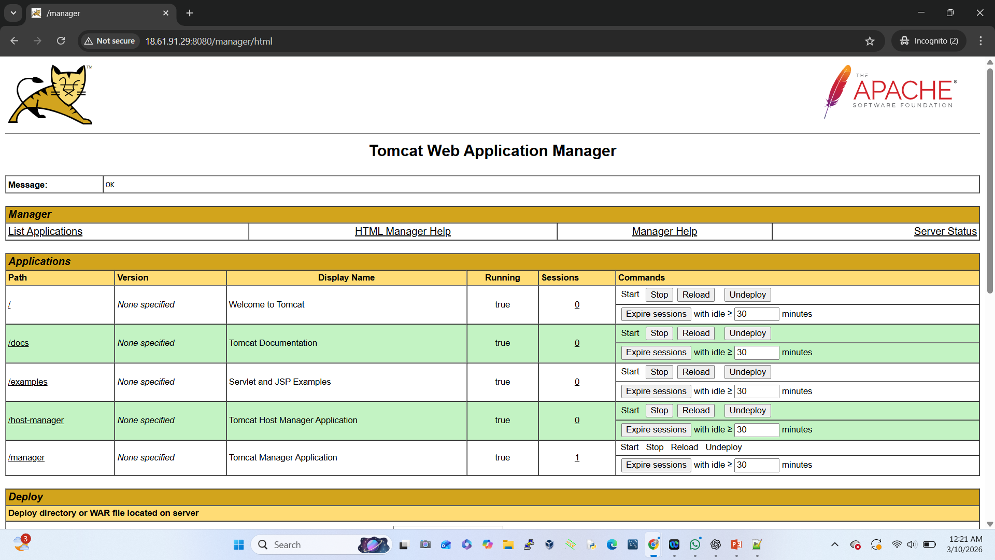
Now use Executable Ansible command:
✔ $ ansible-playbook install_tomcat.yml
We are copy our server-1 public ip:
Go to chrome browser open new tab
✔ http://98.130.46.170:8080
Click Manager App: not showing tomcat page then use cmd:
Ansible-controller:
✔ $ cd /etc/ansible
✔ $ ansible-playbook -i hosts tomcat_manager_fix.yml
Sercer-1 (node):
✔ sudo /opt/tomcat/bin/shutdown.sh
✔ sudo /opt/tomcat/bin/startup.sh

Slide 9
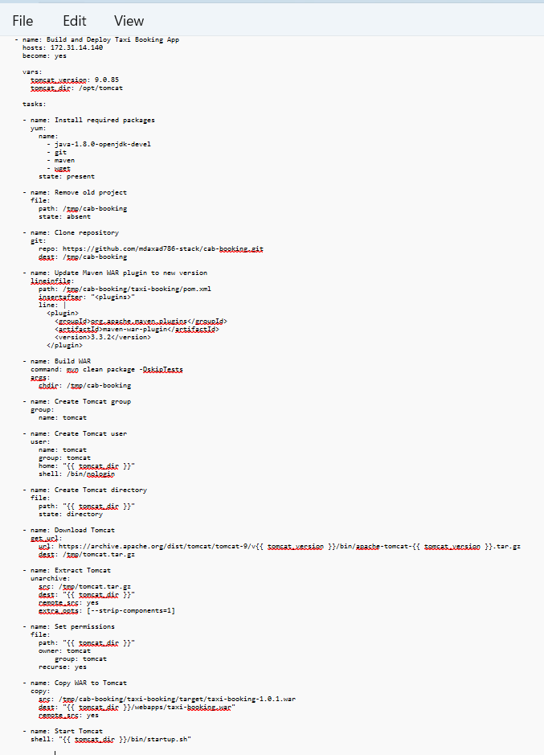
Pull WAR file from GitHub
Open Github A/C choose war file Repository
✔repo name: cab-booking
Now we are copy repo code:
✔https://github.com/mdaxad786-stack/cab-booking.git
Login Ansible-Controller terminal
✔ # su - ansible
✔ $ cd /etc/ansible
✔ $ sudo vi webapp.yml
After open vi editor then paste Ansible Playbook module
Now use Executable Ansible command:
✔ $ ansible-playbook webapp.yml

Slide 10
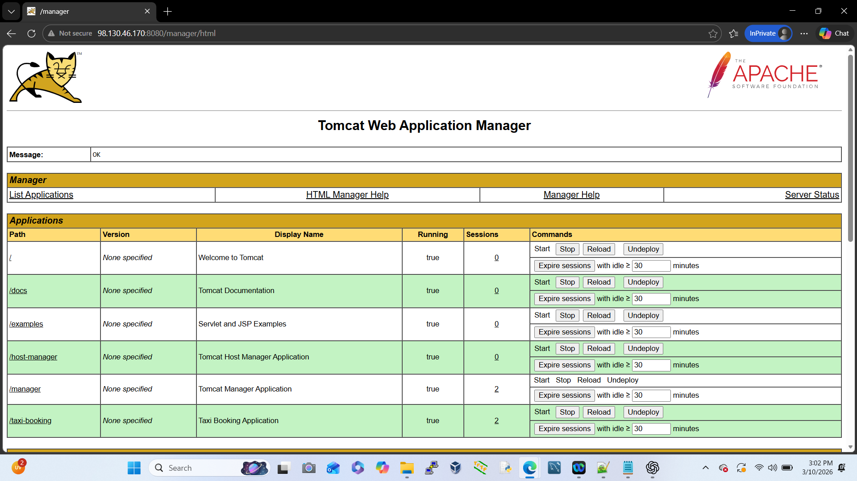
Deploy application to Tomcat webapps directory
After Deploy Webapp in Tomcat Server
Go to the Server-1 or copy public ip
✔ http://98.130.46.170:8080
Go to Chrome Browser Open new tab:
✔ http://98.130.46.170:8080

Slide 11
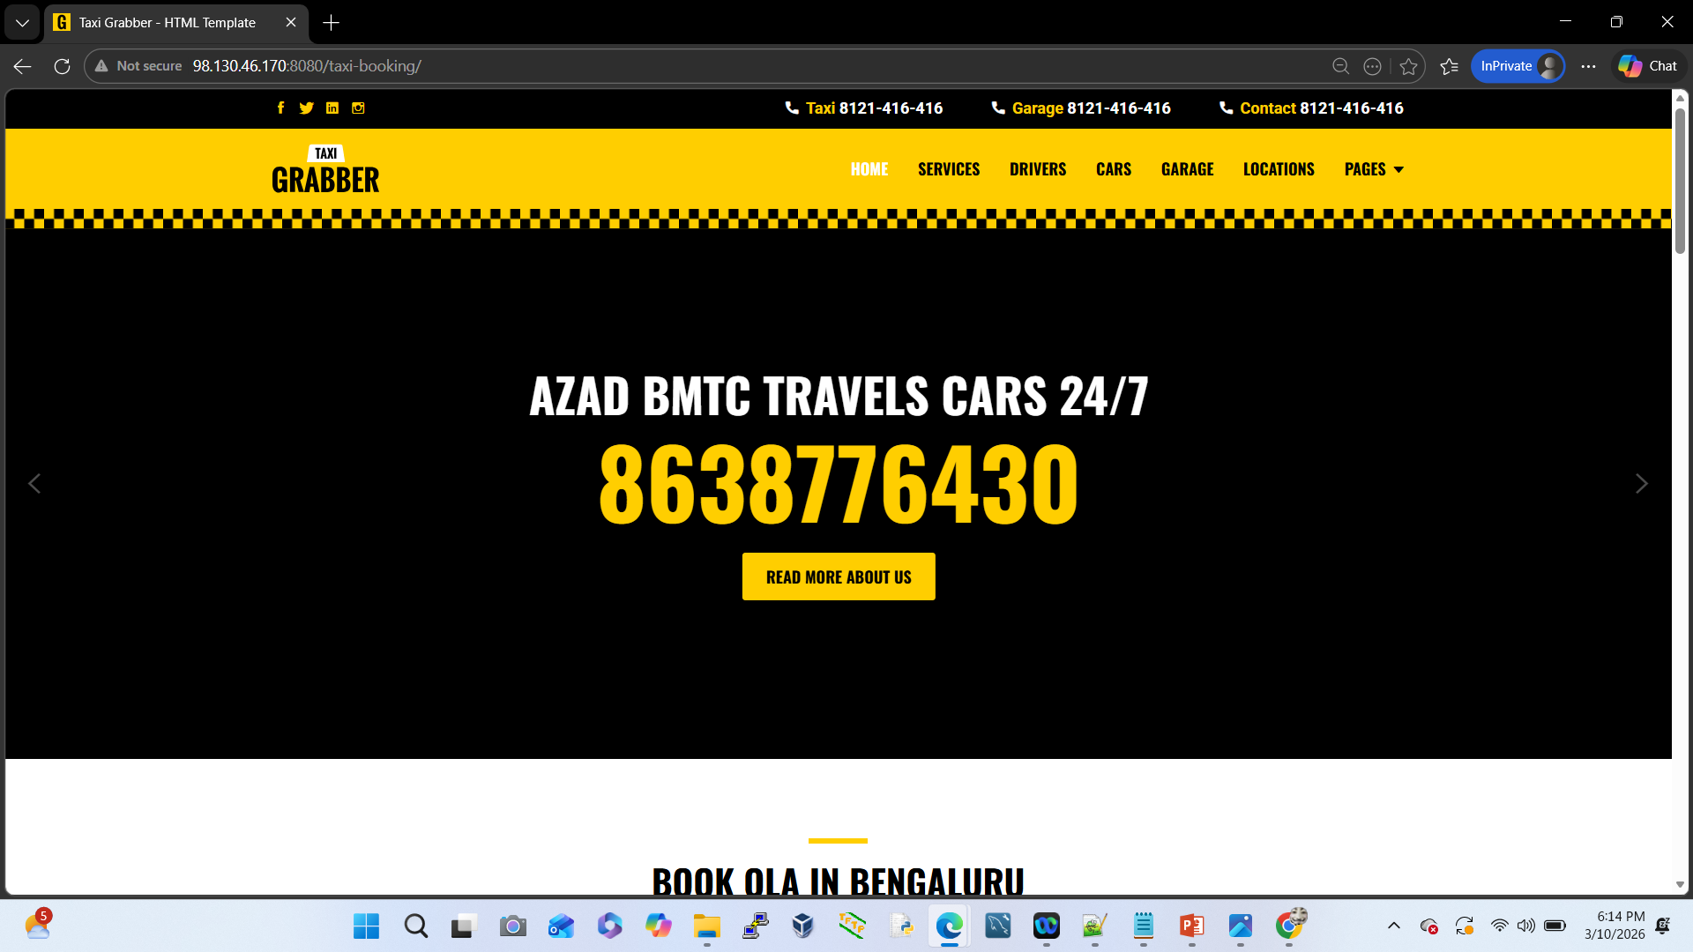
Validate deployment
Go to the Chrome Browser
Open New Tab:
✔http://98.130.46.170:8080/taxi-booking/

