Slide 1
Task Scheduler System
The Task Scheduler System is a backend-only Java Spring Boot application designed for internal ticketing support (e.g., IT Helpdesk or Ops Support). It supports:
✅ Full Task lifecycle management (CRUD + filtering)
📝 Notes for tasks
⏱️ Background Scheduler to mark overdue tasks
🧵 Multi-threaded Task Processing Simulation
📊 Swagger API docs
🧪 Full test coverage (unit + integration)

Slide 2
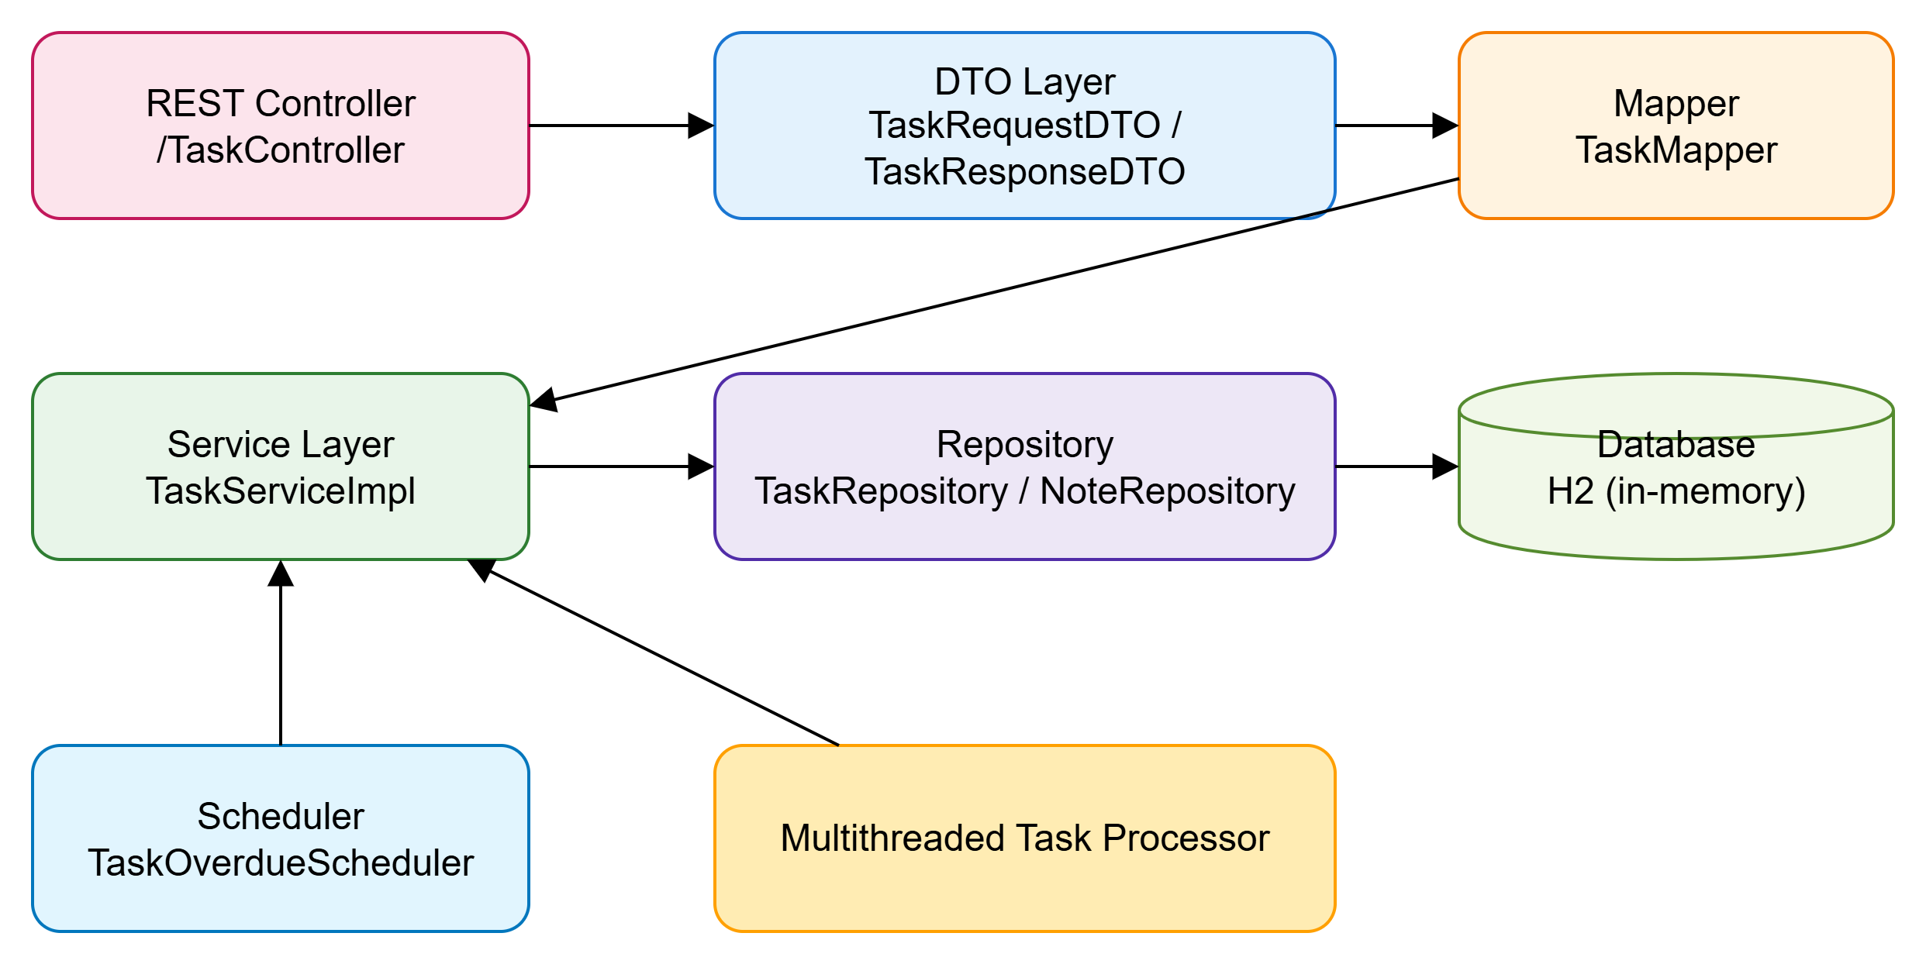
📐 Architecture

Slide 3
Modules
Task Module: Core of the system responsible for managing the lifecycle of tasks.
Note Module: Allows users to append context or updates to a task.
Mapper Layer (DTO Converters): Decouple internal entities from external API contracts.
Scheduler Module: Polls overdue tasks and marks them as FAILED every 60 seconds.
Multithreading Processor: Simulates task processing using a thread pool.
Service Layer: Business logic layer connecting controllers to repositories.
Persistence Layer: Interacts with the H2 database.
Swagger / OpenAPI Documentation: Provide interactive API documentation.

Slide 4
Multithreading & Polling Model (Current Design)
Background Scheduler
Uses @Scheduled(fixedRate = 60_000)
Runs every minute to mark overdue tasks as FAILED
Logs results (can be extended to email/slack alerts)
Processor Thread
Uses ExecutorService to simulate task processing
Picks tasks with IN_PROGRESS status
Simulates random processing time
Updates to COMPLETED or FAILED
Thread Safety Considerations:
Shared access only through service layer
Synchronization via single-threaded scheduler logic

Slide 5
Alternative Models Considered
Model | Description | Note (Why Rejected)
Event Queue (RabbitMQ/Kafka) | Tasks pushed to a queue and processed by consumers | Too heavy for a backend-only assignment
Spring Batch / Quartz | Rich job scheduling libraries | Overkill for simple 1-min polling
Manual Thread Creation | Threads via new Thread() or Runnable | No thread pooling, poor control
Asynchronous Events | @Async tasks with callbacks | Less predictable control and testing overhead

Slide 6
Why This Design?
Simple and reliable with Spring Boot defaults
Easy to debug, test, and extend
Controlled concurrency using ExecutorService
No external dependencies required
Fits well for backend-only, local processing scenario
Improvements & Extensions for Future
Use ScheduledExecutorService for flexible job scheduling
Add retry queue for FAILED tasks
Store processing logs for observability
Integrate metrics via Prometheus/Grafana

