Slide 1

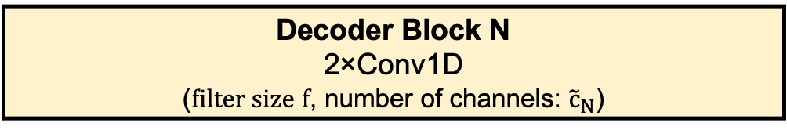
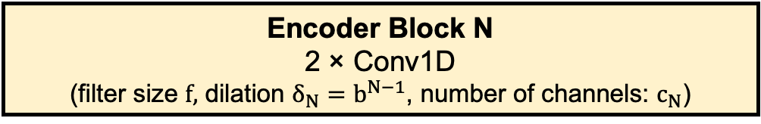
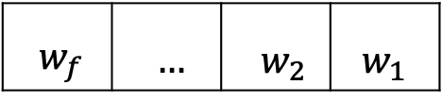
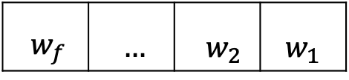
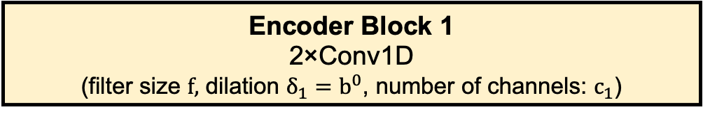
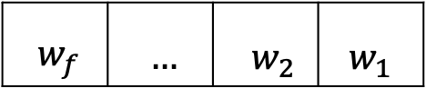

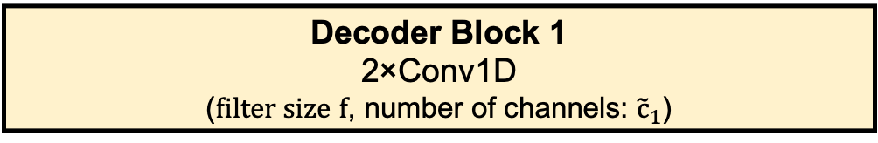
Forecasted BG Sequence
Glucose $G^{\left(k+1:k+H\right)}$
Final Conv1D
Decoder Block N
2×Conv1D
($\text{f}\text{ilter} \text{size} f$, number of channels: ${\tilde{c}}_{N}$)
Upsample
Temporal Residual Block
+
Decoder
….
Upsample
ReLU
Decoder Block 1
2×Conv1D
($\text{filter} \text{size} f$, number of channels: ${\tilde{c}}_{1}$)
Causal Conv1D ($f, δ_{j}$, c_{j})
1×1 Conv1D
Encoded Latent Sequence
ReLU
Causal Conv1D ($f,{ δ}_{j}$, c_{j})
Encoder Block N
2 × Conv1D
(filter size $f,$ dilation $δ_{N}=b^{N−1}$, number of channels: $c_{N}$)
AvgPool
Bayesian Causal Conv1D
Encoder
….
c_{j}
…
…
AvgPool
Encoder Block 1
2×Conv1D
(filter size $f,$ dilation $δ_{1}=b^{0}$, number of channels: $c_{1}$)
.
$${ w}_{f}$$ | $$…$$ | $${ w}_{2}$$ | $${ w}_{1}$$
$${ w}_{f}$$ | $$…$$ | $${ w}_{2}$$ | $${ w}_{1}$$
dot product
$${ w}_{f}$$ | $$…$$ | $${ w}_{2}$$ | $${ w}_{1}$$
Conv1D (kernel size k)
c_{j}
Glucose $G^{\left(k−d_{G}:k\right)}$
Meal $M^{\left(k−d_{M}:k\right)}$
… | x_{E} | … | x₂ | x₁ | …
… | x_{E} | … | x₂ | x₁ | …
Insulin $I^{\left(k−d_{I}:k\right)}$
c_{j-1}
Input Feature Tensor
Multichannel Input Sequence

