Slide 1


Coevolving Neural Networks and Body Morphologies for Soft Robotics using EvolutionGym
Matthew Del Branson
CSC 742 Evolutionary Computing

Slide 2

Introduction
Neuroevolution -
Evolving Neural Networks
Apply evolutionary algorithms to optimize neural network controllers
Population-based search through weight and topology space
NEAT (Neuroevolution of Augmenting Topologies)
Complexification: Gradually increase network complexity
Historical markings enable crossover between different topologies
Speciation protects innovative solutions
CSC 742 Evolutionary Computing
1
Notes:
Goal: Set the context of your presentation.
• Brief overview of the project topic and its significance.
• Clearly state the research objectives or goals.
• Brief summary of the problem or gap that your research addresses.

Slide 3
Introduction
Co-evolution: Evolving Multiple Interacting Components
In nature: Bodies and brains evolved together
Fitness emerges from interaction, not isolation
Types of co-evolution:
Competitive: Predator-prey, game-playing strategies
Cooperative: Team members, body-brain systems
1-population cooperative co-evolution
CSC 742 Evolutionary Computing
2
Notes:
Goal: Set the context of your presentation.
• Brief overview of the project topic and its significance.
• Clearly state the research objectives or goals.
• Brief summary of the problem or gap that your research addresses.

Slide 4
Introduction
Original Objective:
Test multiple NEAT implementations with a degradation framework that could simulate malfunction or disrepair, observing how well each network can adapt to a failing body.
Revised Scope:
Getting even one NEAT implementation working well can be fraught with challenges, and once you start performing speciation, you need larger populations to really see the benefit, resulting in longer, more computationally expensive test runs.
CSC 742 Evolutionary Computing
3
Notes:
Goal: Set the context of your presentation.
• Brief overview of the project topic and its significance.
• Clearly state the research objectives or goals.
• Brief summary of the problem or gap that your research addresses.

Slide 5
Research Questions
Can NEAT effectively co-evolve neural controllers alongside changing morphologies?
How does speciation protect innovative body-brain combinations during evolution?
What implementation challenges arise when adapting NEAT to soft robotics?
CSC 742 Evolutionary Computing
4
Notes:
Goal: Define the problem or research question you’re addressing.
• Clearly define the problem or research question.
• Explain why this problem is important.
• If applicable, state any hypotheses you are testing.

Slide 6
Methodology
EvolutionGym
Soft body physics simulation (voxel-based)
4 voxel types: Rigid, Soft, Vertical muscle, Horizontal muscle
Why soft robotics: More robust, adaptive, closer to biological systems
Observation space: Position and velocity for each voxel
Action space: Actuation values for muscle voxels
CSC 742 Evolutionary Computing
5
Notes:
Goal: Outline the approach and methods you are using in your research.
• Research design
• Data collection methods, if applicable
• Tools and technologies used (software, simulations).

Slide 7
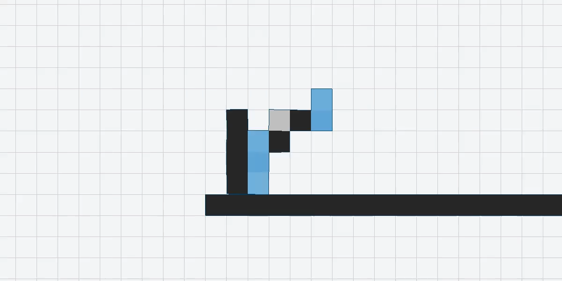
Random Control (f=3.68)
CSC 742 Evolutionary Computing
6

Slide 8
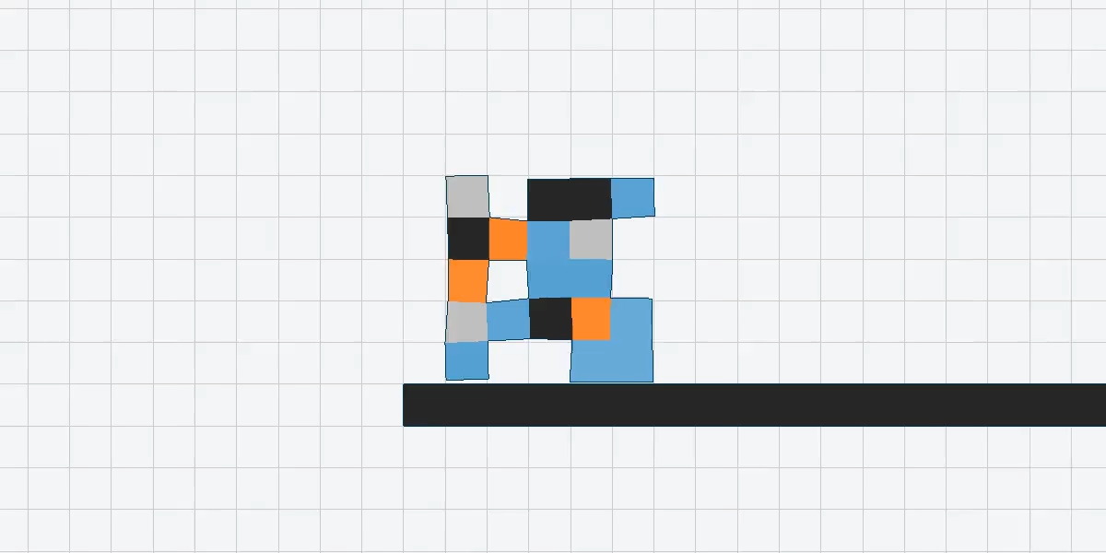
Neural Network – Mutation (f=3.05)
CSC 742 Evolutionary Computing
7

Slide 9
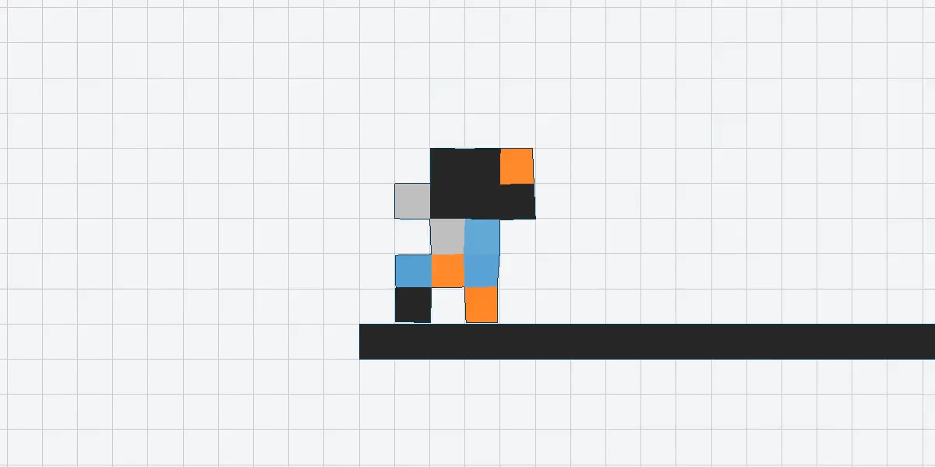
Neural Network – Crossover (f=3.26)
CSC 742 Evolutionary Computing
8

Slide 10
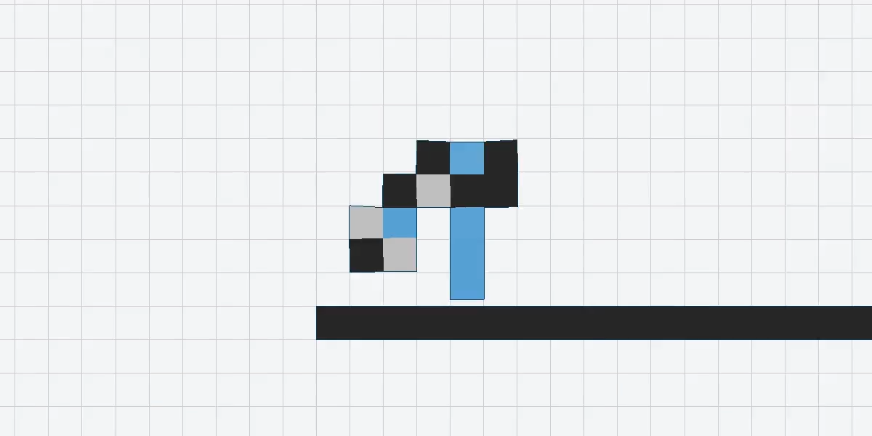
Speciation – Early Champ (f=3.57)
CSC 742 Evolutionary Computing
9

Slide 11
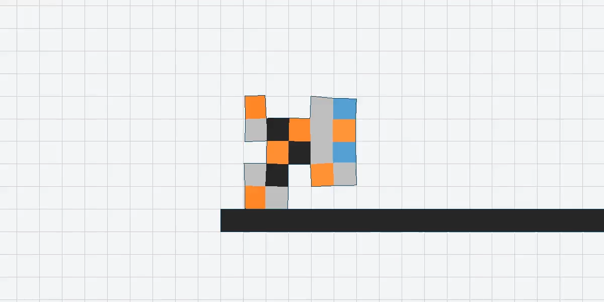
Speciation – Protected Niche (f=1.17)
CSC 742 Evolutionary Computing
10

Slide 12
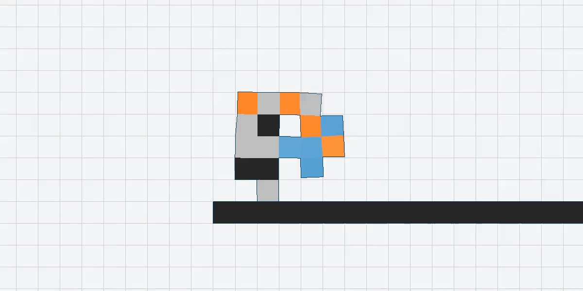
Speciation – Niche Descendant (f=4.18)
CSC 742 Evolutionary Computing
11

Slide 13
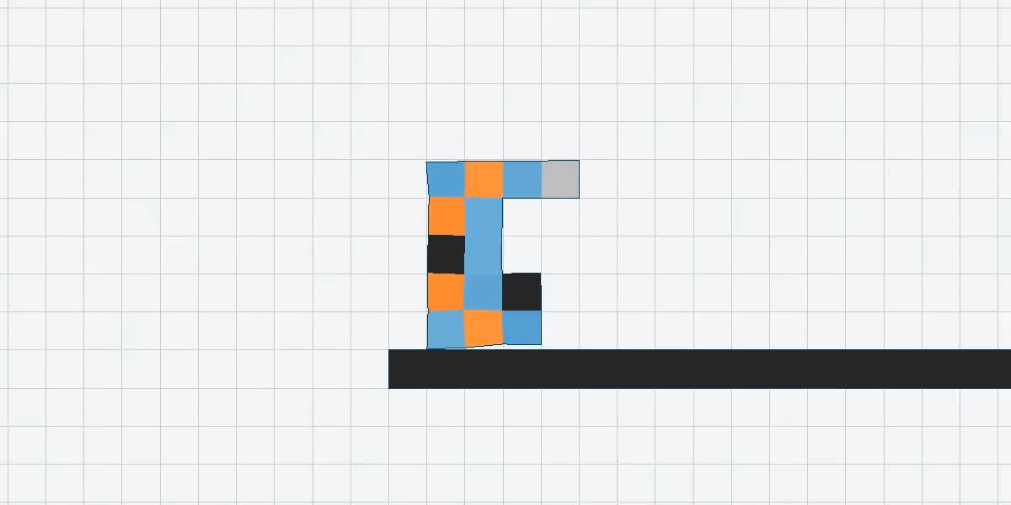
Improved Sensation (f=4.39)
CSC 742 Evolutionary Computing
12

Slide 14
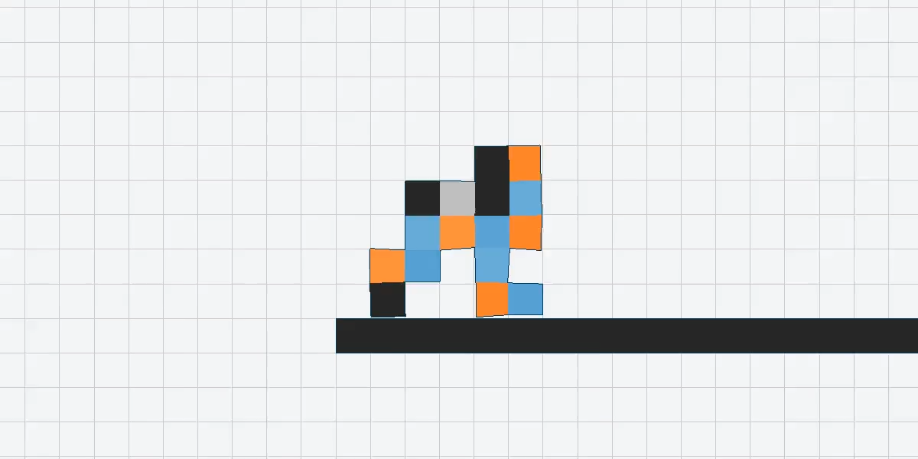
Enable/Activation Functions (f=5.14)
CSC 742 Evolutionary Computing
13

Slide 15
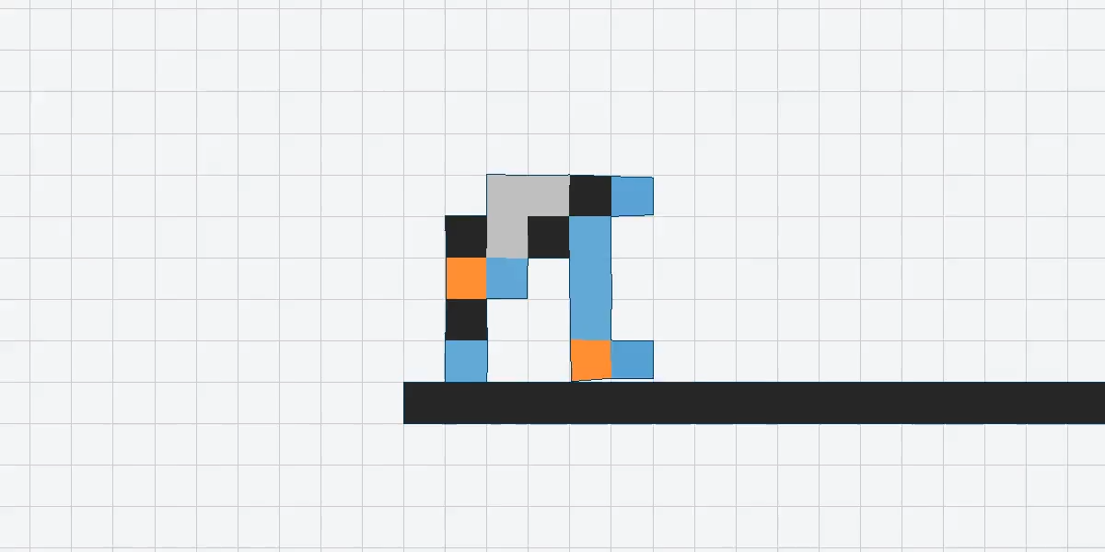
Dynamic Parameter Scheduling (f=5.61)
CSC 742 Evolutionary Computing
14

Slide 16
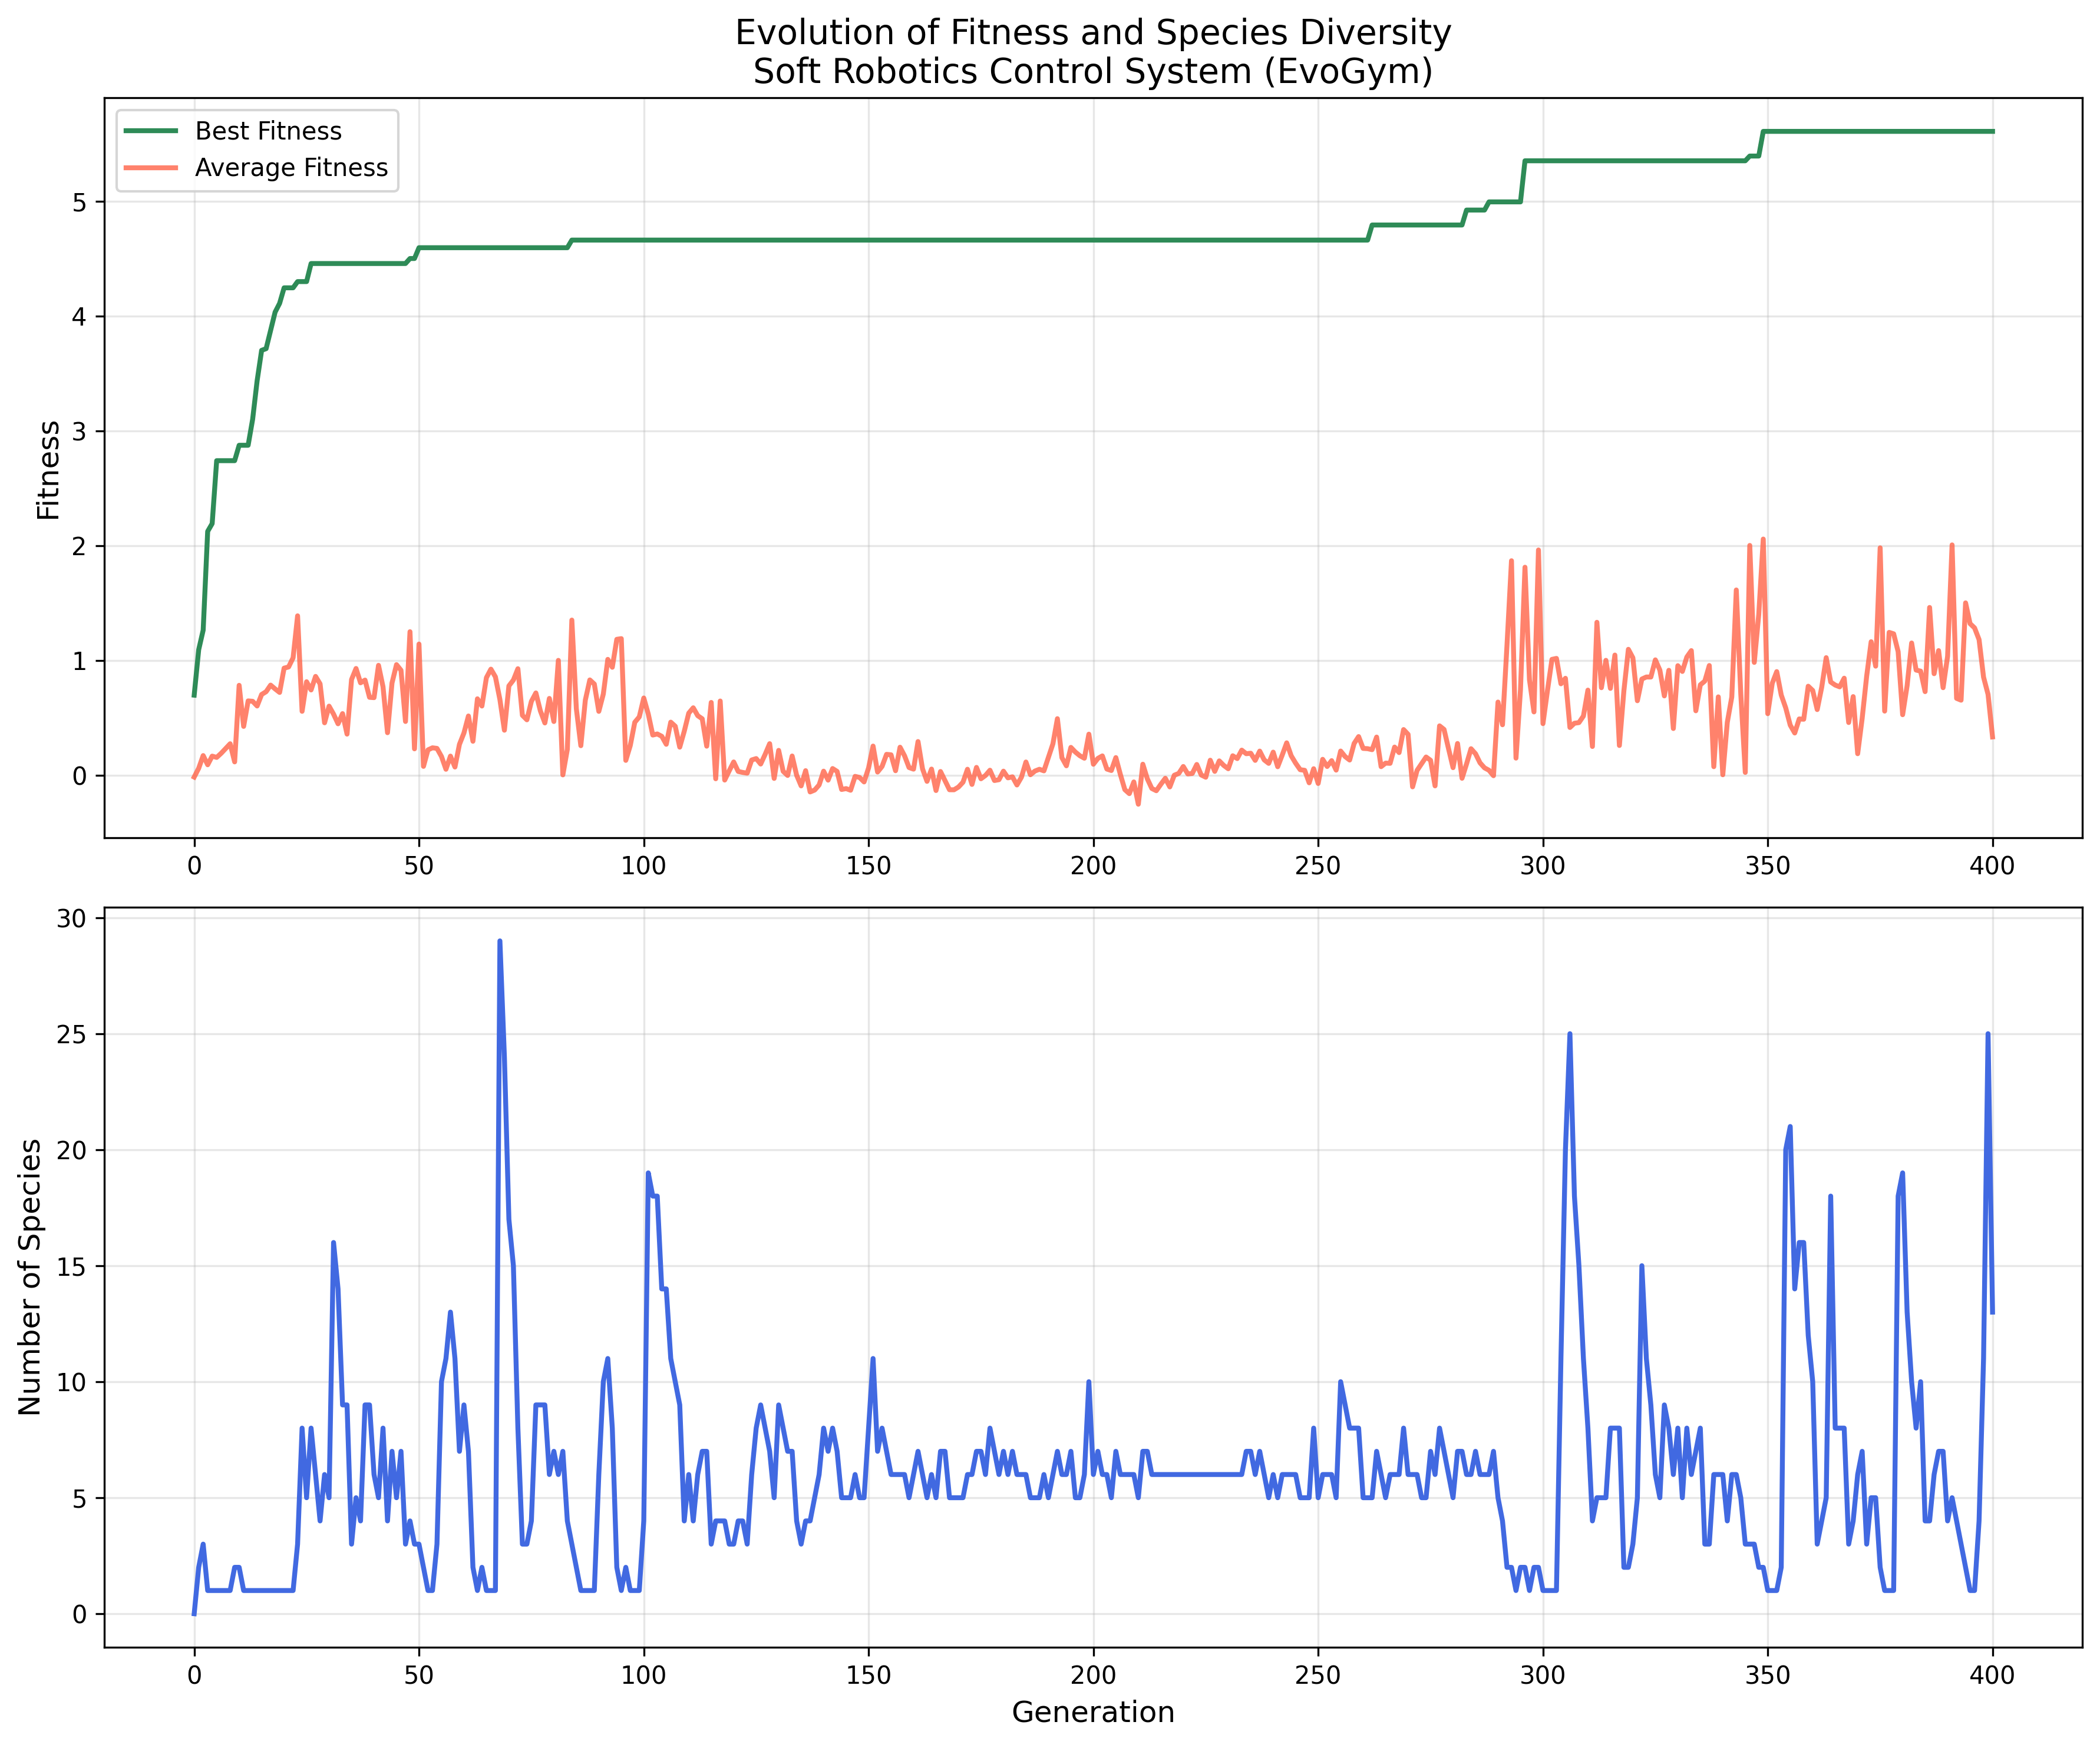
Results and Discussion
The Good:
Rapid early progress (0-50 generations) - the exploration phase works well
Successfully breaks through the long plateau around generation 300
Species diversity shows healthy fluctuations, indicating the compatibility threshold adjustments are working
The Bad:
That massive plateau from ~100-300 is brutal - 200 generations of stagnation!
Average fitness remains very low throughout, suggesting many individuals are poorly performing
The species count explosions (up to 29!) might be too extreme
CSC 742 Evolutionary Computing
15
Notes:
Goal: Present outcomes from your project.
• Present key findings (use graphs, charts, or tables if needed).
• Interpret the results: What do they mean? Do they support your hypothesis?
• Discuss whether any unexpected or surprising outcomes occurred.

Slide 17
Challenges and Risks
Challenges Faced:
Computational Complexity: So many robots to evaluate
Limited Time: Presentation deadline approaching
Parameter Tuning: 20+ interacting parameters with no clear optimal values
Expensive Mistakes: Code bugs or bad parameters waste days of compute
How I Addressed Them:
Multiprocessing: Parallel evaluation across all CPU cores
Scope Reduction: Focused on one solid implementation vs. multiple variants
Dynamic Scheduling: Make it tune its own parameters
Additional Resources: Recruited extra computers for parallel experiments
CSC 742 Evolutionary Computing
16
Notes:
Goal: Discuss any roadblocks or risks encountered.
• Technical, logistical, or other challenges faced.
• How these challenges were addressed.

Slide 18
Conclusion and Future Work
Accomplishments:
Successful NEAT implementation co-evolving bodies and brains
Demonstrated importance of speciation in protecting innovation
Created extensible framework for evolutionary robotics research
Key Contributions:
Showed how each NEAT component enables emergent complexity
Developed dynamic scheduling for automated parameter tuning
Future Directions:
Parameter Refinement: More aggressive intervention, adaptive phase transitions
Minimal Topology Start: True NEAT-style sparse initial networks
Task Diversity: Climbing, jumping, carrying - test robustness across domains
HyperNEAT: Exploit geometric regularities for scalable body plans
Degradation Studies: How controllers adapt to damage and component failure
CSC 742 Evolutionary Computing
17

