Slide 1

Submission for HACCOVID conducted by EXURO
An encyclopedia for PPE decontamination strategies
Chest No: HC_003

Slide 2
Hospital workers are the most exposed to covid-19
20%
of NYC healthcare workers are expected to contract corona virus
20,000+
healthcare workers have contracted coronavirus accross
52 countries
550+
healthcare workers have contracted coronavirus in India

Slide 3
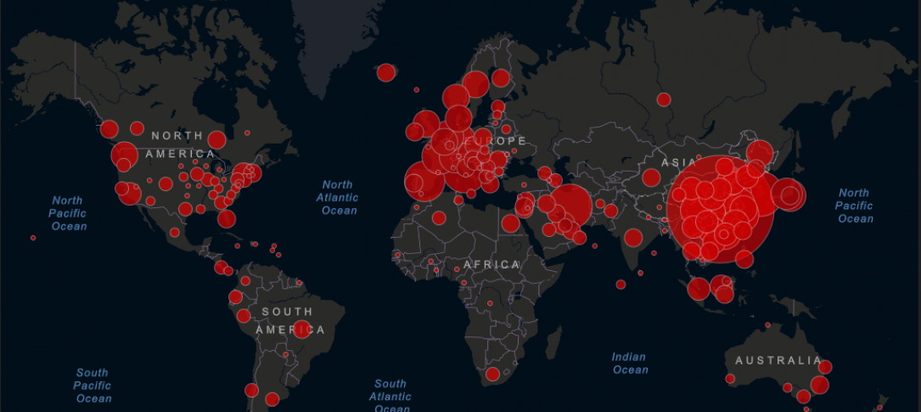
Covid-19
35,00,000+ cases in the world and it is spreading

Slide 4

Problem
During the COVID-19 epidemic,
There has been a severe shortage of personal protective equipments, such as N95 respirators, surgical masks, gloves and gowns.
This equipments are normally either disposable or designed for short term use to minimize cross-contamination, but healthcare providers have been forced to use them for long periods of time out of necessity.
Given this situation, many providers have been seeking out solutions for sanitizing and reusing their equipment in a more safe manner, but information on how to do this is scattered, hard to find, and not vetted for quality.

Slide 5
Implementation
A Non-profit platform that allows healthcare providers to easily share strategies for sanitizing and reusing their personal protective equipment.
This strategies should only be used as extrodinary last-resort method in the event of imminent shortage of such kits.
Strategies are organized by type and model of PPE.
Users who submit strategies are vetted to ensure they are qualified healthcare professionals.
Users can vote on strategies submitted by other users.
Strategies that appear to be effective and are evidence based with the source of strategy listed
Our small development team built a Django web app to implement our idea

Slide 6



Tech Stack Used
We will be going to make use of the following tools and technologies to build our webapp:
1.HTML,Bulma (Front end)
2.Django ( backend)

Slide 7
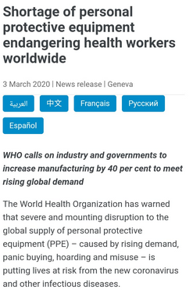
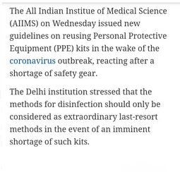
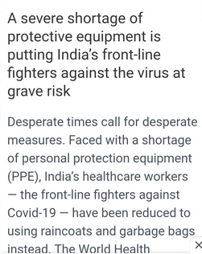
Why this will help
Reusing is one method of controlling supply shortages.
This is a one stop platform for all reuse methods to help in the event of extreme shortage
03 March,BBC
12 April,Business Line
20 April,The Hindu

Slide 8
Cost Structure
1.Computing costs(hosting)
2.Dissemination activities and other improvisations
Business Model(B2C)
Absolutely free! Our main initiative is to help as many people as we can during this pandemic

Slide 9
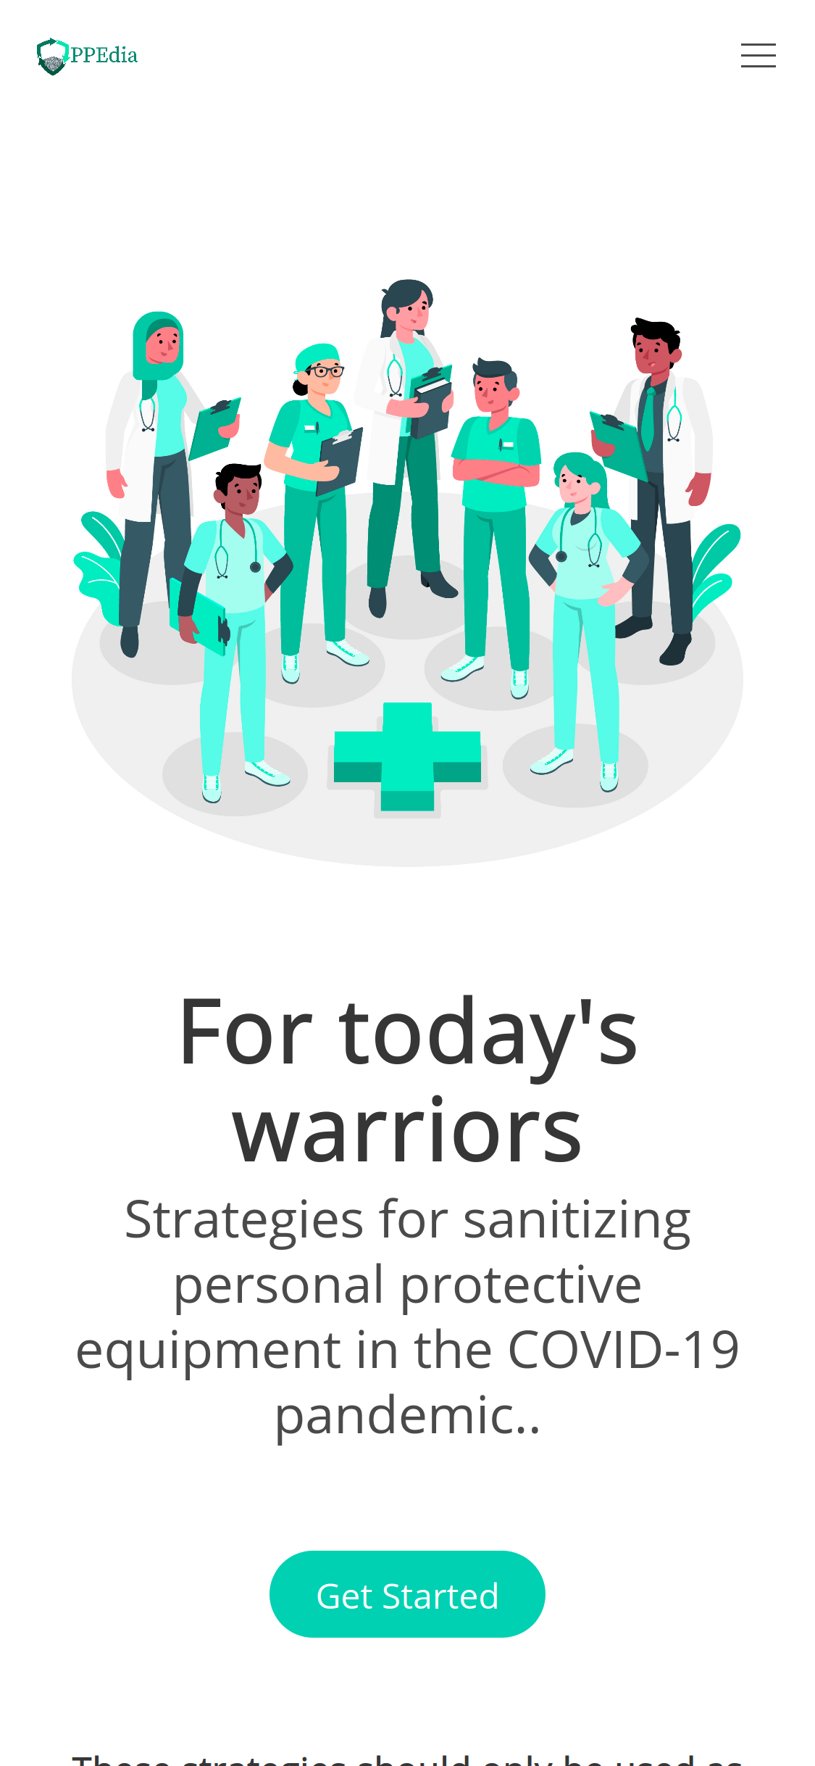
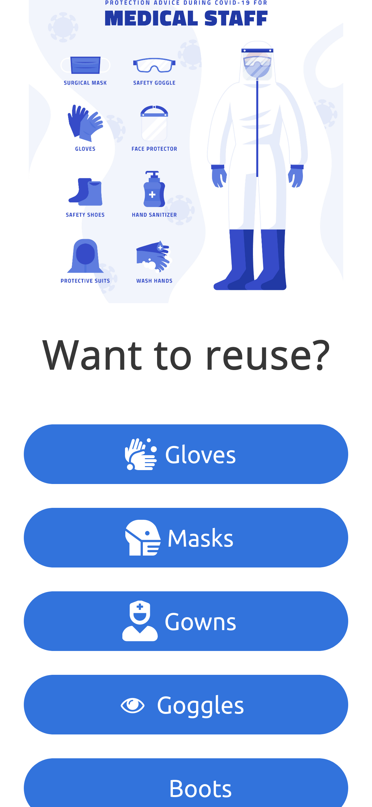
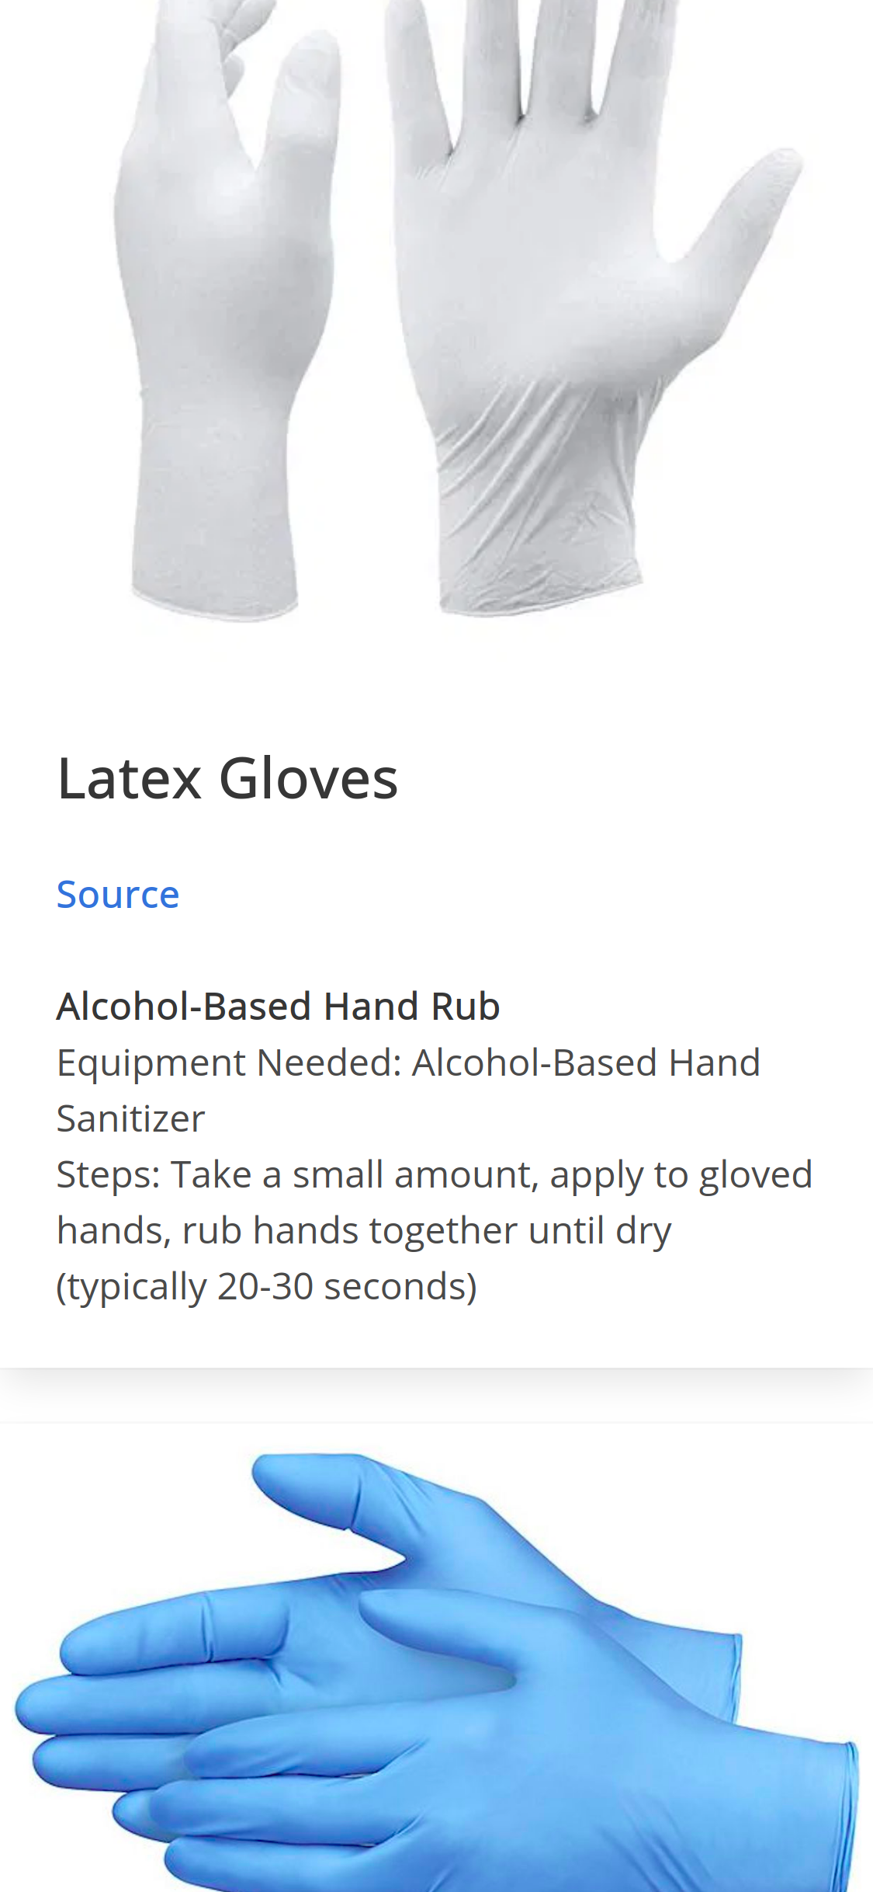
WebApp Screenshots
Home
Menu
Gloves page

Slide 10
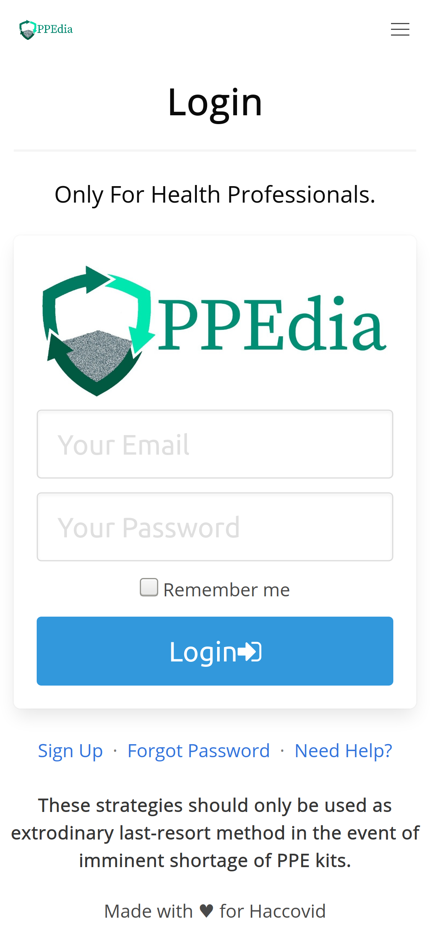
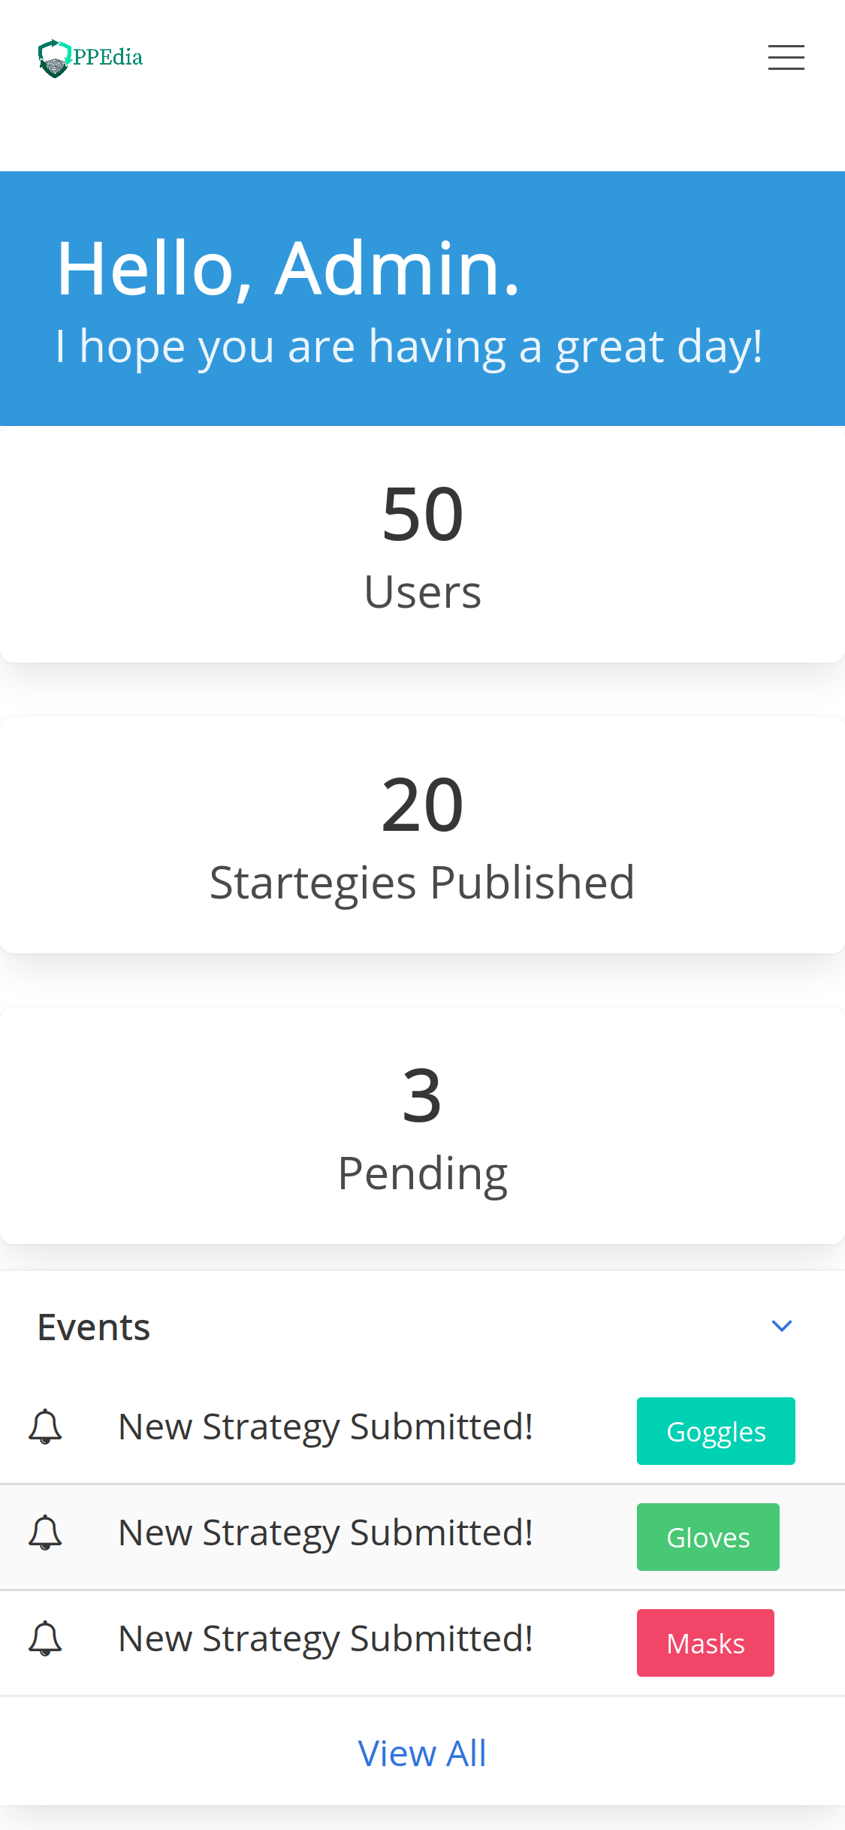
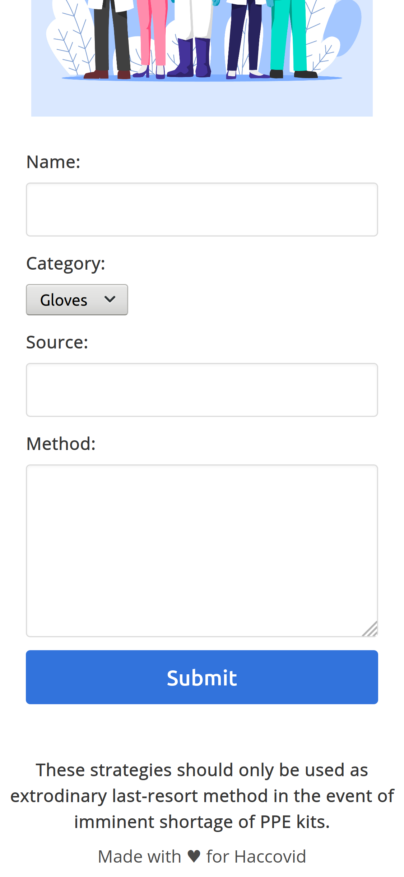
Login
Page Admin
Submit Strategy

Slide 11

Project Demo
The website is live at- https://ppeapp.herokuapp.com/

Slide 12
What’s Next…?
Collect data of local vendors to act as a median between suppliers and buyers
Improvisation to help local PPE demand to find local PPE supply, and vice-versa
We can use assistance from global partners who can help bring this project to scale to help communities get the resources to protect their healthcare workers.

Slide 13
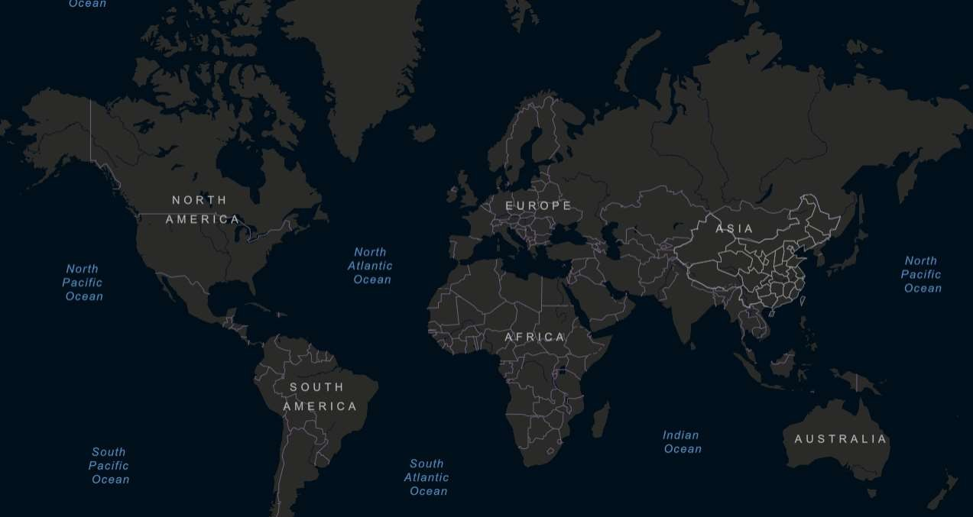
Hoping to see the world free again

