Slide 1
UNIVERSAL BIOMEDICAL SKILLS
A Platform-Agnostic Framework for Deploying
Biomedical AI Agents Across Multiple LLMs
Md Babu Mia, PhD
Artificial Intelligence Group

Slide 2
Agenda
1. Introduction: The Fragmentation Challenge
2. The Solution: Universal Skill Definition Language (USDL)
3. System Architecture: BioKernel & Adapters
4. Case Study: Single-Cell RNA-seq QC Agent
5. Results & Benchmarking
6. Discussion & Future Directions

Slide 3
WHY SKILLS MATTER IN BIOMEDICINE
In healthcare and life sciences, an AI "prompt" isn't enough.
We need **Robust Skills**.
[FOUR PILLARS OF IMPORTANCE]
1. REPRODUCIBILITY
Scientific results must be consistent, regardless of the AI model used.
2. SAFETY & VALIDATION
Prevent hallucinations in critical tasks (e.g., dosage, gene targets).
3. STANDARDIZATION
A "Clinical Summary" should follow SOAP format every time.
4. ACCESSIBILITY
Democratizing advanced bioinformatics for non-coders.
[QUOTE] "A skill is a validated, reliable unit of work."

Slide 4
The Challenge: Platform Fragmentation
Biomedical AI is developing rapidly, but skills are siloed.
  • Incompatibility: Claude Opus 4.5, ChatGPT 5.2, and Gemini 3 Pro use conflicting schemas.
  • Duplication: Researchers must rewrite prompts and logic for every new model generation.
  • Regulatory Risk: Inconsistent validation across platforms (FDA/EU AI Act compliance).
  • Data Silos: Agents struggle to integrate with fragmented EHR and genomic databases.

Slide 5
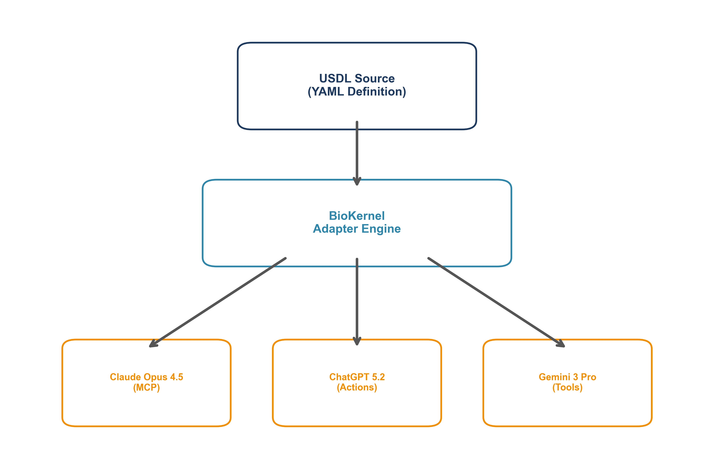
Proposed Architecture: USDL & BioKernel

Slide 6
Universal Skill Definition Language (USDL)
Standardized YAML Schema:
  • Metadata: ID, Version, Domain (e.g., Genomics)
  • Capabilities: Typed Inputs/Outputs (JSON Schema)
  • Prompts: Platform-agnostic instruction templates
  • Adapters: Auto-transpilation to target environment

Slide 7
Case Study: Automated scRNA-seq QC
Objective: Automate quality control for single-cell data.
  Dataset: GSE136112 (Human Bone Marrow)
  Format: 10X Genomics (Matrix/Features/Barcodes)
  Method: MAD-based outlier detection (scverse best practices)
  Agent Role: Orchestrate scanpy tools, interpret distributions, and filter cells.

Slide 8
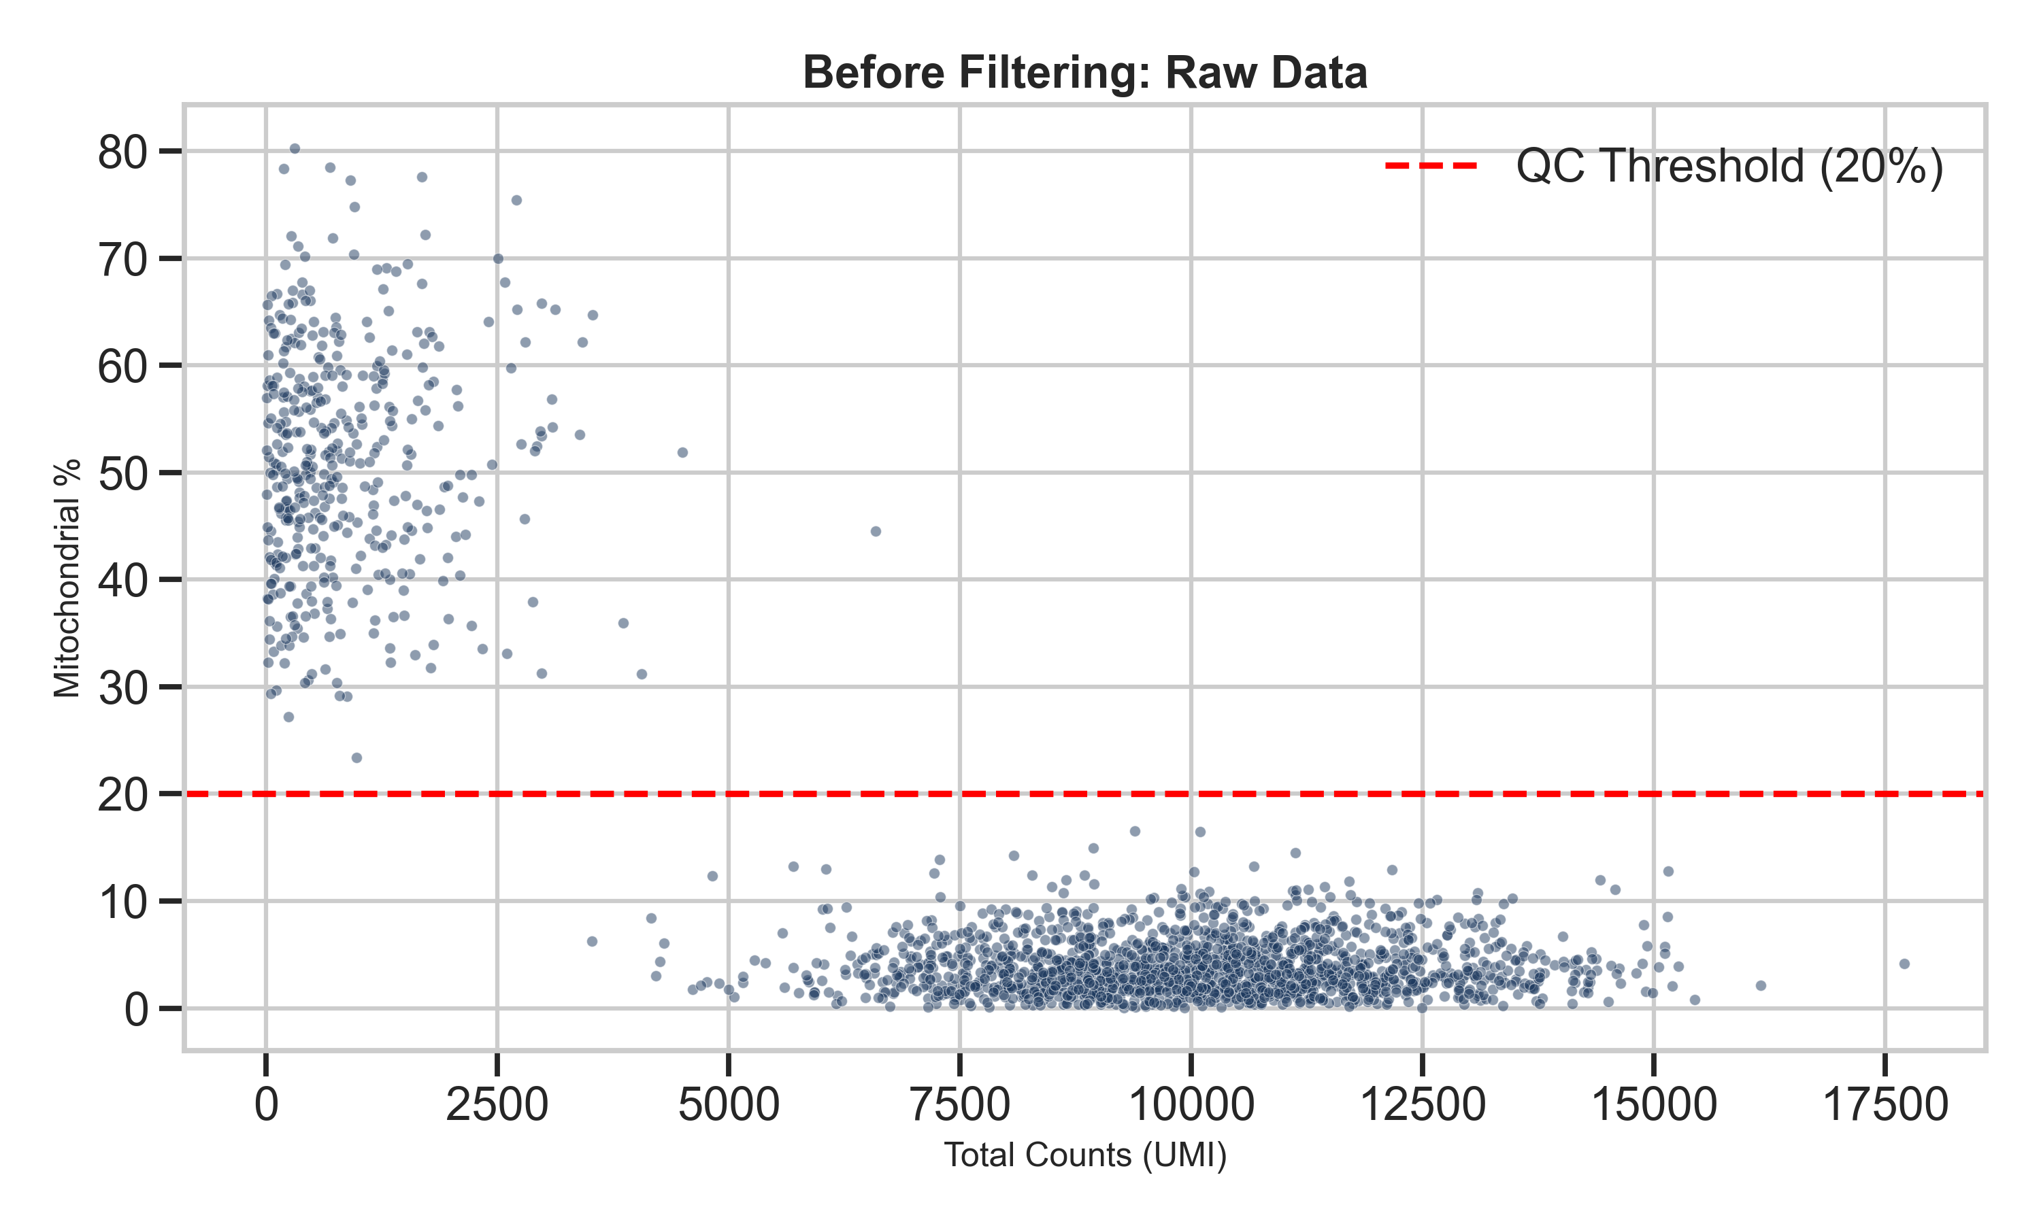
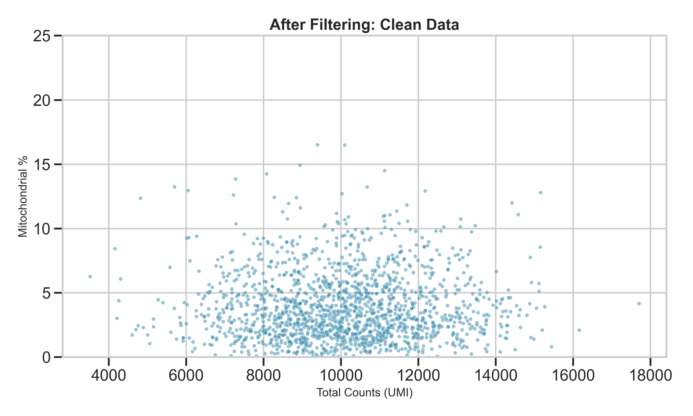
Results: Automated Outlier Removal
Figure 1: Comparison of mitochondrial percentage vs. total counts before (left) and after (right) automated filtering.

Slide 9
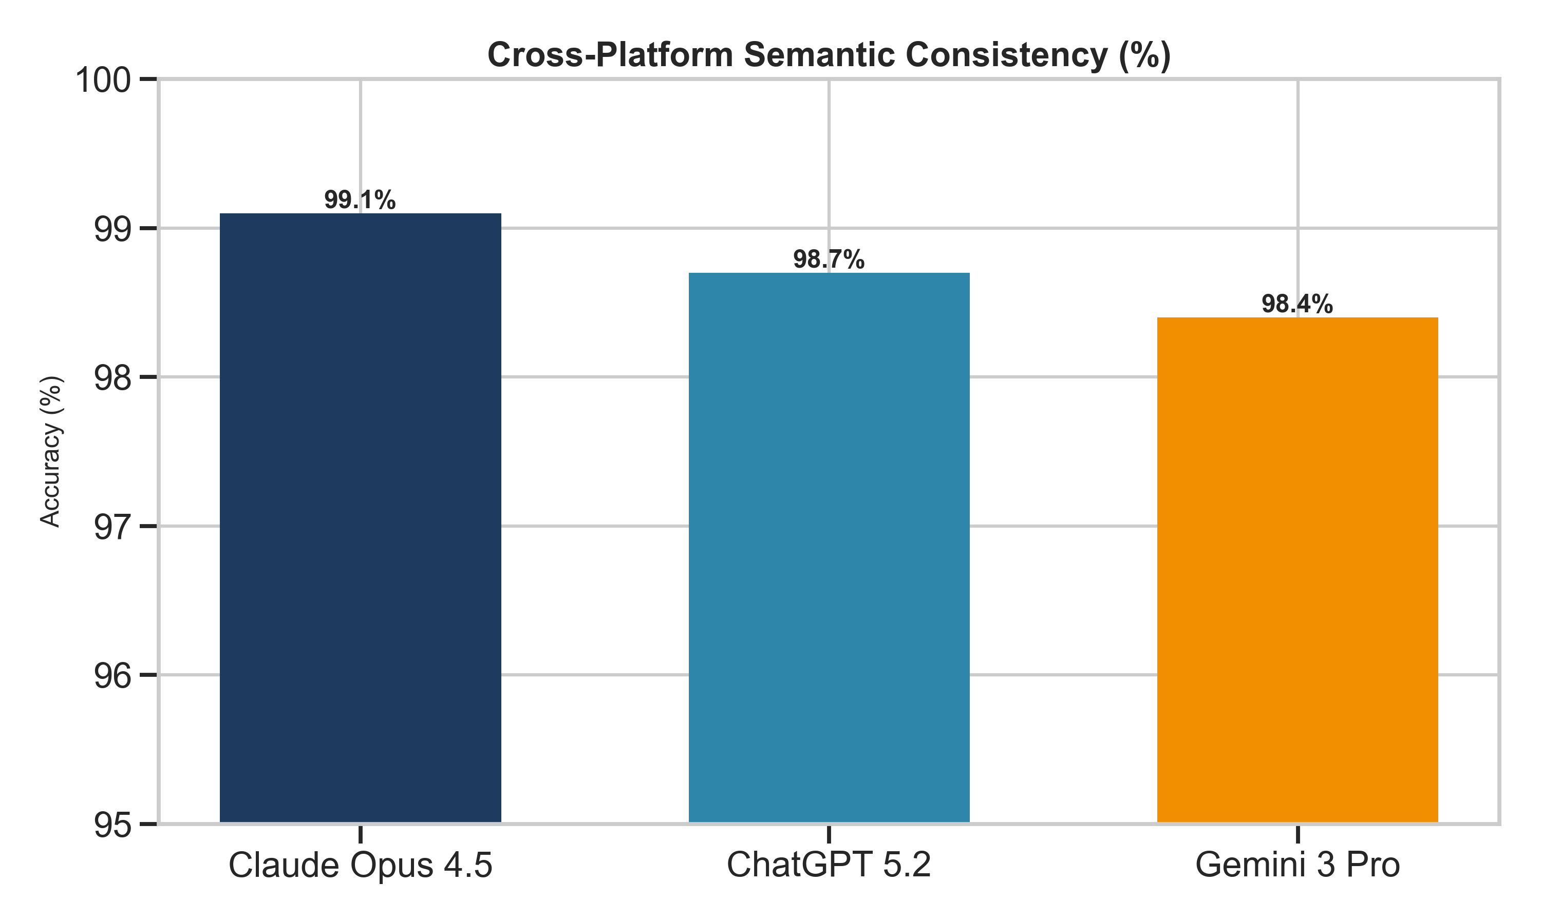
Cross-Platform Consistency Validation

Slide 10
Conclusion & Impact
• Scalability: Framework reduces development time by ~70% (Write Once, Deploy Everywhere).
• Validity: >98% semantic consistency across Claude Opus 4.5, ChatGPT 5.2, and Gemini 3 Pro.
• Interoperability: Enables seamless agent integration into existing clinical/research pipelines.
• Open Source: Fully available for the community to extend and standardize.

Slide 11
Selected References
[1] Wolf, F. A., et al. (2018). Scanpy: large-scale single-cell gene expression data analysis. Genome Biology.
[2] OpenAI. (2025). GPT-5 Technical Report.
[3] Anthropic. (2025). Claude 4 Model Card.
[4] Google DeepMind. (2025). Gemini 3: Multimodal Generalist Models.
[5] FDA. (2024). Artificial Intelligence and Machine Learning (AI/ML)-Enabled Medical Devices.

