Slide 1
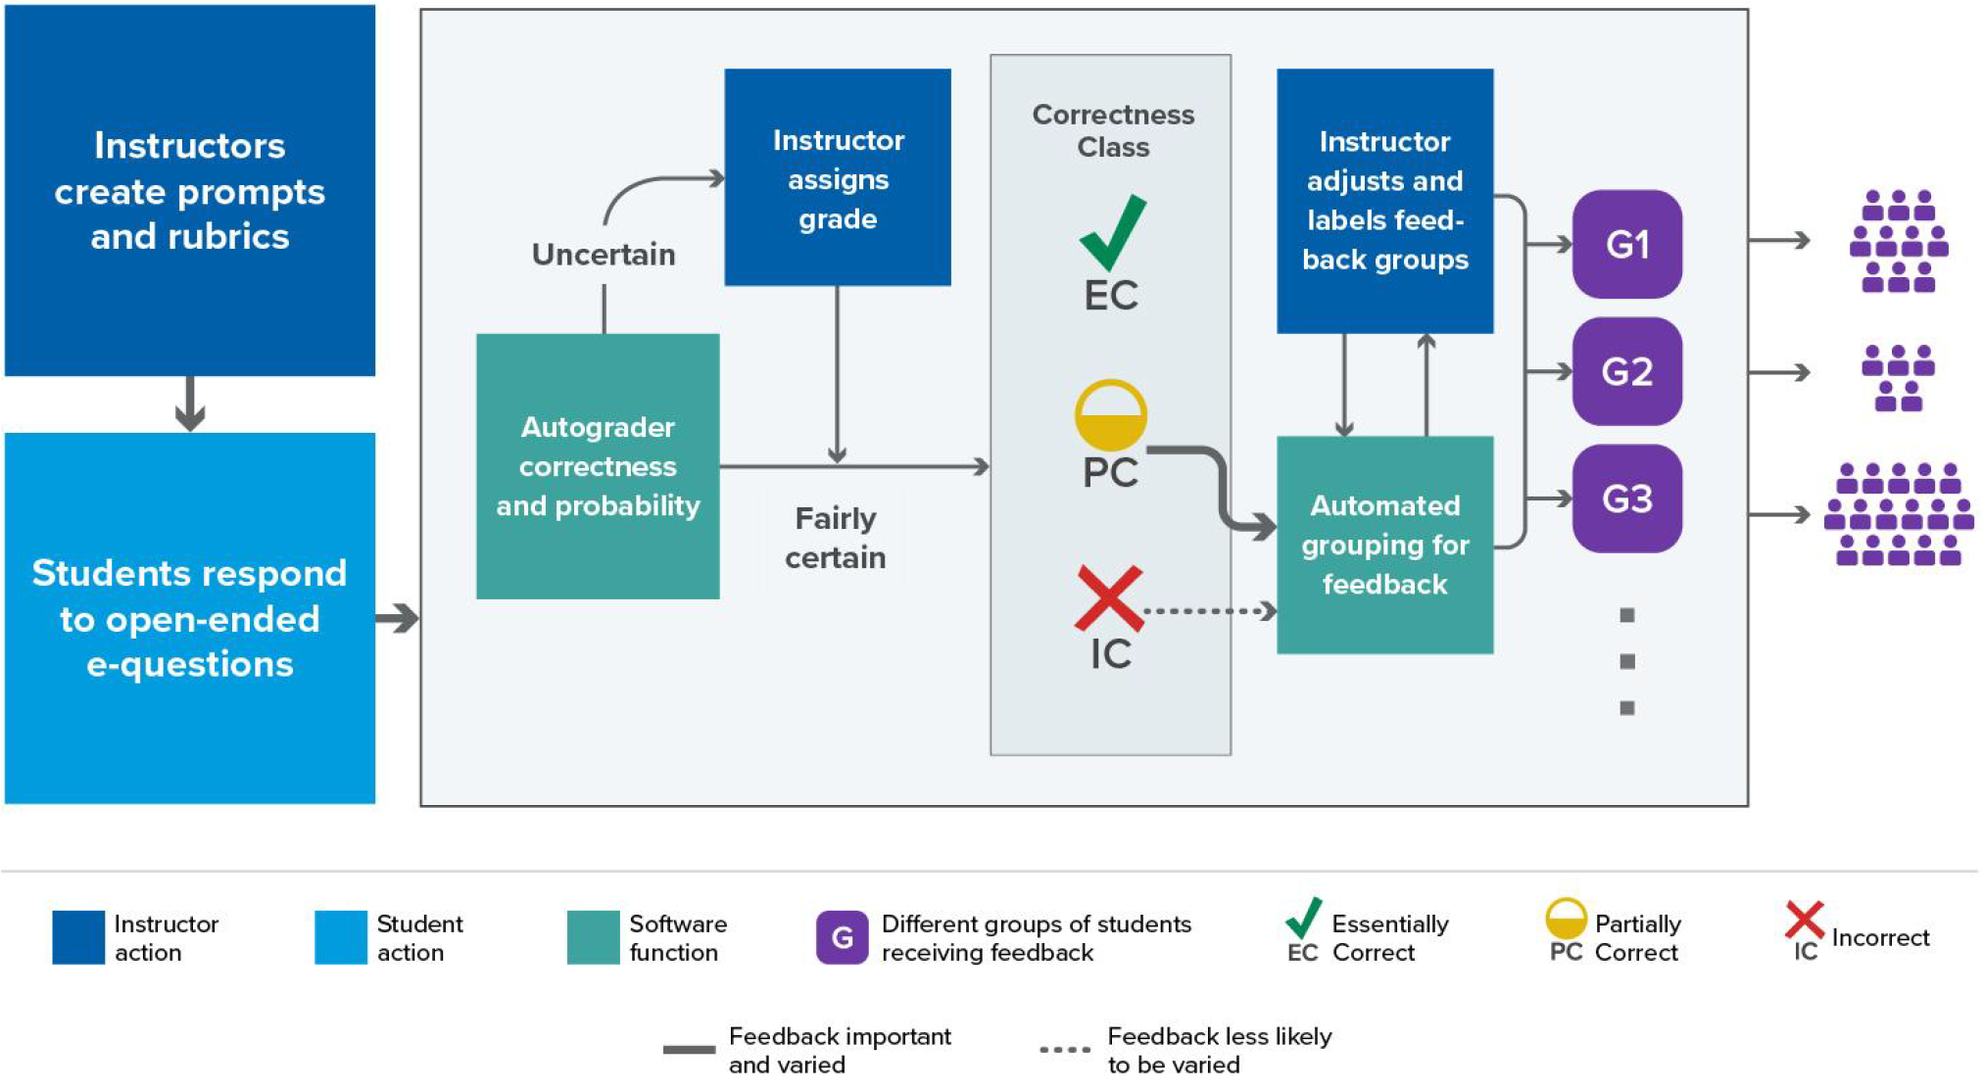
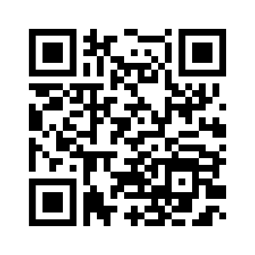

Progress toward NLP-assisted formative assessment feedback
"write-to-learn" tasks improve learning outcomes, yet constructed-response methods become unwieldy when class sizes are large
Logistical obstacles impair pedagogical best practices
Investigating NLP tools with human-in-the-loop architecture to facilitate scalability—improve student benefit while mitigating instructor burden
Schematic: Q >> A >> evaluate >> cluster >> feedback
Recent (Susan Lloyd): Classification performance & HIL policy
Ongoing (Elle Tang): Implications of language diversity
Future: Evaluate competing methods of feedback; assess effectiveness, student engagement, scalability, etc
Related Papers & Acknowledgement:
Li, Z., Lloyd, S., Beckman, M. D., & Passonneau, R. J. (2023). Answer-state Recurrent Relational Network (AsRRN) for Constructed Response Assessment and Feedback Grouping. *Findings of the Conference on Empirical Methods in Natural Language Processing (EMNLP) 2023*. https://doi.org/10.18653/v1/2023.findings-emnlp.254
Lloyd, S. E., Beckman, M., Pearl, D., Passonneau, R., Li, Z., & Wang, Z. (2022). Foundations for AI-Assisted Formative Assessment Feedback for Short-Answer Tasks in Large-Enrollment Classes. In Proceedings of the eleventh international conference on teaching statistics. Rosario, Argentina.
NSF Award #2236150 (Project CLASSIFIES)
Curious about SDSE?
Talk to me!
SDSE Research Lab—Spring 24 Wed @ 4pm in 421 Thomas Bldg
JSM Sessions
eCOTS Conference
IASE catalog of PhD dissertations in statistics education
causeweb.org
Matthew Beckman
Statistics & Data Science Education (SDSE) Research
^^ 20 Second Survey ^^
Contact:
mdb268@psu.edu
421C Thomas Building
mdbeckman.github.io
mdbeckman.github.io/2024-PSU-Stat-Research-Day

