Slide 1
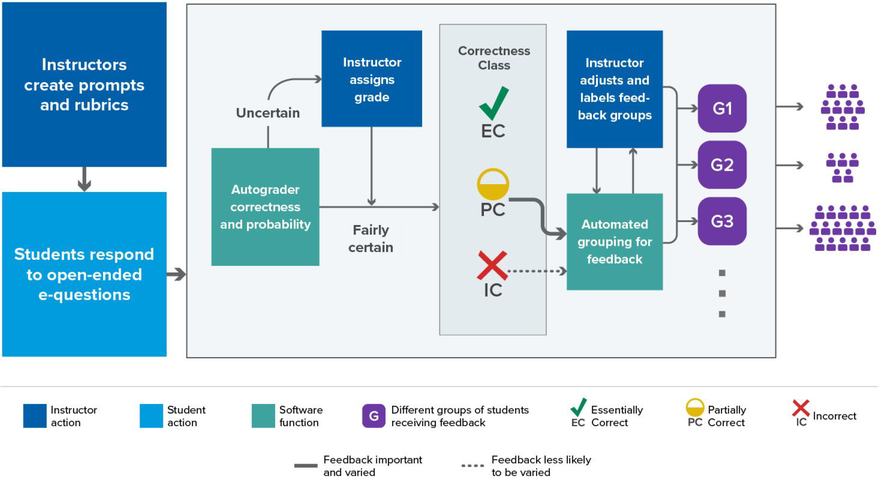
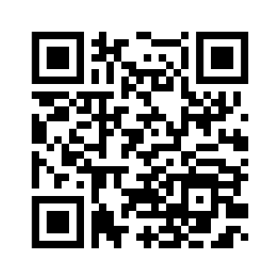

Progress toward NLP-assisted formative assessment feedback
"write-to-learn" tasks improve learning outcomes, yet constructed-response methods become unwieldy when class sizes are large
Logistical obstacles impair pedagogical best practices
Investigating NLP tools with human-in-the-loop architecture to facilitate scalability—improve student benefit while mitigating instructor burden
Schematic: Q >> A >> evaluate >> cluster >> feedback
Recent (Susan Lloyd): Classification performance & HIL policy
Ongoing (Elle Tang): Implications of language diversity
Future: Evaluate competing methods of feedback; assess effectiveness, student engagement, scalability, etc
Related Papers & Acknowledgement:
Li, Z., Susan Lloyd, Beckman, & Passonneau (2023). Answer-state Recurrent Relational Network (AsRRN) for Constructed Response Assessment and Feedback Grouping. Findings of the Conference on Empirical Methods in Natural Language Processing (EMNLP) 2023
Susan Lloyd, Beckman, Pearl, Passonneau, Li, & Wang (2022). Foundations for AI-Assisted Formative Assessment Feedback for Short-Answer Tasks in Large-Enrollment Classes. In Proceedings of the eleventh international conference on teaching statistics. Rosario, Argentina.
NSF Award #2236150 (Project CLASSIFIES)
Other Projects/Interests
Educational Assessment
Developing & analyzing tools to measure specific learning outcomes. Novel approaches to assessment.
”Tests" for research across academic institutions;
Formative assessment; e.g., feedback for self-regulated learning and/or adaptive instruction
> Sayali Phadke, Beckman, Lock Morgan (in review). Measuring contextualized statistical literacy: Evidence from an isomorphic assessment.
Data Science Education
Intersection of stat education & computing education
Studying DS/CS topics introduced as learning objectives in statistics curricula
Data literacy, data acumen, EDA for Data Science
> Alyssa Hu, Hatfield, Beckman (in review). Exploring How Novices and Experts Engage in Computational Thinking with Data.
> Beckman et al (2021). Implementing Version Control With Git and GitHub as a Learning Objective in Statistics and Data Science Courses. JSDSE, 29(1).
Matthew Beckman
Statistics & Data Science Education (SDSE) Research
^^ 20 Second Survey Before Talk ^^
Curious about SDSE?
SDSE Research Lab—Spring 2024 Wed @ 4pm in 421 Thomas Bldg
Conferences: JSM; eCOTS; USCOTS
IASE catalog of PhD dissertations
causeweb.org
Talk to me!
mdb268@psu.edu
421C Thomas Building
mdbeckman.github.io

