Slide 1
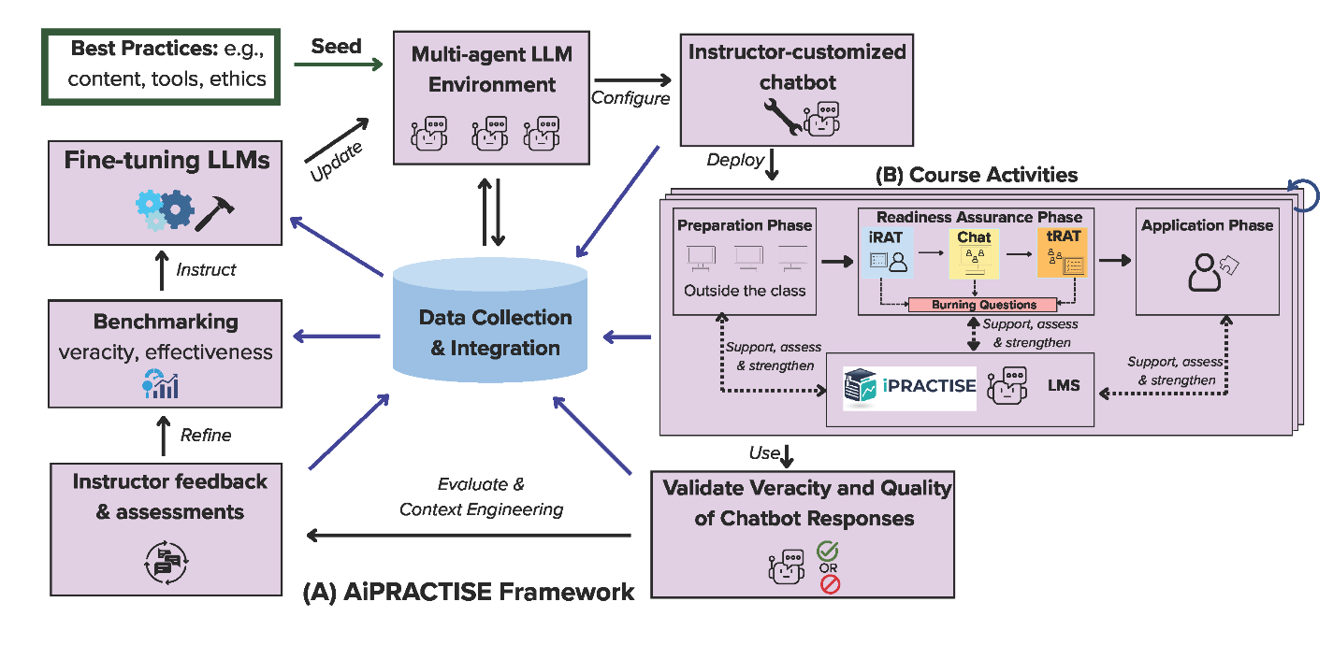
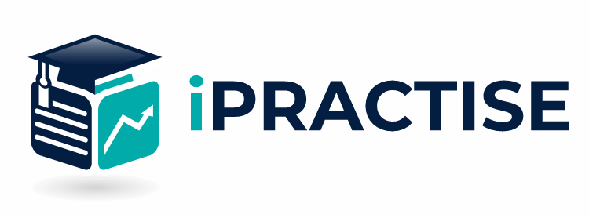
Chatbots to answer burning questions 24/7 and promote collaborative learning with team members
https://ipractise.net
Assessments (adaptive + traditional) and training resources on R, calculus, probability theory
Notes:
Figure 1. (A) An overview of the proposed AiPRACTISE framework featuring multiple iterations of deployment, validation, benchmarking, and fine-tuning of a multi-agent LLM environment hosting multiple courses; and (B) multiple iterations of course activities with TBL utilizing iPRACTISE, chatbots, and LMS. TBL is an approach to education that integrates direct didactic instructions (e.g., large class lecturing) with more open, small-group-based assignments(Michaelsen et al., 2002; Michaelsen & Sweet, 2008; Rotgans et al., 2018). A TBL-cycle consists of three phases: (1) a preparation phase; (2) a readiness assurance phase comprising iterations through an individual readiness assurance test (iRAT), team readiness assurance test (tRAT), and burning questions to strengthen students’ understanding; and (3) an application phase(Parmelee & Michaelsen, 2010) that encourage students to apply what they have learned.
Michaelsen, L. K., Knight, A., & Fink, L. (2002). Team-based learning: A transformative use of small groups.
Michaelsen, L. K., & Sweet, M. (2008). The essential elements of team-based learning. New Directions for Teaching and Learning, 2008(116), 7–27. https://doi.org/10.1002/tl.330
Parmelee, D., & Michaelsen, L. K. (2010). Twelve tips for doing effective Team-Based Learning (TBL). Medical Teacher, 32, 118–122.

