Slide 1
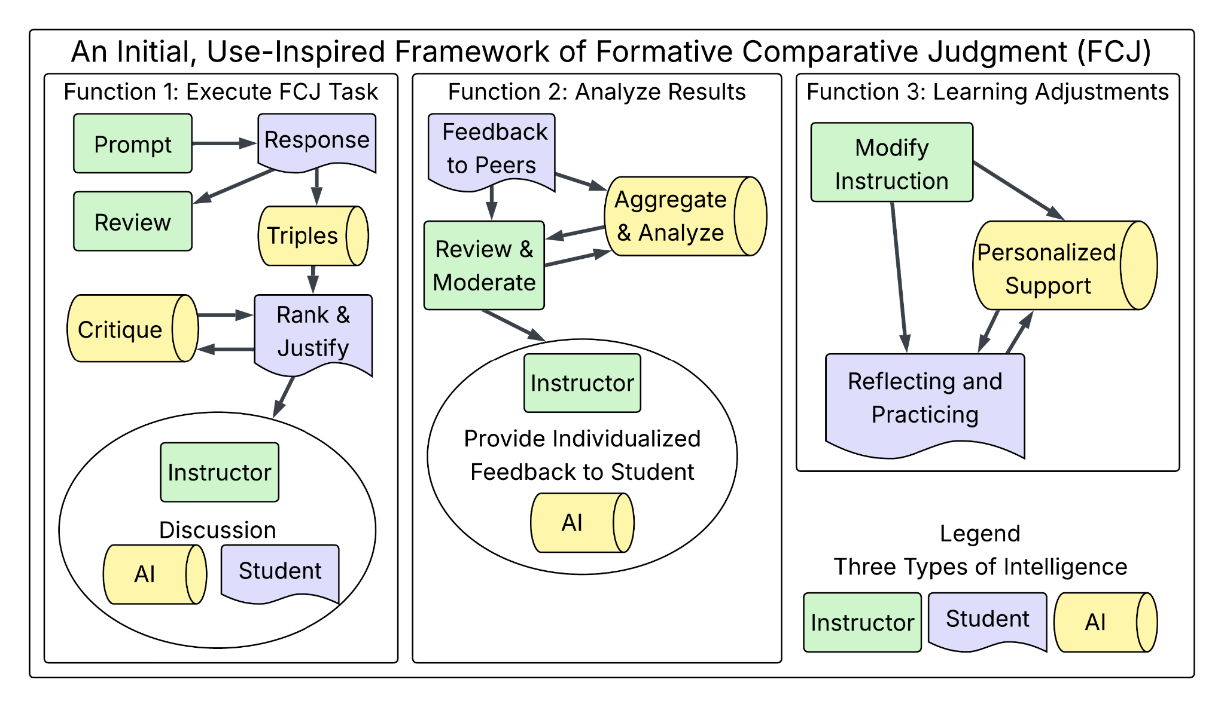
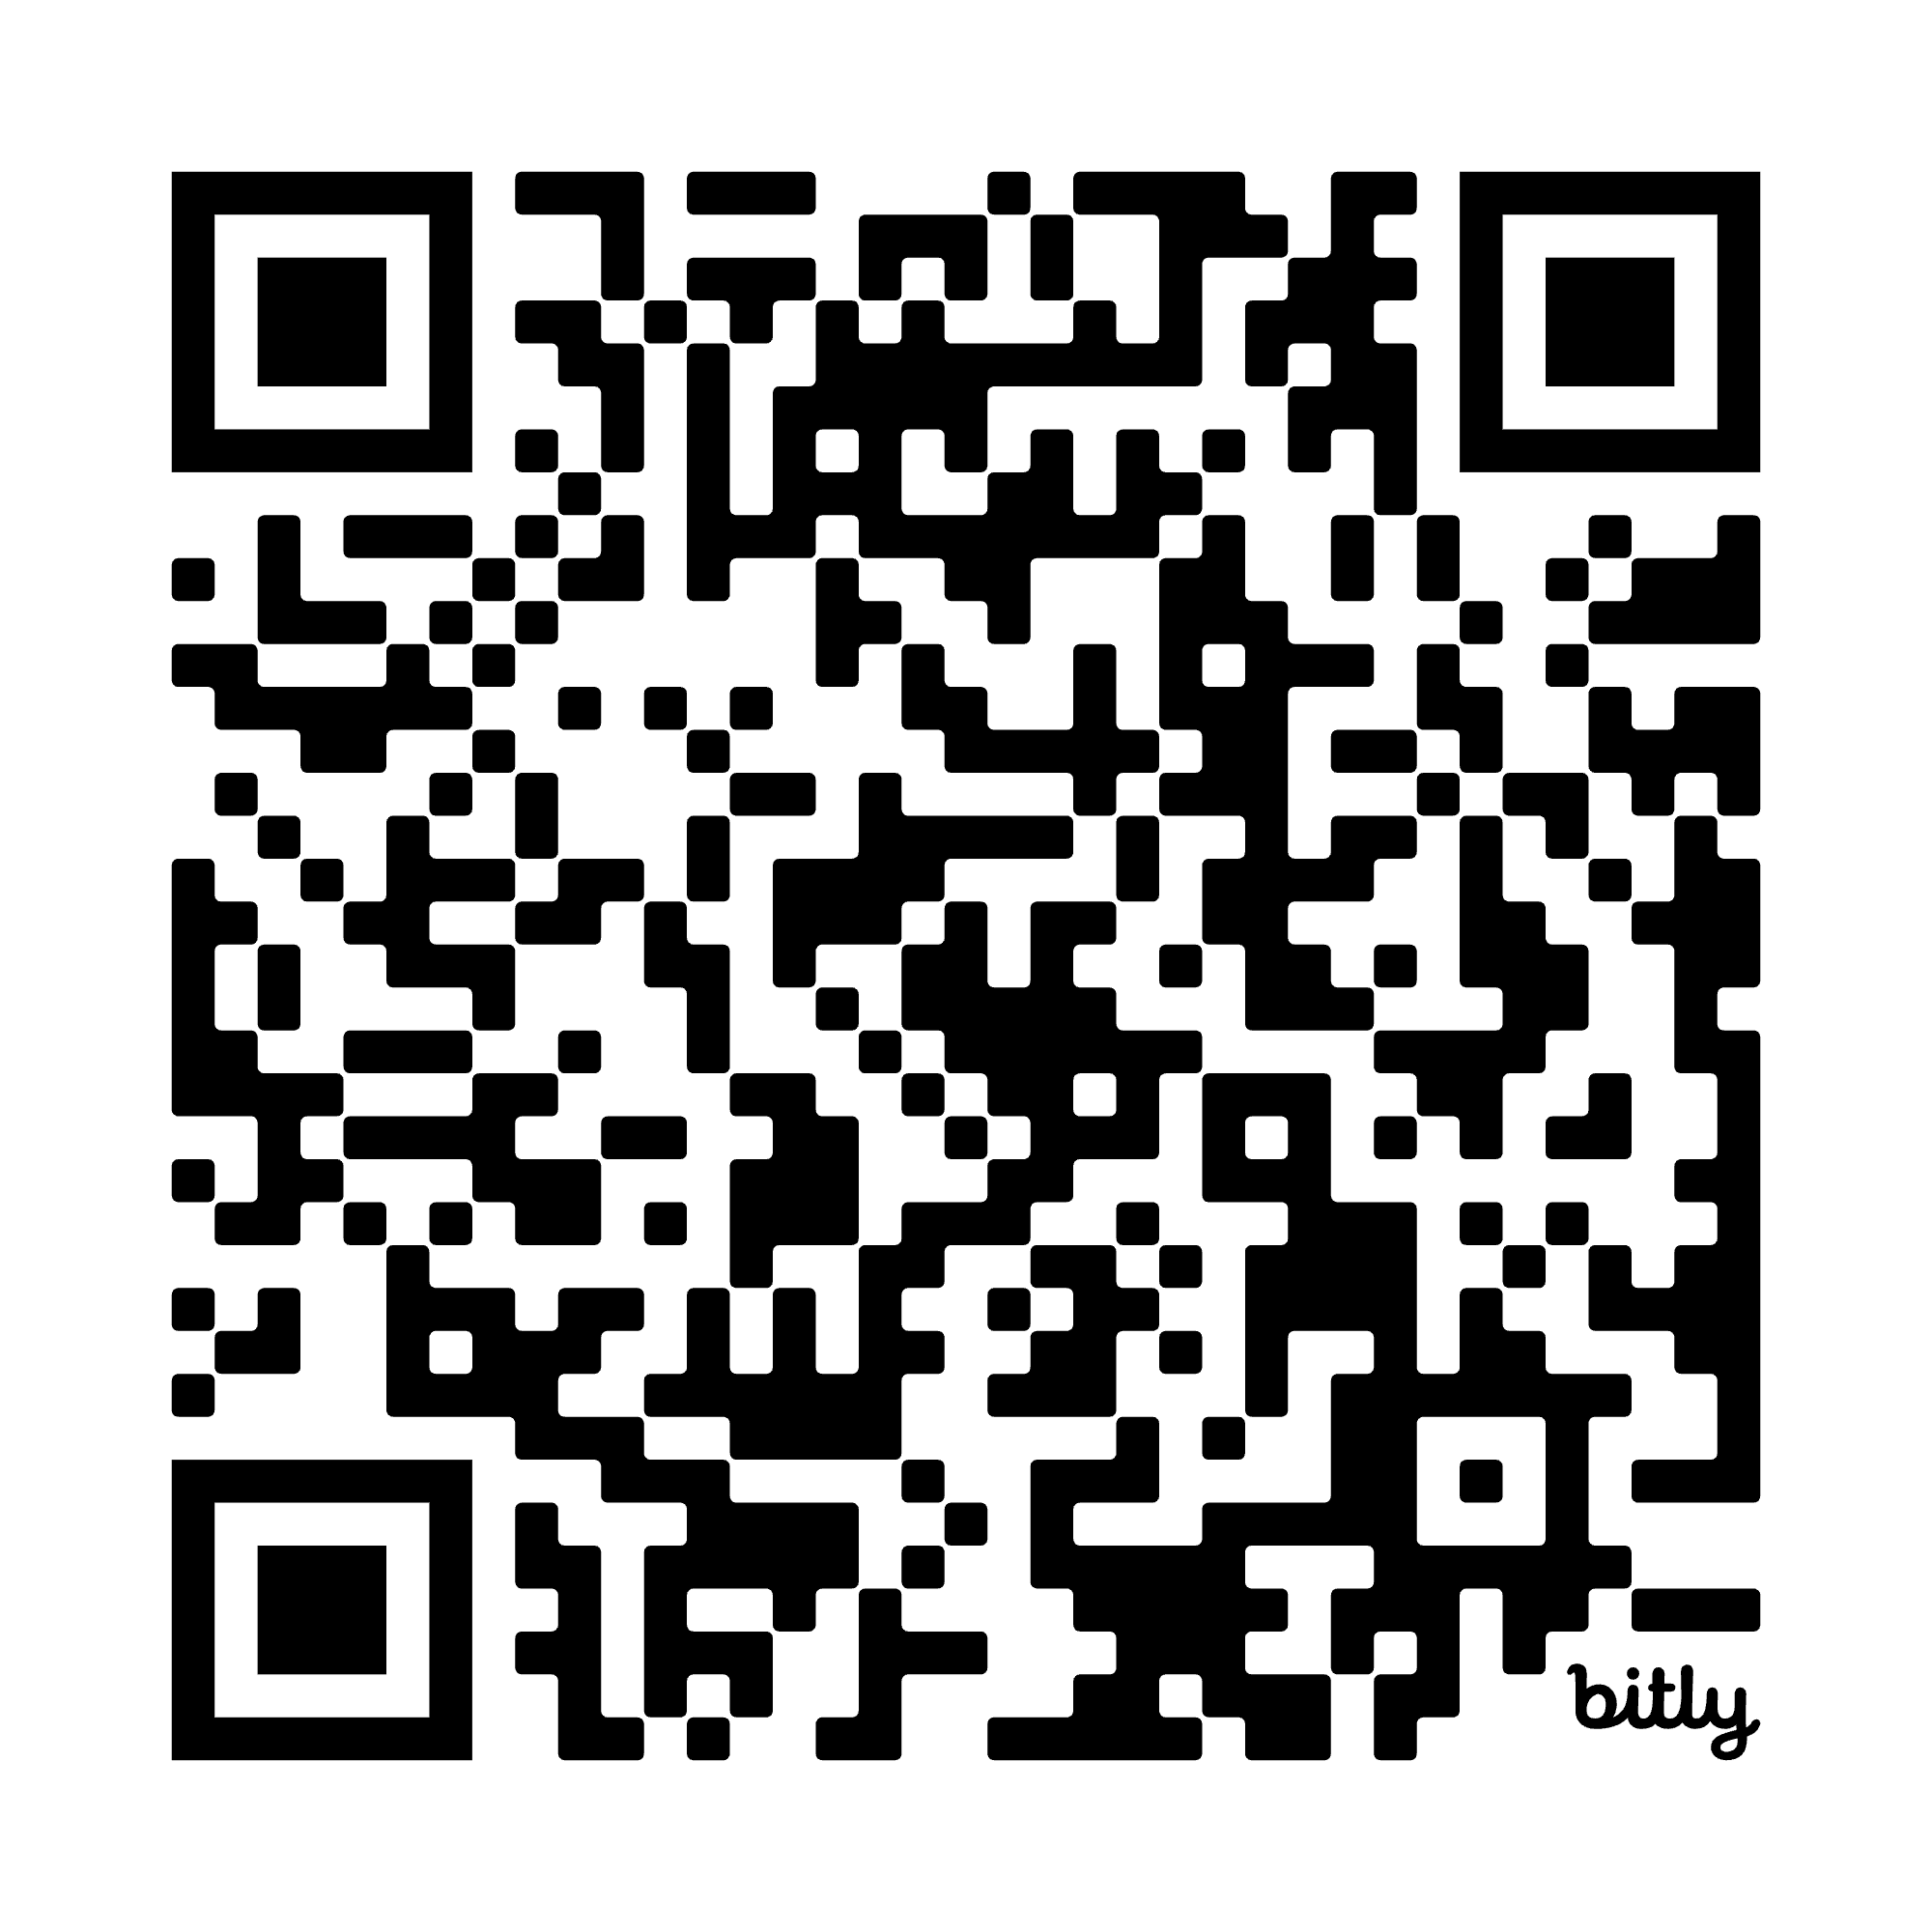

AI-support for teaching and learning at scale
"write-to-learn" tasks improve learning outcomes, yet constructed-response methods become unwieldy when class sizes are large
Develop LLM and AI-based tools intended to amplify instructor efforts to provide timely, personalized feedback
Build trust and confidence that human-AI partnerships make a responsible contribution
Related Papers & Acknowledgement:
Beckman, Burke, Fiochetta, Fry, Susan Lloyd, Patterson, Elle Tang (in review). Developing Consistency Among Undergraduate Graders Scoring Open-Ended Statistics Tasks. Preprint URL: https://arxiv.org/abs/2410.18062
Li, Susan Lloyd, Beckman, & Passonneau (2023). Answer-state Recurrent Relational Network (AsRRN) for Constructed Response Assessment and Feedback Grouping. Findings of the Conference on Empirical Methods in Natural Language Processing (EMNLP) 2023
Susan Lloyd, Beckman, Pearl, Passonneau, Li, & Wang (2022). Foundations for AI-Assisted Formative Assessment Feedback for Short-Answer Tasks in Large-Enrollment Classes. In Proceedings of the eleventh international conference on teaching statistics. Rosario, Argentina.
NSF Awards 2236150 & 2423026
Penn State CSRAI Seed Grant #025243
Penn State Global Strategic Partnership with University of Auckland (NZ)
Other Projects/Interests
Educational Assessment
Developing & analyzing tools to measure specific learning outcomes. Novel approaches to assessment.
”Tests" for research across academic institutions;
Formative assessment; e.g., feedback for self-regulated learning and/or adaptive instruction
> Sayali Phadke, Beckman, Lock Morgan (2024). Measuring contextualized statistical literacy: Evidence from an isomorphic assessment.
Data Science Education
Intersection of stat education & computing education
Mixed-methods analysis of Intro DS Course content
Studying DS/CS topics introduced as learning objectives in statistics curricula
Data literacy, data acumen, EDA for Data Science
> Alyssa Hu, Hatfield, Beckman (2025). Exploring individuals’ computational thinking with data. ZDM Mathematics Education, 57.
> Beckman et al (2021). Implementing Version Control With Git and GitHub as a Learning Objective in Statistics and Data Science Courses. JSDSE, 29(1).
Matthew Beckman
Statistics & Data Science Education (SDSE) Research
https://bit.ly/2026-Beckman-PSU
Want to learn more?
SDSE Research Lab (email me)
Drop by my office! (420 Thomas)
Ashtekar Lecture Feb 28th @ 11am
Conferences: JSM; eCOTS 2026
causeweb.org
mdb268@psu.edu
mdbeckman.github.io

