Slide 1

July 6, 2021
CAUSE Research Workshop
Dennis Pearl

Slide 2

CAUSEweb (Pearl & Woodard: built website)
CAUSEway (Pearl & Short: workshop & webinar series)
CAUSEmos (Pearl & Rumsey: conferences & faculty communities)

Slide 3

Phase I: Creating a Shared Vision
Phase II: Planning & Initial Actions
Phase III: Support for Researchers
Phase IV: Support for Programs/Institutions

Slide 4

Motivation
  Need to develop and promote high-quality interdisciplinary graduate programs in statistics education
  Address issues common in emerging fields such as support for statistics education faculty, building infrastructure, defining a core curriculum
Phase I workshop October 24/25, 2008
Final Report at
www.CAUSEweb.org/research/programs

Slide 5

Summer Institutes (phase II focus)
Statistics Education Research Retreats (phase III)
National Mentoring Program
Statistics Education On-line Opportunities
Leveraging Connections to other STEM Ed Programs
Phase II workshop July 30/31, 2009

Slide 6

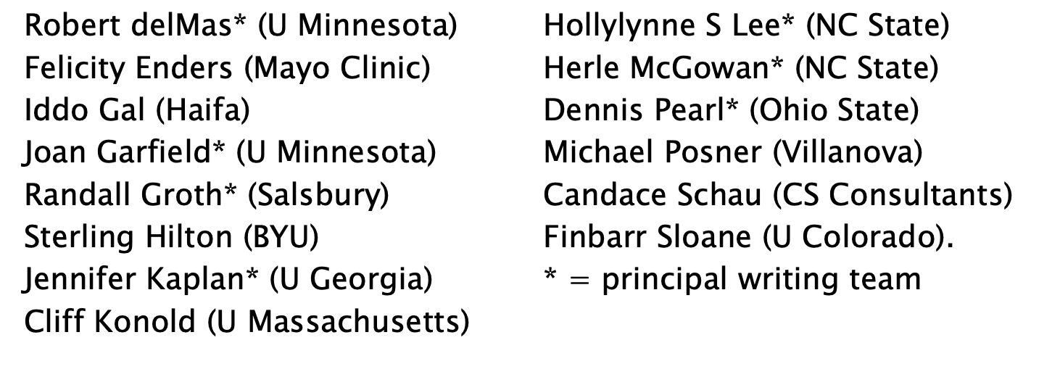
Phase III Final Report at
www.CAUSEweb.org/research/guidelines
Phase IV workshop September 28/29, 2012

Slide 7

Report arising from:
research retreat (June 14-15, 2010) and
writing team meeting (May 21-22, 2011).

Slide 8

To foster productivity and coherence in statistics education research by providing guidance on important priorities in the field, and
To provide the impetus for development and wide use of instruments needed to address fundamental questions in statistics education research.

Slide 9

Broad descriptions of issues,
Gateways to the literature,
Research priorities & example questions,
Measurement/assessment needs
Why questions are important and the implications of addressing them.

Slide 10

Cognitive outcomes
Affective constructs
Curriculum
Teaching Practice
Teacher Development
Technology
+ Bonus chapter on General Statistics Education Assessment Issues
Notes:
Describe Jessica’s ASA Presidential initiative to update and expand to include K to grey and data science. Can these become living documents on the web that are regularly updated- perhaps on a rotating basis?

Slide 11

Cognitive outcomes
  (2 priorities; 8 research questions; and 3 implications)
Affective constructs
  (4 priorities; 11 research questions; and 4 implications)
Curriculum
  (2 priorities; 13 research questions; and 10 implications)
Teaching Practice
  (2 priorities; 9 research questions; and 6 implications)
Teacher Development
  (3 priorities; 11 research questions; and 2 implications)
Technology
  (6 priorities; 39 research questions; and 12 implications)

Slide 12

Build a virtual community for statistics education graduate programs
Create shared virtual course(s)
ASA/NCTM Joint Committee charged with recommendations for training K-12 teachers
Develop guides and assistance for a research practicum
Create an international young scholars visitor program

