Slide 1
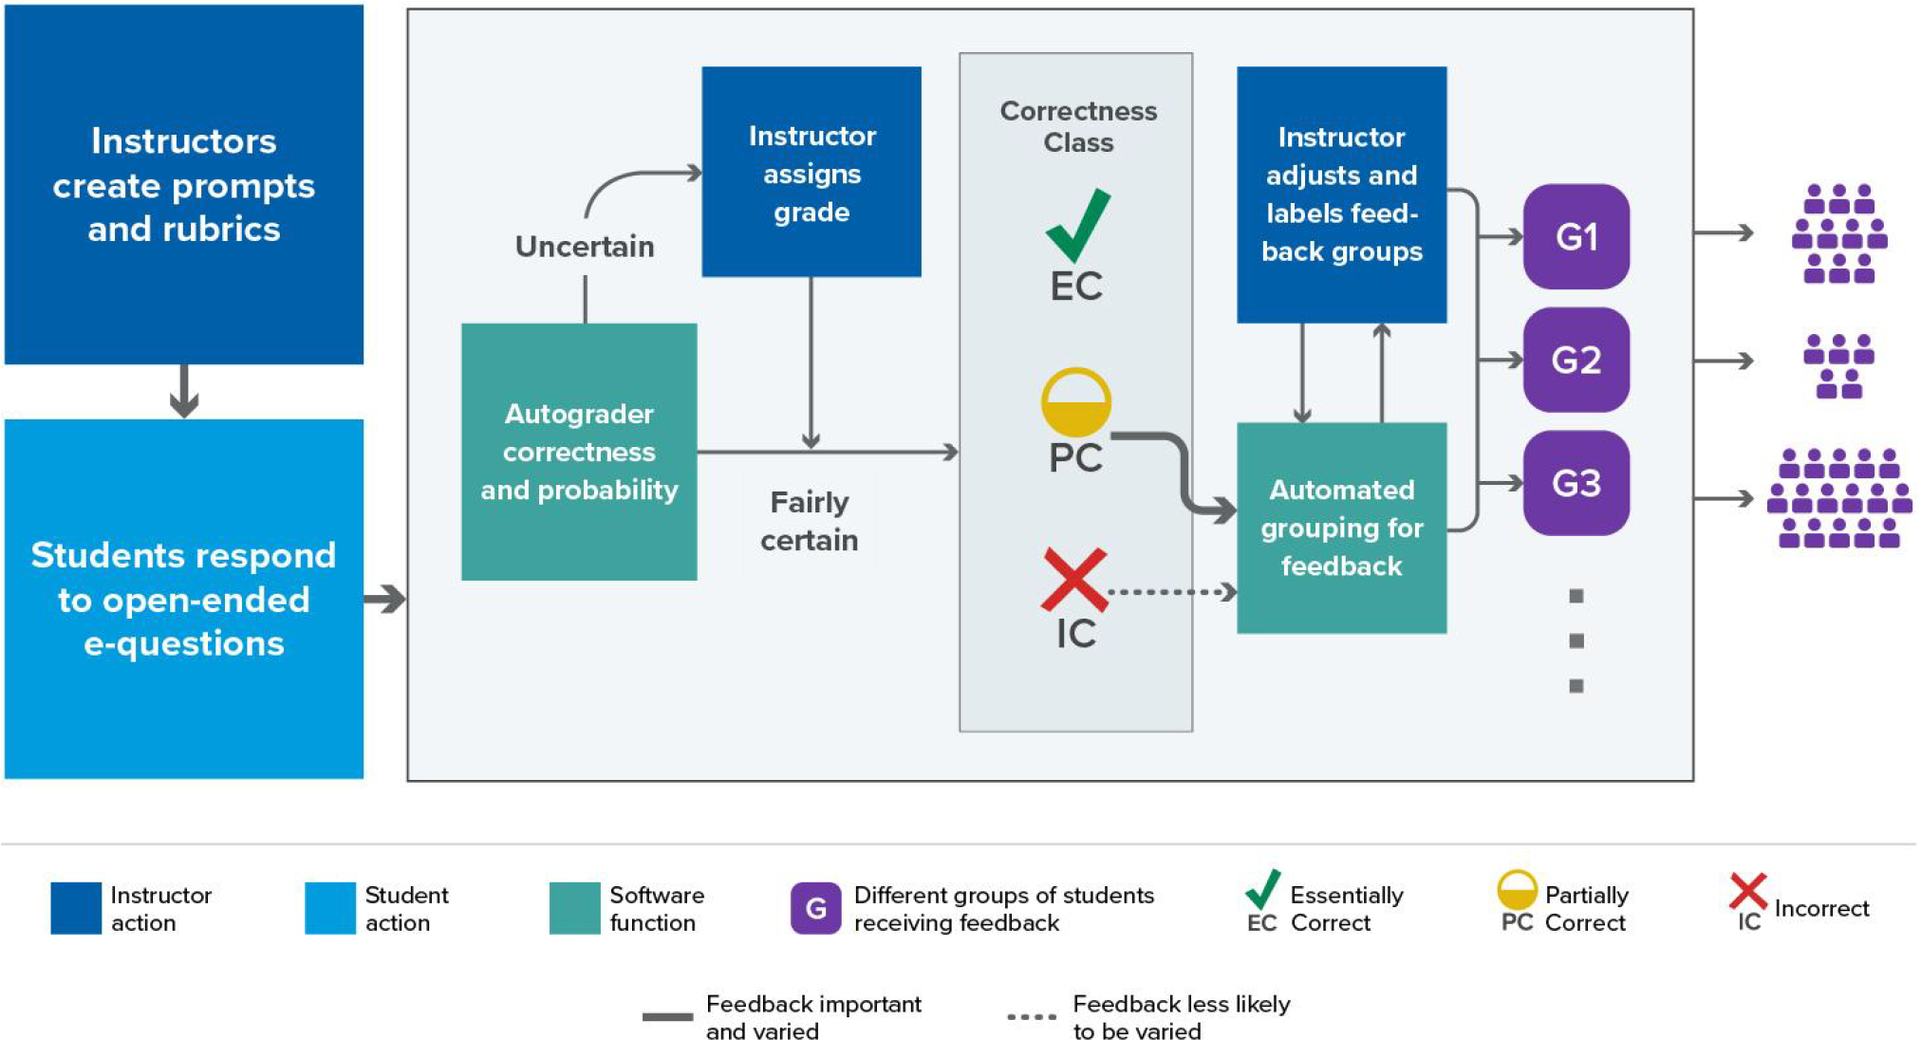
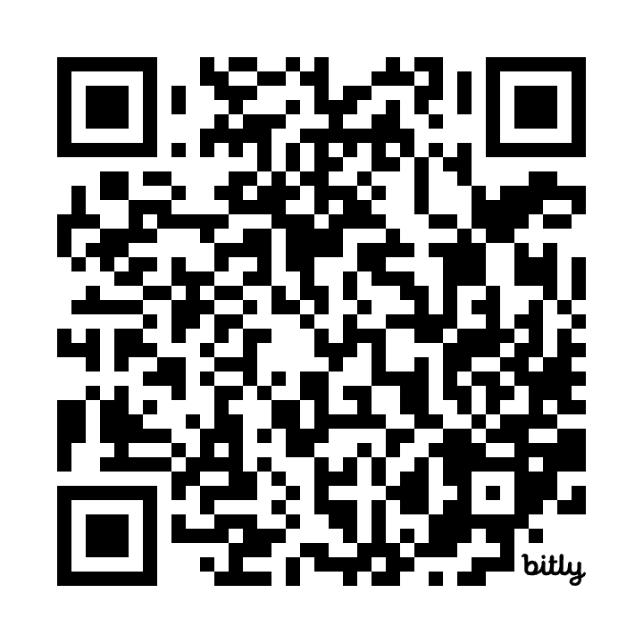

Progress toward NLP-assisted formative assessment feedback
"write-to-learn" tasks improve learning outcomes, yet constructed-response methods become unwieldy when class sizes are large
Logistical obstacles impair pedagogical best practices
Investigating NLP tools with human-in-the-loop architecture to facilitate scalability—improve student benefit while mitigating instructor burden
Schematic: Q >> A >> evaluate >> cluster >> feedback
Recent (Susan Lloyd): Classification performance & HIL policy
Ongoing (Elle Tang): Implications of language diversity
Future: Evaluate competing methods of feedback; assess effectiveness, student engagement, scalability, etc
Related Papers & Acknowledgement:
> Li, Z., Susan Lloyd, Beckman, & Passonneau (2023). Answer-state Recurrent Relational Network (AsRRN) for Constructed Response Assessment and Feedback Grouping. Findings of the Conference on Empirical Methods in Natural Language Processing (EMNLP) 2023
> Susan Lloyd, Beckman, Pearl, Passonneau, Li, & Wang (2022). Foundations for AI-Assisted Formative Assessment Feedback for Short-Answer Tasks in Large-Enrollment Classes. In Proceedings of the eleventh international conference on teaching statistics. Rosario, Argentina.
NSF Award #2236150 (Project CLASSIFIES)
Other Projects/Interests
Educational Assessment
Developing & analyzing tools to measure specific learning outcomes. Novel approaches to assessment.
”Tests" for research across academic institutions;
Formative assessment; e.g., feedback for self-regulated learning and/or adaptive instruction
> Sayali Phadke, Beckman, Lock Morgan (in review). Measuring contextualized statistical literacy: Evidence from an isomorphic assessment.
Data Science Education
Intersection of stat education & computing education
Studying DS/CS topics introduced as learning objectives in statistics curricula
Data literacy, data acumen, EDA for Data Science
> Alyssa Hu, Hatfield, Beckman (in review). Exploring How Novices and Experts Engage in Computational Thinking with Data.
> Beckman et al (2021). Implementing Version Control With Git and GitHub as a Learning Objective in Statistics and Data Science Courses. JSDSE, 29(1).
Matthew Beckman
Statistics & Data Science Education (SDSE) Research
bit.ly/BeckmanResearch2024
Curious about SDSE?
SDSE Research Lab
Conferences: JSM; USCOTS 2025
IASE catalog of PhD dissertations
causeweb.org
Talk to me!
mdb268@psu.edu
mdbeckman.github.io

