Slide 1
A Lab to Build an Altair Clone on a Breadboard
Margaret Black
Assoc. Professor and Chair, Computer Science
Bridgewater State University
ITICSE 2021
m1black@bridgew.edu
http://www.github.com/mdblack

Slide 2
A Lab to Build an Altair Clone on a Breadboard
Margaret Black
Assoc. Professor and Chair, Computer Science
Bridgewater State University
ITICSE 2021
m1black@bridgew.edu
http://www.github.com/mdblack

Slide 3
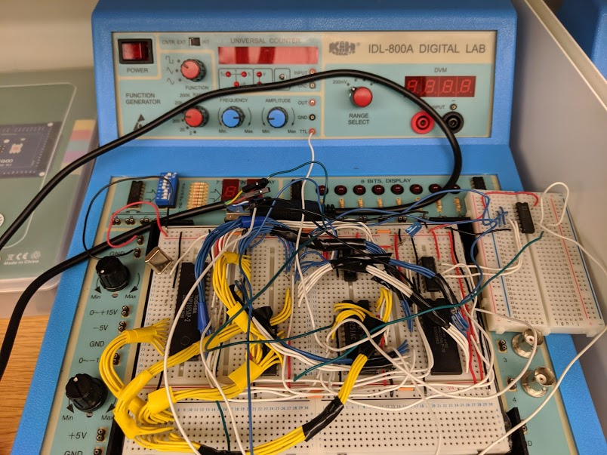
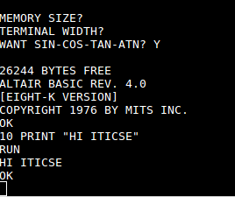
Objective
Students construct a computer from scratch that runs BASIC and plays games

Slide 4
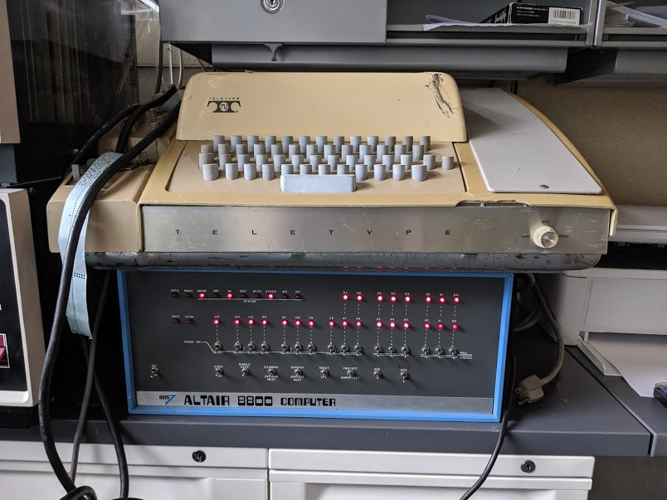
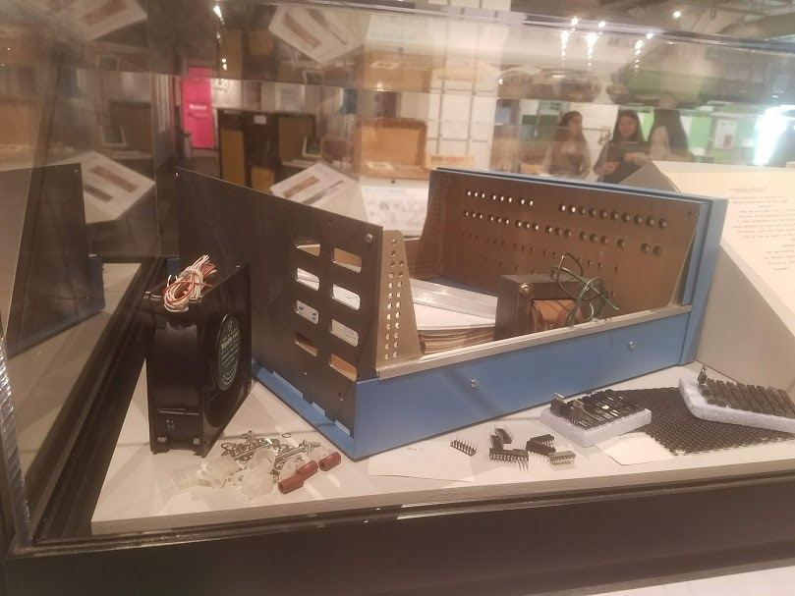
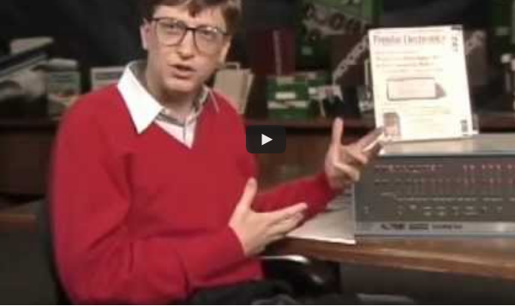
MITS Altair 8800, 1975
my office
Living Computer Museum, Seattle
https://retrocomputingforum.com

Slide 5
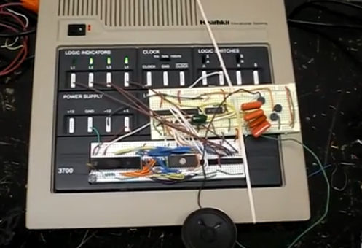
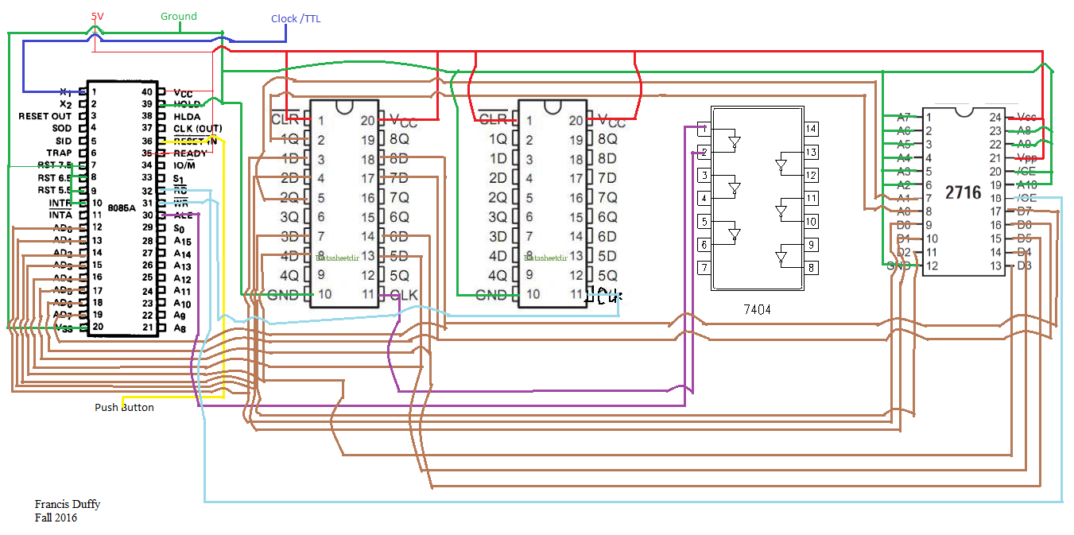
8085 Lab
2nd year Computer Organization
8085 CPU, EEPROM, glue logic
Final result: flashing LEDs
~ 20 iterations, 300-400 students
90% completion rate
https://www.youtube.com/watch?v=JbVZOA--3RA

Slide 6
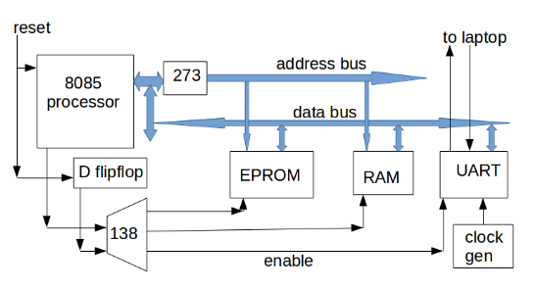
New project: Run MS BASIC
Additions
  32k RAM, UART (serial), relocation logic
  modified Altair 4k BASIC

Slide 7
Test case:
History of Computing Class
22 students: 9 undergraduate, 13 MS
50% no previous electronics experience
two 3-hour labs + tutorial
100% completion rate

Slide 8
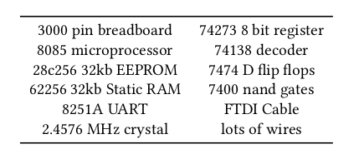
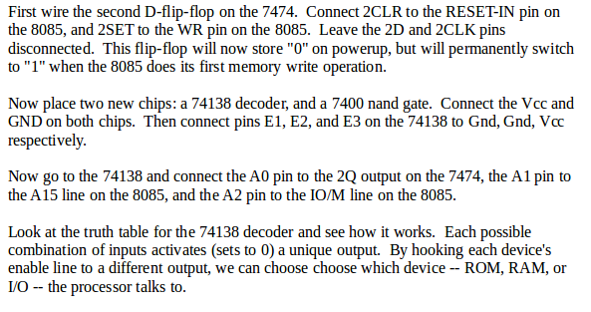
Materials
Parts:
Excerpt from lab instructions:
Also Jameco “Digital Design Lab” board
with 5v supply and function generator

Slide 9
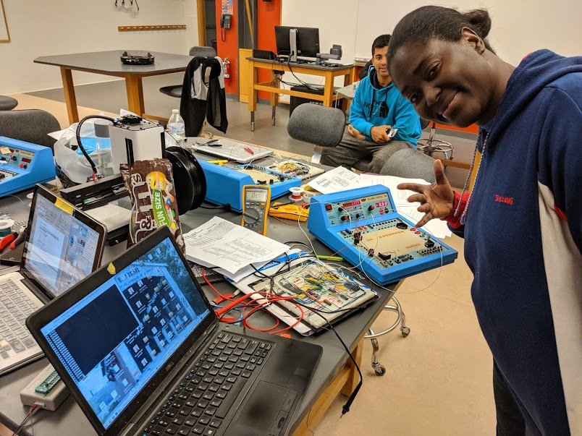
Completed Lab

Slide 10
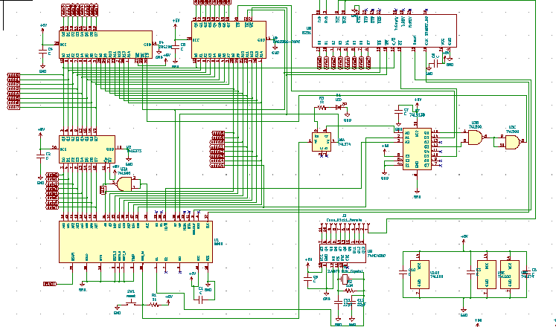

Slide 11
Links
http://www.github.com/mdblack/8085lab
  Lab writeup
  Kicad schematics
  binary code
  Altair emulator
  slides
contact:
  Margaret Black
  m1black@bridgew.edu

