Slide 1
Advanced databases
Edit rules – additional exercises

Slide 2
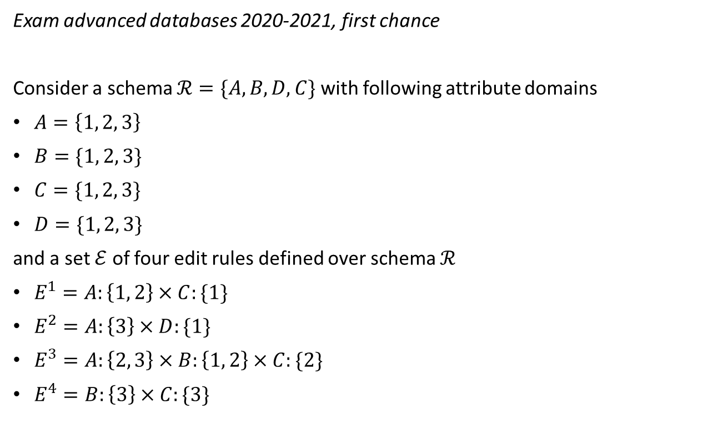
Exercise 1
Exam advanced databases 2020-2021, first chance
Consider a schema $ℛ=\{A, B, D, C\}$ with following attribute domains
$A=\left\{1, 2, 3\right\}$
$B=\{1, 2, 3\}$
$C=\{1, 2, 3\}$
$D=\{1, 2, 3\}$
and a set $ℰ$ of four edit rules defined over schema $ℛ$
$E^{1}=A:\left\{1, 2\right\}×C:\{1\}$
$E^{2}=A:\left\{3\right\}×D:\{1\}$
$E^{3}=A:\left\{2, 3\right\}×B:\left\{1, 2\right\}×C:\{2\}$
$E^{4}=B:\left\{3\right\}×C:\{3\}$

Slide 3
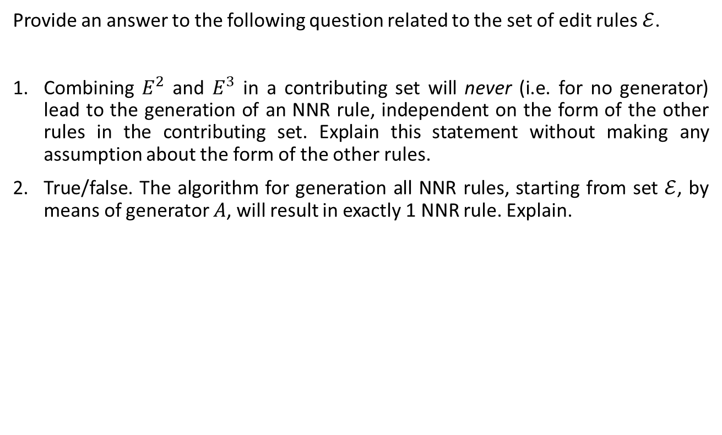
Exercise 1
Provide an answer to the following question related to the set of edit rules $ℰ$.
Combining $E^{2}$ and $E^{3}$ in a contributing set will never (i.e. for no generator) lead to the generation of an NNR rule, independent on the form of the other rules in the contributing set. Explain this statement without making any assumption about the form of the other rules.
True/false. The algorithm for generation all NNR rules, starting from set $ℰ$, by means of generator $A$, will result in exactly 1 NNR rule. Explain.

Slide 4
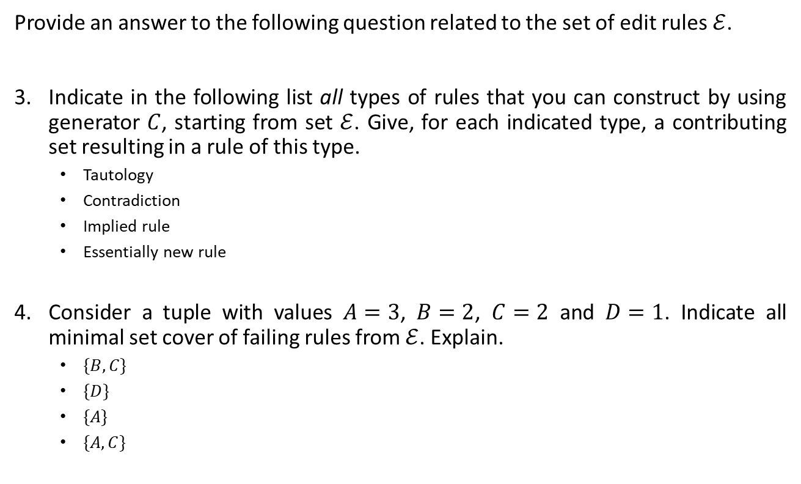
Exercise 1
Provide an answer to the following question related to the set of edit rules $ℰ$.
Indicate in the following list all types of rules that you can construct by using generator $C$, starting from set $ℰ$. Give, for each indicated type, a contributing set resulting in a rule of this type.
Tautology
Contradiction
Implied rule
Essentially new rule
Consider a tuple with values $A=3$, $B=2$, $C=2$ and $D=1$. Indicate all minimal set cover of failing rules from $ℰ$. Explain.
$\{B, C\}$
$\{D\}$
$\{A\}$
$\{A, C\}$

Slide 5
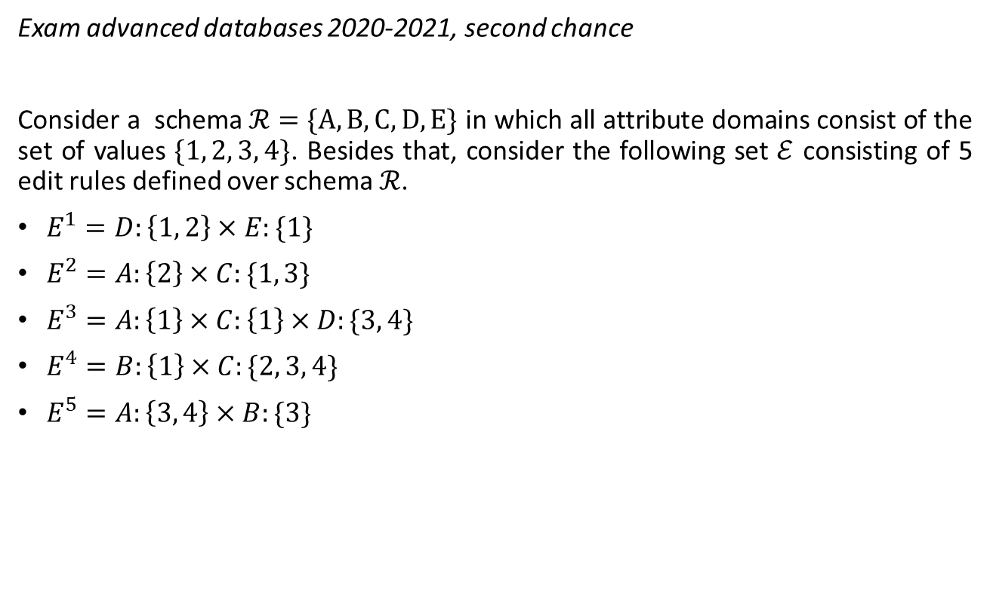
Exercise 2
Exam advanced databases 2020-2021, second chance
Consider a schema $ℛ=\{A, B, C, D, E\}$ in which all attribute domains consist of the set of values $\{1, 2, 3, 4\}$. Besides that, consider the following set $ℰ$ consisting of 5 edit rules defined over schema $ℛ$.
$E^{1}=D:\left\{1, 2\right\}×E:\{1\}$
$E^{2}=A:\left\{2\right\}×C:\{1, 3\}$
$E^{3}=A:\left\{1\right\}×C:\left\{1\right\}×D:\{3, 4\}$
$E^{4}=B:\left\{1\right\}×C:\{2, 3, 4\}$
$E^{5}=A:\left\{3, 4\right\}×B:\{3\}$

Slide 6
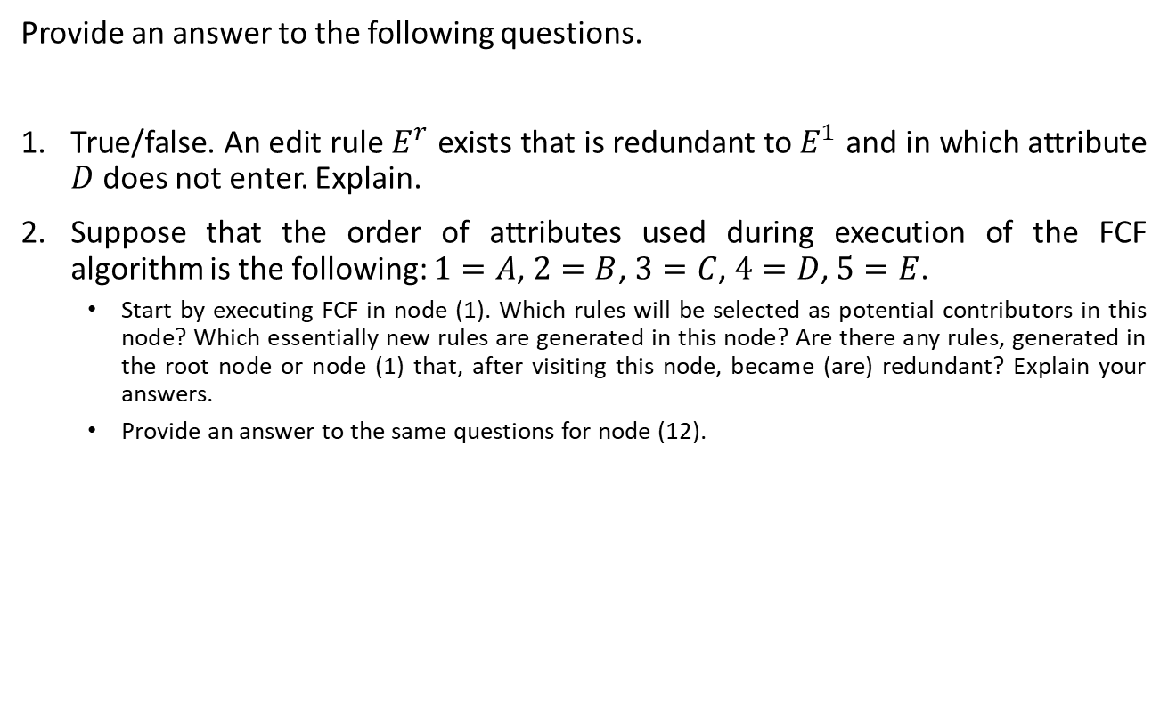
Exercise 2
Provide an answer to the following questions.
True/false. An edit rule $E^{r}$ exists that is redundant to $E^{1}$ and in which attribute $D$ does not enter. Explain.
Suppose that the order of attributes used during execution of the FCF algorithm is the following: $1=A$, $2=B$, $3=C$, $4=D$, $5=E$.
Start by executing FCF in node (1). Which rules will be selected as potential contributors in this node? Which essentially new rules are generated in this node? Are there any rules, generated in the root node or node (1) that, after visiting this node, became (are) redundant? Explain your answers.
Provide an answer to the same questions for node (12).

Slide 7
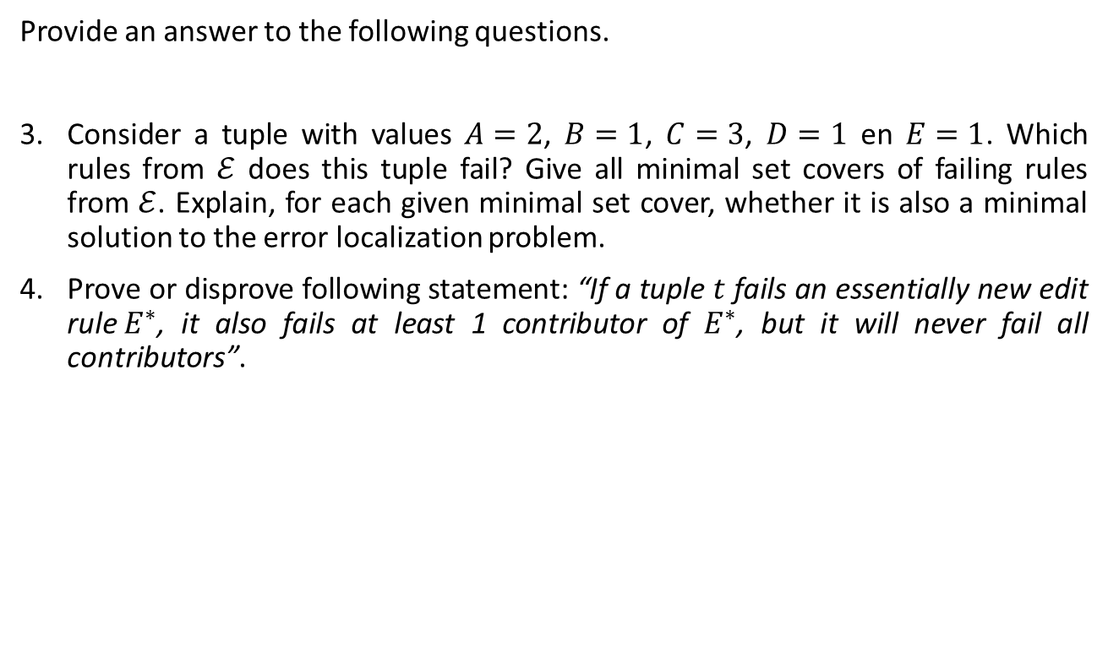
Exercise 2
Provide an answer to the following questions.
Consider a tuple with values $A=2$, $B=1$, $C=3$, $D=1$ en $E=1$. Which rules from $ℰ$ does this tuple fail? Give all minimal set covers of failing rules from $ℰ$. Explain, for each given minimal set cover, whether it is also a minimal solution to the error localization problem.
Prove or disprove following statement: “If a tuple $t$ fails an essentially new edit rule$E^{∗}$, it also fails at least 1 contributor of $E^{∗}$, but it will never fail all contributors”.

Slide 8
Exercise 3
Exam advanced databases 2019-2020, first chance
Consider a relational schema consisting of the following attributes and values
Attribute ID | Attribute name | Values
1 | school attendance | Not in school, In school
2 | education | None, Preschool, Elementary, Middle school, High school
3 | employment status | N/A, Employed, Unemployed, Not in labor force
4 | class of worker | N/A, Self employed, Salary worker, New worker, Family worker, Unemployed
5 | worked last year | No, Yes
6 | last worked | N/A, Current year, Previous year, Longer ago, Never worked
7 | transport to work | N/A, Car, Mobile transport, Bicycle, On foot, Other

Slide 9
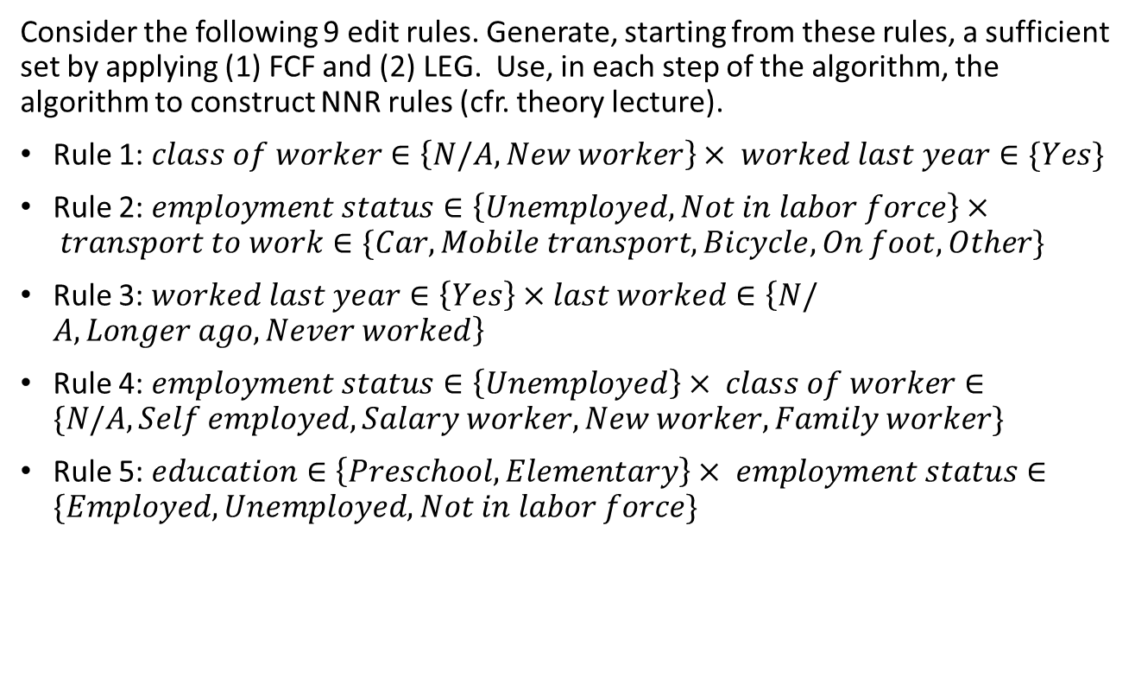
Exercise 3
Consider the following 9 edit rules. Generate, starting from these rules, a sufficient set by applying (1) FCF and (2) LEG. Use, in each step of the algorithm, the algorithm to construct NNR rules (cfr. theory lecture).
Rule 1: $class of worker∈\left\{N/A, New worker\right\}× worked last year∈\{Yes\}$
Rule 2: $employment status∈\left\{Unemployed, Not in labor force\right\}× transport to work∈\{Car, Mobile transport, Bicycle,On foot, Other\}$
Rule 3: $worked last year∈\left\{Yes\right\}×last worked∈\left\{N/A, Longer ago,Never worked\right\}$
Rule 4: $employment status∈\left\{Unemployed\right\}× class of worker∈\{N/A, Self employed, Salary worker, New worker, Family worker\}$
Rule 5: $education∈\left\{Preschool, Elementary\right\}× employment status∈\{Employed, Unemployed, Not in labor force\}$

Slide 10
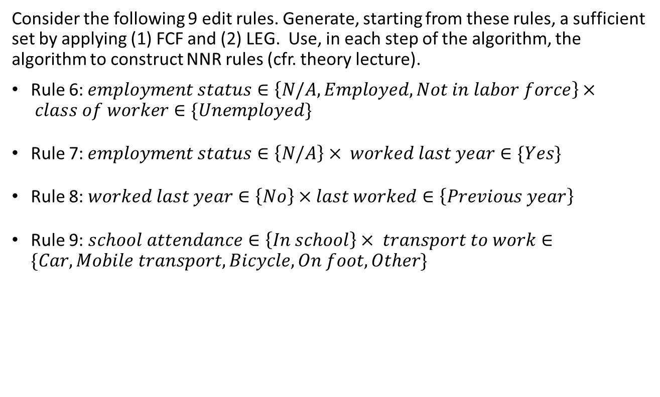
Exercise 3
Consider the following 9 edit rules. Generate, starting from these rules, a sufficient set by applying (1) FCF and (2) LEG. Use, in each step of the algorithm, the algorithm to construct NNR rules (cfr. theory lecture).
Rule 6:$employment status∈\left\{N/A, Employed,Not in labor force\right\}× class of worker∈\{Unemployed\}$
Rule 7:$employment status∈\left\{N/A\right\}× worked last year∈\{Yes\}$
Rule 8: $worked last year∈\left\{No\right\}×last worked∈\left\{Previous year\right\}$
Rule 9: $school attendance∈\left\{In school\right\}× transport to work∈\{Car, Mobile transport,Bicycle, On foot, Other\}$

