Slide 1
Advanced databases
Field Code Forest algorithm

Slide 2
Introduction
Introduced by Garfinkel, Kunnathur & Liepings (during the 80’s)
Efficient method to calculate a sufficient set of edit rules
Named after the Field Code Forest data structure

Slide 3

Sufficient set of edit rules
Sufficient set $⊆$ Complete set
Sufficient set has 2 properties:
The set of non-permissible value combinatons is equal to the set of non-perissible value combinations defined by the explicit set of edit rules
Each set of attributes that is a solution of the error localization problem also is a minimal cover of failing edit rules in the sufficient set

Slide 4
Example
4 attributes
Attribute ID | Attribute name | Values
1 | model | P, S, X
2 | arms | 1, 2, 3
3 | parallel | Yes, No
4 | crossover | Yes, No

Slide 5
Field Code Forest
1
2
3
4
12
13
14
23
24
34
123
124
134
234
1234

Slide 6
Root node
1
2
3
4
12
13
14
23
24
34
123
124
134
234
1234

Slide 7
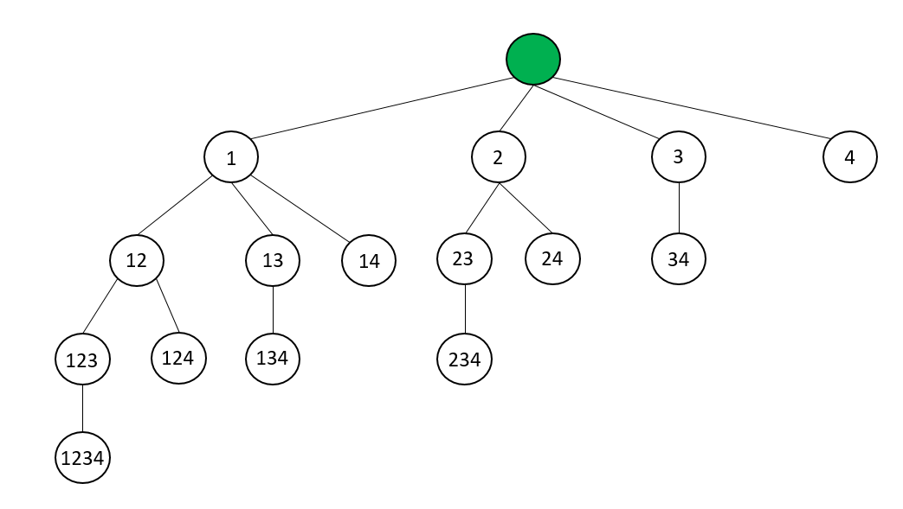
Root node
Initially: 6 rules are given
Rule | model | arms | parallel | crossover
1 | P, X | 1 | dom(parallel) | dom(crossover)
2 | S, X | dom(arms) | Yes | dom(crossover)
3 | P | dom(arms) | No | dom(crossover)
4 | X | dom(arms) | dom(parallel) | No
5 | S, P | dom(arms) | dom(parallel) | Yes
6 | S | 2, 3 | dom(parallel) | dom(crossover)

Slide 8
Node 1
Depth-first search!
1
2
3
4
12
13
14
23
24
34
123
124
134
234
1234

Slide 9
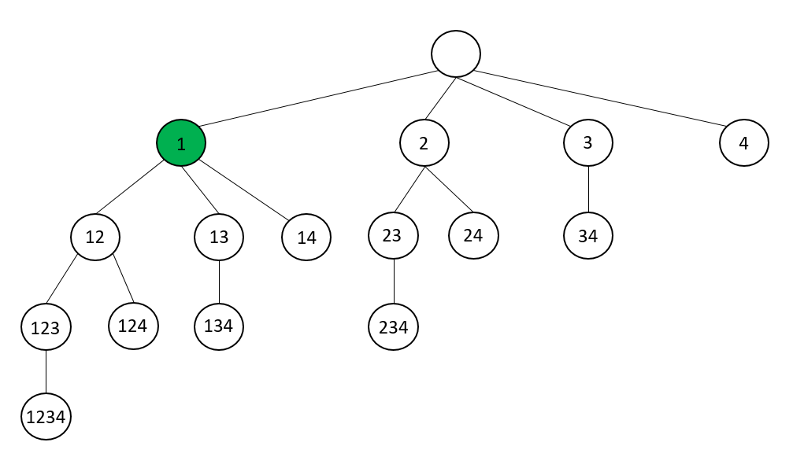
Node 1
Select all rules from the same branch in which attribute 1 enters (= all rules)
Rule | model | arms | parallel | crossover
1 | P, X | 1 | dom(parallel) | dom(crossover)
2 | S, X | dom(arms) | Yes | dom(crossover)
3 | P | dom(arms) | No | dom(crossover)
4 | X | dom(arms) | dom(parallel) | No
5 | S, P | dom(arms) | dom(parallel) | Yes
6 | S | 2, 3 | dom(parallel) | dom(crossover)
root node

Slide 10

Node 1
Combine these rules to essentially new edit rules for generator model
$→$ cfr. theory class

Slide 11
Node 1
Combine these rules to essentially new edit rules for generator model
1 & 2
Rule 1: {P, X} x {1} x dom(parallel) x dom(crossover)
Rule 2: {S, X} x dom(arms) x {Yes} x dom(crossover)
EN: dom(model) x {1} x {Yes} x dom(crossover)
Be careful: you should not further investigate this combination because adding a contributor to this combination will lead to a redundant edit rule
1 & 3
Rule 1: {P, X} x {1} x dom(parallel) x dom(crossover)
Rule 3: {P} x dom(arms) x {No} x dom(crossover)
NEN: {P, X} x {1} x {No} x dom(crossover)
Check whether adding a new rule leads to an EN rule
1 & 4
Rule 1: {P, X} x {1} x dom(parallel) x dom(crossover)
Rule 4: {X} x dom(arms} x dom(parallel) x {No}
NEN: {P, X} x {1} x {No} x dom(crossover)
Check whether adding a new rule leads to an EN rule

Slide 12
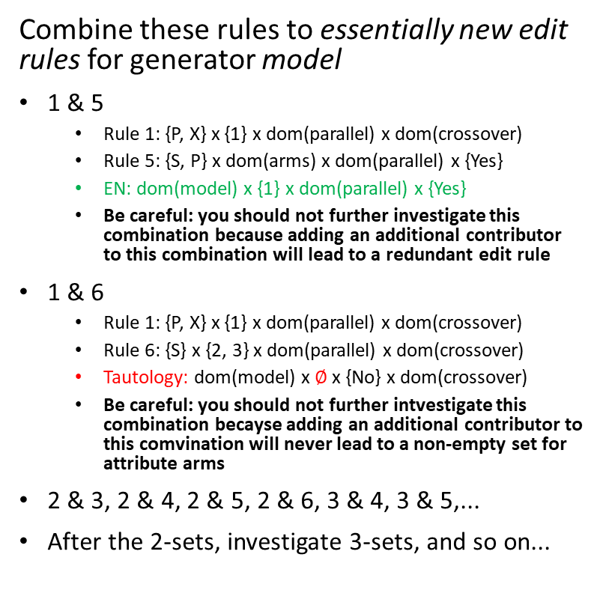
Node 1
Combine these rules to essentially new edit rules for generator model
1 & 5
Rule 1: {P, X} x {1} x dom(parallel) x dom(crossover)
Rule 5: {S, P} x dom(arms) x dom(parallel) x {Yes}
EN: dom(model) x {1} x dom(parallel) x {Yes}
Be careful: you should not further investigate this combination because adding an additional contributor to this combination will lead to a redundant edit rule
1 & 6
Rule 1: {P, X} x {1} x dom(parallel) x dom(crossover)
Rule 6: {S} x {2, 3} x dom(parallel) x dom(crossover)
Tautology: dom(model) x $∅$ x {No} x dom(crossover)
Be careful: you should not further intvestigate this combination becayse adding an additional contributor to this comvination will never lead to a non-empty set for attribute arms
2 & 3, 2 & 4, 2 & 5, 2 & 6, 3 & 4, 3 & 5,...
After the 2-sets, investigate 3-sets, and so on...

Slide 13
Node 1
Essentially new rules
Rule | model | arms | parallel | crossover | Contributing set
7 | dom(model) | 1 | Yes | dom(crossover) | 1, 2
8 | dom(model) | 1 | dom(parallel) | Yes | 1, 5
9 | dom(model) | dom(arms) | Yes | Yes | 2, 5
10 | dom(model) | 2, 3 | No | No | 3, 4, 6
node 1

Slide 14
Node 1
Check redundancy new rules +
substitute redundant rules by their dominating rules
Rule | model | arms | parallel | crossover | Contributing set
7 | dom(model) | 1 | Yes | dom(crossover) | 1, 2
8 | dom(model) | 1 | dom(parallel) | Yes | 1, 5
9 | dom(model) | dom(arms) | Yes | Yes | 2, 5
10 | dom(model) | 2, 3 | No | No | 3, 4, 6
node 1

Slide 15
Node 1
Check redundancy in all previous nodes +
substitute redundant rules by their dominating rule
Rule | model | arms | parallel | crossover
1 | P, X | 1 | dom(parallel) | dom(crossover)
2 | S, X | dom(arms) | Yes | dom(crossover)
3 | P | dom(arms) | No | dom(crossover)
4 | X | dom(arms) | dom(parallel) | No
5 | S, P | dom(arms) | dom(parallel) | Yes
6 | S | 2, 3 | dom(parallel) | dom(crossover)
root node

Slide 16
Node 12
Depth-first search!
1
2
3
4
12
13
14
23
24
34
123
124
134
234
1234

Slide 17
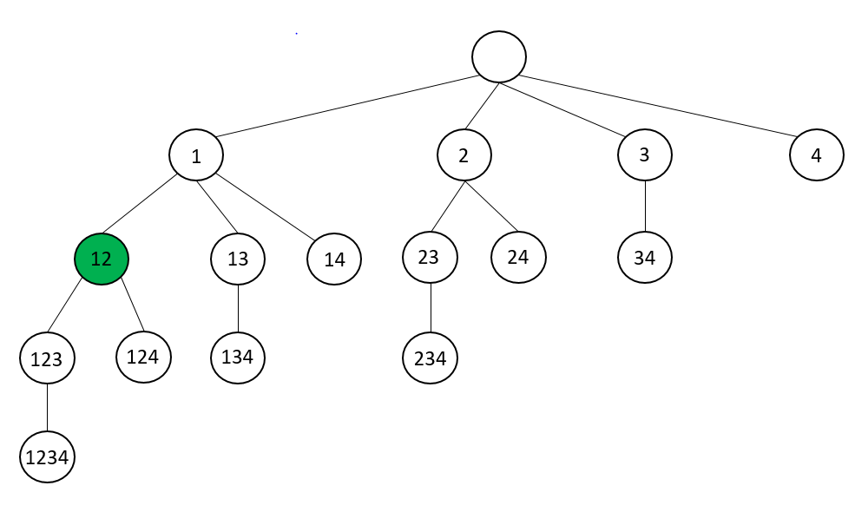
Node 12
Select rules from same branch in which attribute 2 enters but attribute 1 does not
Rule | model | arms | parallel | crossover
1 | P, X | 1 | dom(parallel) | dom(crossover)
2 | S, X | dom(arms) | Yes | dom(crossover)
3 | P | dom(arms) | No | dom(crossover)
4 | X | dom(arms) | dom(parallel) | No
5 | S, P | dom(arms) | dom(parallel) | Yes
6 | S | 2, 3 | dom(parallel) | dom(crossover)
7 | dom(model) | 1 | Yes | dom(crossover)
8 | dom(model) | 1 | dom(parallel) | Yes
9 | dom(model) | dom(arms) | Yes | Yes
10 | dom(model) | 2, 3 | No | No
root node
node 1

Slide 18

Node 12
Combine these rules to essentially new edit rules for generator arms
$→$ cfr. theory class

Slide 19
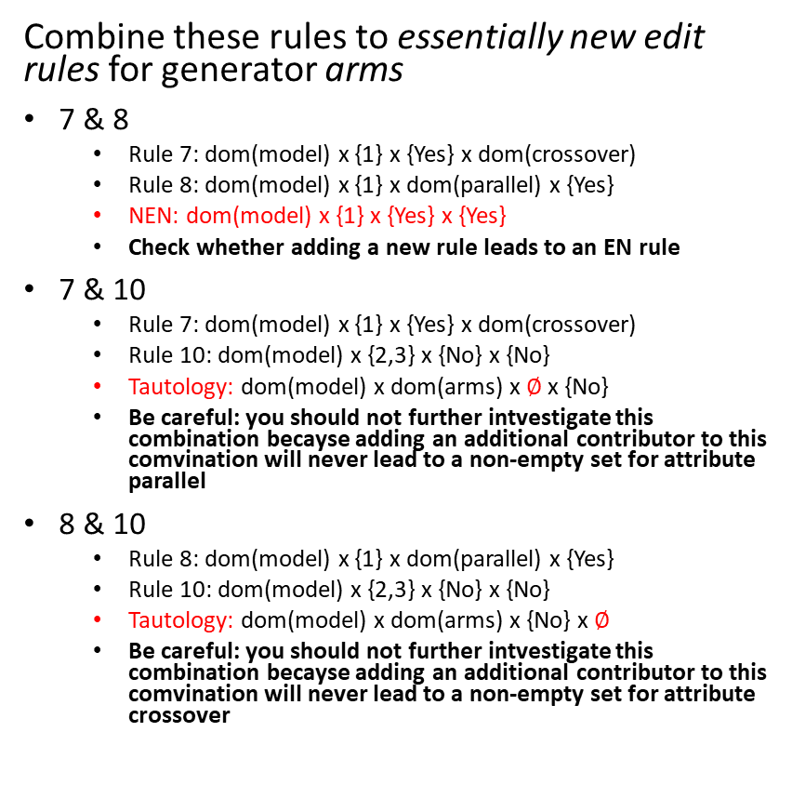
Node 12
Combine these rules to essentially new edit rules for generator arms
7 & 8
Rule 7: dom(model) x {1} x {Yes} x dom(crossover)
Rule 8: dom(model) x {1} x dom(parallel) x {Yes}
NEN: dom(model) x {1} x {Yes} x {Yes}
Check whether adding a new rule leads to an EN rule
7 & 10
Rule 7: dom(model) x {1} x {Yes} x dom(crossover)
Rule 10: dom(model) x {2,3} x {No} x {No}
Tautology: dom(model) x dom(arms) x $∅$x {No}
Be careful: you should not further intvestigate this combination becayse adding an additional contributor to this comvination will never lead to a non-empty set for attribute parallel
8 & 10
Rule 8: dom(model) x {1} x dom(parallel) x {Yes}
Rule 10: dom(model) x {2,3} x {No} x {No}
Tautology: dom(model) x dom(arms) x {No} x $∅$
Be careful: you should not further intvestigate this combination becayse adding an additional contributor to this comvination will never lead to a non-empty set for attribute crossover

Slide 20
Node 12
No EN rules: prune!
1
2
3
4
12
13
14
23
24
34
123
124
134
234
1234

Slide 21
Node 13
Depth-first search!
1
2
3
4
12
13
14
23
24
34
123
124
134
234
1234

Slide 22
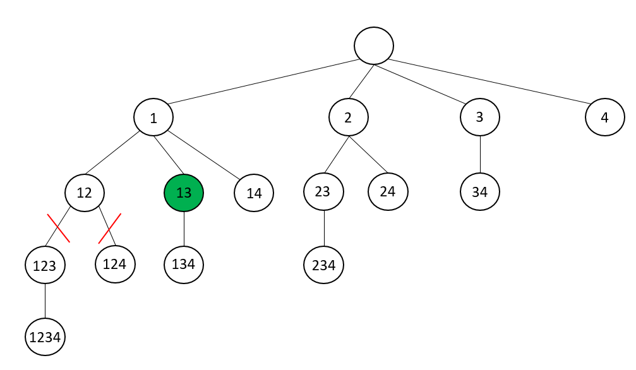
Node 13
Select rules from same branch in which attribute 3 enters but attribute 1 does not
Rule | model | arms | parallel | crossover
1 | P, X | 1 | dom(parallel) | dom(crossover)
2 | S, X | dom(arms) | Yes | dom(crossover)
3 | P | dom(arms) | No | dom(crossover)
4 | X | dom(arms) | dom(parallel) | No
5 | S, P | dom(arms) | dom(parallel) | Yes
6 | S | 2, 3 | dom(parallel) | dom(crossover)
7 | dom(model) | 1 | Yes | dom(crossover)
8 | dom(model) | 1 | dom(parallel) | Yes
9 | dom(model) | dom(arms) | Yes | Yes
10 | dom(model) | 2, 3 | No | No
root node
node 1

Slide 23

Node 13
Combine these rules to essentially new edit rules for generator parallel
$→$ cfr. theory class

Slide 24
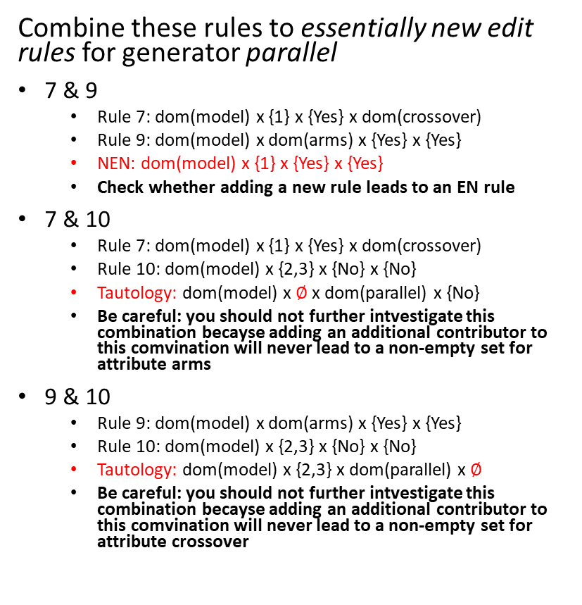
Node 13
Combine these rules to essentially new edit rules for generator parallel
7 & 9
Rule 7: dom(model) x {1} x {Yes} x dom(crossover)
Rule 9: dom(model) x dom(arms) x {Yes} x {Yes}
NEN: dom(model) x {1} x {Yes} x {Yes}
Check whether adding a new rule leads to an EN rule
7 & 10
Rule 7: dom(model) x {1} x {Yes} x dom(crossover)
Rule 10: dom(model) x {2,3} x {No} x {No}
Tautology: dom(model) x $∅$x dom(parallel) x {No}
Be careful: you should not further intvestigate this combination becayse adding an additional contributor to this comvination will never lead to a non-empty set for attribute arms
9 & 10
Rule 9: dom(model) x dom(arms) x {Yes} x {Yes}
Rule 10: dom(model) x {2,3} x {No} x {No}
Tautology: dom(model) x {2,3} x dom(parallel) x $∅$
Be careful: you should not further intvestigate this combination becayse adding an additional contributor to this comvination will never lead to a non-empty set for attribute crossover

Slide 25
Node 13
No EN rules: prune!
1
2
3
4
12
13
14
23
24
34
123
124
134
234
1234

Slide 26
Node 14 and so on...
Depth-first search!
1
2
3
4
12
13
14
23
24
34
123
124
134
234
1234

