Slide 1

From Roman de la Rose to the
Star Spangled Banner:
Document Image Analysis at
The Digital Knowledge Center
  Sheridan Libraries
  Michael Droettboom

Slide 2
Part I: Gamera: A Python-based framework for building document image analysis systems
Part II: Optical music recognition

Slide 3
Part I: Gamera
There are many types of documents not supported by standard off-the-shelf OCR
Researchers building specialized recognition systems often “reinvent the wheel” with each new system
Gamera provides a programming foundation on which to build these systems

Slide 4
Gamera applications

Slide 5
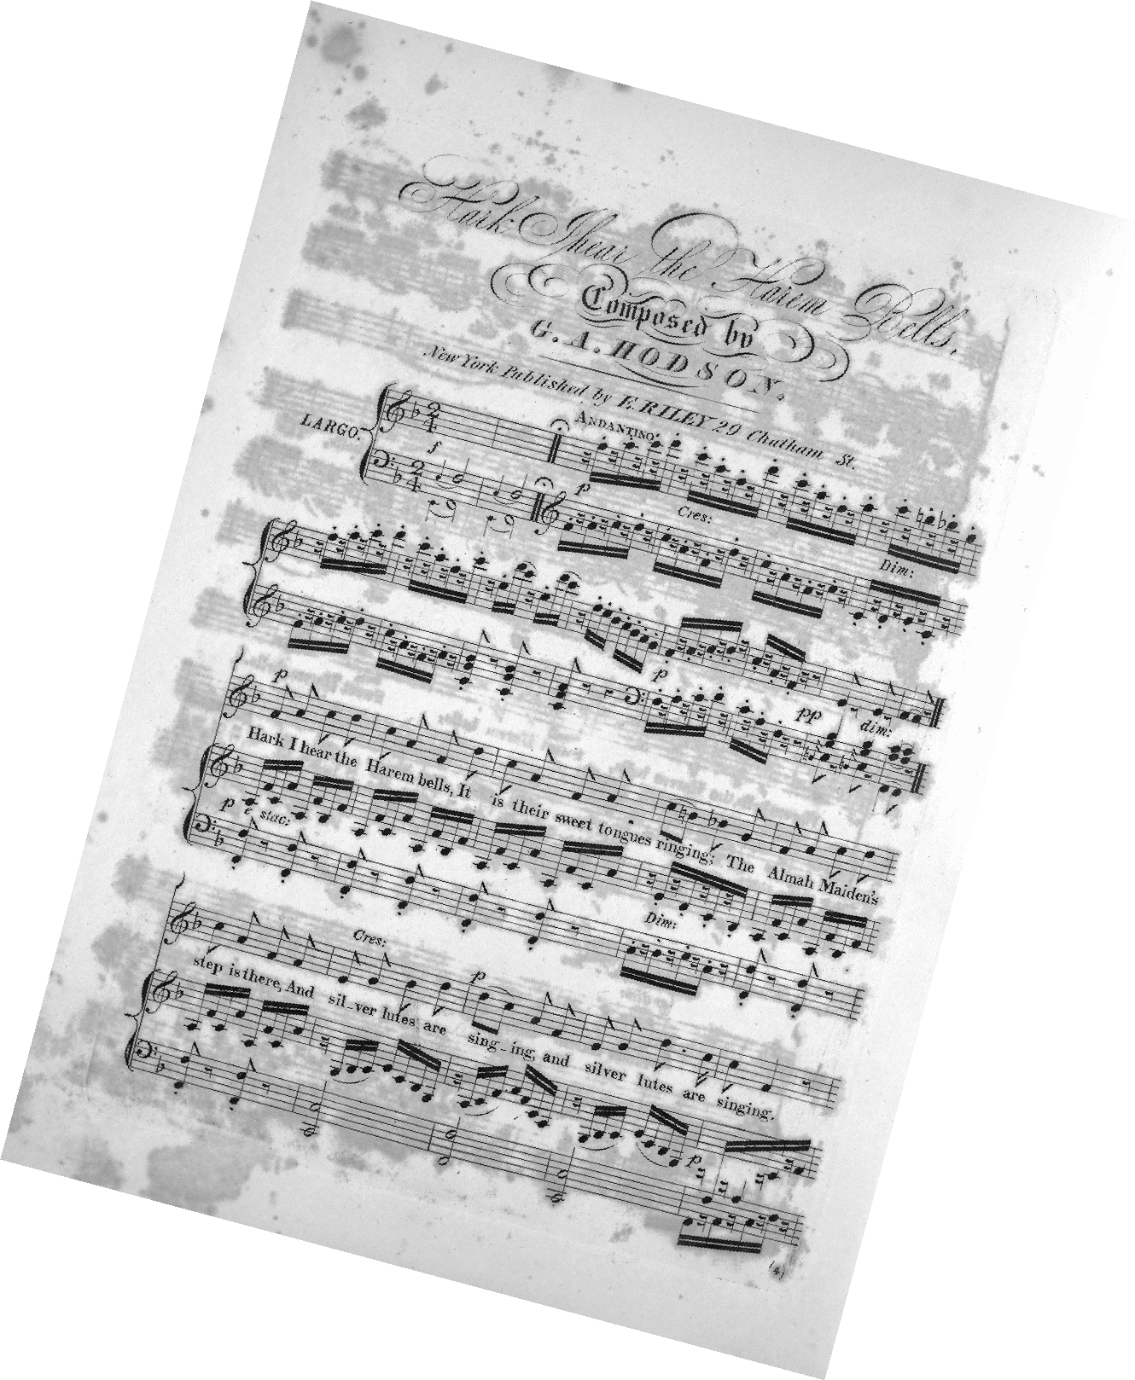
Common Western Music Notation
Michael Droettboom,
Johns Hopkins University
Ichiro Fujinaga,
McGill University

Slide 6
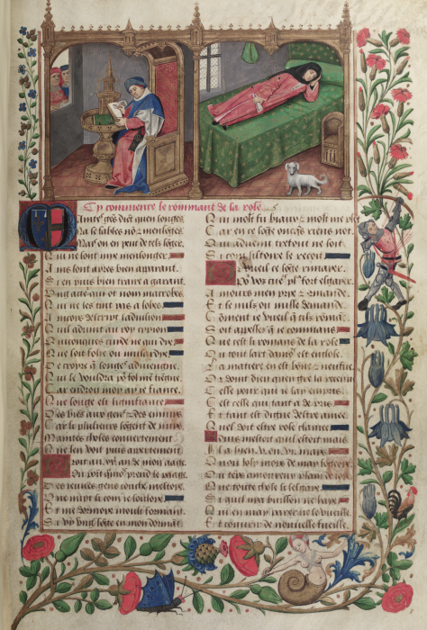
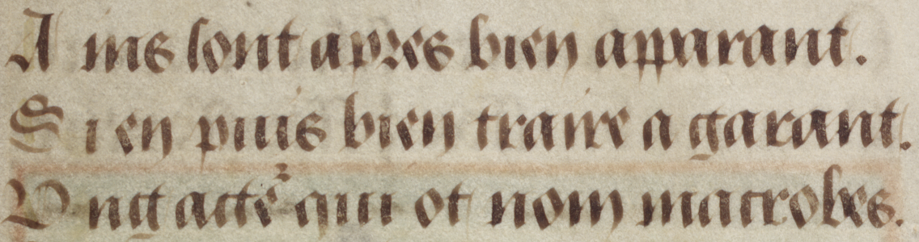
Medieval Manuscript
Sourin Das,
Johns Hopkins University
University of Edinburgh,
Bodleian Library, Oxford

Slide 7
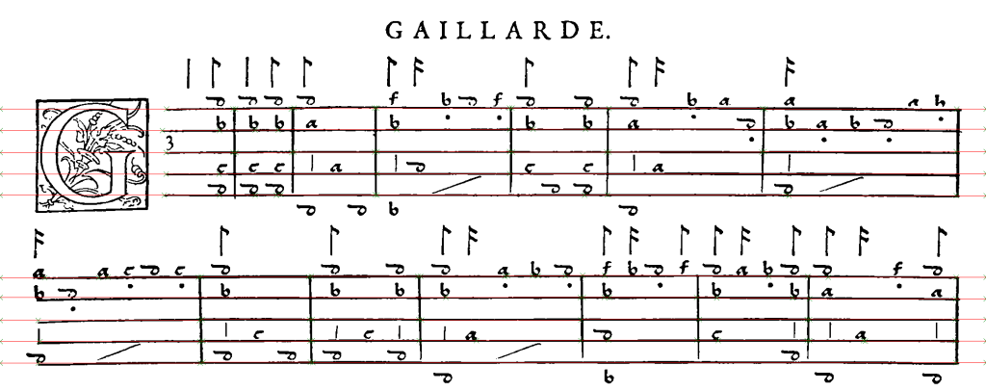
Renaissance Lute Tablature
Christoph Dalitz and Thomas Karsten, Hochschule Niederrhein
David Lewis and Tim Crawford, City University (London)

Slide 8
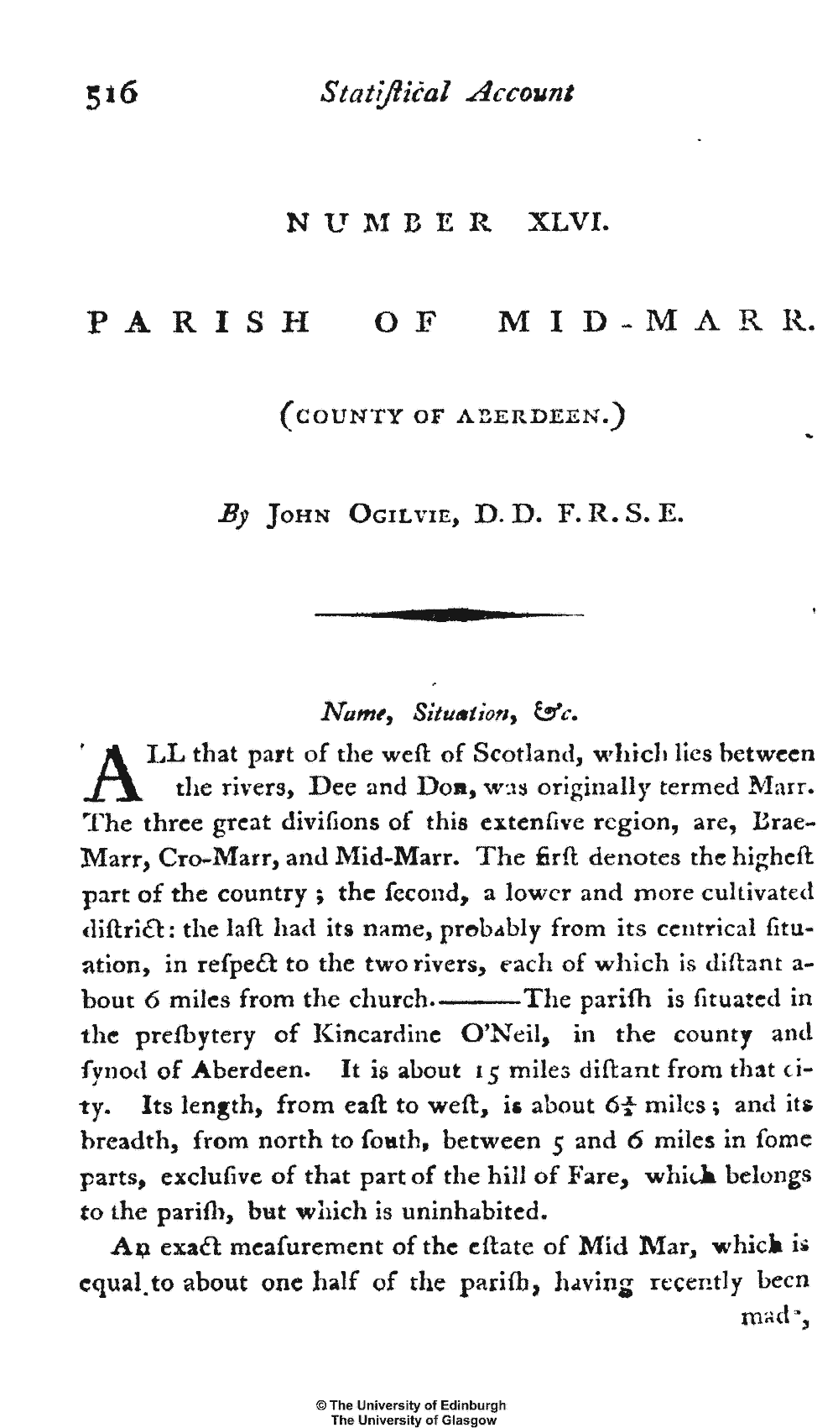
The Statistical Accounts of Scotland
18th century “cheaply printed” materials
Robert Ferguson,
Johns Hopkins University
University of Edinburgh

Slide 9
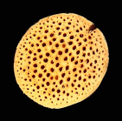
Vascular anatomy of plants
Alex Cobb, Harvard University

Slide 10
Gamera in education
FFT-based feature extraction research
  Jared Hopkins, Tim Anderson, U. Idaho @ Boise
Undergraduate course in Computer Vision
  Christoph Dalitz, Hochschule Neiderrhein

Slide 11
Gamera overview
Open source (GPL)
Cross-platform: Win32, Linux, Mac OS X
Python for high-level control
C++ for low-level image processing
Full-fledged GUI (in wxPython) for training and experimentation
Fully scriptable for batch processing

Slide 12
Gamera funding
NSF Information Technology Research (ITR) grant
Institute for Museum and Library Services (IMLS)
Lester S. Levy Estate

Slide 13
Gamera history
Began in April 2001
  Major rewrite a year later
Released on SourceForge, January 2004
  Mailing list
    ~15 active members
    ~10 interested lurkers
    ~10 probable spammers
Version 3.0: June 2005

Slide 14
Advanced image types
Polymorphic image types in Python and C++
  Write once, and (where possible) support RGB, Greyscale, Binary, Floating-point, Complex images
Adaptors for other C/C++ image processing libraries
  Source-level compatibility with VIGRA, XITE, LTI
  Overhead “compiles away”
Bridges to other Python-based matrix and imaging systems
  Numeric, numarray, Python imaging library
  Numeric/numarray slices are analogous to Gamera's “views”

Slide 15
C++ wrapper mechanism
Custom system for easily developing C++ “plugins” and wrapping them for access from Python
  Why? At least in 2002...
  Boost Python had way too much runtime overhead for polymorphic classes
  SWIG didn't understand C++ template-based “duck typing” inheritance
  Pyrex and SIP seemed too immature at that time.

Slide 16
General structure
Pre-processing
Document-level segmentation
Symbol-level segmentation and classification
Syntactical and structural analysis
Output

Slide 17
General structure
Pre-processing
Document-level segmentation
Symbol-level segmentation and classification
Syntactical and structural analysis
Output

Slide 18
Pre-processing
Standard image-processing cleanup operations:
  Noise removal
  De-rotation
  Contrast adjustment
  Binarization

Slide 19
Document segmentation
Analyse high-level image structure and “divide-and-conquer”
  In music, remove the stafflines
  In newspapers, separate the text from the figures

Slide 20
Symbol segmentation and classification
Divide image into low-level atoms and classify those parts
  In text, individual characters
Gamera includes a standard k-nearest neighbor classifier
  Team at U. Idaho Boise is adding a neural network
  Sourin Das at JHU is adding a hidden Markov model

Slide 21
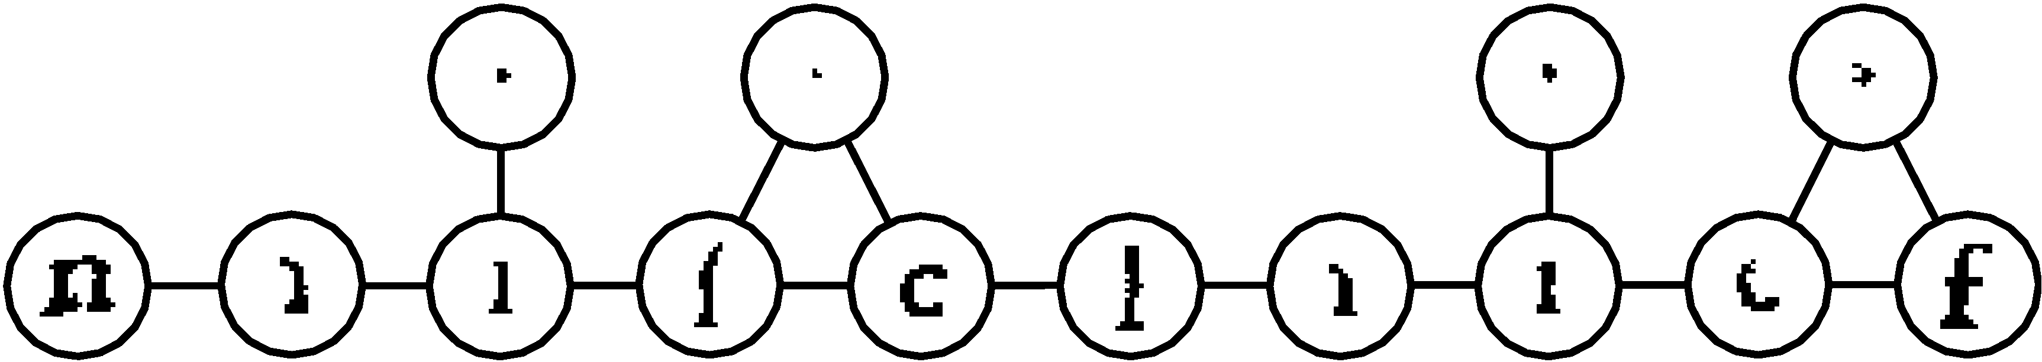
Symbol segmentation and classification
The classifier can “drive” the segmenter, thereby recognizing broken or touching characters

Slide 22
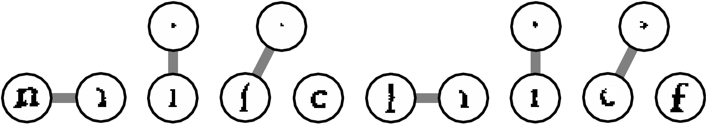
Symbol segmentation and classification
The classifier can “drive” the segmenter, thereby recognizing broken or touching characters

Slide 23
Syntactical and structural analysis
The “meat” of most problems
  In text, turning characters into lines and paragraphs
  In music, given the symbols pitch and durations etc.
General purpose tools
  Rule engine
  Geometric analysis
Mostly custom Python code

Slide 24
Output
Generating the domain-specific output for the problem
  Python includes basic XML tools, but XML is not a requirement

Slide 25
Training and experimentation GUI
An advanced GUI is provided
  To train classifiers
  The experiment with recognition techniques that will later be “scripted.”
Demo

Slide 26
Questions about Part I?

Slide 27
Part II: Optical music recognition
Why OMR?
The Lester S. Levy Sheet Music Collection
An overview of the process
Metric correction
Status report

Slide 28
Why OMR?
Searching by melody or rhythm requires a “symbolic representation” of the music
To make the music in images accessible to individuals who don't read music

Slide 29
Why not from audio?
The “cocktail party” effect is still a largely unsolved problem
  Most musical recordings feature many instruments, each playing many notes at once
  Access to multi-track recordings may help, but still aren't the whole answer

Slide 30
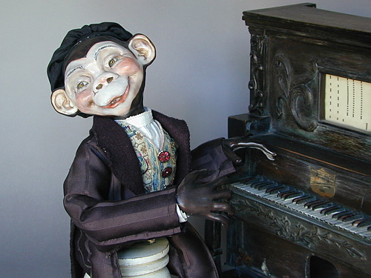
Why not manual entry?

Slide 31
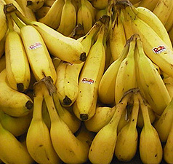
Manual entry

Slide 32
Lester S. Levy
Sheet Music Collection
Just over 29,000 pieces
American popular music
  Early 18th – mid 20th century
Historical, rather than musical, focus
Most of the collection is digitized and online at:
http://levysheetmusic.mse.jhu.edu

Slide 33
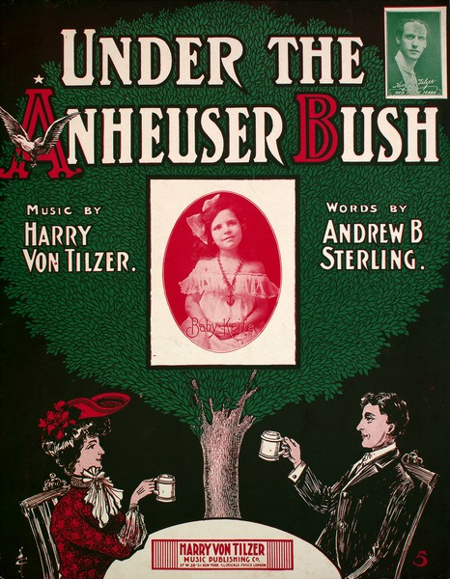

Slide 34
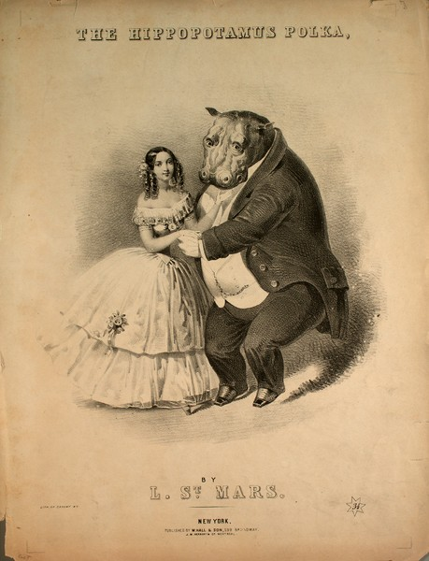

Slide 35
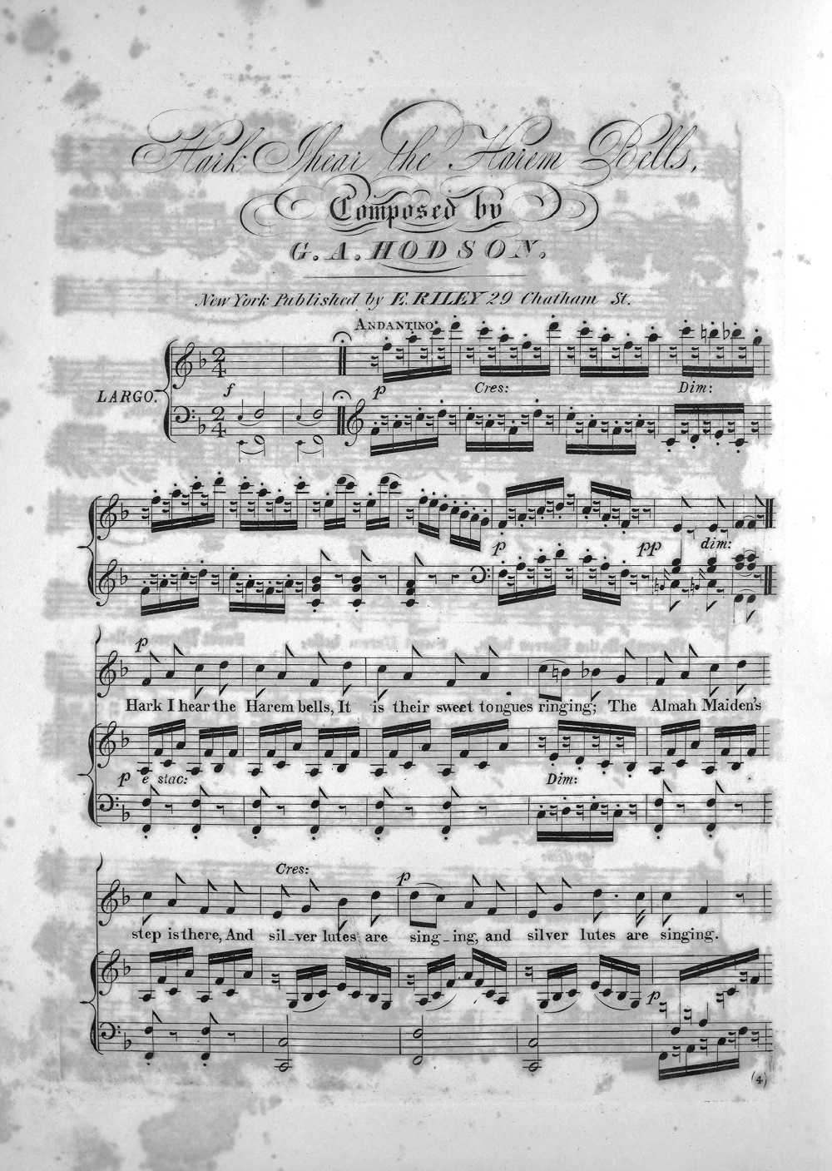
Overview of the process

Slide 36
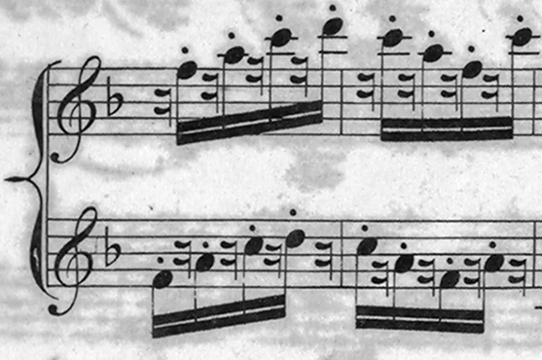
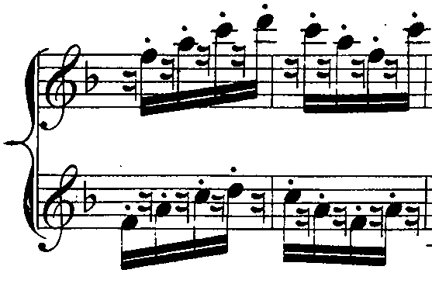
1. Preprocessing

Slide 37
2. Staff line removal

Slide 38
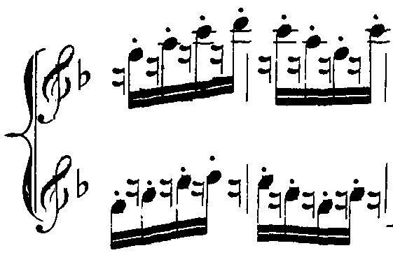
2. Staff line removal

Slide 39
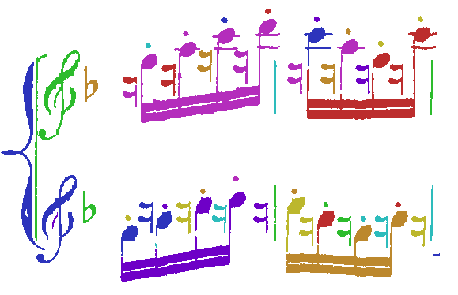
3. Classification
Treble clef

Slide 40
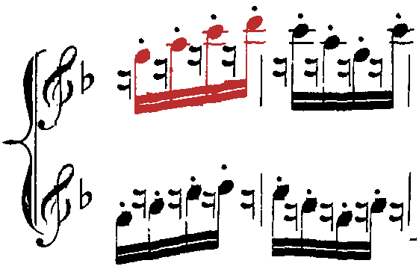
4. Decomposition
Treble clef

Slide 41


4. Decomposition

Slide 42
6. Interpretation

Slide 43
7. Metric correction

Slide 44
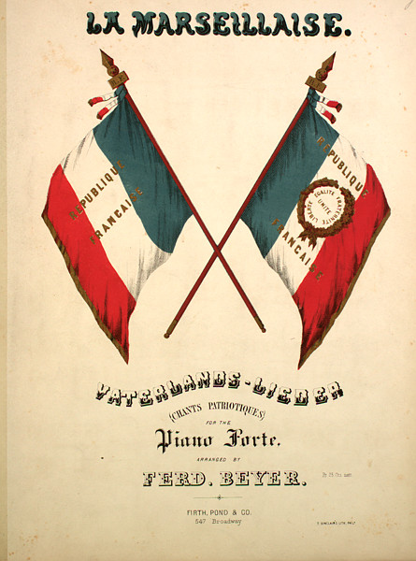

Slide 45
Metric correction in detail
Two approaches work in tandem:
  Inference from layout using constraints (rule-based)
  Matching to other rhythms (learning-based)

Slide 46
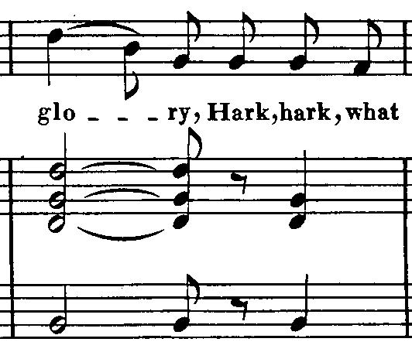
1. Constraints
Notes and rests that are vertically aligned with notes and rests in other parts are played at the same time

Slide 47
1. Constraints
The number of beats in a measure should (usually) agree with the time signature, or at least agree across all parts
¼ 1/8 1/8 1/8 1/8 1/8 = 7/8
½ 1/8 1/8 ¼ = 1
½ 1/8 1/8 ¼ = 1

Slide 48
1. Constraints
Certain symbols have certain possibilities for durations, eg.
  Filled noteheads: 1/4, 1/8, 1/16, 1/32 ...
  Hollow noteheads: 1, ½
Custom constraint engine:
  Constraint solvers are an application of symbolic computation
  Over finite domains
  With discrete, non-integral (rational) values

Slide 49
Example
Missing dot

Slide 50
Vertical alignment
0 1/4 3/8
0 1/2
0 1/2

Slide 51
b ∈
{1/4,
3/8,
3/16,
1/8,
1/16,
...}
c ∈
{1/4,
3/8,
3/16,
1/8,
1/16,
...}
a ∈
{1/4,
3/8,
3/16,
1/8,
1/16,
...}
d ∈
{1/4,
3/8,
3/16,
1/8,
1/16,
...}
e ∈
{1/4,
3/8,
3/16,
1/8,
1/16,
...}
f ∈
{1/4,
3/8,
3/16,
1/8,
1/16,
...}
g ∈
{1/4,
3/8,
3/16,
1/8,
1/16,
...}

Slide 52
b ∈
{1/4,
3/8,
3/16,
1/8,
1/16,
...}
c ∈
{1/4,
3/8,
3/16,
1/8,
1/16,
...}
a < 1
a*fudge ≥ b
a < d
a < f
a+b ≤ d
a+b ≤ f
b < 1
b*1/fudge ≥ a
b < d
b < f
a+b ≤ d
a+b ≤ f
...
a ∈
{1/4,
3/8,
3/16,
1/8,
1/16,
...}
d ∈
{1/4,
3/8,
3/16,
1/8,
1/16,
...}
e ∈
{1/4,
3/8,
3/16,
1/8,
1/16,
...}
f ∈
{1/4,
3/8,
3/16,
1/8,
1/16,
...}
g ∈
{1/4,
3/8,
3/16,
1/8,
1/16,
...}

Slide 53
Constraint solvers are great!
(for this problem, at least)
Goal is to find a globally optimal solution, by enumerating possibilities and testing against a fitness function
The fitness function is the bottleneck
Enumerate all combinations
  Example: 15¹⁰ x 6² ~= 2 x 10¹³ combinations
With the constraint solver, the domain can be greatly reduced
  Example: 129 combinations + overhead of constraint solver (symbolic computation)

Slide 54
             
1/8
3/16
1/16
1/4
...
1/8
3/16
1/16
1/4
...
1/4
3/8
3/16
1/8
1/16
...
8/8
1/2
3/4
1/1
...
1/8
3/16
1/16
1/4
...
8/8
1/2
3/4
1/1
...
1/8
3/16
1/16
1/4
...
8/8

Slide 55
            
1/8
3/16
1/16
1/4
...
1/8
3/16
1/16
1/4
...
1/4
3/8
3/16
1/8
1/16
...
8/8
1/2
3/4
1/1
...
1/8
3/16
1/16
1/4
...
8/8
1/2
3/4
1/1
...
1/8
3/16
1/16
1/4
...
8/8

Slide 56
2. Rhythmic pattern matching
Assumption: rhythmic patterns tend to repeat within the same piece of music
  Not a good assumption for all music, but it tends to work for the music we've got.
Rhythmic patterns that occur elsewhere are more likely to be correct than singleton examples

Slide 57
Histogram of rhythmic patterns on the first page of the Marseillaise
7                    
4    
3                  
3               
3               →   
3                      
3 
2                     
2                    
1          →   
1              
1             
1                     
1               
1                     

Slide 58
1/8
3/16
1/16
1/4
...
1/8
3/16
1/16
1/4
...
= 1             
1/4
3/8
3/16
1/8
1/16
...
8/8
1/2
3/4
1/1
...
1/8
3/16
1/16
1/4
...
8/8
1/2
3/4
1/1
...
1/8
3/16
1/16
1/4
...
8/8

Slide 59
1/8
3/16
1/16
1/4
...
1/8
3/16
1/16
1/4
...
= 0              
1/4
3/8
3/16
1/8
1/16
...
8/8
1/2
3/4
1/1
...
1/8
3/16
1/16
1/4
...
8/8
1/2
3/4
1/1
...
1/8
3/16
1/16
1/4
...
8/8

Slide 60
Flash demo
“Bouncing ball” playback using Macromedia Flash
  TIFF -> Gamut -> MusicXML
  MusicXML -> pyScore -> MIDI
  MIDI -> Timidity++ -> MP3
  MP3+TIFF -> Ming -> Flash (SWF)

Slide 61
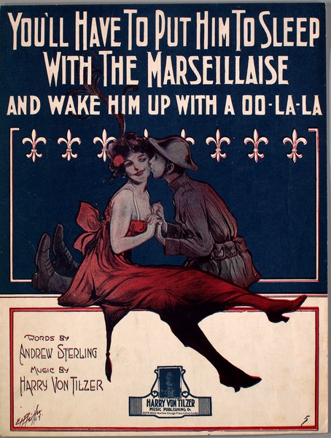

Slide 62

Questions?

