Slide 1
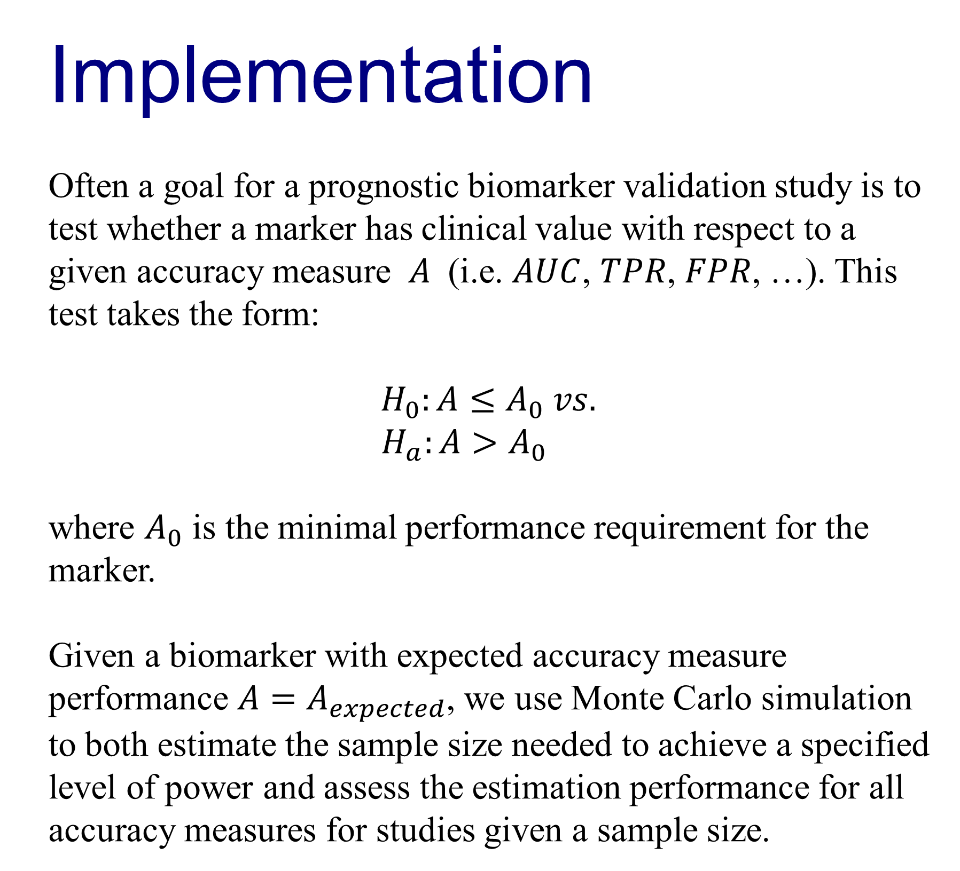
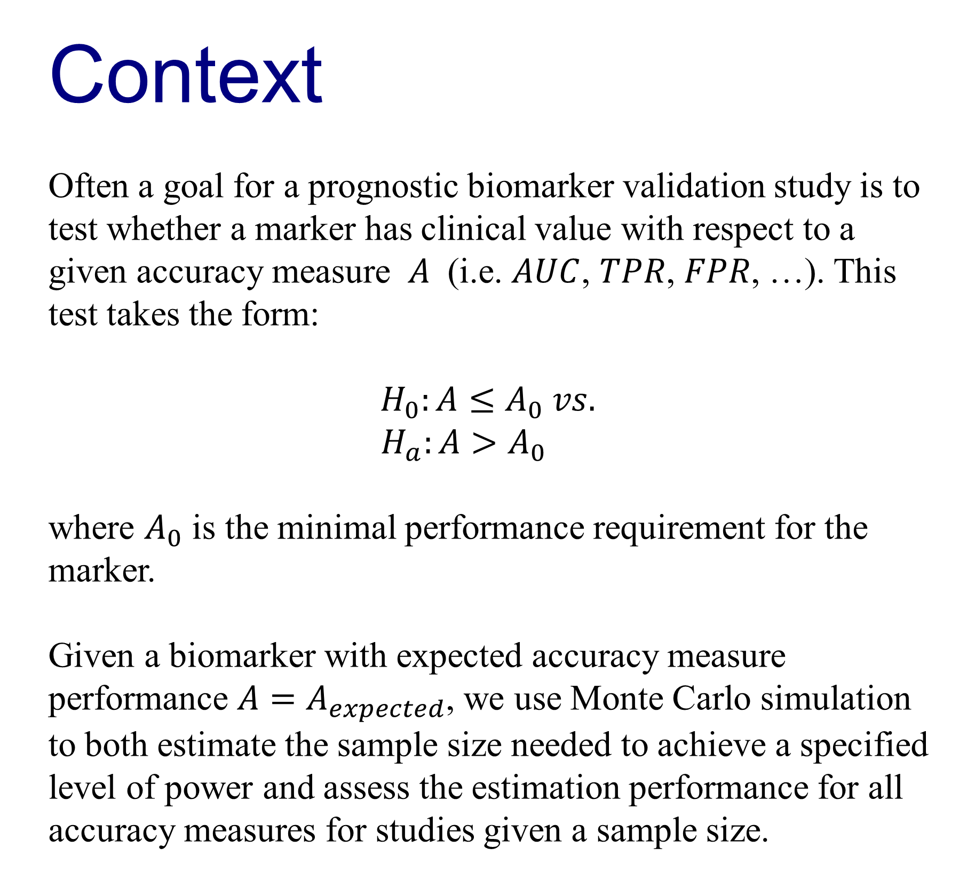
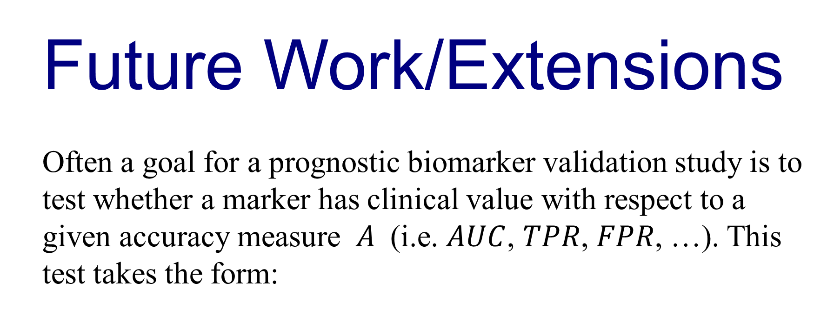
Power calculations for prognostic biomarker validation studies with time to event data
Marshall D. Brown and Yingye Zheng
Tianxi Cai
Fred Hutchinson Cancer Research Center
Harvard School of Public Health
How should researchers determine the sample size needed to draw conclusions from biomarker validation study with censored time to event data?
Schema of simulation design
figure
Implementation:
Shiny
Modeling Choices
In order to generate time to event data such that the performance of the marker yields Aexpected for a given measure, we make the following modelling choices:
Distribution of the marker Y: This application assumes Y∼N(0,1). More options for the distribution of Y may be added later.
The failure time T: We model survival via the survival function S(t|Y)=P(T>t|Y) and assume a Cox-Proportional hazards model:
S(t|Y)=S0(t)eβY
where the baseline survival distribution S0(t) is assumed to be exponential:
S0(t)=e−at
The value for a is determined by the inputs for baseline survival S0(t0) for a given time t0, and the value for β is determined by the expected value of the accuracy measure of interest.
Censoring: We assume non-informative censoring. Censoring times follow an exponential distribution with rate parameter to chosen to fix the average percentage of censored observations.
References
This is the text that will go into the poster after you have written it, this is the text that will go into the poster after you have written
t, is the text that will go into the poster after you have written it, is the text that will go into the poster after you have written it, is the text
that will go into the poster after you have written it, is the text that will go into the poster after you have written it, is the text
that will go into the poster after you have written it, is the text that will go into the poster after you have written it, is the text that will
go into the poster after you have written it,
screenshot
screenshot
screenshot
Acknowlegements
This is the text that will go into the poster after you have written it, this is the text that will go into the poster after you have written it, is the text that will go into the poster after you have written it, is the text that will go into the poster after you have

