Slide 1
Programming with ChatGPT
Basically, forget almost everything I just taught you.

Slide 2
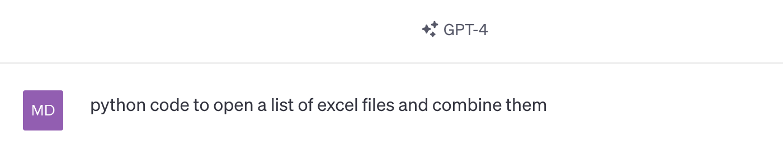
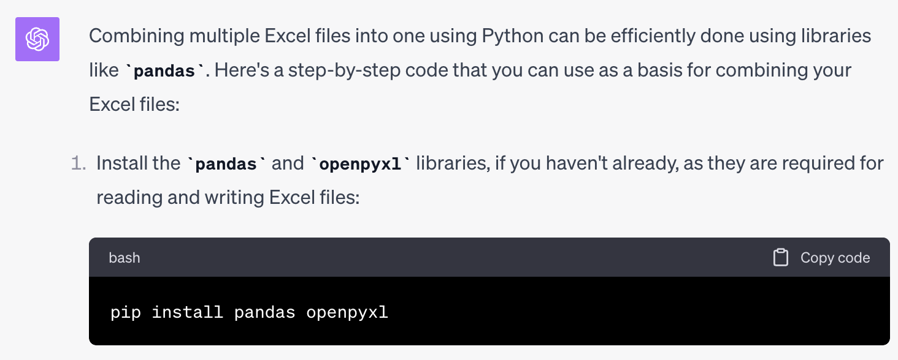

Slide 3
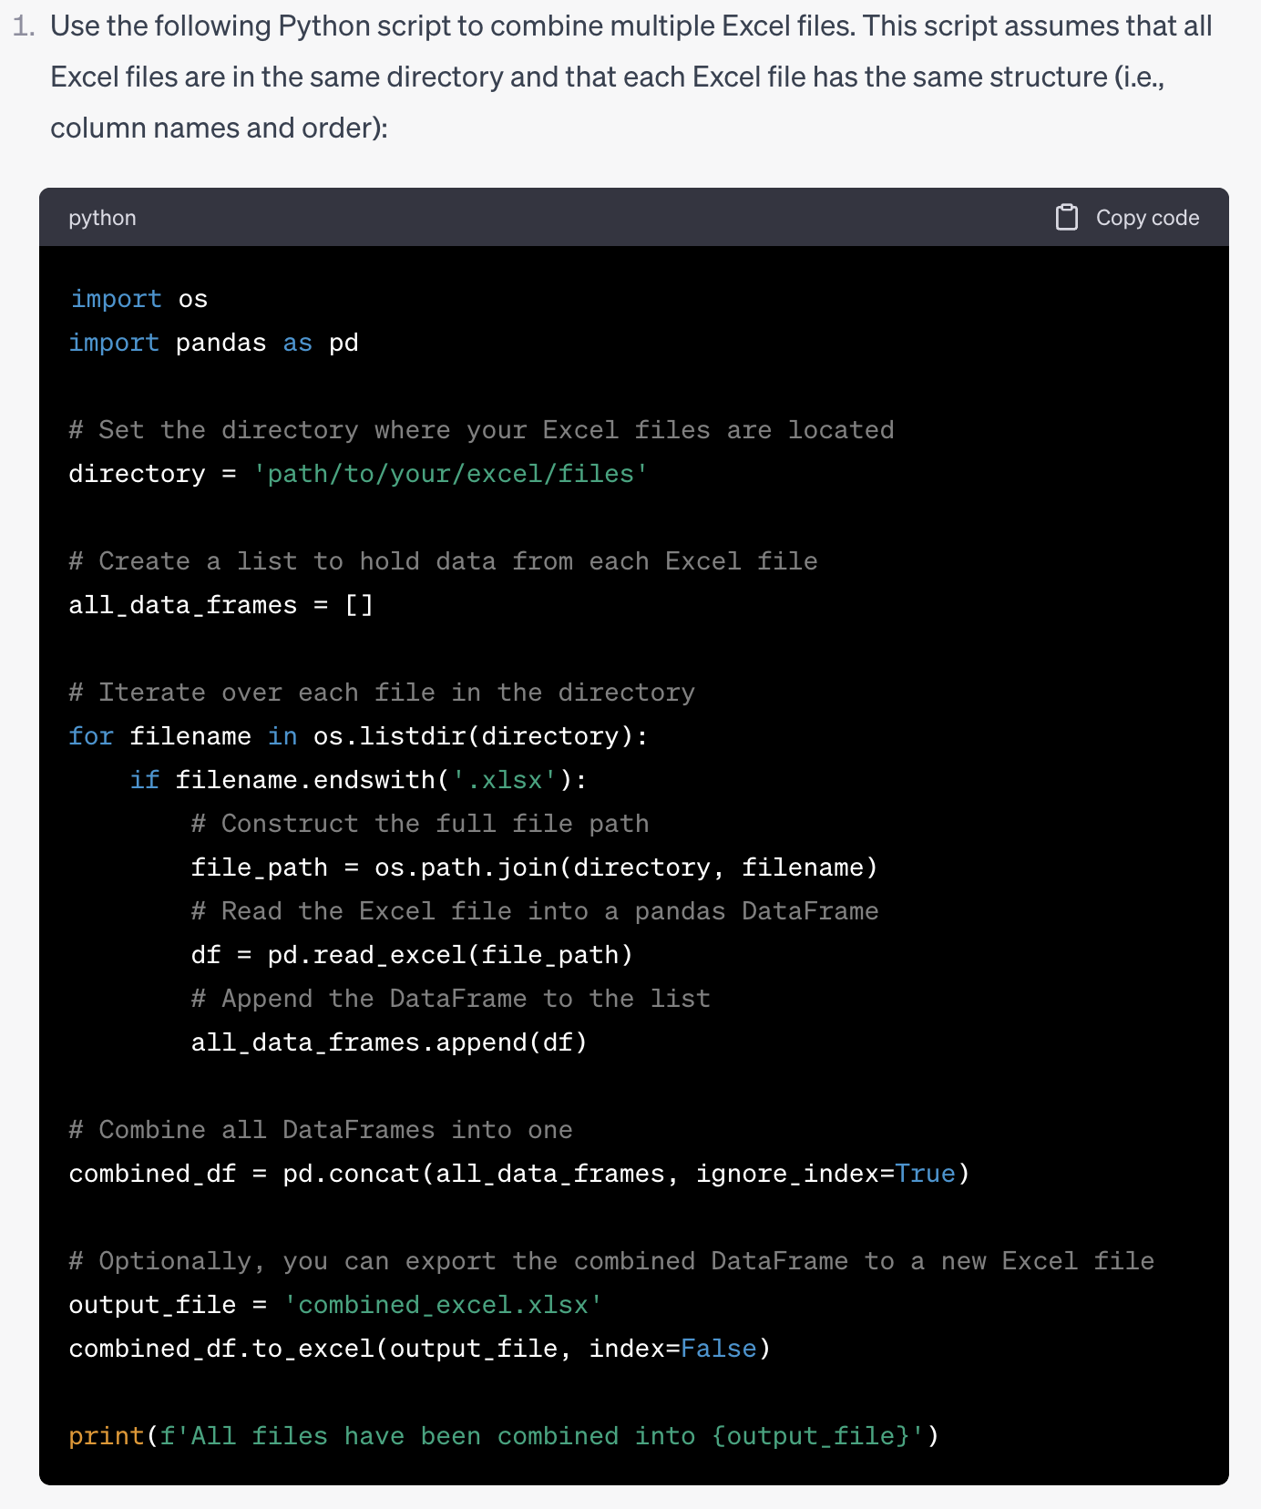
Copy/paste into jupyter

Slide 4
