Slide 1
A Distributed Approach to Group Model Building
Masters Project Defense
Committee: Todd Sproull, Chris Gill, and Peter Hovmand
Matt D Burch

Slide 2
Collaboration Effort
Social System Design Lab (SSDL)
  Brown School of Social Work
  Advance the practice of group model building in human services including:
    Social work
    Education
    Public health
  Advance methodology of group modeling process
    Techniques
    Design
    Group dynamics
Notes:
I approached Peter looking for potential projects as I have a common interest in the social sciences
Solve problems like
Childhood Obesity
Community violence
Mental health
etc
One of the leaders in researching how models are built (group dynamics, methods, etc)
There is a lot that goes into these sessions and likewise there is a lot that can go wrong
How to design group model building sessions so that they are more successful

Slide 3
What is Group Model Building?
Group of people exchange their perceptions of a problem
Explore questions such as:
  What exactly is the problem we face?
  How did this problem originate?
  What might be the underlying causes?
  How can the problem be tackled?
  (Vennix 1996, p.3)
Notes:
Team of members
Include many stake holders in the problem (law makers, advocacy groups, affected people, researchers)
Tries to create a shared understanding in conflicting views
Conflicting in what the problem is or whether there is one
Based on personal experiences/ walks of life
Conflicting goals
Domestic abuse Advocates: Increase victim safety Justice System: Increase batterer accountability
Lot of different aspects
Background research, audience, scope, planning activities, analysis, recruiting
But I am focusing on the model formulation aspect
Created an iPad application to help with model creation

Slide 4
Model Example – World Population
As Population increases, Deaths also increase
As Population decreases, Deaths also decrease
+
+
Births
R
Population
B
Deaths
+
-
More Deaths lead to a lower Population
Fewer Deaths lead to a greater Population
Legend
+ Variables both increase or both decrease
- One variable increases while the other decreases
B Balancing
R Reinforcing
Notes:
Take a look at a sample model to get you familiar with what these models mean when you look at them
Population and Deaths are variables in the model
Much like mathematical variables
How do we show that variables relate?
Arrows represent relationship, but what kind?
Plus sign is a “polarity”
Change in the same direction
As population goes up so does the deaths
As population goes down so does the deaths (less people around to die later)
Negative Polarity
Does not mean has a negative effect
Variables change in opposite direction
As deaths increase, population decreases
As deaths decrease, the population remains higher
As you can see we have a feedback loop (Balancing = more leads to less)
Adding symbol is really just a comment that helps tell the story about the model
Helpful when you have huge models -> feedback loop may not be as obvious
Balancing because the relationships counteract each other
A produces more of B which in turn produces less of A
The world population is not going to last long with just deaths, need births too
As births increase, so does the total population
Larger your population, the more births you have
Have another feedback loop
This one is reinforcing however
A produces more of B which in turn produces more of A

Slide 5
Current Problems at the SSDL
Unsatisfactory Modeling Software
  Complicated user interfaces
  Not designed for Group Model Building
Models Cease to be Boundary Objects
  Shared representations of the dependencies and perceptions of problems across multiple social worlds*
  Models built in pre-defined building sessions
  Collaboration outside sessions non-existent
Limitations of Observation Methods
  Constrained to group model building sessions
  Observations methods are qualitative
*Black & Andersen 2012, p. 195
Notes:
Unsatisfactory Modeling Software
The tools they currently use are not so simple
Not designed for targeted audience of the lab
SSDL works in groups not individually
Models Cease to be Boundary Object (This is a good thing!!!)
Bridge gap among social worlds, coherent
The models are the boundary object in this case
As mentioned participants come from different walks of life -> and their understanding, perceptions, intentions may vary
The object aims to capture these differences into a cohesive representation that everyone understands and agrees with
Models built in pre-defined building sessions
Communication outside of these sessions among participants is non-existent
Metrics *** Most Important and exciting***
Relies on additional researcher
Inconsistent data
If people work on models outside of sessions no data/observation
How people understand GMB not as prevalent

Slide 6
There’s an app for that! - iModelBuilder
Simple User Interface
  Provide essential building blocks of a model
Sharing Mechanism
  Promote distributed model building
  Extend models as boundary objects beyond sessions
Automated Observation of Model Building
  Objective/Quantitative data
  Expose advantages of mobile technology
  Improve existing techniques
Notes:
UI
Focus more on learning and comprehending modeling concepts
Want it to be easy for users so that they will want to turn to using the app
Sharing
More easily share progress
Providing a tool that these conflicting views can work together and share their different ideas is beneficial
Metrics
Eliminate extra researcher and have quantitative data
Using new technology
How can we leverage this
How are current techniques performing?

Slide 7
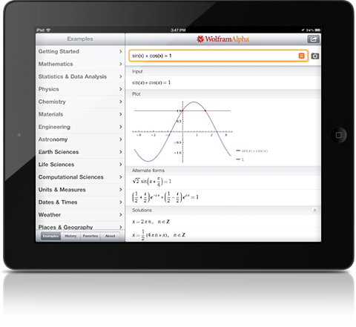
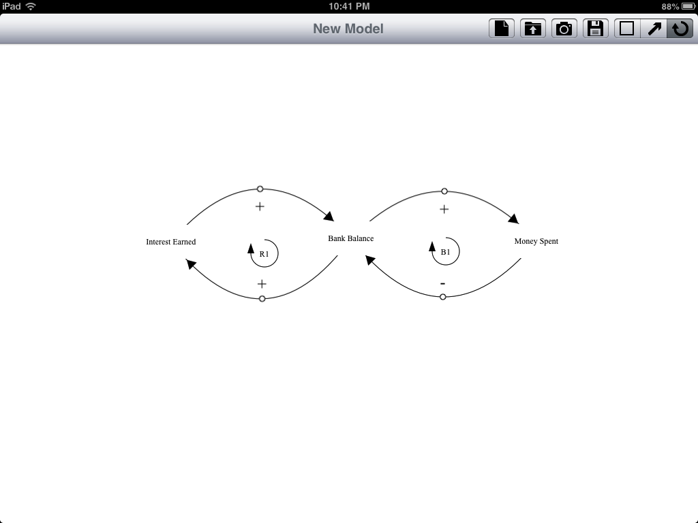


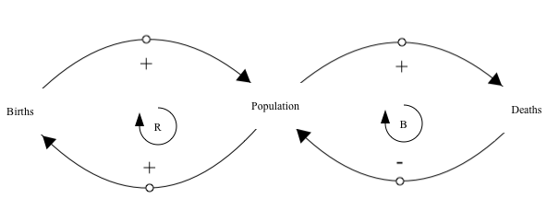

iModelBuilder Components
iModelBuilder
Cloud Based
File Management
User Interface
Metrics Gathering
Notes:
Simple UI
Promote users turning to the app
Tablets and touch Uis are becoming very popular -> exploit what people are familiar with
Cloud Based File Management
Integrate a sharing mechanism across all participants
Promote colaboration
Metrics
Data provides insight not previously experienced

Slide 8
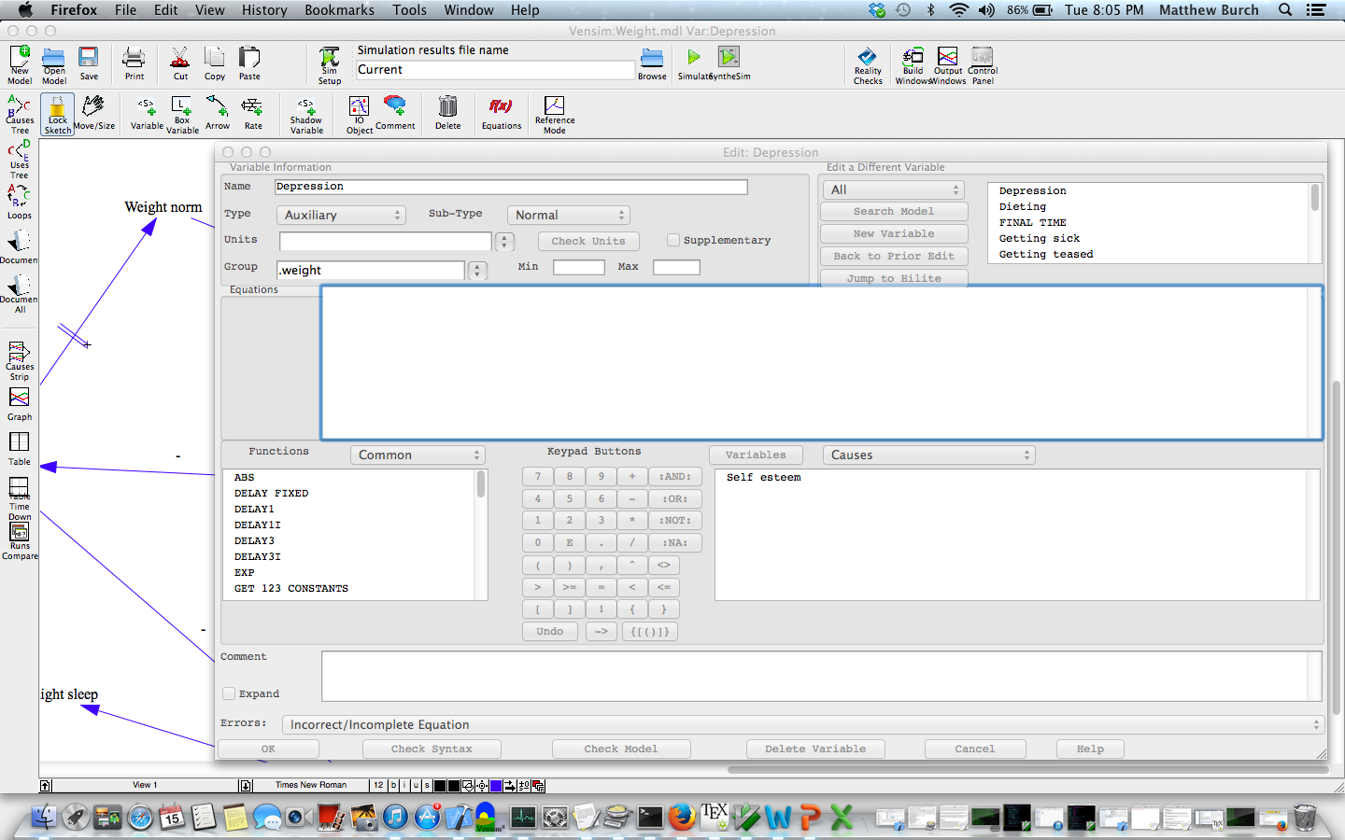


Current Tools - Vensim
Different Model Building Approach
    Vensim
      Individual modelers
      Modeling Experts
    SSDL
      Models created in groups
      Novices to modeling
        Have knowledge in education, public health, etc.
Notes:
Modeling software is not a new thing
Desktop software
Freely available
Windows or Mac
Vensim used during modeling sessions -> will be projected for all the participants as they build the model
Lots of Buttons
Pop up window
Catch all popup when Vensim is not happy
Extra features used for more advanced stages of modeling (simulations)
Clutters and overshadows the basic building blocks of the models
Target Audience
Of the software
Group model building experts or even software experts
Of the Lab
Models created in groups not by one person as Vensim intended
Domain experts
Have knowledge in education, public health, social work
Learning GMB for the first time
Want something easy that they can pick up

Slide 9
User Interface
7 buttons vs. 54 buttons!!!
Notes:
Showing the example we walked through earlier
Much simpler than the Vensim tool
Only provides users with what they need to create basic models
7 buttons vs 54 buttons

Slide 10

User Interface
Add Object
Variable/Relationship/Label
Create
New Model
Open
Model
Take
Picture
Save
Model
Notes:
Create Model
Creates a brand new model
Will clear out everything on the screen
Open Model
Will redirect the user to cloud storage to open up a model
Take Picture
Takes picture of entire model even if it doesn’t fit on the screen
Saves it in your photo album
Save Model
Allows user to save it back to cloud
Add object
Which object you would like to add to the screen

Slide 11
Cloud Based File Management
Problem:
  No collaboration in current tools
  Models cease to be Boundary Objects
Model Building Process
  Build models through Vensim during sessions
  Save models to the cloud
  Participants open up model in the app
  Make changes and save their extensions
  Other participants can see changes
Cloud Based File Management
Vensim
Models
Cloud File Storage
App
Models
Notes:
Problem
Current software not designed for collaboration
Centralized process
They build these models in the distinct model session times
At the end receive a print out of the model they created
Wouldn’t be cool if after a modeling session you could go home and it is waiting on your iPad?
Boundary Objects
Paper objects no expandable
Cant be modified by all the participants
Are not shared -> expansions do not represent the representation of the group
Individualistic
Stress Vensim
Show printout
Makes it easier to update models and feed info back to researchers
Dropbox – an online my documents folder
Dropbox has shared folders
Can have community violence, obesity folders
Everyone can share and take a look at what other people working on
Update people’s models
From Vensim
More so for the researchers
Compatibility between my app and the Vensim software
I reversed engineered Vensim’s model files
Parse them out and can be edit in my app
Group Modeling App
More so for the users
Create a model
Researchers can then open in Vensim
If they want to do more advanced modeling
Participants can now all expand the same model
Work at their own pace or when they are free
Extend modeling beyond pre-defined sessions
No longer static between sessions
Collaboration promotes the shared representation

Slide 12
Metrics Gathering
Problem:
  Limited observation methods of modeling process
  Difficult to understand participants comprehension of Group Model Building topics
Metrics Gathering
Track user
Interactions
with UI
Cloud Database
Log Files
Web Service
Advantages over previous methods:
  Objective quantitative data
  Data when researchers are absent
  Data to evaluate teaching efficiency
  Data on how to leverage this technology
Notes:
Problem
Based on what the researchers can track based on observation
Prone to inconsistent data from different observers
Supervision of the researchers
No method to track how users work on models outside of session
But how do people comprehend models
What do they understand?
What do they struggle with?
Methods they follow
Have actually provided my event logging architecture, design, code to Modeling software company called Stella Modeler
This provides a new GMB method (distributed iPad system)
Eliminates an additional researcher
Consistent data for all building sessions
Gathering data can demonstrate how to best use this method and make improvements
Can previous techniques be improved?
Can we use this knowledge to create better methods to explain GMB and to create more beneficial building sessions

Slide 13
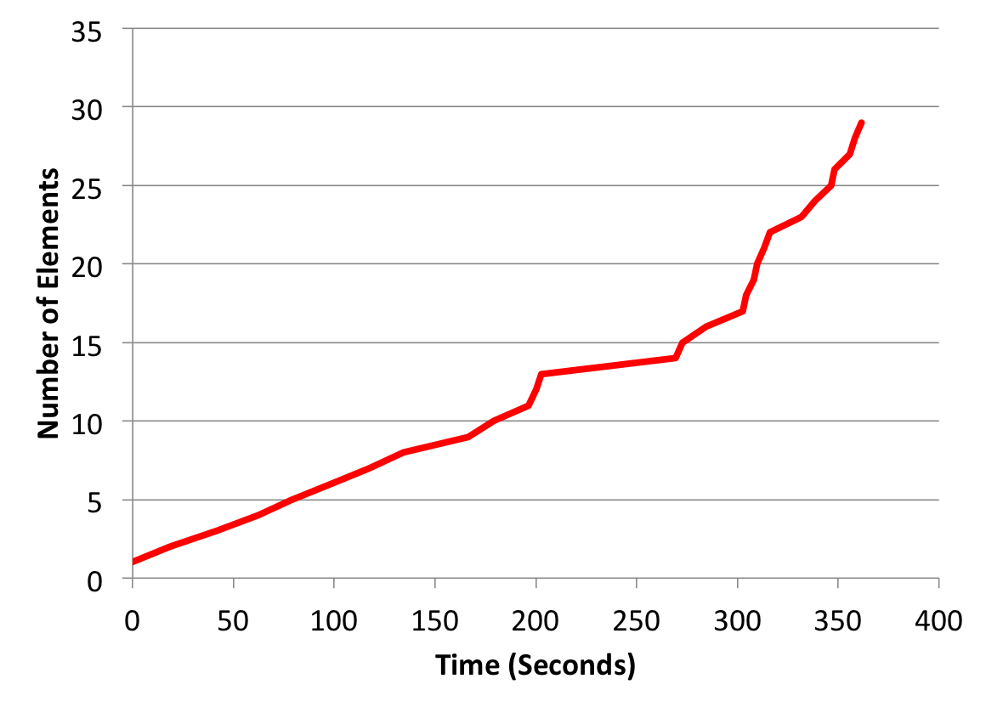
Time series of modeling behavior over time in digitizing task for expert
Entering variables
Entering links
Notes:
Digitizing task – taking a model that is in a paper format and converting it to a digital format
When experts enter models they create all the variables first then add the links (relationships)
This is different than typical modeling
Average 12 seconds to add a new element to the model
About 6 minutes to recreate an entire model
Appears that adding variables takes longer (have to update the name?)

Slide 14
Contributions
Goal | Contribution | Researchers | Participants
Simple User Interface | Basic functionality for novices | X | X
 | Increases modeling speed and learning | X | X
Sharing Mechanism | Dropbox Integration | X | X
 | Distributed Model Building Method | X | X
 | Extension of model as a Boundary Object | X
 | Compatibility with Vensim | X
Metrics Gathering | Automated Data Gathering | X
 | Quantitative Data | X
 | Assessment Tool | X
 | Efficiency in teaching | X
 | Database storage | X
Notes:
Basic Functionality for novices – easy for participants to learn, lets researchers use this app in the GMB sessions to help the participants learn the tool and make it easier for them to see what is going on.
Increases modeling speed and learning – touch interface, only can do things they are suppose to
Dropbox Integration– allows researchers to use what they are already using. More easily distribute models and keep tabs on progress. For participants they can more easily add to models and work with other people and researchers
Distributed Model Building Method – new approach to GMB , allows participants to share
Boundary Object – By allowing this collaboration of ideas outside of the sessions and allowing all members to modify the model, the model continues to act as a boundary object. Models no longer remain static
Compatibility with Vensim –allows researchers to continue using what they know and perform more advanced stages of analysis that the app does not offer
Automated Data Gathering – less man hours to gather data, researchers can be absent
Quantitative Data – makes comparison of data easier, all data up to this point has been qualitative
Assessment Tool – Of distributed and mobile GMB, and of existing methods as well. Improves teaching of GMB
Database storage – researchers do not have to worry about models getting overwritten, keeps tracks of sequencing etc.

Slide 15
Conclusions
Created a modeling application
  Applied group model building in an entirely new way
  Solving problems SSDL was enduring
Collaborated with industry
  iSee Systems Stella Modeler
    SSDL influence on future products
Additional Academic Usage
  Deakin University
    Close partner with SSDL
    Received funding to build a tablet modeling application
Open Source Solution
  Code freely available
    https://github.com/mdburch/GroupModeling
Notes:
Sharing with iSee systems – researchers can compare these two interfaces to see relative advantages and disadvantages as well as build better tools.
Deakin University – A close partner to the SSDL. They have received significant funding to create a modeling app, that this app can be helpful for.
Computers – distributed GMB

Slide 16
Questions?

Slide 17
Demonstration
Notes:
Life expectancy
Make sure to explain the touch gestures I am using!
Notice that we have two records in Parse
Data is pushed on each file save
CSV File
Can reconstruct an entire model just by looking at the event log
As mentioned event logs stored in cloud
Actually store more than events logs
Cool thing about Parse is that you can store files
Entry in my table actually stores two files
The event log
Corresponding model file
Store a starting hash and ending hash
Used to track progress on the same file
Global ID (GID)
Unique value between user and model
Used to track how a specific user progresses in building a model

Slide 18
Sources
http://www.biomedcentral.com/1472-6963/7/123/figure/F1
https://www.dropbox.com/
http://products.wolframalpha.com/images/mobile/mobile-ipad.png
https://parse.com/products/data
https://www.iconfinder.com/icons/40094/receptionist_icon
J.A.M. Vennix. Group Model Building Facilitating Team Learning Using System Dynamics. John Wiley & Sons Inc. 1996.
L.J Black & D.F. Andersen (2012) “Using Visual Representations as Boundary Objects to Resolve Conflict in Collaborative Model-Building Approaches” Systems Research and Behavioral Science 29: 194-208. doi: 10.1002/sres.2106
Notes:
REST = Representational State Transfer architectural style developed by W3C with HTTP 1.1.
Conventially consist of clients and servers.
Clients initiate requests to servers;
Servers process requests and return appropriate responses.

Slide 19
BACKUP SLIDES

Slide 20
Human Services
Approaching the objective of meeting human needs through an interdisciplinary knowledge base
  Focusing on prevention as well as remediation of problems
  Maintaining a commitment to improving the overall quality of life of service populations

Slide 21
Boundary Objects
An object which lives in multiple social worlds and which has different identities in each (S & G, 412)
Portray dependencies and relationships among participants objectives, expertise, decisions and actions (B & A, 203)
Can be modified by input from every participant (S & G 203)
The creation and management of boundary objects is a key process in developing and maintaining coherence across intersecting social worlds (S & G, 393)
When participants in the intersecting world create representations together, their different commitments and perceptions resolved into representations. (S & G 413)

Slide 22
Boundary Objects
Plastic enough to adapt to local needs and the constraints of the several parties employing them, yet robust enough to maintain a common identity across sites (393)
Weakly structured in common use, and become strongly structured in individual-site use (393)
Each social world has partial jurisdiction over the resource represented by that object, and mismatches causes by the overlap become problems for negotiation (412)
Objects come to form a common boundary between worlds by inhabiting them both simultaneously (413)
(Star & Griesemer)

Slide 23
Boundary Objects
Robust boundary object: representative of dependencies among the actors, relatively ‘concrete’, given the participants’ differing expertise and experience and transformable by all actors
If an object is transformable, then anyone involved has the ability to manipulate and alter the representation to show more clearly the consequences of the dependencies she/he perceives
Shared visual representations do not facilitate collaboration, however, unless they function as boundary objects
By ensuring that these representations show dependencies and are modifiable by ongoing participants input, they can ensure that the representations serve as boundary objects
Tangible two-dimensional or three-dimensional shared representations
(Black & Andersen, p 200, 203)

Slide 24
Causal Loop Diagrams
Type of model that aids in visualizing how different variables in a system are interrelated
  Feedback loops
    Count the number of negatives
    Odd number of ‘-’ means reinforcing

Slide 25
Creating Models
  Vensim
    Save to cloud
    Parse model file and edit in iPad app
  iModelBuilder App
    Save to cloud through the application
    Open model in Vensim

Slide 26
User Interactions
Adding, deleting, moving objects
Editing attributes of objects
Selecting menu options
Rotating the device

Slide 27
REST
Representational State Transfer
  Architectural style developed by W3C with HTTP 1.1
  Conventionally consist of client and servers
    Client initiate request to servers
    Servers process request and return appropriate responses

Slide 28
